Slide 1
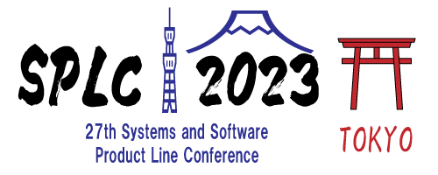

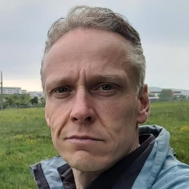

INDUSTRY CHALLENGES
Gabriela K. Michelon
Karsten A. M. Guenther
HYBRID INDUSTRY CHALLENGES WORKSHOP

Slide 2




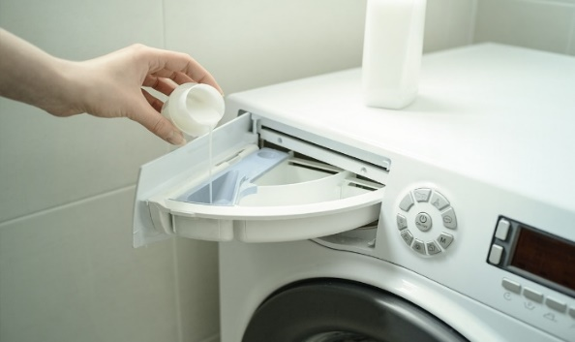

Who is Marquardt?
Creative mechatronics expert, founded in 1925 22 locations and 11,000 employees
Operating Components (HMI)
Battery Management
Drive Authorization Systems
Lighting
Pumps
Switches and Sensors

Slide 3
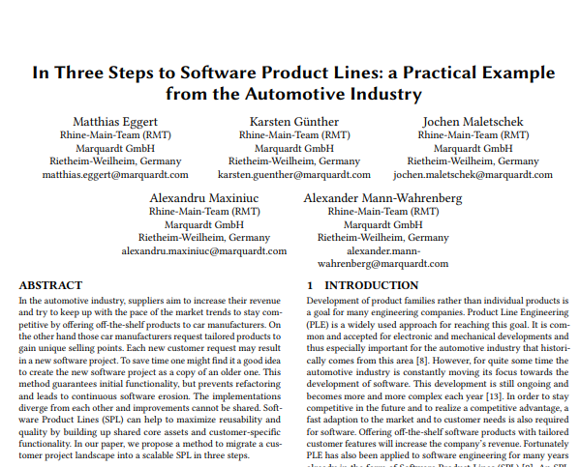
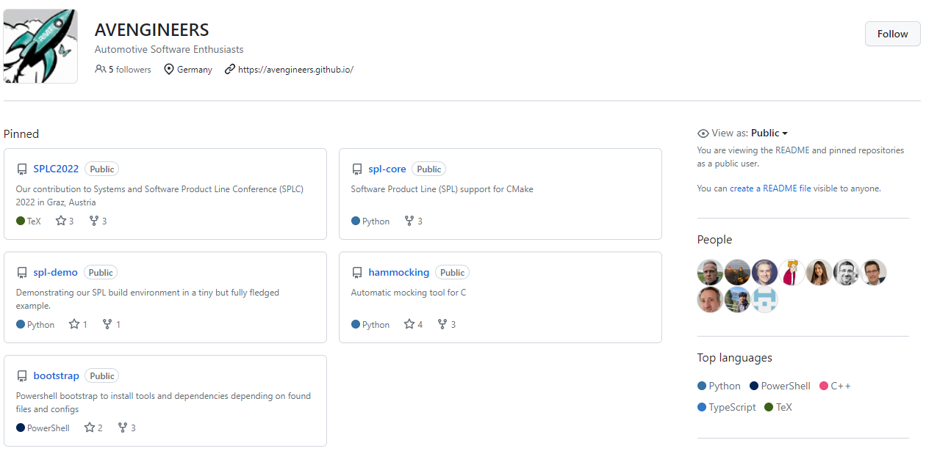

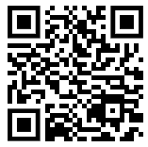

Who are we?
Rhine-Main Team (RMT)
Located in Sulzbach, Germany (Rhine-Main area)
Working on
System/Software Engineering
Software Product Line Engineering
Open Source Contributions

Slide 4
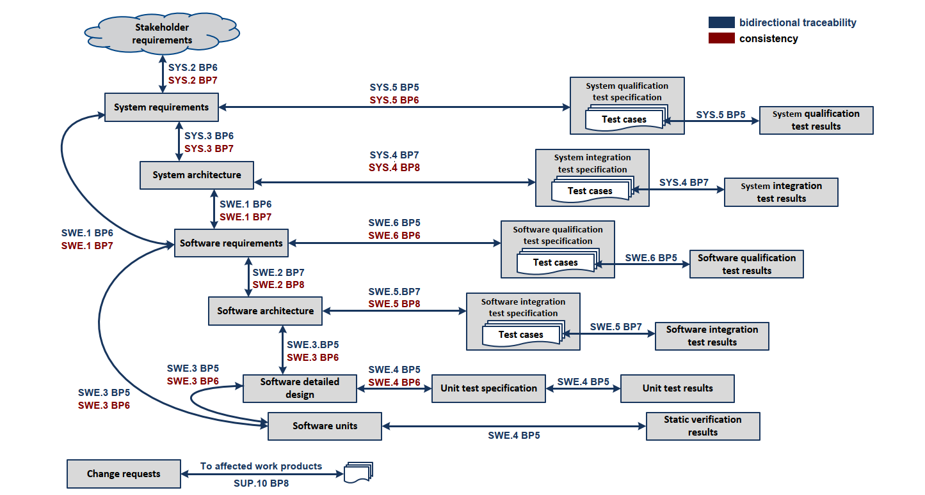
Automotive SPICE
Challenge: How to handle variability in all required work products?
Notes:
As Gabriela already explained, our team is responsible for the introduction of Software Product Line Engineering (SPLE) into Marquardt’s SW development.
So, we try to drive the transition away from project development towards product development.
But as we are working in the automotive industry, we must fulfill the process requirements as defined in Automotive SPICE.
This is essential to stay competitive.
Click
As you can see in the V-Model figure of A.SPICE there are a lot of work products from System requirements and System qualification test results down to software units.
If you think about variant or feature configuration for the source code of software units one possible answer is Kconfig.
We easily managed to introduce Kconfig to configure not only the source code but also the build system, the unit test specification and even the software detailed design.
But what about requirements and architecture usually managed in automotive tools like Doors, IBM Rhapsody and others?
There are a few solutions available, but we are missing the overall picture here.
Click
So the challenge is: how to handle variability of an SPL in all work products required by Automotive SPICE?

Slide 5
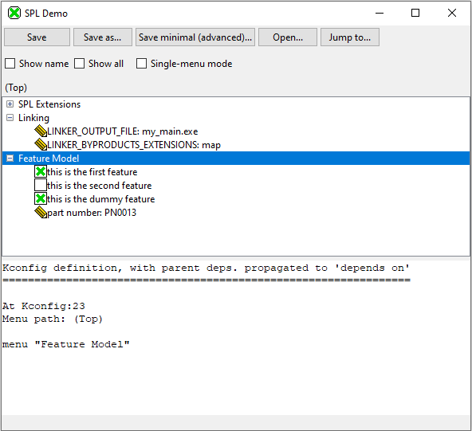
Feature Configuration with Kconfig
Usability
Overview of features
Configuration of features
Challenge: Is Kconfig the right tool for feature configuration in an SPL?
Notes:
Another challenge we face is Kconfig itself.
Click
As far as we know, Kconfig does not know anything about variants nor components, so the usability in an SPL is rather limited.
Click
We are missing a GUI or similar that supports the overview of features and their configuration over all or even several variants of an SPL.
Click
We would like to be able to change the configuration of several variants at once in a GUI.
We are even asking ourselves if Kconfig is the best tool for the job of variant configuration and management in an SPL and for the programming language C?
And furthermore, we would like to know what tools other companies use for their SPLs and have a comparison of those tools with pros and cons.
So the challenge is whether Kconfig is the right tool for feature configuration in an SPL?

Slide 6
Continuous Integration and Delivery (CI/CD)
Fast feedback
Quality gates
Developer/customer/project acceptance
Challenge: How could a test strategy for an SPL look like?
Notes:
Development of an SPL with many variants and a high variability requires a high degree of automation.
Therefore, our team established CI with its common methods like protected branches, automated builds and regression tests for every SW change.
For the main development branch and all release branches all delivery artifacts are archived and published.
Sound like CI/CD, right? So where is the challenge?
Click
Well: the main acceptance criteria for CI/CD is fast feedback.
When a developer wants to verify her or his change, a feedback is required in a couple of minutes. NOT HOURS!
But how to run every test for each SW change when you have an SPL with a huge number of variants and features?
Click
We believe a well-defined test strategy is needed here that defines certain quality gates that matches the development stages defined by A.SPICE.
Such a test strategy for CI/CD must guarantee a feedback for each development stage matching the timing and verification requirements for that stage.
Click
It must establish a high degree of acceptance of each developer, customer and project.
We are certain that we are not the only company looking for such a strategy or trying to develop one by ourselves.
Click
The challenge: how does such a test strategy for an SPL could look like?

Slide 7

Challenge: Changing the Organization
Notes:
But the biggest challenge we face is to drive changes within our organization.
How to change the way of developing software?
How to train developers in state-of-the-art methods with a high degree of acceptance?
How to avoid the unnecessary usage of expensive tools just because they are expensive and certified?
How to raise the acceptance of Open-Source SW as something good, not evil?
And finally regarding SPLE how to foster the transition from project development towards product development?

Slide 8
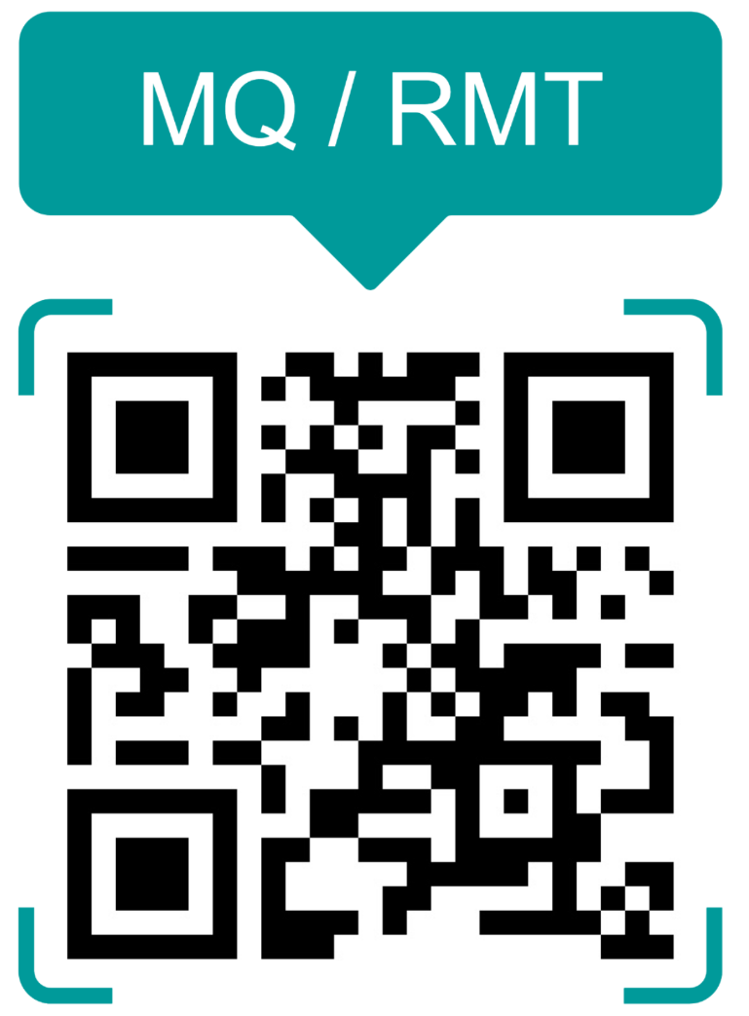
Contact
Notes:
Thank you very much for your attention.

