Slide 1

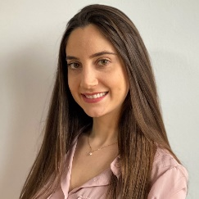
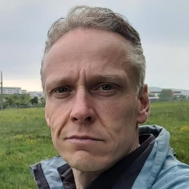


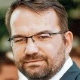
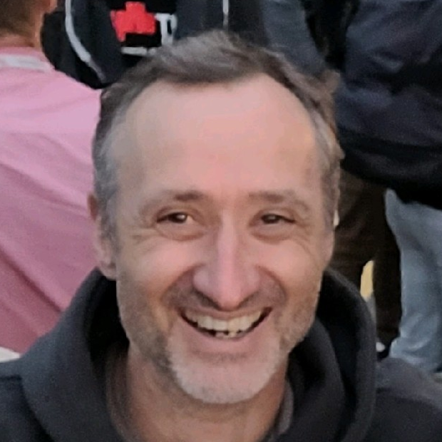

INDUSTRY CHALLENGES
Gabriela K. Michelon
Karsten A. M. Guenther
Alexandru Maxiniuc
Akshit Kobagapu
Frank
Peschke
Jochen Maletschek
HYBRID INDUSTRY CHALLENGES WORKSHOP

Slide 2
Agenda
Introduction
Marquardt
Who are we?
Challenges
Variant Configuration with Kconfig
Automotive SPICE
Organizational Challenges
Continuous Integration

Slide 3
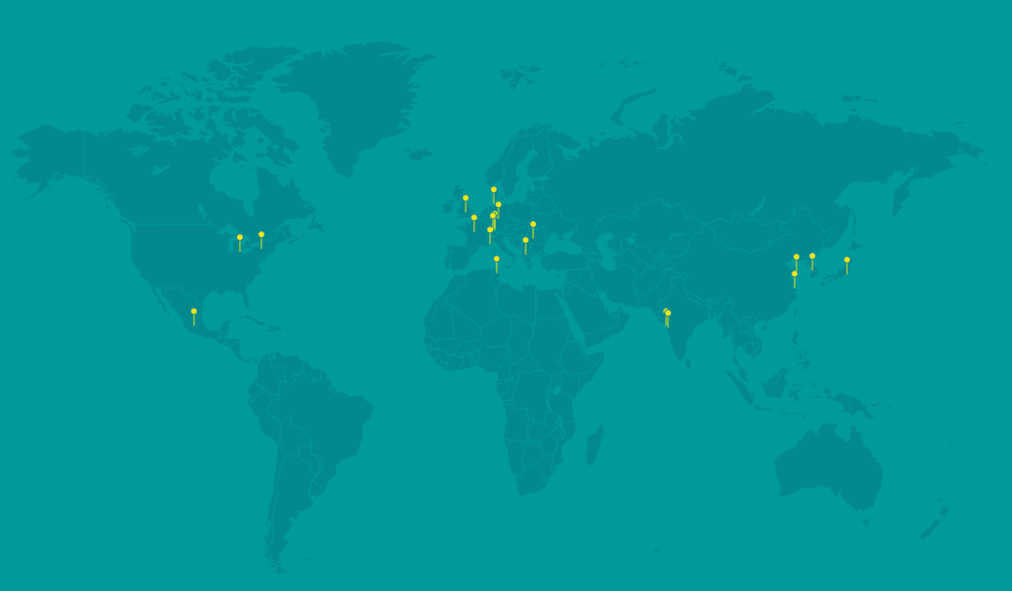
Introduction
Marquardt is a creative mechatronics expert, founded in 1925
Worldwide on site with 22 locations and 11,000 employees
Germany
France
Italy
Great Britain
North Macedonia
Romania
USA
Mexico
China
India
South Korea
Japan
Tunisia

Slide 4

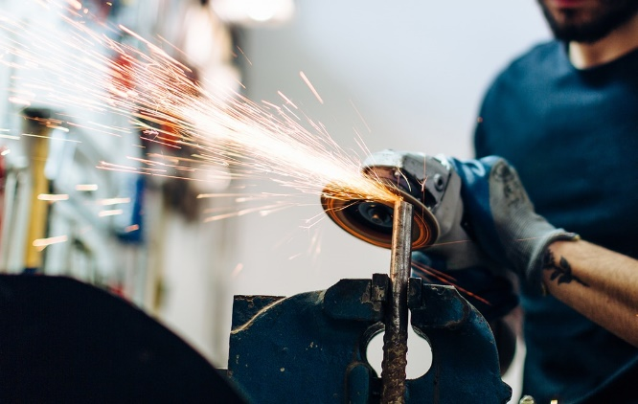

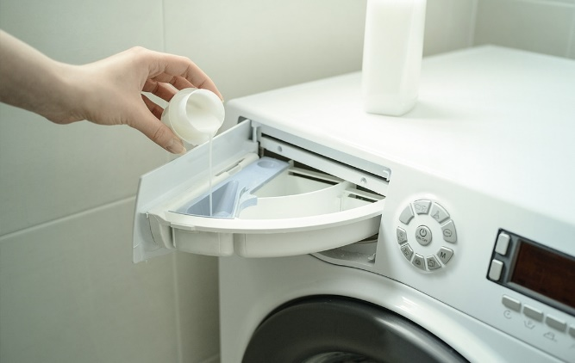



Solutions
Operating Components (HMI)
Switches
Drive Authorization Systems
Pumps
Lighting
Battery Management
Sensors

Slide 5
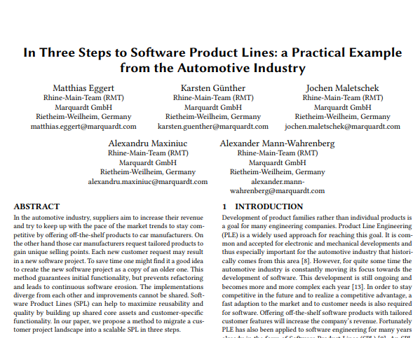
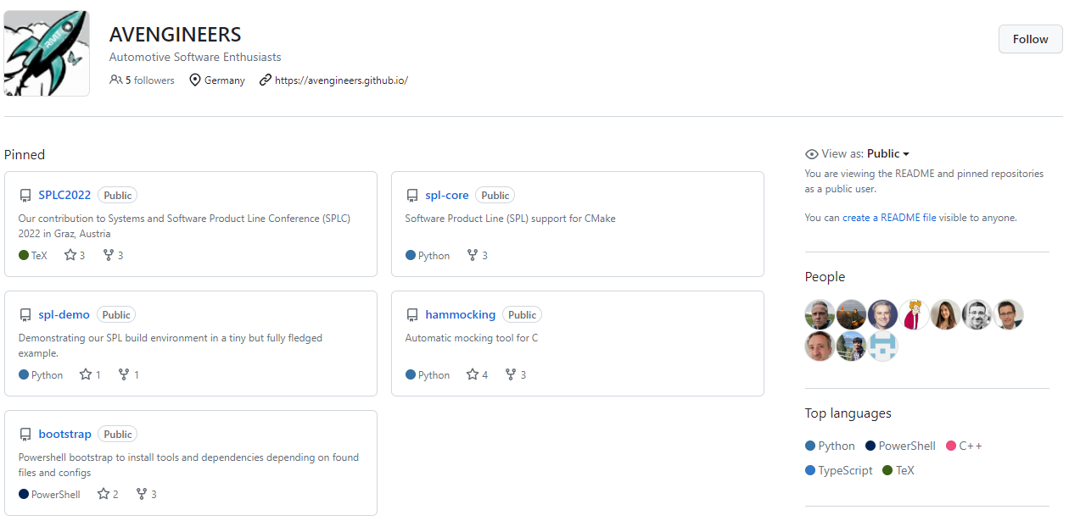



Rhine-Main Team (RMT)
Located in Sulzbach, Germany (Rhine-Main area)
Working on
System/Software Engineering
Software Product Line Engineering
Open Source Contributions

Slide 6
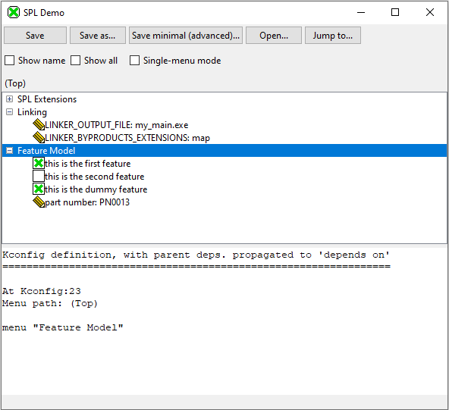
Variants Configuration with Kconfig
Usability
Overview of features
Configuration of features
Notes:
Is it the best tool for C project?
Tabular view to see the features and change the values for the variants (configuration for more than one variant)
Which parameters, switches, etc other companies configure and how

Slide 7
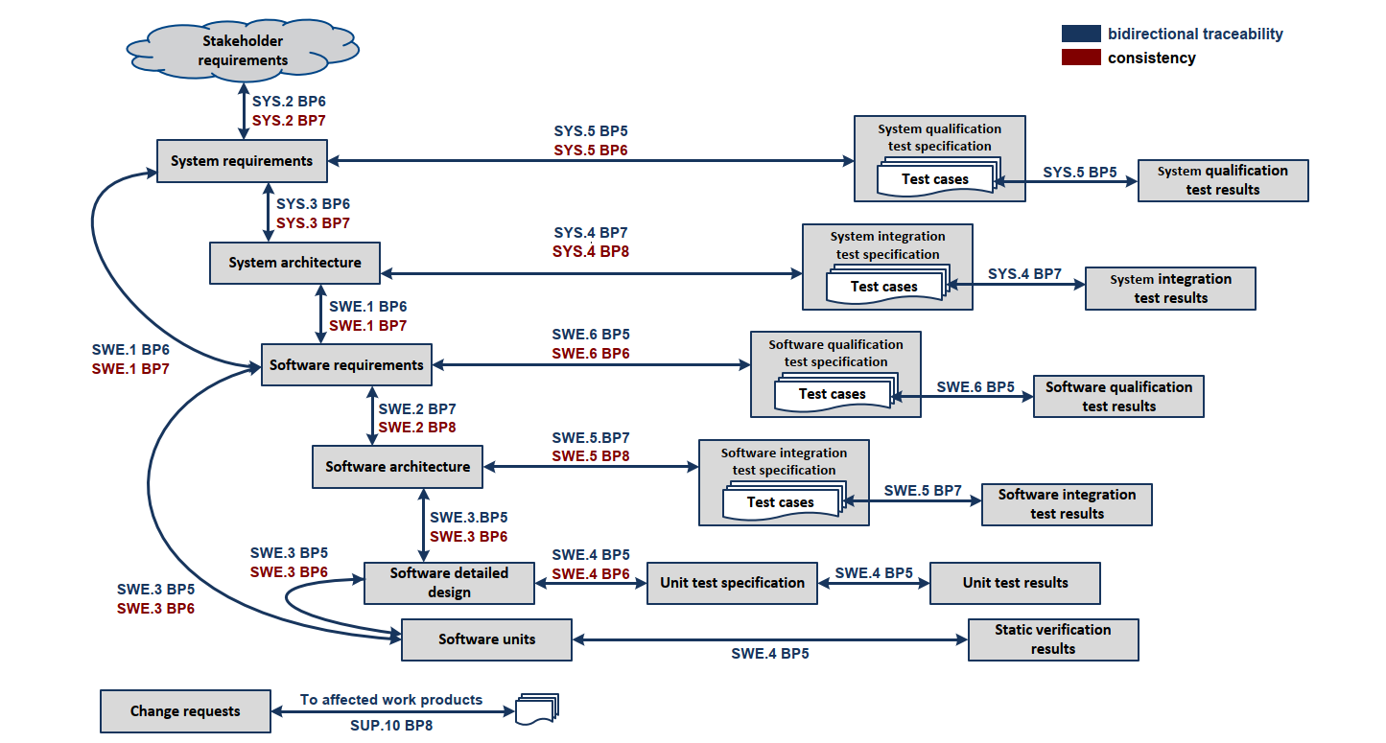
Automotive SPICE
Documentation
Requirements
Reporting
Traceability
Notes:
How we should consider variants or manipulate an SPL on all the ASPICE processes

Slide 8

Organizational Challenges
Introducing new tools and methodologies in the organization
Notes:
change old and archaic style of work
hard to convince
requires time and patience from people to adapt and learn

Slide 9
Continuous Integration
Test strategy
Fast feedback
Quality gates
User/customer/project acceptance
Notes:
How to get fast feedback if you have an SPL with a huge number of variants

Slide 10

Contact

