Slide 1
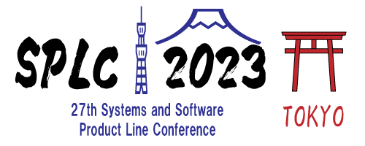
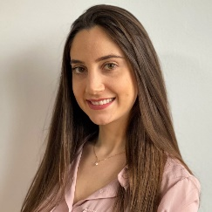
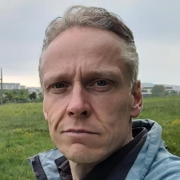

INDUSTRY CHALLENGES
Gabriela K. Michelon
Karsten A. M. Guenther
HYBRID INDUSTRY CHALLENGES WORKSHOP

Slide 2




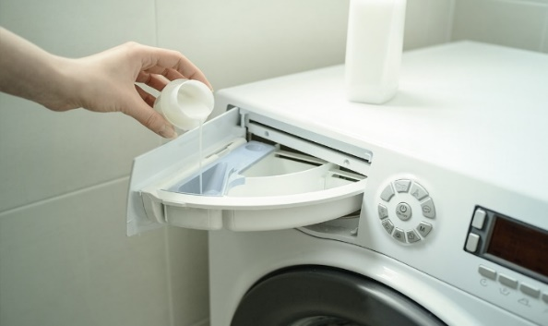

Who is Marquardt?
Creative mechatronics expert, founded in 1925, 22 locations and 11,000 employees
Operating Components (HMI)
Battery Management
Drive Authorization Systems
Lighting
Pumps
Switches and Sensors

Slide 3
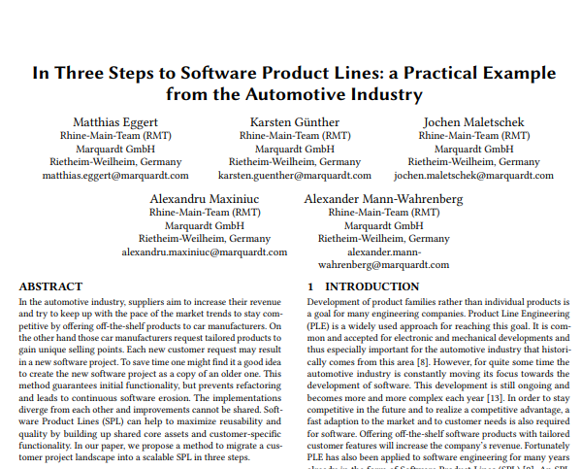
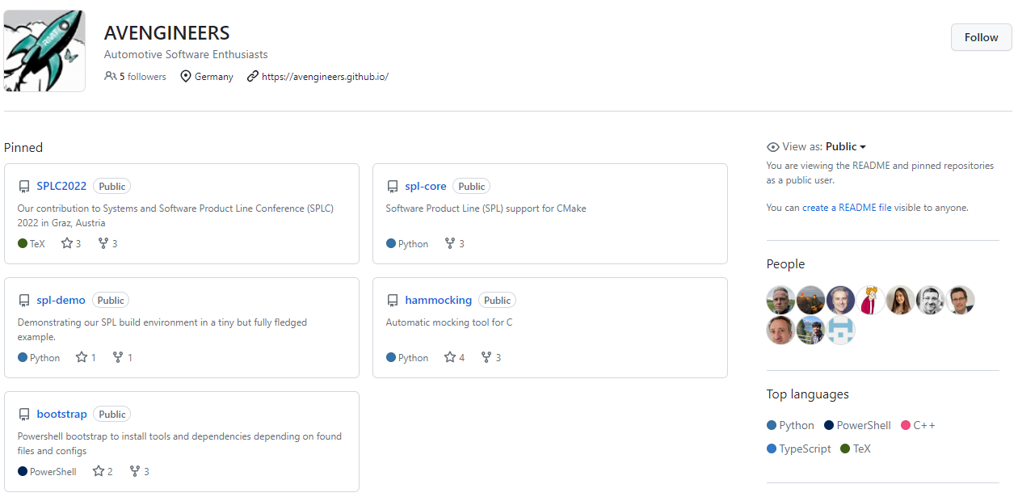

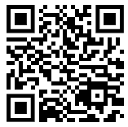

Who are we?
Rhine-Main Team (RMT)
Located in Sulzbach, Germany (Rhine-Main area)
Working on
System/Software Engineering
Software Product Line Engineering
Open Source Contributions

Slide 4
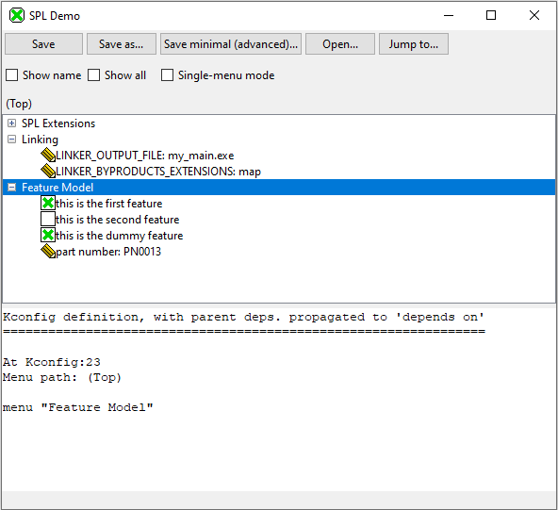
Variants Configuration with Kconfig
Usability
Overview of features
Configuration of features
Notes:
Is it the best tool for C project?
Tabular view to see the features and change the values for the variants (configuration for more than one variant)
Which parameters, switches, etc other companies configure and how

Slide 5
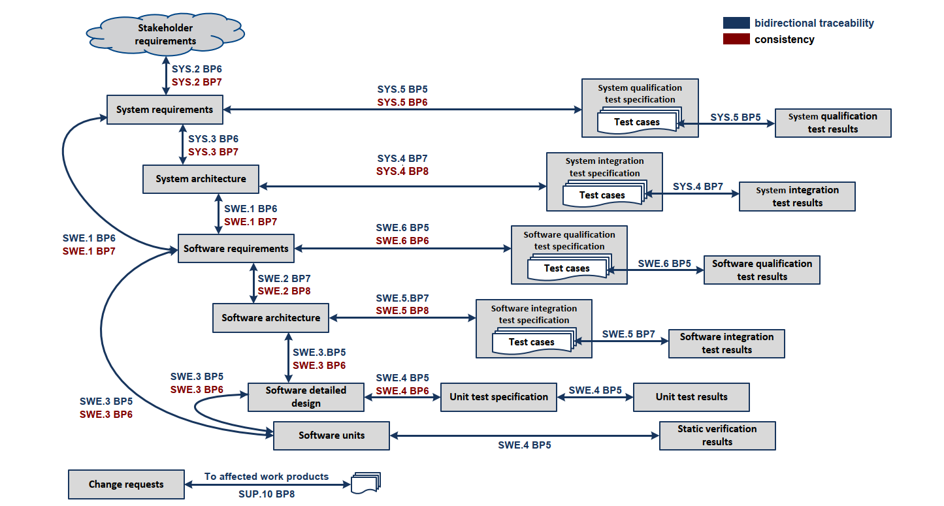
Automotive SPICE
Documentation
Requirements
Reporting
Traceability
Notes:
How we should consider variants or manipulate an SPL on all the ASPICE processes
Variability with Kconfig for code. Easy
Variability for documentation -> Sphinx, Python, rst, Jinja
What about Architecture, requirements?

Slide 6
Continuous Integration
Test strategy
Fast feedback
Quality gates
User/customer/project acceptance
Notes:
How to get fast feedback if you have an SPL with a huge number of variants
SW erosion
Feature creep
Variant creep

Slide 7

Organizational Challenges
Introducing new tools and methodologies in the organization
Notes:
change old and archaic style of work
hard to convince
requires time and patience from people to adapt and learn
Usage of expensive tools
Open Source is bad
From projects to products

Slide 8

Contact

