Slide 1
CONTESTED
by DB/Server Team
Beendal Patel
Prerana Sonawane
Rohan Mhatre
Paras Patel

Slide 2
Objectives
To describe the detail implementation of server side programming.
To discuss client requests, server requests and responses, models and heartbeat.
To run demo of server side requests for multiple clients.

Slide 3
Outline
Client requests to server (dummy program).
Handle requests coming from client and respond accordingly.
Model Classes
Heartbeat
Demo of requests & responses.

Slide 4
Client Requests to server
Created a dummy client program to send all the requests
to server and get responses from server.
Create a python file
-- Client_Requests.py
It contains 10 different requests to send to server.

Slide 5
Client requests to server
Login Request(101): To check user has been logged.
Character creation(104): To check that user has created character.
Move Request(106): To check that character has been moved.
Change Health Request(108): To check changes in character health.
Attack Request (107): To check attack that has been made by character.

Slide 6
Client requests to server
Control Point Capture (112): To check and keep track of Control point capture.
Chat Request (105): To chat with other users.
Control Point State (111): To check the state of control point.
Logout Request (102): To keep track of logout.
Heartbeat (301): To keep record of heartbeat.

Slide 7
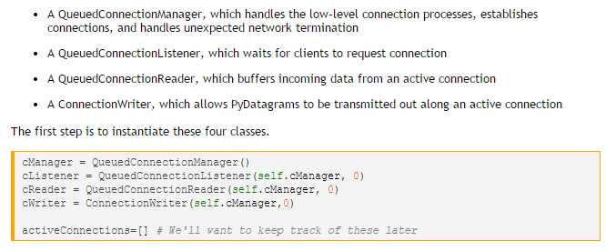
Panda 3D: Client-Server Connection

Slide 8
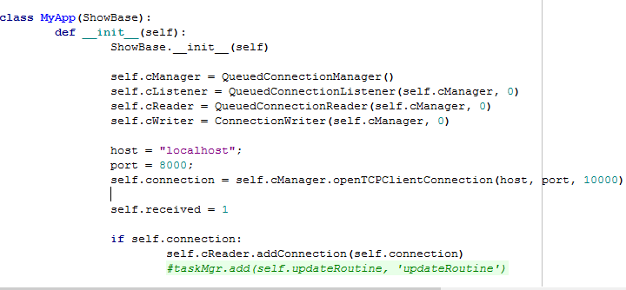
Connection to Server

Slide 9
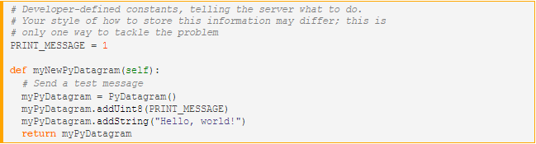
Send & Receive a message
Send a message
Receive a message

Slide 10
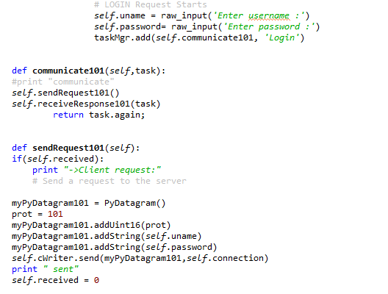
Login request to server

Slide 11
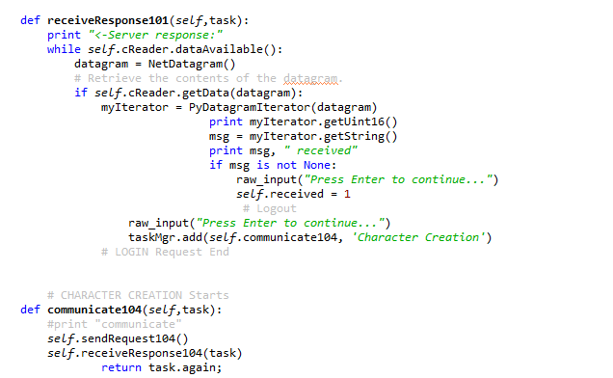
Login request to server
Login request to server

Slide 12
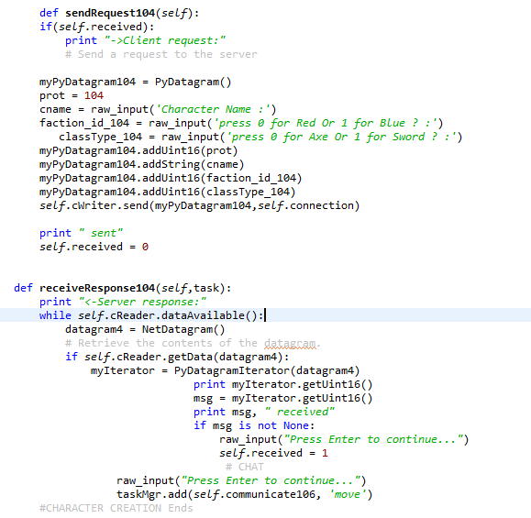
Character Creation request

Slide 13
Outline
Client requests to server (dummy program).
Handle requests coming from client and respond accordingly.
Model Classes
Heartbeat
Demo of requests from clients to server.

Slide 14
Requests and Responses
Requests:
Type of Request
Processing the request
Generating respective response
Response
Accept the response generated from request file
Store in GamePacket and send to client.

Slide 15
Request Files
RequestLogin
RequestLogout
RequestRegistration
RequestCharacterCreation
RequestChat
RequestMove
RequestHeartbeat
RequestCharacterAttack
RequestCharacterChangeHealth
RequestControlPointState
RequestControlPointCapture

Slide 16
Classes for Request and Response
GameRequest.java :
An abstract class maintains information of request for each and every client.
GamePacket.java :
Creates a packet to send to client.
contains all conversion methods according to python client.

Slide 17
Request File Methods
parse() - accepts inputs from client
DoBusiness() - process the request
respond() - response is generated in a byte array.

Slide 18
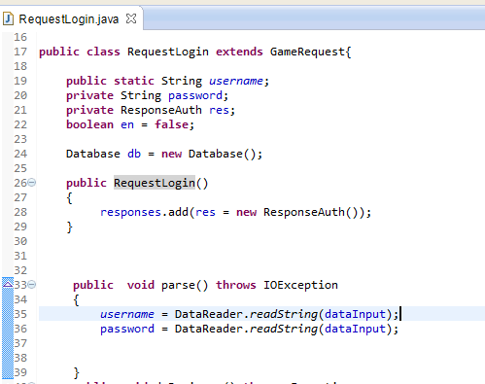
RequestLogin.java

Slide 19
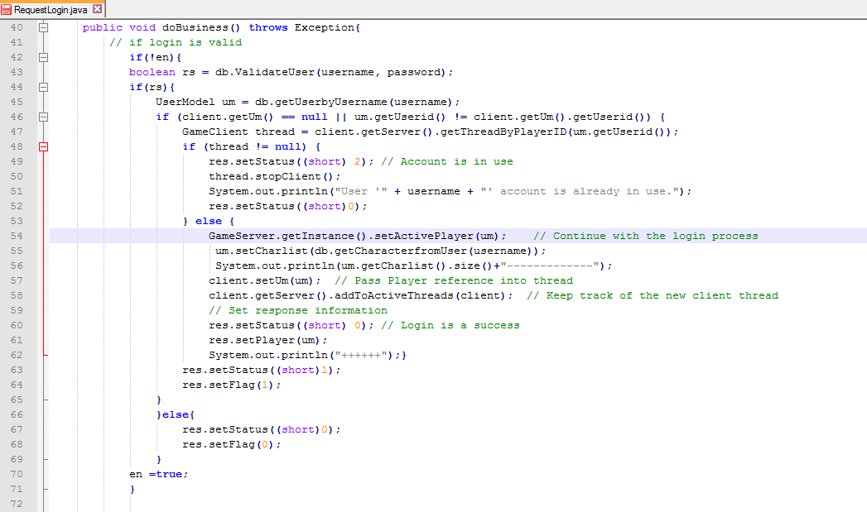

Slide 20
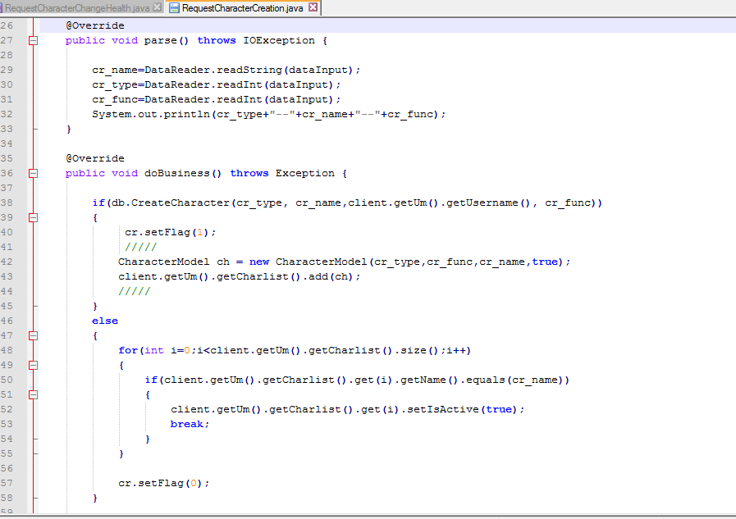
RequestCharacterCreation.java

Slide 21
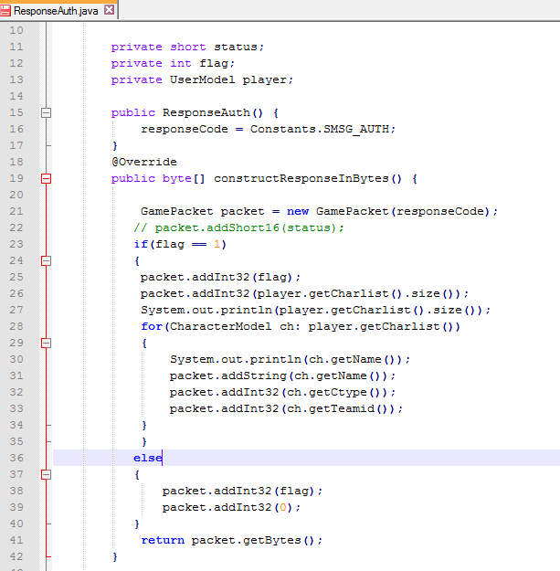
ResponseAuth.java

Slide 22
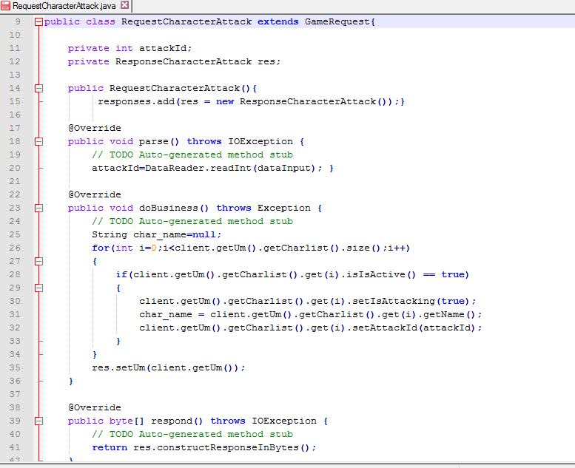
RequestCharacterAttack.java

Slide 23
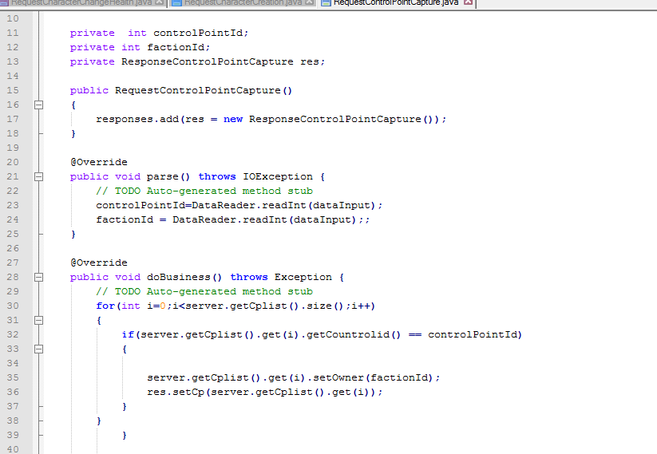
RequestControlPointCapture

Slide 24
Outline
Client requests to server (dummy program).
Handle requests coming from client and respond accordingly.
Model Classes
Heartbeat
Demo of requests & responses.

Slide 25
Model Classes
Model Class
UserModel.java
CharacterModel.java
NPCModel.java
ControlPointModel.java

Slide 26
UserModel.java
Maintains active user in GameClient
Each User may have multiple characters hence we have maintained ArrayList<Character> in UserModel.

Slide 27
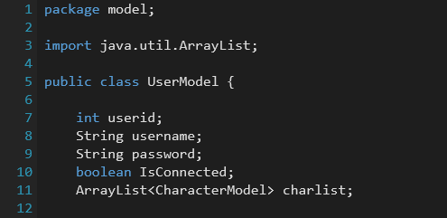

Slide 28
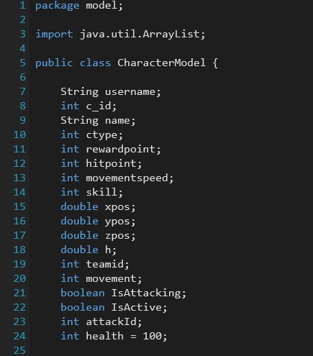
CharacterModel.java

Slide 29
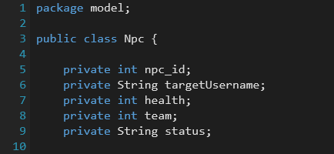
NPCModel.java

Slide 30
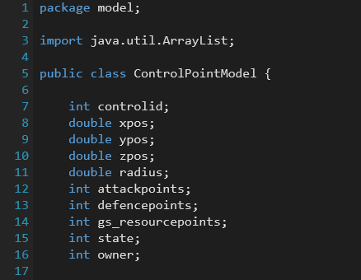
ControlPointModel.java

Slide 31
GameServer.java
Stores List of active Players
Maintaining Control Points of Active Players

Slide 32

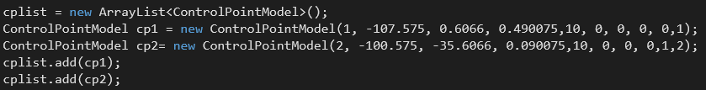
snippets

Slide 33
GameClient.java
This class represents each client on a thread and holds the client's state.
Maintain the active UserModel in List.

Slide 34
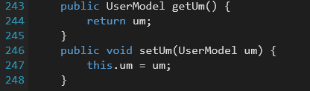
snippet

Slide 35
Code Demo

Slide 36

Server Side Implementation

