Slide 1

NUTSHELL
A BASIC TOPIC-FOCUSED MULTI-DOCUMENT SUMMARIZATION SYSTEM
SHANNON LADYMON HALEY LEPP BENNY LONGWILL AMINA VENTON

Slide 2
RELATED READINGS
Gunes Erkan and Dragomir R. Radev. 2004. Lexrank: Graph-based lexical centrality as salience in text summarization. J. Artif. Int. Res., 22(1):457–479.
Jahna Otterbacher, Gunes Erkan, and Dragomir Radev. 2005. Using random walks for question-focused sentence retrieval. In Proceedings of Human Language Technology Conference and Conference on Empirical Methods in Natural Language Process- ing, pages 915–922, Vancouver, British Columbia, Canada. Association for Computational Linguistics.
Jahna Otterbacher, Gunes Erkan, and Dragomir R. Radev. 2009. Biased lexrank: Passage retrieval using random walks with question-based priors. Inf. Process. Manage., 45(1):42–54.

Slide 3
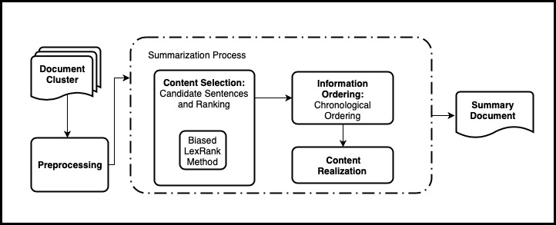
SYSTEM ARCHITECTURE

Slide 4
DATA PREPARATION & PREPROCESSING
Data
ACQUAINT and ACQUAINT2 corpora
Parsing XML files
Beautiful Soup Python Library
Tokenization
NLTK.sent_tokenize
Stopword Removal
NLTK.corpus stopwords list

Slide 5
CONTENT SELECTION
Modified Biased LexRank graph approach
Based on Pagerank inter-sentential similarity weighting
Similarity graph
Nodes are sentences
Edges are inter-sentential similarity weights
tf-idf Cosine Similarity
Additional bias for the query topic
Biased LexRank and Power Iteration
Sentence Selection

Slide 6
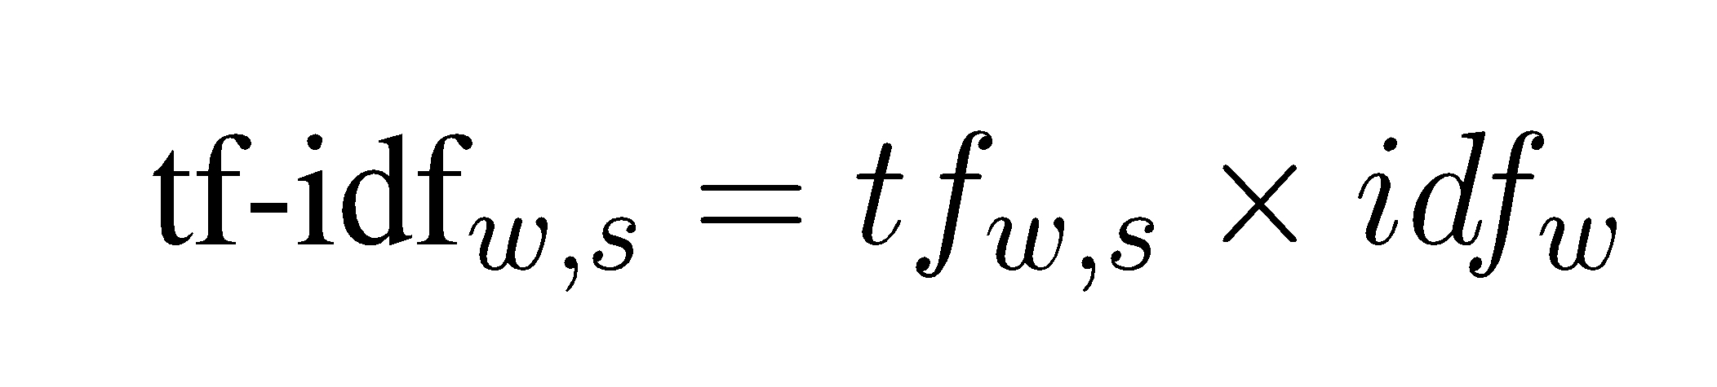
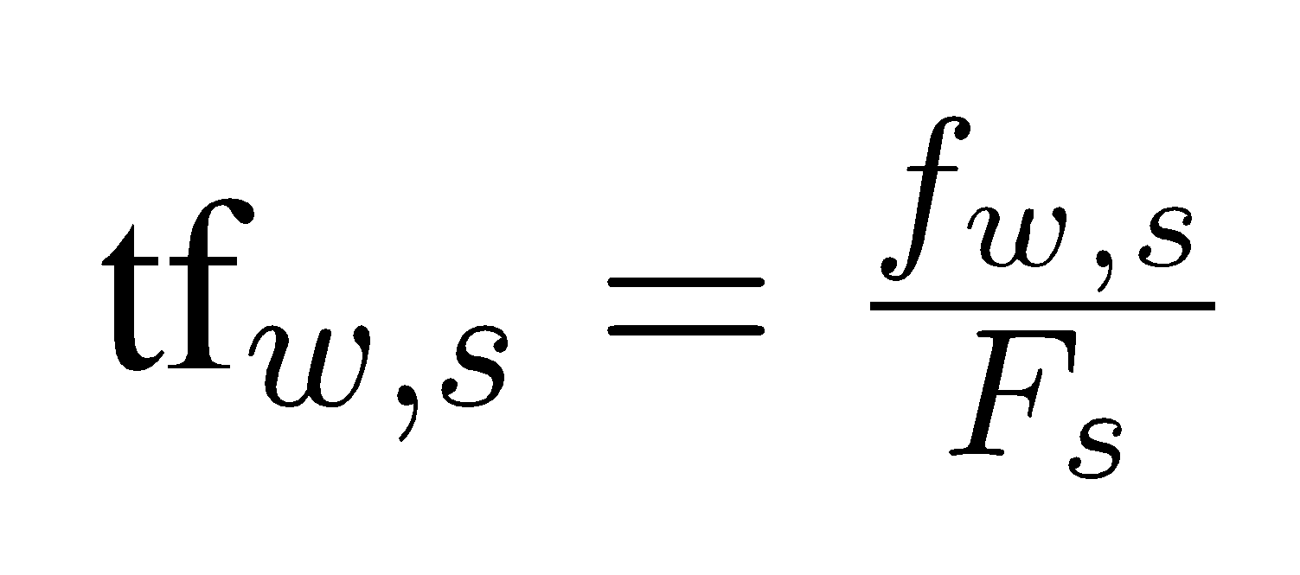
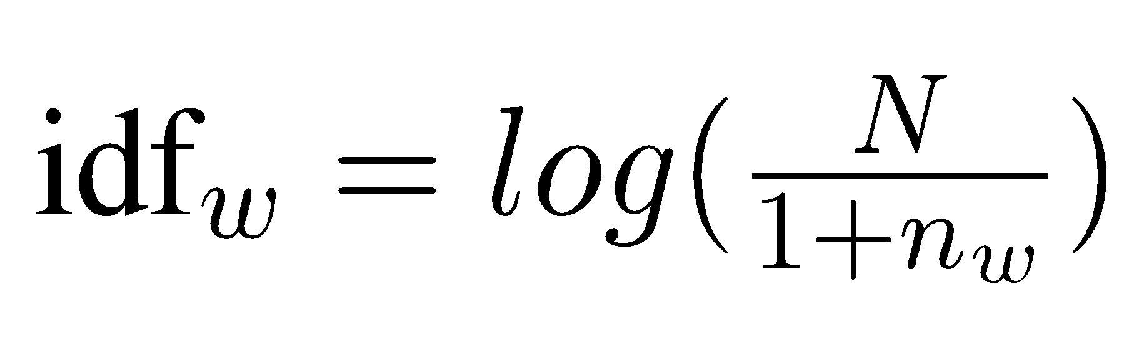
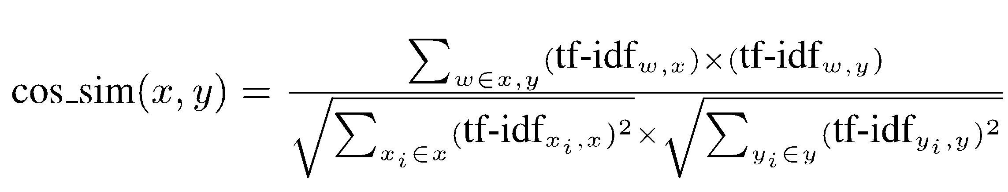
TF-IDF COSINE SIMILARITY
To calculate topic sentence and inter-sentential similarity:
f_{w,s} = count of words w in sentence s
F_{s} = total num of words in s *
N = num of sentences in the topic
n_{w} = num of sentences where w occurs
To calculate similarity between 2 sentences x and y:
Use cosine similarity of tf-idf values
Minimum threshold of 0.15
for inter-sentential cosine similarity
Notes:
* unusual to divide by this term, why did we do this?

Slide 7
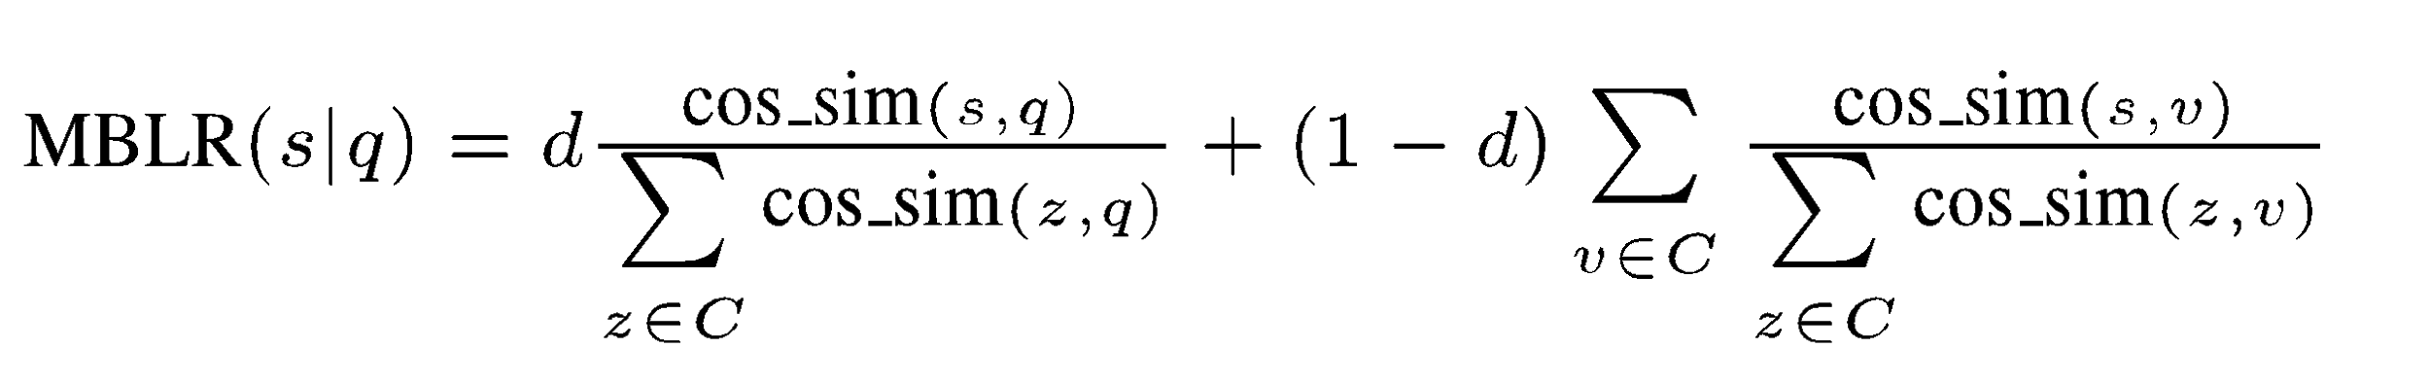
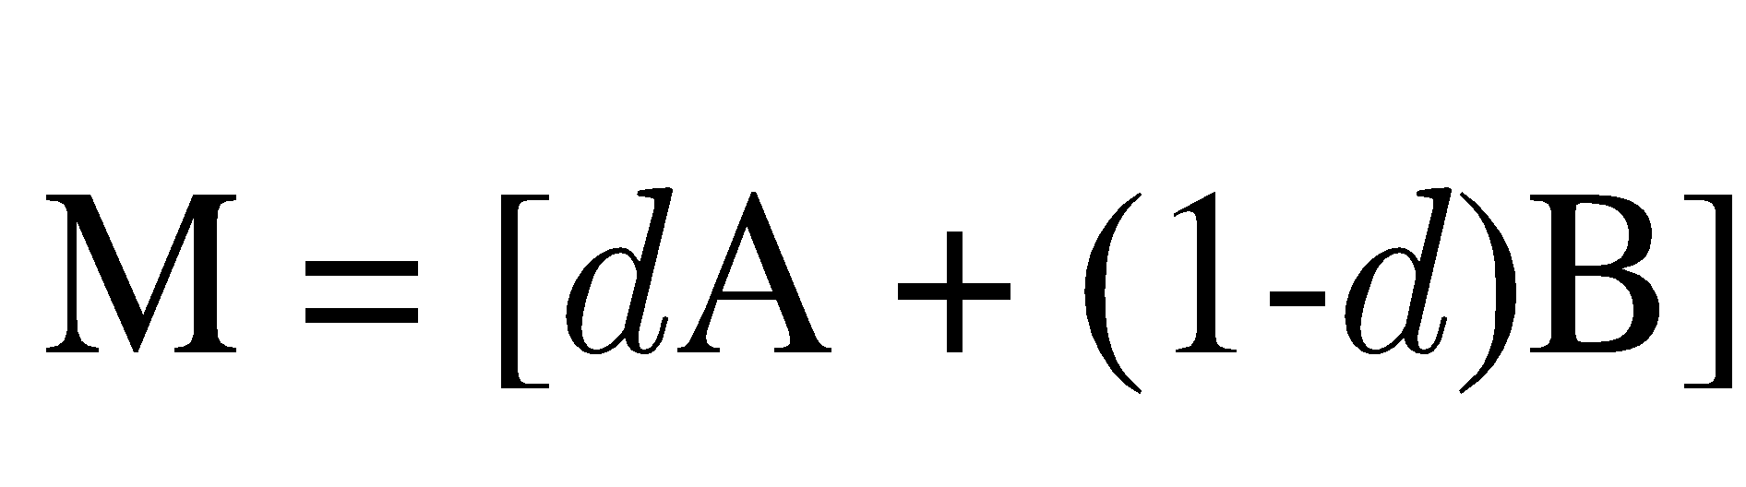
BIASED LEXRANK
To calculate the Modified Biased LexRank score for a sentence s given query topic q:
d = weight to give to the topic bias
C = set of sentences in topic document cluster
From this formula, we create a Markov Matrix:
A = bias vector of cosine similarity between sentences and the topic
B = inter-sentential similarity matrix

Slide 8
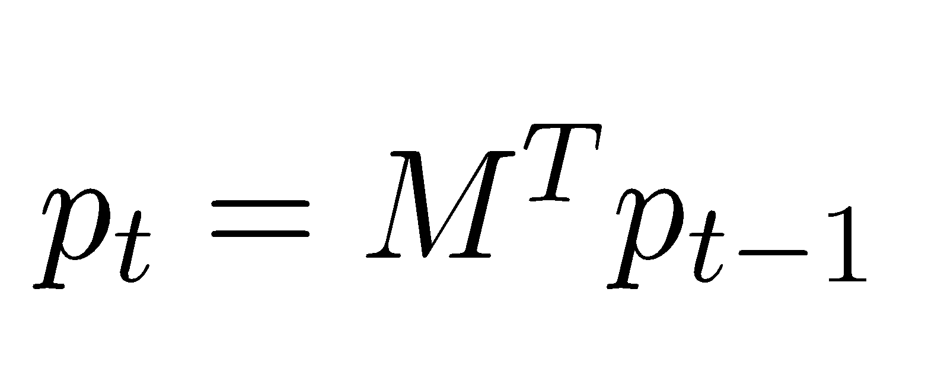
POWER ITERATION
To calculate final LexRank values for each sentence: Recall the Markov Matrix:
Begin with p₀ as a uniform probability distribution
Iterate until convergence, epsilon = 0.1
Update p at each step
Final set of scores p_{t} ranks sentence salience

Slide 9
SENTENCE SELECTION
Greedy iterative approach
Select sentence from sorted Modified Biased LexRank scores, from highest to lowest
Must fit within 100-word requirement
Filter out redundancy using cosine similarity >= 0.5

Slide 10
INFORMATION ORDERING & CONTENT REALIZATION
Information Ordering
(Reverse) Chronological Order
Content Realization
Currently copied from Information Ordering

Slide 11
SUCCESSES
Nutshell outperforms LEAD baseline
Nutshell is a fully functioning base end-to-end summarization system
We all work well as a team
Results
 | ROUGE-1 | ROUGE-2
LEAD BASELINE | - | 0.05376
MEAD BASELINE | - | 0.05927
NUTSHELL | 0.22720 | 0.05710

Slide 12
ISSUES
Getting used to Git
Branching and merging
Avoiding merge conflicts
Lack of clarity in the literature
Multiple versions of formulas without explanation
Unclear about important details of implementation e.g. stemming
Lack of transparency with how the file system is set up
Lots of trial and error
Confusing tags in XML files e.g. dateline = Los Angeles

Slide 13
FUTURE WORK
Stemming words in preprocessing
Tuning hyperparameters e.g. d, cosine sim thresholds
Tuning Modified Biased LexRank formulas
Information Ordering
Content Realization

Slide 14
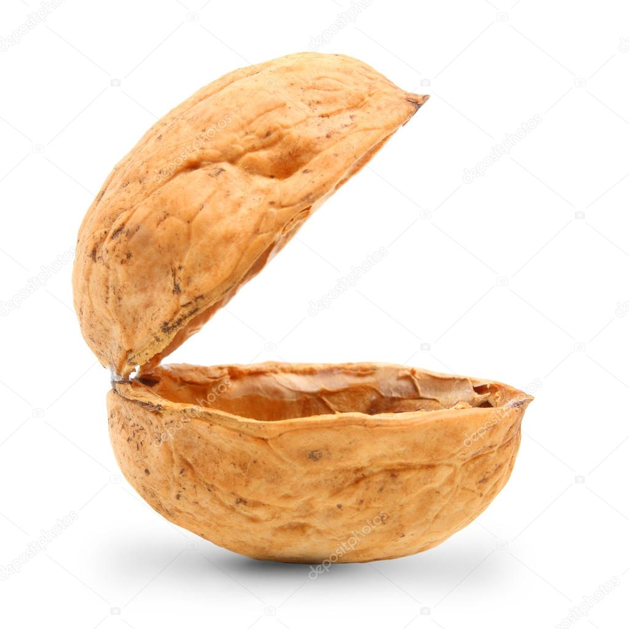
THANK YOU!
QUESTIONS / COMMENTS ?

