Slide 1
Optimizing Sushi Restaurants in Toronto

Slide 2
Location is everything
When opening a restaurant of any kind, where you open it is one of the most important factors.
The location of the restaurant can greatly boost your revenue and number of customers
Less competition means and more demand of your services means more money
A higher density of population means more potential customers for your business

Slide 3
The Data
Restaurant and venue information from Foursquare API
Toronto neighborhood and postal code info from Wikipedia
Latitude and longitude data in Toronto from the geolocator library

Slide 4
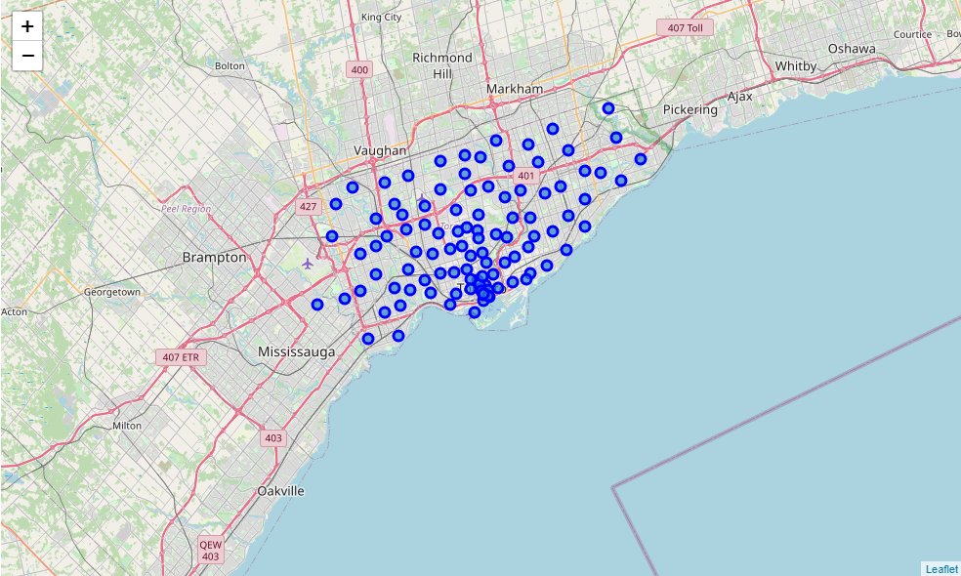
Map of Toronto Neighborhoods

Slide 5
There is a large portion of neighborhoods densely clustered around the center of the city. This means the center is an area of high population and activity. We want our restaurant to be as close as possible to this area.

Slide 6
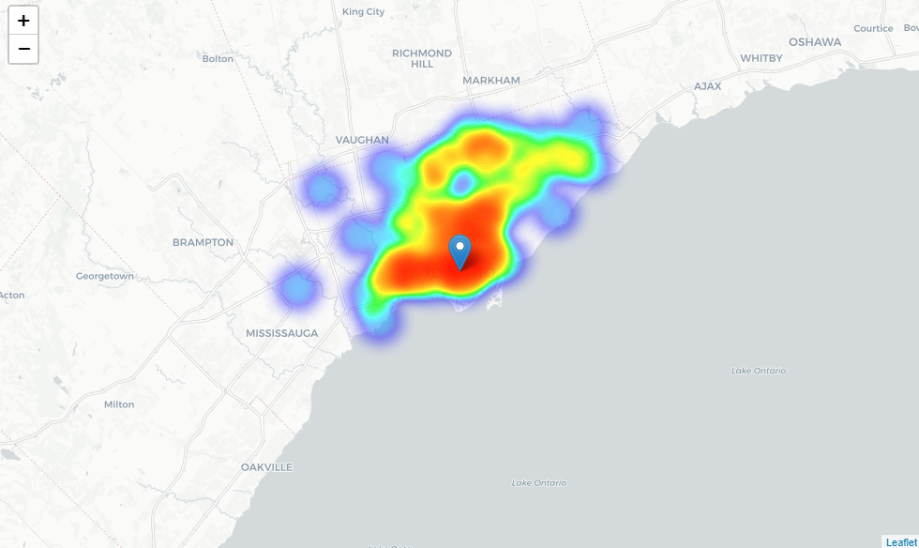
Heatmap of all Restaurants in Toronto

Slide 7
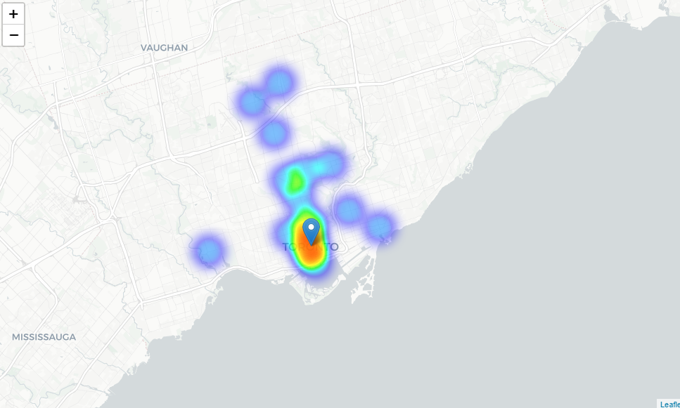
Heatmap of Sushi Restaurants in Toronto

Slide 8
The first heatmap shows us that the restaurants are like the neighborhoods in that they’re most densely populated near the center and then evenly distributed throughout the rest of the city.
The second heatmap shows us that there are a lot of sushi restaurants directly next to the center but far less frequent elsewhere. These are potentially good areas to open the restaurant in.

Slide 9
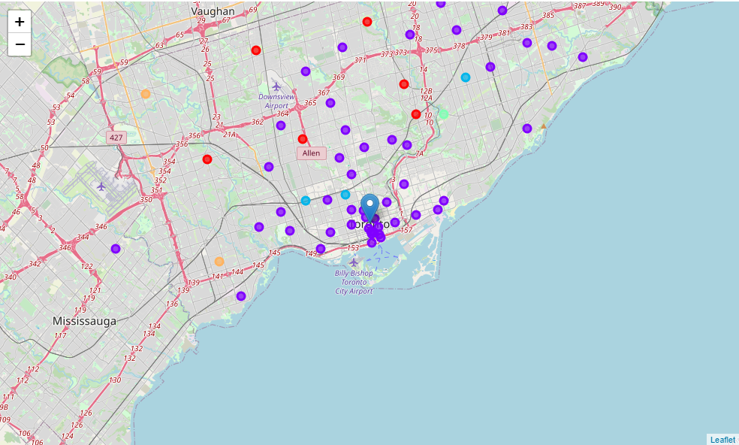
Neighborhoods by restaurant cluster

Slide 10
I ran the K-means classifier model on the restaurant data. This grouped neighborhoods into certain clusters based on what kinds of restaurants they had and how far away from the center they were. This helped me identify target neighborhoods and what neighborhoods to avoid. The target clusters were in the 1 and 2 (purple and blue).

Slide 11
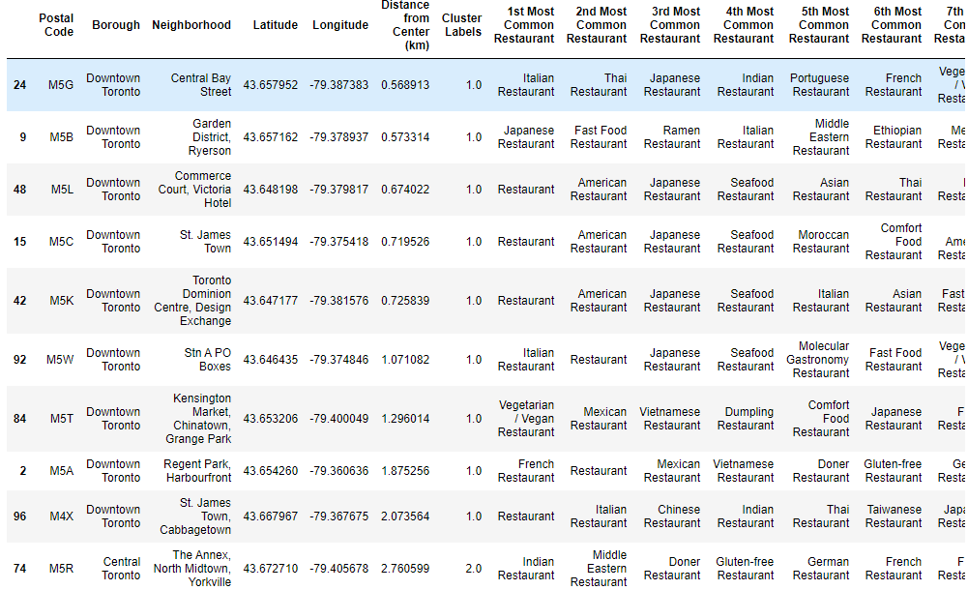
Final dataframe

Slide 12
Conclusion
This is the final dataframe of potentially good locations for the restaurant. In particular the last neighborhood on the list seemed like a very good location for the restaurant and is my final recommendation. Based on the heatmap data and the fact that it lacks any sushi restaurants at all the neighborhoods in postal code M5R are the best pick. The location is close to the center without being too close to other sushi restaurants, it also wouldn’t face much competition from other asian or seafood restaurants.

