Slide 1



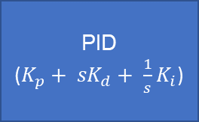



Cart Pole (Plant)
$$θ_{d}\left(s\right)=0$$
PID
($K_{p}+ {sK}_{d}+ {\frac{1}{s}K}_{i}$)
$$F(s)$$
$$θ(s)$$
$$F(s)$$
$$G\left(s\right)= \frac{θ(s)}{F(s)}$$
$$θ(s)$$

Slide 2

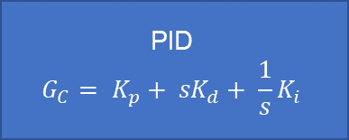


Cart Pole (Plant)
$$f_{dist}$$
$$u\left(s\right)=f_{dist} − G_{c}θ(s)$$
$$θ(s)$$
+
-
PID
$$G_{C}= K_{p}+ {sK}_{d}+ {\frac{1}{s}K}_{i}$$

