Slide 1
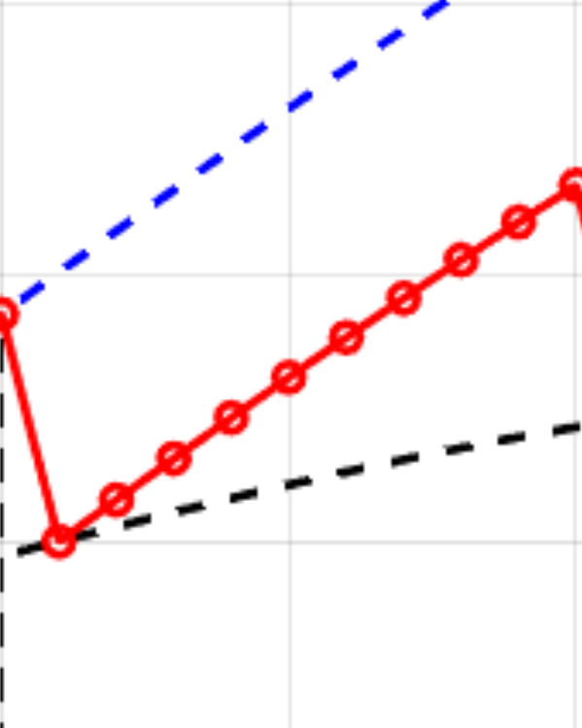
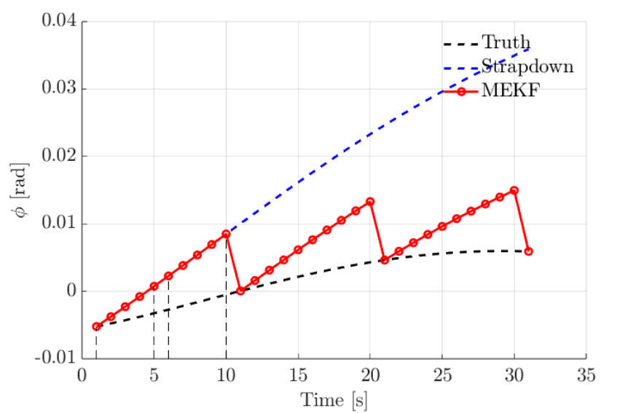

Slide 2
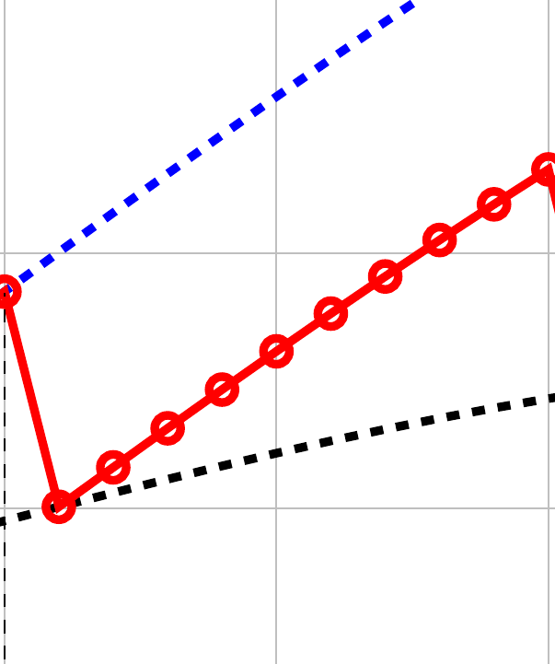
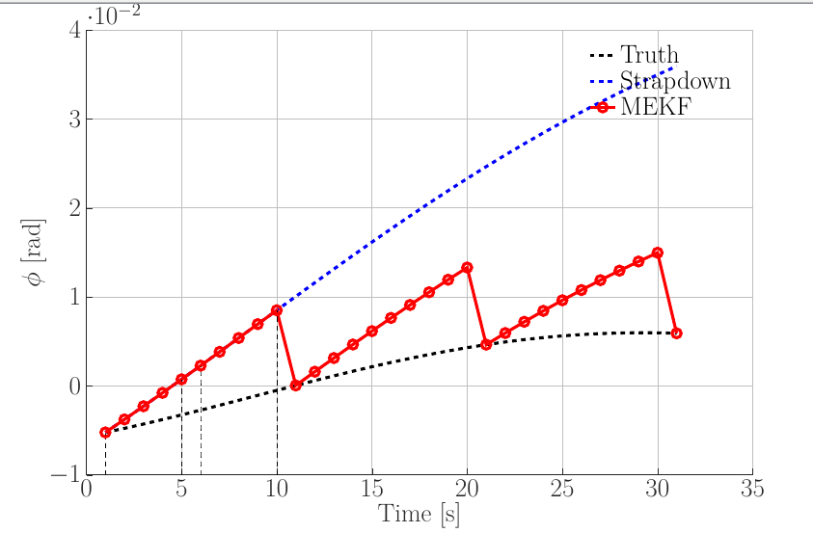

Slide 3
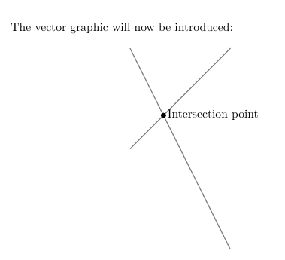
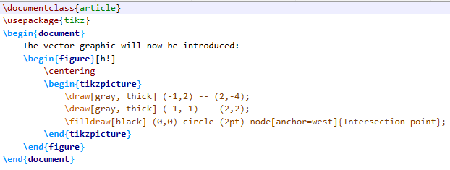

Slide 4
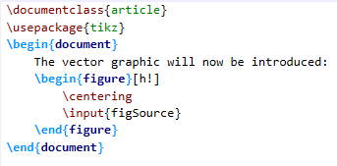


Slide 5
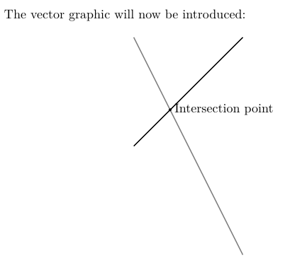
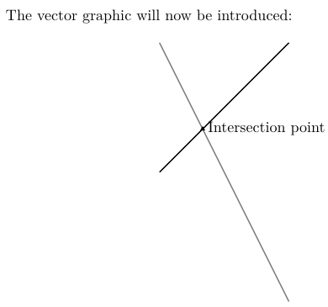

Slide 6
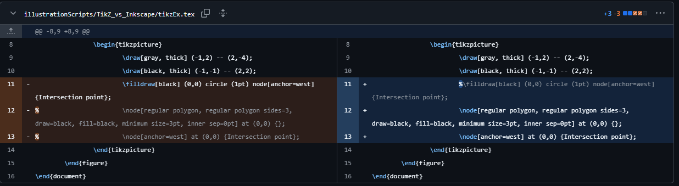

Slide 7
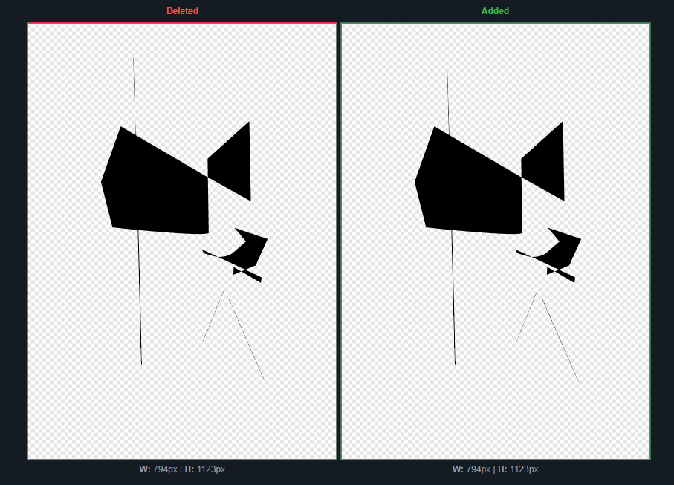

Slide 8
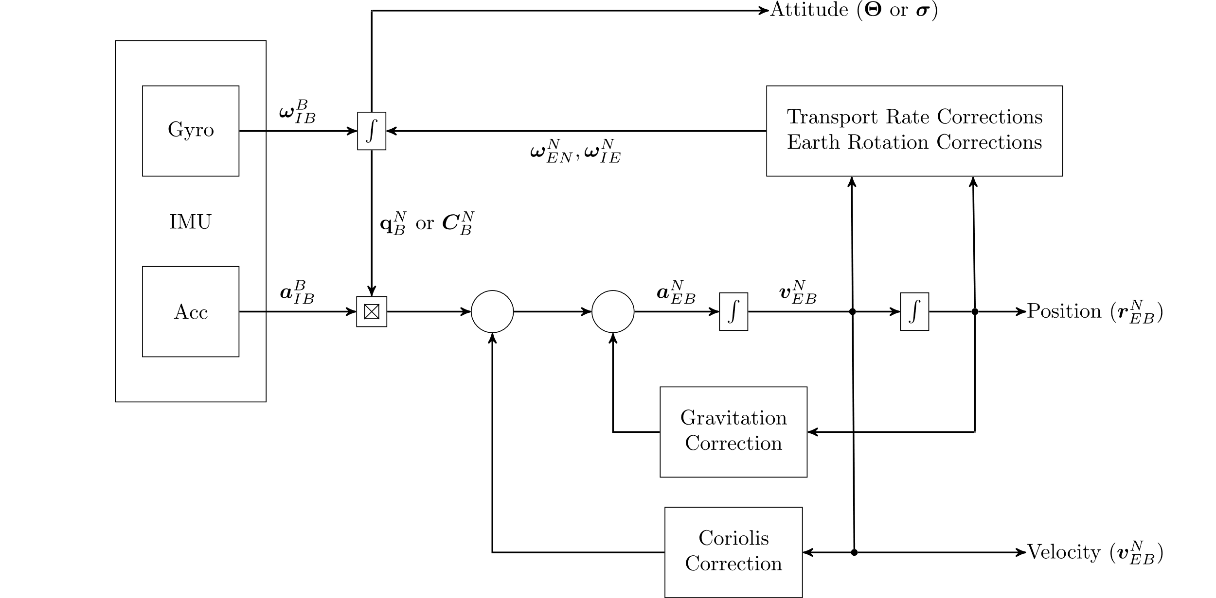
\usepackage{tikz}
\usepackage{arrows}

Slide 9

TikZ styles preamble (local to each tikzpicture graphic)
\tikzstyle{imu} = [draw, rectangle, minimum height=6cm, minimum width=2.5cm]
\tikzstyle{block} = [draw, rectangle, minimum height=1.5cm, minimum width=1.6cm]
\tikzstyle{blockM} = [draw, rectangle, minimum height=0.5cm, minimum width=0.5cm]
\tikzstyle{blockS} = [draw, rectangle, minimum height=0.5mm, minimum width=0.5mm]
\begin{tikzpicture}[auto, node distance=3cm, >=stealth‘]
\node[imu] (imu) {IMU}; % IMU Block
\end{tikzpicture}
Local Name of node inside tikzpicture environment
\node[nodeType] (nodeName) {Text inside Node};
Usually defined in TikZ preamble

Slide 10

\tikzstyle{imu} = [draw, rectangle, minimum height=6cm, minimum width=2.5cm]
\tikzstyle{block} = [draw, rectangle, minimum height=1.5cm, minimum width=1.6cm]
\tikzstyle{blockM} = [draw, rectangle, minimum height=0.5cm, minimum width=0.5cm]
\tikzstyle{blockS} = [draw, rectangle, minimum height=0.5mm, minimum width=0.5mm]
\begin{tikzpicture}[auto, node distance=3cm, >=stealth‘]
\node[imu] (imu) {IMU}; % IMU Block
\node[block, above of = imu, node distance = 1.5cm] (gyro) {Gyro}; % Gyro Block
\end{tikzpicture}
\node[nodeType, nodePosition] (nodeName) {Text inside Node};
Absolute or relative (wrt other nodes) position

Slide 11

\tikzstyle{imu} = [draw, rectangle, minimum height=6cm, minimum width=2.5cm]
\tikzstyle{block} = [draw, rectangle, minimum height=1.5cm, minimum width=1.6cm]
\tikzstyle{blockM} = [draw, rectangle, minimum height=0.5cm, minimum width=0.5cm]
\tikzstyle{blockS} = [draw, rectangle, minimum height=0.5mm, minimum width=0.5mm]
\begin{tikzpicture}[auto, node distance=3cm, >=stealth‘]
\node[imu] (imu) {IMU}; % IMU Block
\node[block, above of = imu, node distance = 1.5cm] (gyro) {Gyro}; % Gyro Block
\node[block, below of = imu, node distance = 1.5cm] (acc) {Acc}; % Acc Block
\end{tikzpicture}

Slide 12

\tikzstyle{imu} = [draw, rectangle, minimum height=6cm, minimum width=2.5cm]
\tikzstyle{block} = [draw, rectangle, minimum height=1.5cm, minimum width=1.6cm]
\tikzstyle{blockM} = [draw, rectangle, minimum height=0.5cm, minimum width=0.5cm]
\tikzstyle{blockS} = [draw, rectangle, minimum height=0.5mm, minimum width=0.5mm]
\begin{tikzpicture}[auto, node distance=3cm, >=stealth‘]
\node[imu] (imu) {IMU}; % IMU Block
\node[block, above of = imu, node distance = 1.5cm] (gyro) {Gyro}; % Gyro Block
\node[block, below of = imu, node distance = 1.5cm] (acc) {Acc}; % Acc Block
\node[blockS, right of = gyro] (int1) {$\int$}; % Integrator Block
% Product block
\node[blockM, right of = acc] (product) {$$};
\node[blockS, right of = acc] (product1) {$$};
\coordinate (c1) at (product1.north west);
\coordinate (c2) at (product1.north east);
\coordinate (c3) at (product1.south west);
\coordinate (c4) at (product1.south east);
\draw (c1) -- (c4);
\draw (c2) -- (c3);
\end{tikzpicture}

Slide 13

\tikzstyle{imu} = [draw, rectangle, minimum height=6cm, minimum width=2.5cm]
\tikzstyle{block} = [draw, rectangle, minimum height=1.5cm, minimum width=1.6cm]
\tikzstyle{blockM} = [draw, rectangle, minimum height=0.5cm, minimum width=0.5cm]
\tikzstyle{blockS} = [draw, rectangle, minimum height=0.5mm, minimum width=0.5mm]
\begin{tikzpicture}[auto, node distance=3cm, >=stealth‘]
\node[imu] (imu) {IMU}; % IMU Block
\node[block, above of = imu, node distance = 1.5cm] (gyro) {Gyro}; % Gyro Block
\node[block, below of = imu, node distance = 1.5cm] (acc) {Acc}; % Acc Block
\node[blockS, right of = gyro] (int1) {$\int$}; % Integrator Block
% Product block
\node[blockM, right of = acc] (product) {$$};
\node[blockS, right of = acc] (product1) {$$};
\coordinate (c1) at (product1.north west);
\coordinate (c2) at (product1.north east);
\coordinate (c3) at (product1.south west);
\coordinate (c4) at (product1.south east);
\draw (c1) -- (c4);
\draw (c2) -- (c3);
%% Connections
\draw[connector](gyro) -- node{$\bm{\omega}^B_{IB}$} (int1);
\draw[connector](acc) -- node{$\bm{a}^B_{IB}$} (product);
\end{tikzpicture}

Slide 14
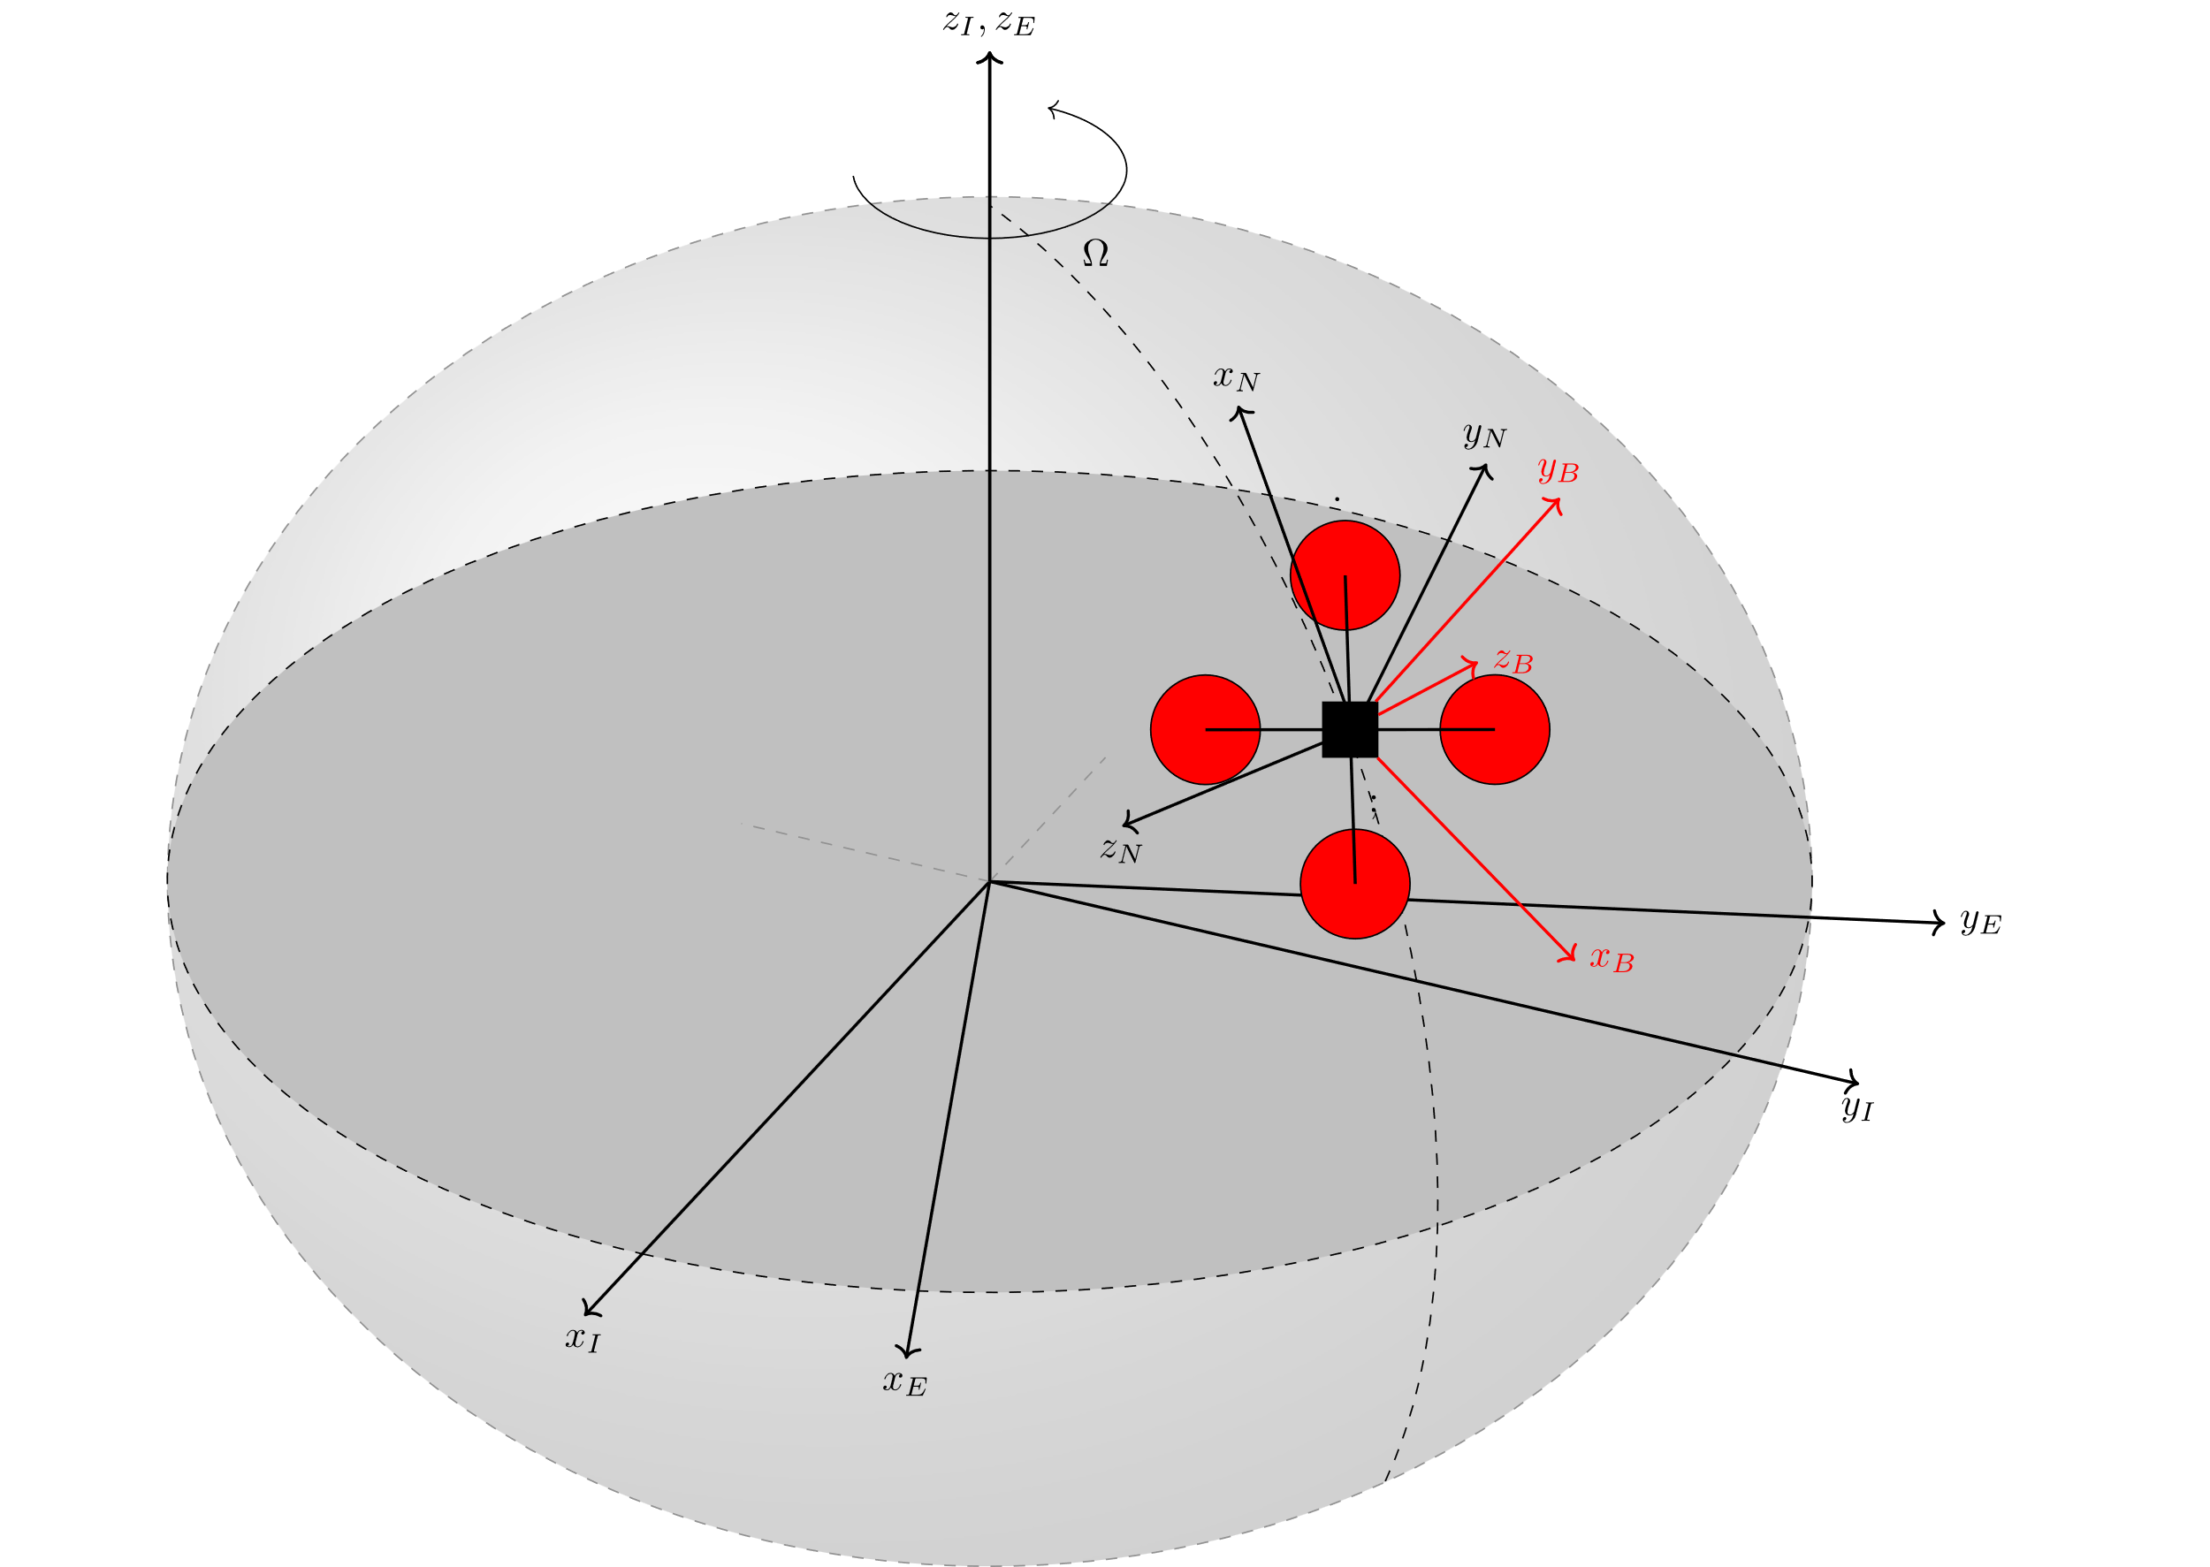
\usepackage{tikz}
\usepackage{tikz-3dplot}
\usepackage{arrows}

Slide 15

\begin{tikzpicture}
% Parent Code
\input{quadCopter.tex}
\end{tikzpicture}

Slide 16
referenceFrames_standalone.tex
referenceFrames.tex
quadCopter.tex

Slide 17
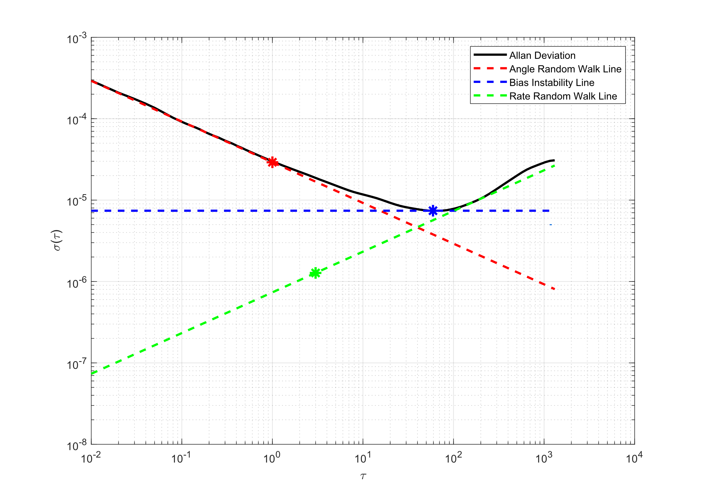
MATLAB Figure
matlab2tikz:
Repository (Matlab Central)
\usepackage{tikz}
\usepackage{pgfplots}
noiseAnalysis.m:
addpath(„<path to matlab2tikz src>“)
********* Code Body *********
figure;
<Figure Code>
cleanfigure;
matlab2tikz(„fileName.tex“) % after figure generation

Slide 18
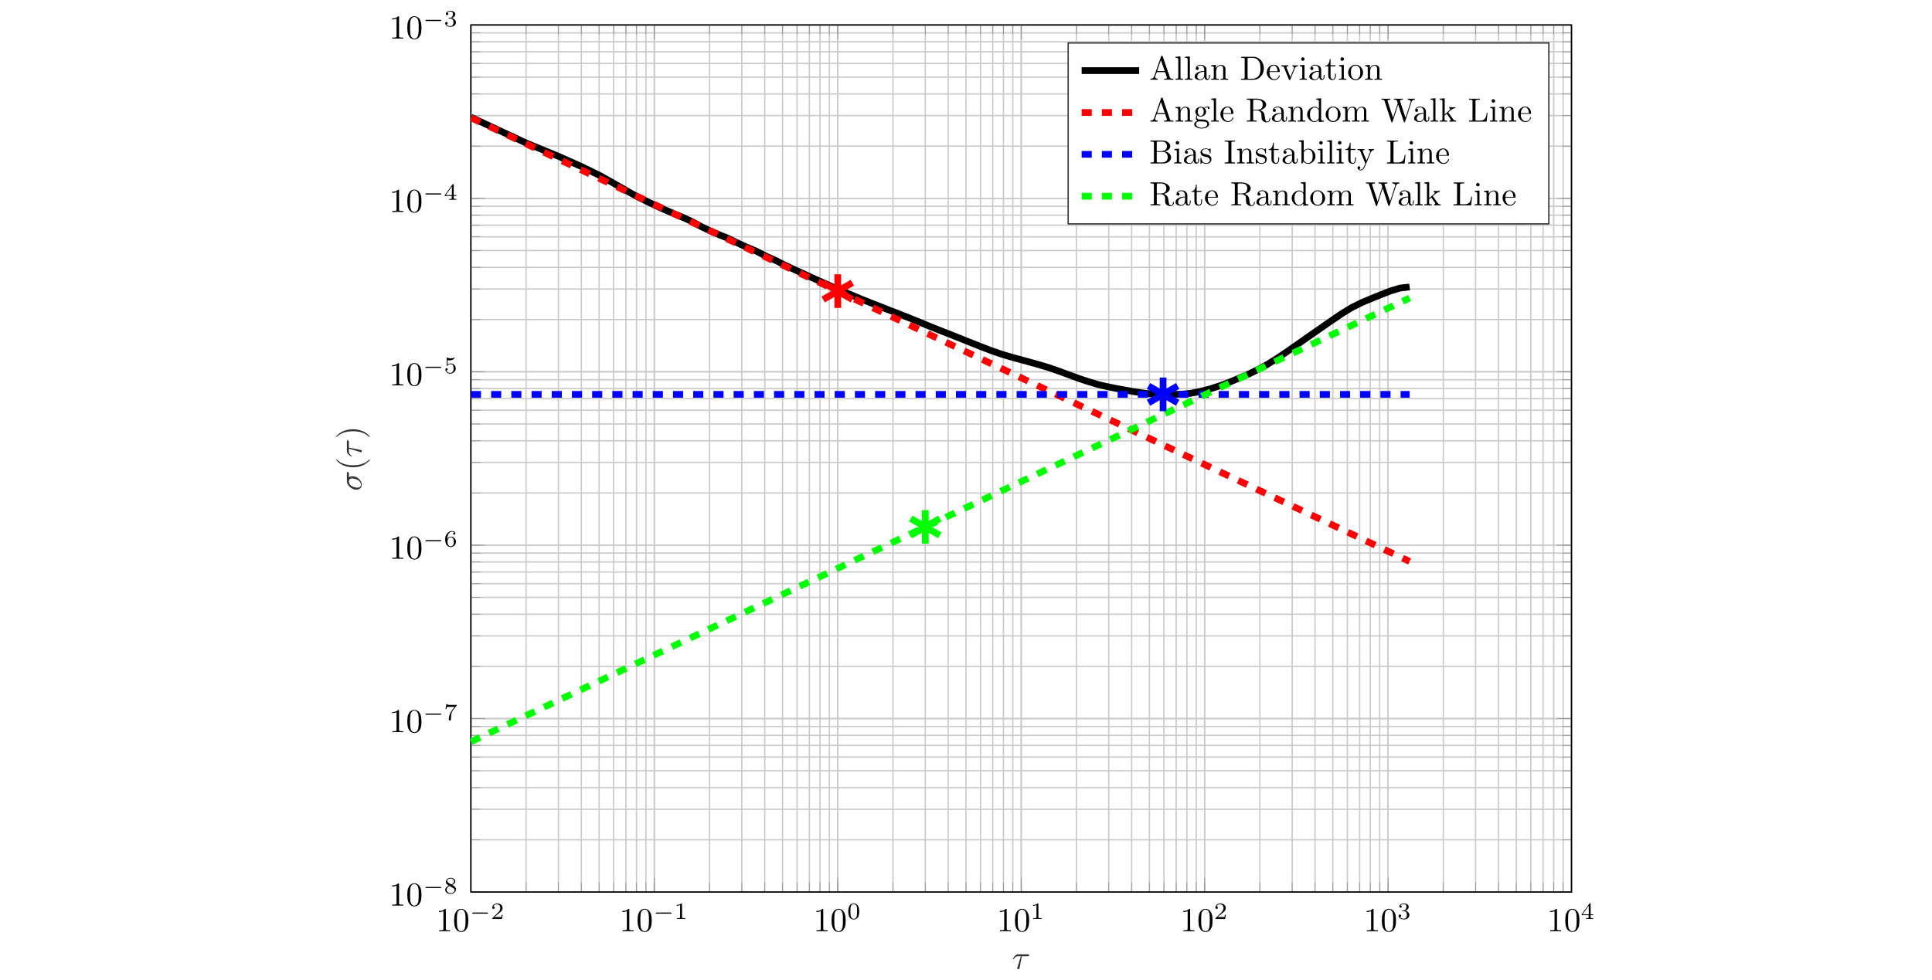
TikZ Figure
allanVar_standalone.tex:
\documentclass[preview]{standalone}
\input{packages}
\pgfplotsset{compat=newest} % Optional
\begin{document}
\begin{figure}
\centering
\scalebox{0.75}[0.75]{\input{allanVar.tex}}
\end{figure}
\end{document}
> help matlab2tikz; % for more customizations
make sure that the src folder for matlab2tikz is in the MATLAB Path
Something similar for other programming languages (eg. Python)?

