Slide 1
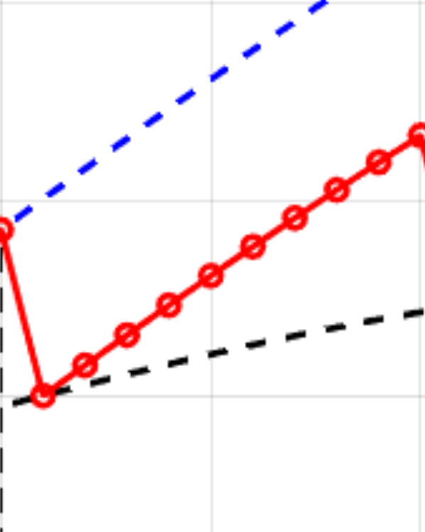
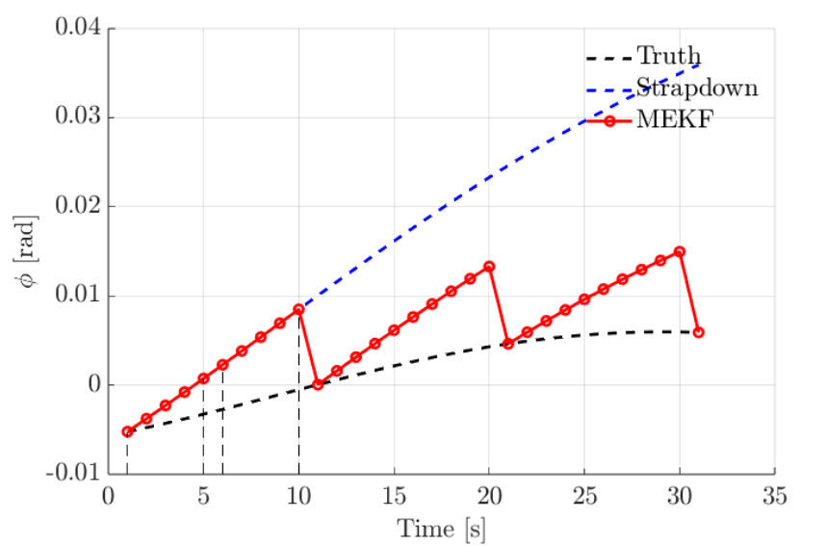

Slide 2
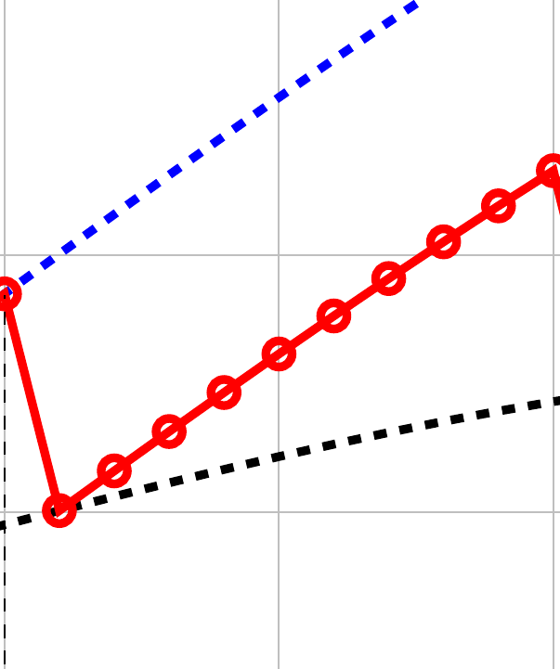
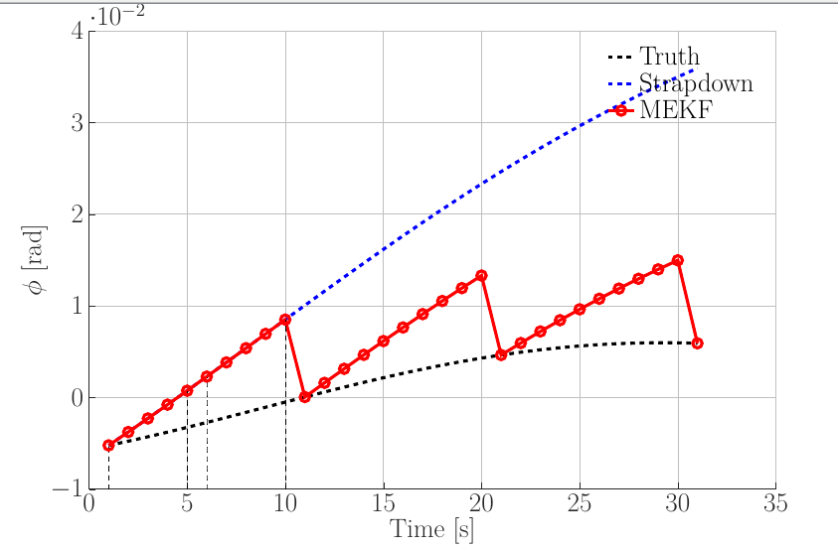

Slide 3
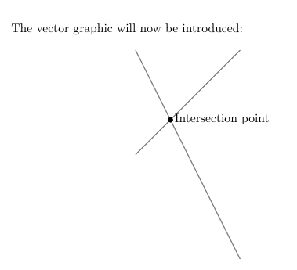
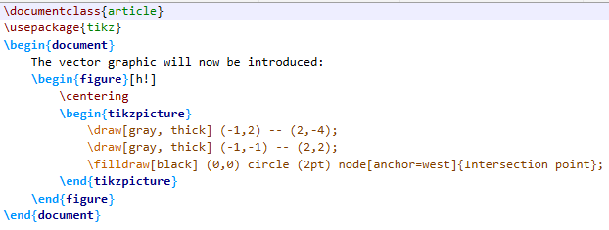

Slide 4
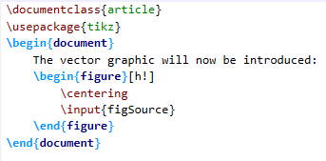


Slide 5
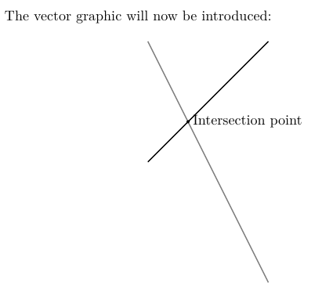
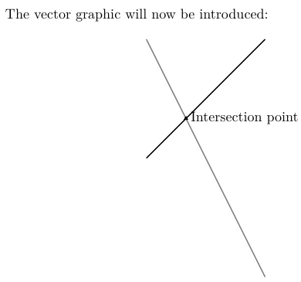

Slide 6
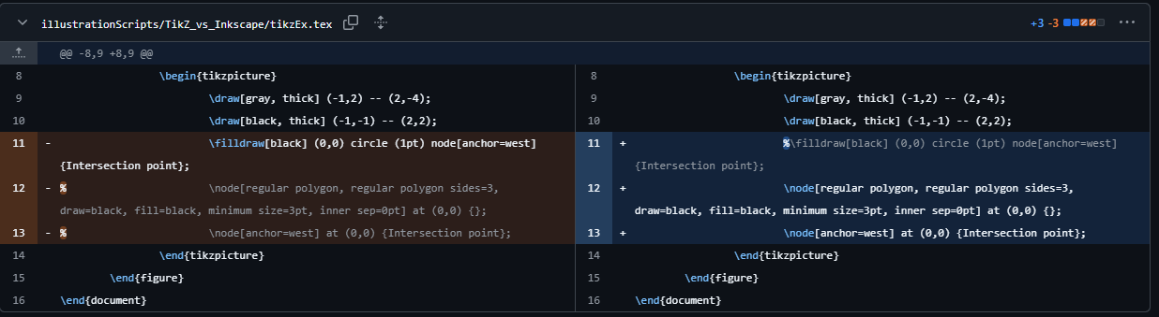

Slide 7
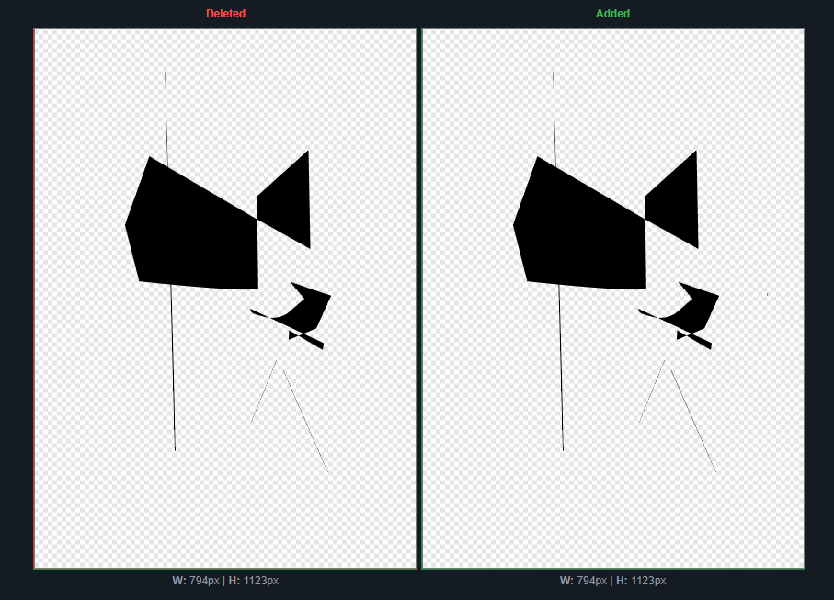

Slide 8
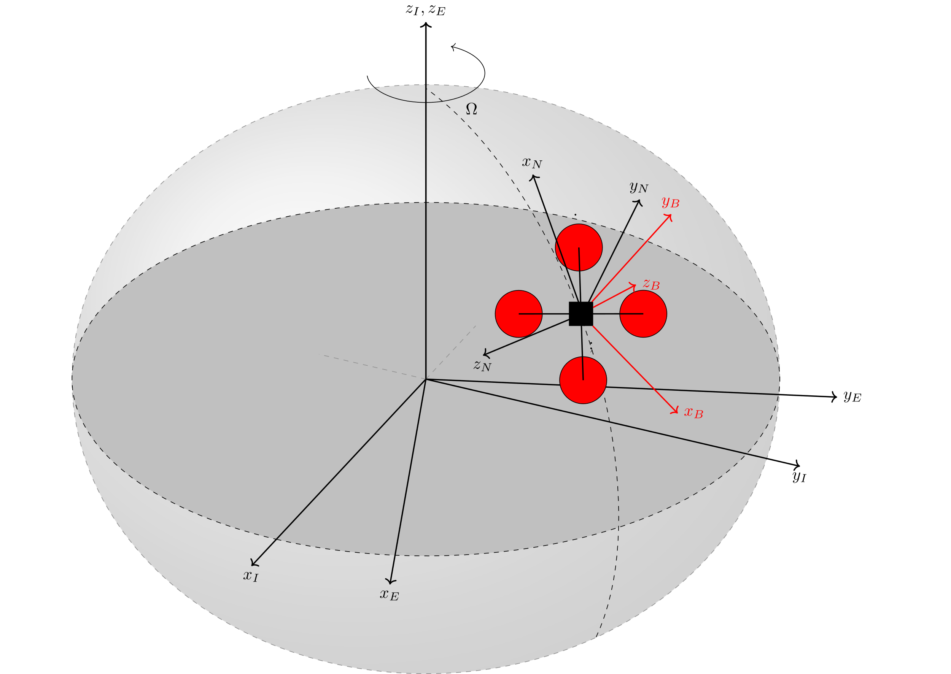
\usepackage{tikz}
\usepackage{tikz-3dplot}
\usepackage{arrows}

Slide 9

\begin{tikzpicture}
% Parent Code
\input{quadCopter.tex}
\end{tikzpicture}

Slide 10
referenceFrames_standalone.tex
referenceFrames.tex
quadCopter.tex

Slide 11
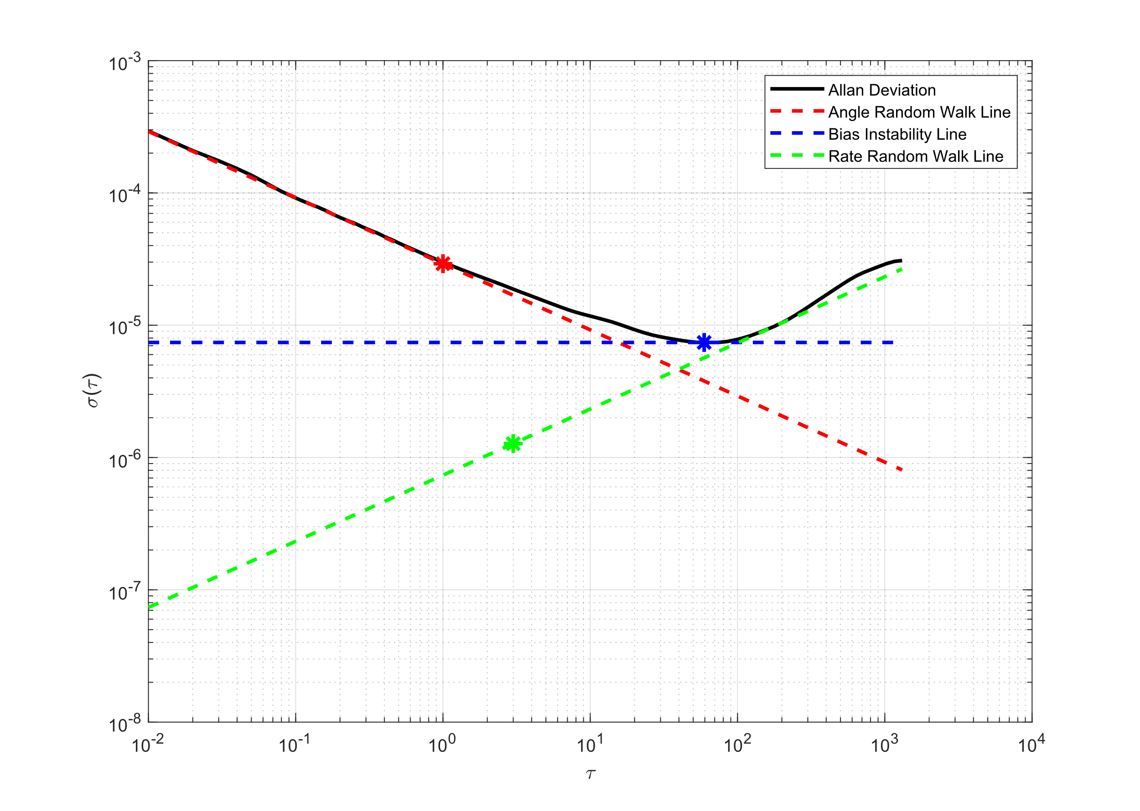
MATLAB Figure
noiseAnalysis.m:
addpath(„<path to matlab2tikz src>“)
matlab2tikz(„fileName.tex“) after figure generation

