Slide 1
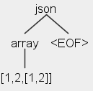
Lab 8: JSON with arrays and objects (fine-grained parse tree)
We just saw how to create a lexer and parser for JSON arrays.
In that implementation the array is one unit. Consequently an application that processes the parse tree would see only one node that contains the entire array.

Slide 2
We want the parse tree to show all the components of the array: left bracket, right bracket, colon, etc.
Furthermore, we want the parser to deal with both arrays and objects: A JSON value can be an array or an object. An object contains name/value pairs, separated by commas as shown below.
Use the below input. The desired parse tree is shown on the next slide. Use json as the name of the start rule.
input.txt
{
"age": 31,
"numSpouses": 2,
"favoriteColors": [6,7]
}

Slide 3
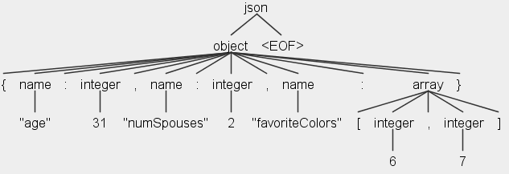
Output (parse tree)
Question: when should you design the lexer/parser grammars that result in parse trees with huge nodes (course-grain parsing) versus parse trees with all the parts and pieces broken out (fine-grain parsing)?

