Slide 1
Lab 10: using modes
Below is the input.
The input contains a title followed by one or more lines.
Discard newlines.
Name the start rule: document
See the next slide for what the parse tree should look like.
This should look familiar. You saw this in Lab 7. This time you are to use modes to parse the input.
input.txt
Gettysburg Address
Four score and seven years ago our fathers brought forth on this continent,
a new nation, conceived in Liberty, and dedicated to the proposition that
all men are created equal.

Slide 2
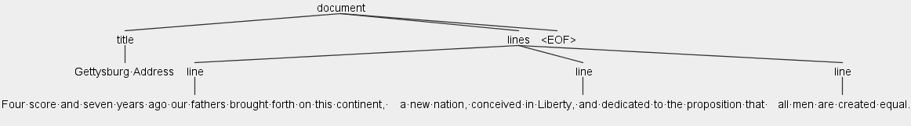
Output (parse tree)

