Slide 1
Lab 20: CSV with escape characters
The input file contains comma-separated-values (CSV). Each field may contain a comma, provided the comma is escaped by a backslash. Here's an example:
Mark and Sally, "Drive to NYC", Hello\, World
That 1-line CSV contains these three fields:
1. Mark and Sally
2. "Drive to NYC"
3. Hello, World
Fields may also contain a backslash, provided it is escaped by a backslash. Here's an example:
John\\Sally, "Drive to NYC", Hello\, World
That 1-line CSV contains these three fields:
continued →

Slide 2
1. Mark\Sally
2. "Drive to NYC"
3. Hello, World
Fields may continue onto the next line, provided the newline character is escaped by a backslash. Here's an example:
John\\Sally, "Drive to NYC", Hello\, World, This is\
a long string
That 1-line CSV contains these four fields:
1. Mark\Sally
2. "Drive to NYC"
3. Hello, World
4. This is a long string
The parse tree is shown on the next slide.

Slide 3
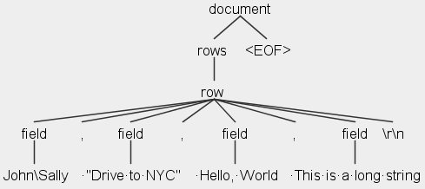
To give you a running start, in this folder is a partially completed MyLexer.g4 and MyParser.g4

