Slide 1

Introduction to GPG
Brief History of encryption
What is GPG?
How does it work?
PGP vs GPG
Utlizing GPG

Slide 2




Who Am I?
Hossein Heydari
A mere senior high school student :)
Nelliel.ir
Nelliel [at] riseup [dot] net
@NELFORZA

Slide 3
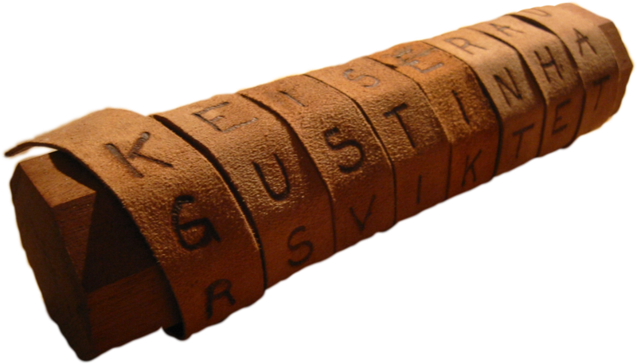
Scytale (Skytale)
500 years before christ
Transposition Cipher
Used by ancient Spartans
Consisting a strip of leather on a rod

Slide 4
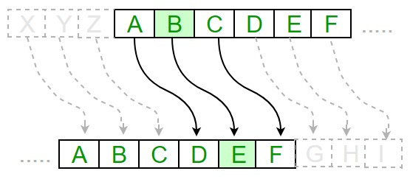
Caesar Cipher
Invented by Julius Caesar
60 years before christ
Substitution Cipher
Shifting letters a fixed amount

Slide 5
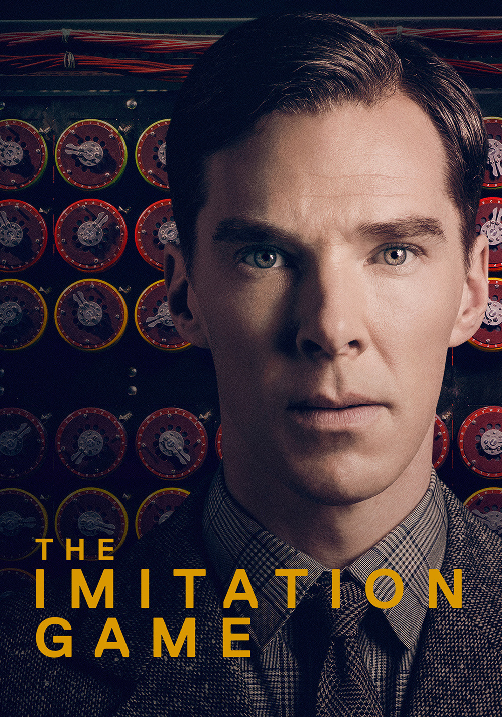
Based on the true story of Alan Turing
In 1939 MI6 recruits a Cambridge graduate
Mathematician named Alan Turing in order to crack enigma coding machine which had been tought unbreakable.

Slide 6
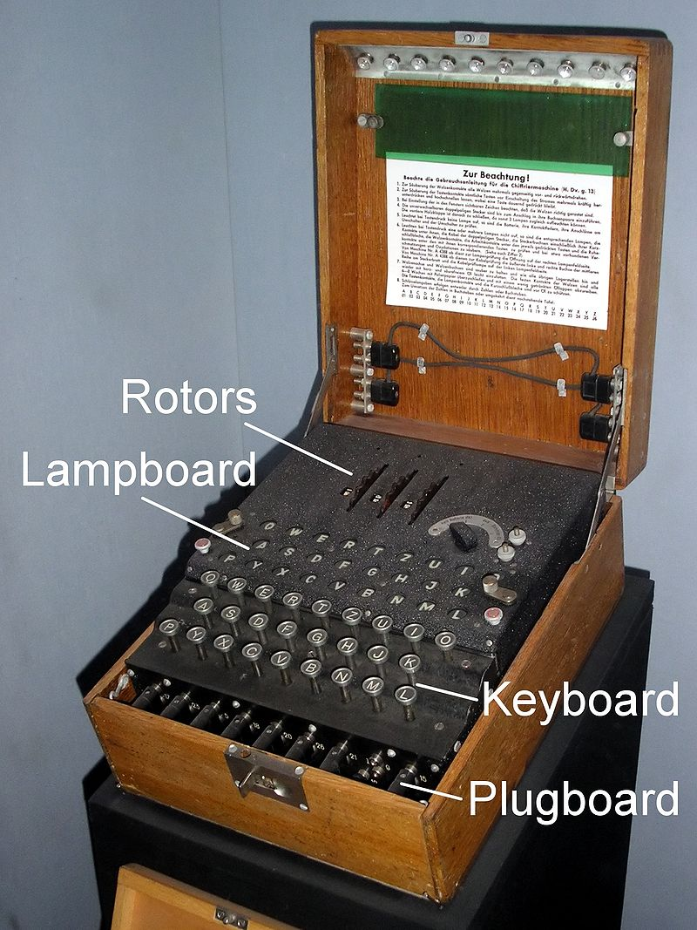
Enigma has an electromechanical rotor mechanism which scrambles alphabet letters, by applying different rotor settings Enigma can scramble letters in different ways.

Slide 7
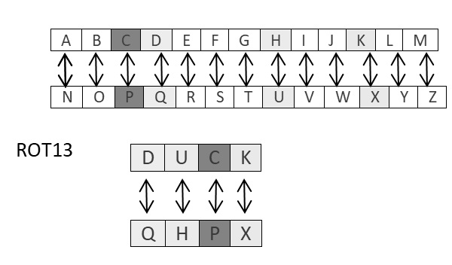
Not always for wars but for fun!
ROT13 is used in online forums as a means of hiding spoilers, punchlines, puzzle solutions, and offensive materials.

Slide 8
GNU Privacy Guard
A free Hybrid cryptographic software which has been being developed by GNU Project in order to encrypt messages through communitcating channels and decrypt them on recipient’s local system.

Slide 9
Cryptosystems:
Symmetric-key Cryptosystem
Public-key cryptosystem
Hybrid cryptosystem
X-bit Key and Key Space:
Amount of All the possible combinations that can make a key are called «Key Space».
X-bit key means there are 2**X possible keys in key space.
Session Key:
Symmetric-key used in hybrid cryptosystem can also be called session key.

Slide 10


How does it work?
Ross
Message
Session Key
Ross’s Public key
Public Key
Private Key

Slide 11
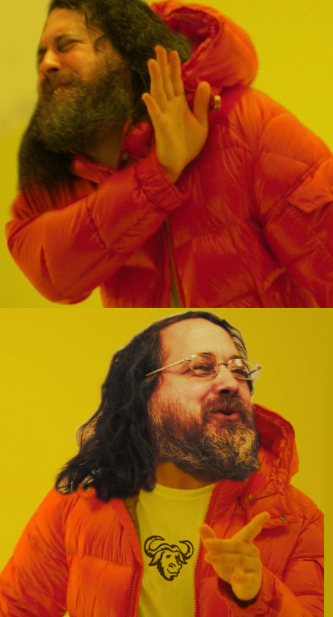
PGP: Pretty Good Privacy
GPG: GNU Privacy Guard

Slide 12
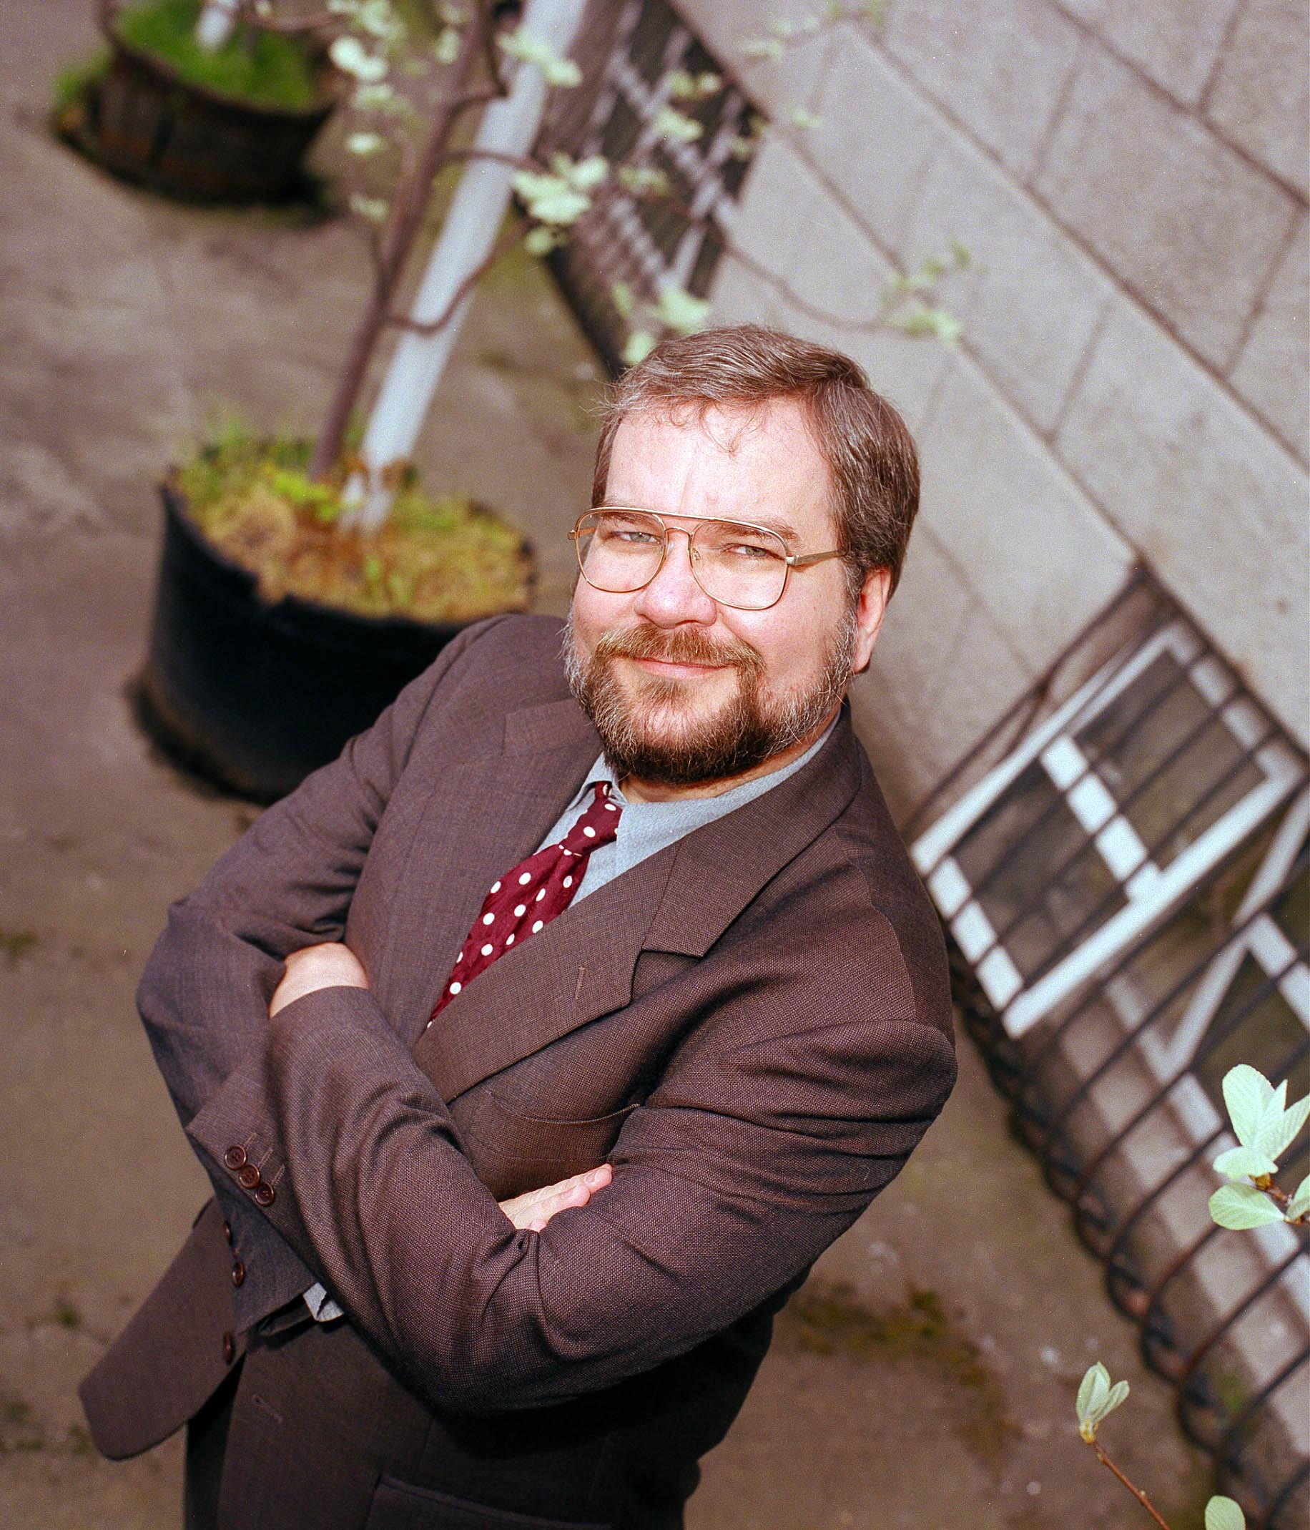
Pretty Good Privacy (PGP) is an encryption program that provides cryptographic privacy and authentication for data communication. PGP is used for signing, encrypting, and decrypting texts, e-mails, files, directories, and whole disk partitions and to increase the security of e-mail communications. Phil Zimmermann developed PGP in 1991.

Slide 13
