Slide 1
Visualizing Cryptocurrency relationships
Jordan Burns

Slide 2
Introduction
Bitcoin has been the major cryptocurrency discussed for the last few years and has been a major driver in the crypto market
Dogecoin, despite being commonly referred to as a "meme" coin, has sparked interest in the Crypto community after rising significantly in value over a short period of time
Being able to determine if the value of the two coins are related could help predict whether the prices will increase or decrease

Slide 3
Data Sets
The data sets used for these visualizations are sourced from blockchain info (retrieved from https://www.kaggle.com/datasets/sudalairajkumar/cryptocurrencypricehistory)
High, Low, Open, and Close values for each of the currencies is recorded daily since 2013 in these data sets
Most activity has occurred in the last two years, and that data will be the focus of this presentation

Slide 4
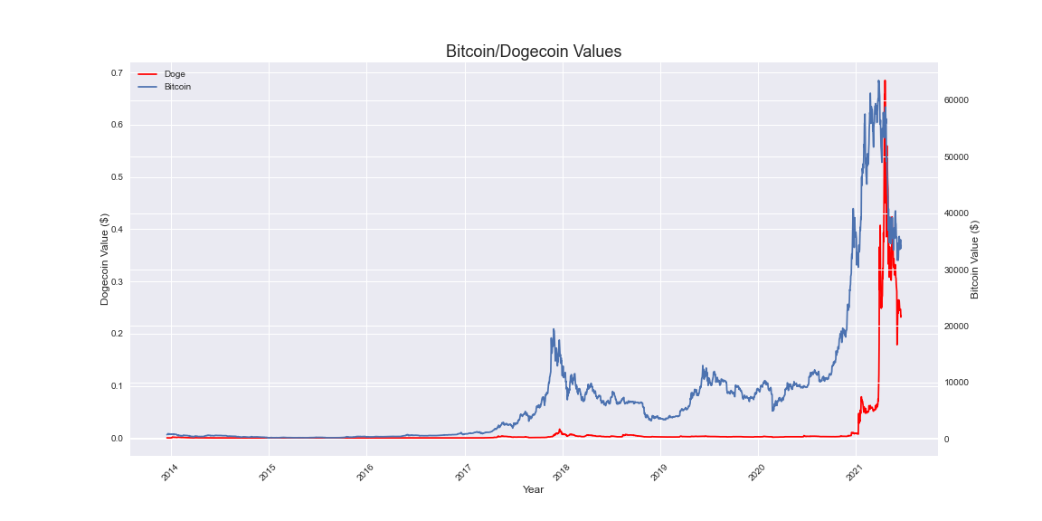
How have the values of Bitcoin and Dogecoin trended?
Bitcoin value increased significantly during an initial boom in late 2017
Dogecoin remained insignificant until 2021
In late 2020 - early 2021, the value of Bitcoin soared, with Dogecoin following
Both coins experienced a significant fall in value shortly after

Slide 5
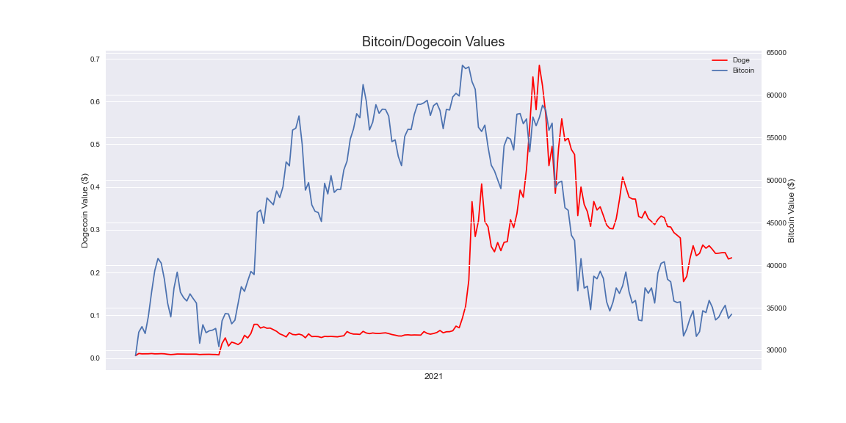
How have the values of Bitcoin and Dogecoin trended in 2021?
2021 has seen a massive increase in the value of both Bitcoin and Dogecoin
The trend generally shows that after the midpoint of 2021, the rate of increase and decrease in the values have been closely associated

Slide 6
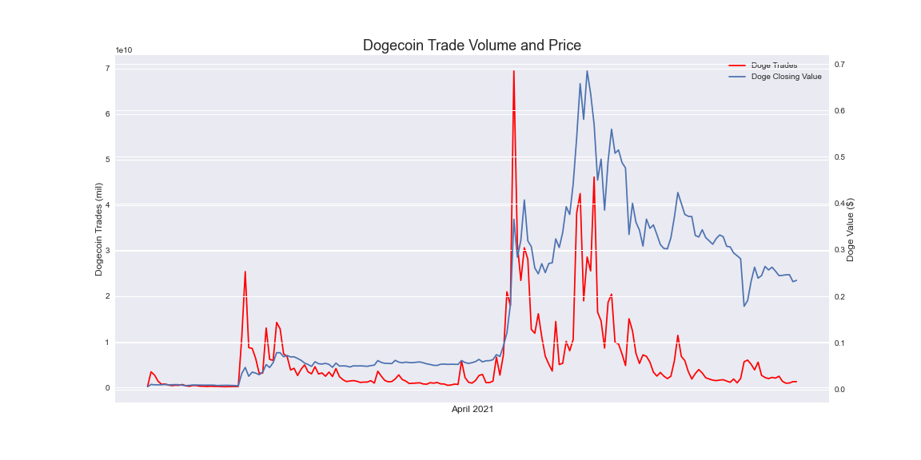
Dogecoin Value v. Transactions April 2021
April 2021 experienced a large amount of activity for Dogecoin in particular
An abnormal number of transactions occurred, driving up the price from a fraction of a penny to over $0.70
Due to the nature of the transactions, it is speculated that the currency was manipulated using a "pump and dump" scheme

Slide 7
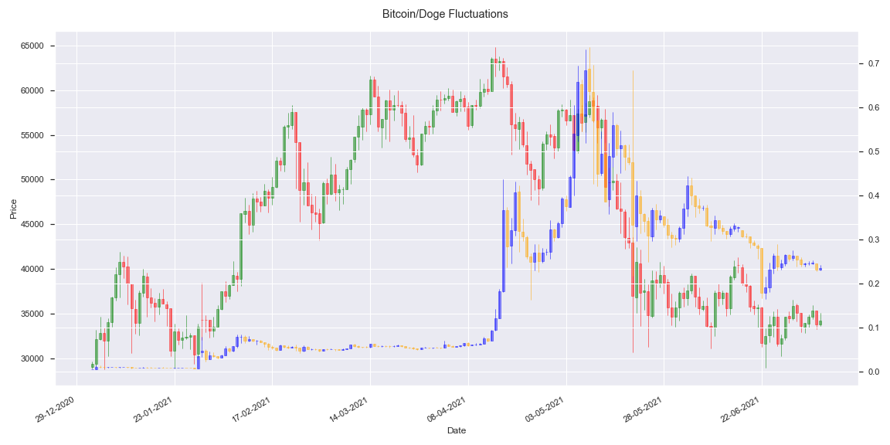
Are the values of Bitcoin and Dogecoin associated?
Candlestick plots are commonly used to compare the increase/decrease in value for stocks
This plot, specifically in the latter have of 2021, shows that on most days the two currencies either both increased in value or both decreased
Legend:
Doge Increase
Doge Decrease
Bitcoin Increase
Bitcoin Decease

Slide 8
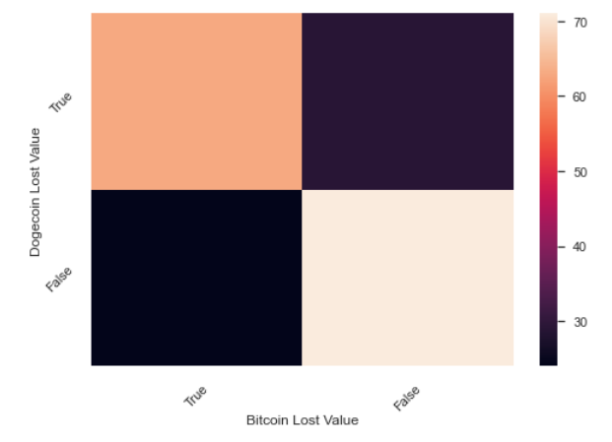
Can the value of Dogecoin be predicted based on Bitcoin?
This heatmap indicates the number of similarities regarding whether Dogecoin lost value on a particular day and whether Bitcoin lost value on that same day
Most occurrences indicate that Dogecoin and Bitcoin share similar statuses regarding loss of value (either both increased in value for the day, or both decreased in value for the day)
Based on the higher number of Dogecoin Lost Value occurrences than Bitcoin, it could be concluded that Bitcoin is the more stable currency of the two

Slide 9
Conclusion
Overall, it is apparent that there is a significant relationship with the value of Bitcoin and the value of Dogecoin
The rate of increase or decrease with the two currencies in 2021 have shown that the change in value generally shares the same behavior
Some of the steps that could be taken next with this type of analysis could include an hour-by-hour assessment of prices rather than the summary at end-of-day
Due to the relationship determined between the two Cryptocurrencies, an hour-by-hour (or even higher frequency) could be used to buy or sell one currency when the other currency begins to rise or fall in value

