Slide 1
Visualizing Video Game Sales with Excel
Jordan Burns

Slide 2
Introduction
The video game industry has a massive global market and is responsible for making game publishers billions per year
The Sony Playstation 4 is one of the most popular video game consoles, and is a platform for a variety of different game genres worldwide
Understanding the distribution of sales for these genres and the markets that certain genres are popular in can be used as a means of identifying marketing/advertising opportunities

Slide 3
Data Used for Analysis
The data used in this presentation consists of video game sales data for the Sony Playstation 4 from 2014 to 2020
The video game sales are captured based on the region (North America, Europe, Japan, Rest of World)
Major data attributes featured in the data set include titles, genres, year of release, and publisher
Source: https://www.kaggle.com/datasets/sidtwr/videogames-sales-dataset?select=PS4_GamesSales.csv

Slide 4
Distribution of Sales by Genre
Based on the distribution of the top sale generating genres per year, some categories are consistently high earners while others are not
Action, Shooter, and Sports games average over 60% of all sales

Slide 5
Sales per Region by Genre
The U.S. and European regions are the two most significant regions in terms of sales
European sales dominate nearly all genres minus fighting and party games

Slide 6
Publisher Sales by Region
Publisher sales by region is relatively consistent throughout the top 10 publishers
2K Sports has potential to expand more into European and Rest of World markets given the high percentage of North American sales

Slide 7
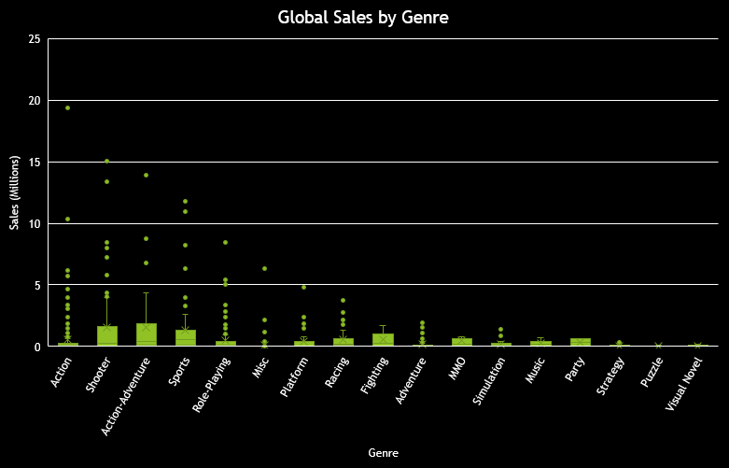
Global Sales by Genre
While the game "GTA V" is an outlier for Action games, games in the Shooter genre are consistently some of the highest selling games
Game publishers are incentivized to continue to develop Action/Shooter games rather than Strategy/Puzzel/Simulation
GTA V

Slide 8
Conclusion
Game publishers are incentivized to produce games in genres such as Shooting, Action, Action-Adventure, and Sports as they consistently generate more sales than other genres
There are opportunities for certain game developers to expand their market share in other regions by developing games that are popular in those regions in addition to their regular markets
Developing more Simulation/Strategy games for console could help expand the sales for these genres

