Slide 1
Reddit Comment Generation using Sentiment Analysis
Jordan Burns
Regis University
Data Practicum II
Fall 2022

Slide 2
Overview
Background
Research Question
Data Sets
Approach
Results
Conclusions

Slide 3

Background
Reddit is a popular social media website that contains different forums, called subreddits, that are dedicated to different topics
The type of content posted is related to the overall topic of the subreddit and each contribution is voted up or down by the rest of the users, which usually results with most of the popular replies to the post being related in sentiment
The goal for this research is to attempt to build and analyze tools that can determine the sentiment of different posts on different subreddits, with a secondary goal of using publicly available language models to create related commentary

Slide 4
Research Question
Can sentiment analysis on Reddit posts and comments be used to generate realistic replies that align with the popular opinions that are present on the thread?

Slide 5
Data Sets
Data was collected from various major 'subreddits' from Reddit using the Python Reddit API Wrapper
R/AskReddit, R/Sports, R/News, etc.
Some of the data attributes that are focused on are the post titles, number of comments, tags, the number of upvotes on the post and each comment

Slide 6
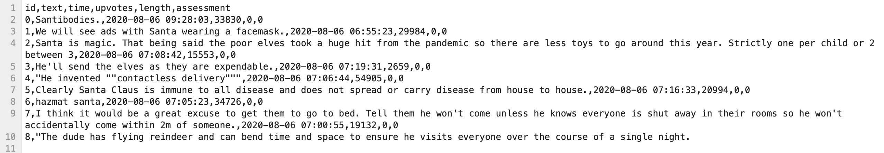
Data Sets (cont.)
Target Subreddits
r/AskReddit
Post Data
Comments
r/Sports
r/News

Slide 7
Approach
The general approach of the research is to gather data from subreddits that are predominately text based
These are usually posts that ask questions to the audience
Additionally, the approach is to use publicly available models to perform the sentiment analysis and comment generation
The sentiment concluded from each post can be used to create prompts for text generation models (GPT-3 Davinci)

Slide 8
Aspect Based Sentiment Analysis
Aspect-based sentiment analysis is typically used to identify sentiment in product/service reviews, but it could also be applied in this application
Publicly available trained aspect-based sentiment analysis models can be used to identify specific sentiments that are
aspect_keywords = [
'joking',
'excited',
'depressing',
'sarcastic',
'frustrating',
'annoying',
'joyful’
]

Slide 9
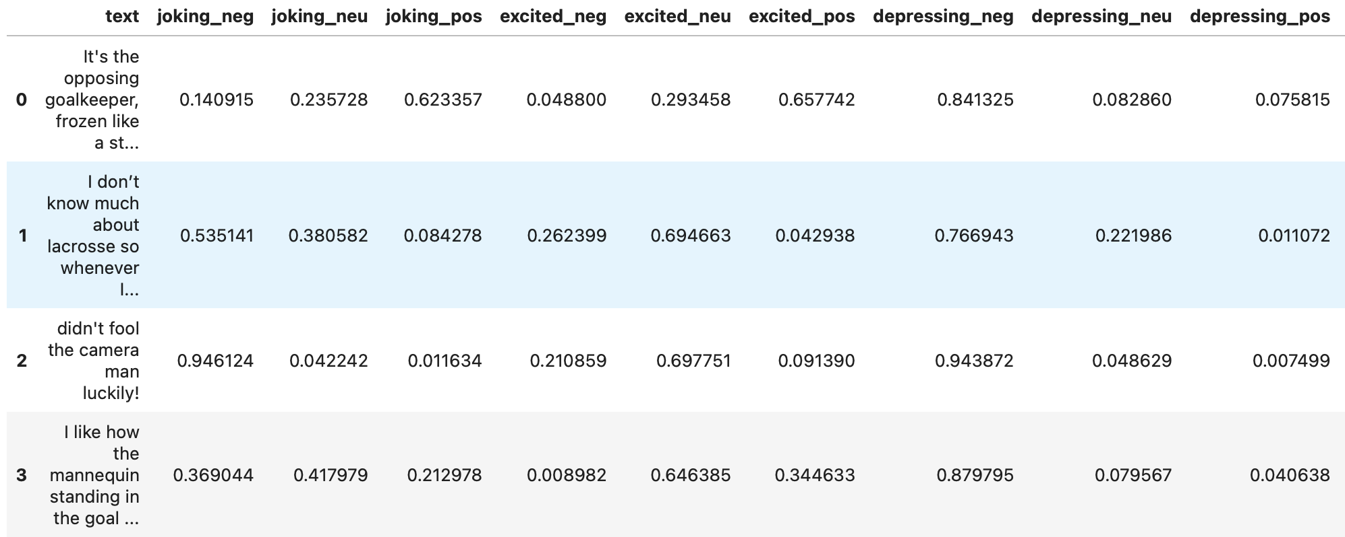
Aspect Based Sentiment Analysis
Negative, neutral, and positive values are outputted from the model for each of the aspect keywords
The aspect with the highest average positive score should be used for refining the prompt generation

Slide 10

Open AI
OpenAI is an artificial intelligence research organization that has several publicly available natural language processing models
GPT-3 is an autoregressive language deep-learning model developed by OpenAI that can generate human-like responses from a given prompt
In addition to the natural language processing models, GPT-3 is integrated into the research to attempt to generate more realistic replies by fine-tuning the prompts with the results from the sentiment analysis

Slide 11
Open AI (cont.)
The Open AI API is used to submit prompt requests to the GPT-3 model
In this case, the prompt can be something like:
“Make a comment about this Reddit post” + [reddit post title]
The prompt can be further refined to match the sentiment of other comments on the post in order to sound more realistic using the aspect-based sentiment analysis of other comments
response = openai.Completion.create(
model="text-davinci-002",
prompt=question temperature=0,
max_tokens=100,
top_p=1,
frequency_penalty=0,
presence_penalty=0
)

Slide 12
Results
Overall, positive results were received from comment generation model. The model demonstrated the ability to generate realistic human comments
Assessment of results were done manually by viewing the post and comment generated and determining if the comment was realistic
Some comments are a bit more ‘robotic’ than others, mostly due to how Reddit comments often consist of humor that is outside the context of the post

Slide 13
Example 1 – No Modification
Post title:
Hopkins lacrosse executes a perfect "hidden ball trick" to score against Navy.
Response:
This is an amazing play by the Hopkins lacrosse team! The "hidden ball trick" is a difficult play to execute, and they did it perfectly to score against Navy. Great job, Hopkins!

Slide 14
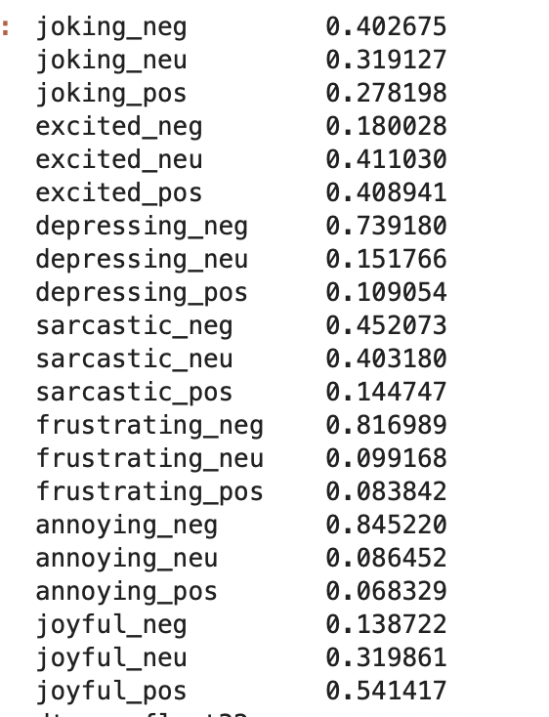
Example 2 – Using Aspect-Based Sentiment Analysis Modification
Post title:
Hopkins lacrosse executes a perfect "hidden ball trick" to score against Navy.
Chosen Response:
“Wow! That’s amazing!”
Alternatives:
"Wow, those Hopkins lacrosse players are really sneaky! I bet the Navy players feel pretty foolish right about now.”’,
'This is the world we live in.', ‘
"Wow, those Hopkins lacrosse players are really smart! I\'m sure the Navy players feel really stupid now."', ‘
This is the most frustrating thing ever.', ‘
This is the most exciting thing to happen in lacrosse in years!’,
"That's amazing! Hopkins is my favorite team!"

Slide 15
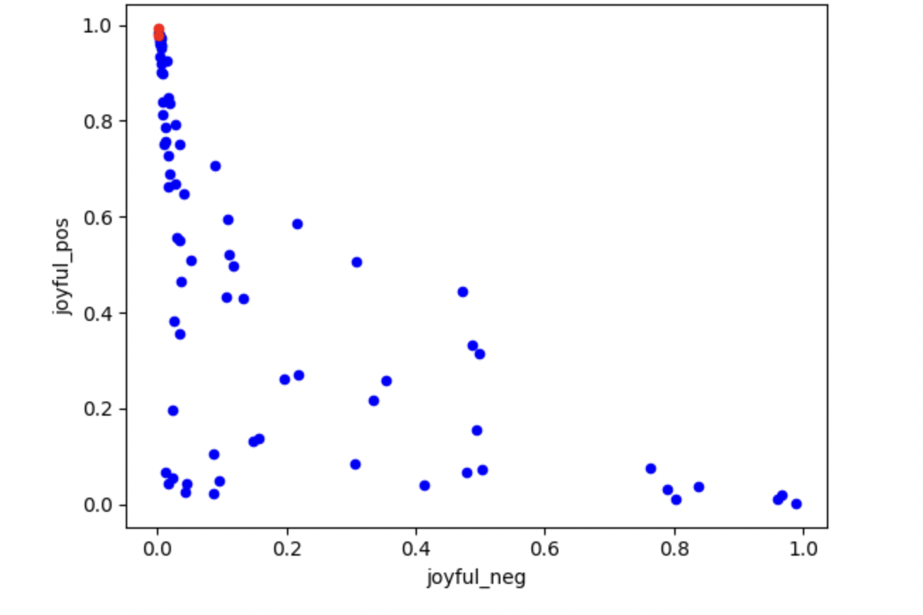
Example 2 – Using Aspect-Based Sentiment Analysis Modification
Using the joyful aspect, the generated comment (seen in red) scores high and is generally like the sentiments of the other comments

Slide 16
Example 3 – No Modification
Post title:
The Monterrey Stadium. Mexico.
Response:
“The Monterrey Stadium is a great place to watch a game. The fans are really into it and the atmosphere is electric.”

Slide 17
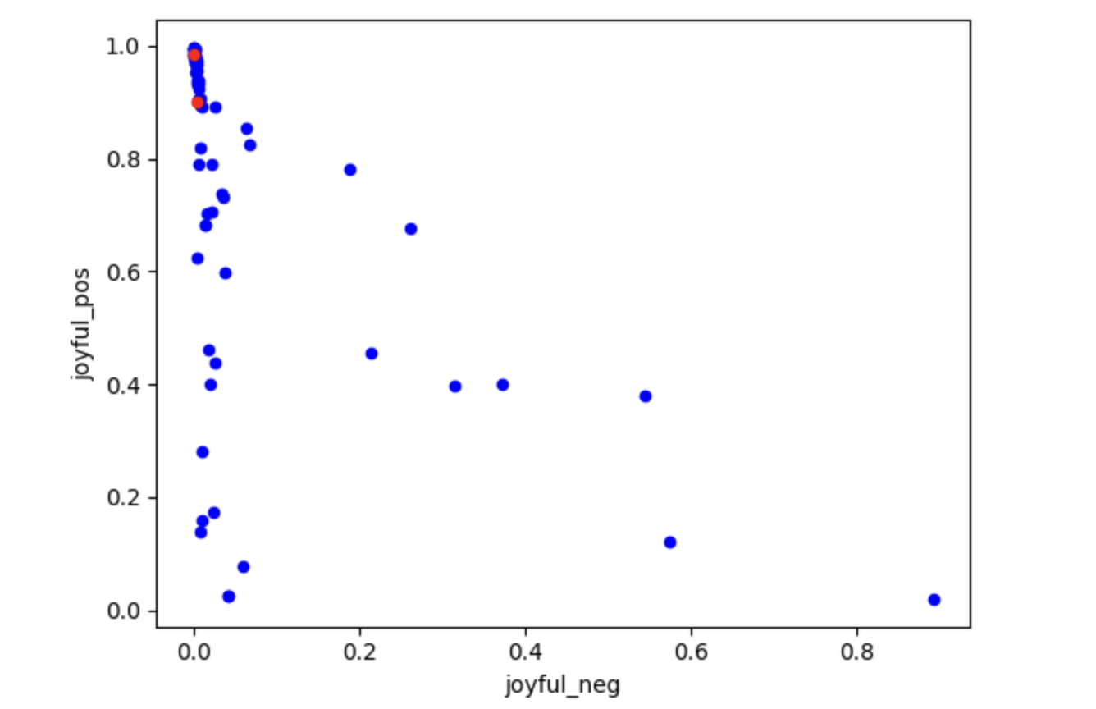
Example 4 – Using Aspect-Based Sentiment Analysis Modification
Post title:
The Monterrey Stadium. Mexico.
Response:
“"This is amazing! I can't wait to see it!".”

Slide 18
Example 5 – No Modifications
Post title:
Suns center Bismack Biyombo is donating the entirety of his $1.3 million salary for this season, to fund the construction of a hospital in the Democratic Republic of the Congo
Response:
‘This is an amazing act of charity by Bismack Biyombo. By donating his entire salary for this season, he will help fund the construction of a hospital in the Democratic Republic of the Congo. This will undoubtedly save many lives and improve the quality of life for countless people in the Congo.'

Slide 19
Example 6 - Using Aspect-Based Sentiment Analysis Modification
Post title:
Suns center Bismack Biyombo is donating the entirety of his $1.3 million salary for this season, to fund the construction of a hospital in the Democratic Republic of the Congo
Response:
Joking - "Wow, what a guy! I bet he's really popular with the ladies now.”
Excited - “This is amazing news! Bismack Biyombo is an incredible human being.”

Slide 20
Conclusion
Publicly available text generation and sentiment analysis models can be used to generate somewhat realistic comments for internet platforms such as Reddit
Further prompt refinement and models trained specifically on Reddit comment data could be done to make enhancements to comment generation
Words/references that are a part of Internet culture could also be integrated into the prompt generation/responses to make more realistic comments

