Slide 1

BIN PACKING PROBLEM
Business Process Design Management and Optimization

Slide 2

ASPECTS TO ANALIZE
PROBLEM
MATHEMATICAL MODEL
SOLUTION
RESULTS

Slide 3
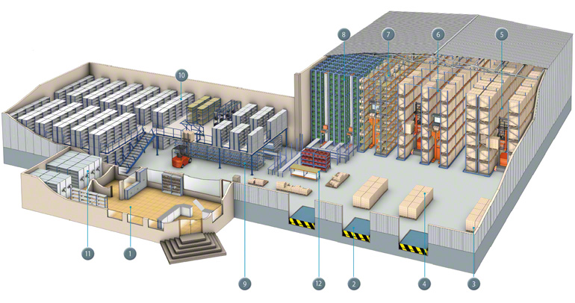

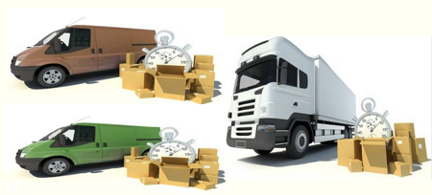


PROBLEM DESCRIPTION
ORDERS
SATELLITE
DELIVERY
VEHICLES

Slide 4
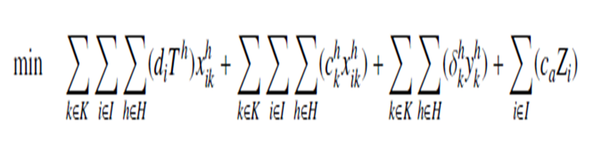

MATHEMATICAL MODEL
DEMAND X TARIFF OF SATELLITE IN TIMESLOT
VEHICLES FIXED COST IN TIMESLOT IF IS USED
VEHICLES COST PER STOP
COST OF THE EVENTUAL EXPRESS DELIVERY

Slide 5
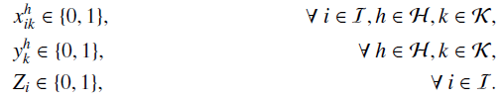








MATHEMATICAL MODEL
C1
C2
C3
C4
$$\sum_{i∈I}{\left(d_{i}x_{i}^{h}\right)}≤C_{h}$$
$$\sum_{i∈I}{\left(d_{i}x_{ik}^{h}\right)}≤V_{k}y_{k}^{h}$$
$$\sum_{h∈H}{x_{i}^{h}}+z_{i}=1$$
$$\sum_{k∈k}{x_{ⅈk}^{h}}=x_{i}^{h}$$
$$∀h∈H$$
$$∀h∈H,k∈k$$
$$∀ⅈ∈I$$
$$∀ⅈ∈I,h∈H$$

Slide 6
GREEDY SOLUTION DESCRIPTION
Input:
List Orders{ demand }
List Vehicles{ VType{ cost, volume }, List CostByStop }
List SatelliteInTimeSlot{ tarif, capacity}
Integer timeslots
Integer expressCost
Integer resultMin = 0
Output:

Slide 7
GREEDY SOLUTION DESCRIPTION
Begin
order Orders List by demand DESC
create List timeSlotOrdered{time, value}: ordered ASC by sum of cost by stop of the vehicles group by TimeSlot
order Vehicles by{
CostByStop(timeSlotOrdered(0)) ASC
VType.volume / VType.cost DESC
CostByStop(timeSlotOrdered(1.. timeslots)) ASC
}
create List demandInTimeSlot //control of the constrain 1, satellite capacity by timeslot
create List List usedCapacityVehicleInTime //for the constrain 2, vehicle capacity by timeslot

Slide 8
GREEDY SOLUTION DESCRIPTION
for each index i, object order : orders do
bool orderIsSatisfied = false
for each object t : timeSlotOrdered do
Integer h = t.time
if ( demandInTimeSlot(h)) + order(i) < = SatelliteInTimeSlot(h).capacity )
for each index k, object vehicle : Vehicles do
if ( usedCapacityVehicleInTime[k][h] + order.demand < = vehicle.VType.volumen ) beging
resultMin += order.demand * SatelliteInTimeSlot(h).tarif
resultMin += vehicle.CostByStop(h)
if ( usedCapacityVehicleInTime[k][h] == 0 ) //First use of the vehicle k in the TimeSlot h
resultMin += vehicle.VType.cost
usedCapacityVehicleInTime[k][h] += order.demand
demandInTime[h] += order.demand
orderIsSatisfied = true
end if end for end for
if (orderIsSatisfied == false)
resultMin += expressCost end for

Slide 9
GREEDY SOLUTION DESCRIPTION
create Integer resultMinSecond = 0
create List demandInTimeSlotSecond //for controller the constrain 1
create List List usedCapacityVehicleInTimeSecond //for the constrain 2
order Vehicles by{
CostByStop(timeSlotOrdered(0.. timeslots)) ASC
VType.volume / VType.cost DESC
}
Apply the Main Algorithm again and get the minimum value between resultMinSecond and resultMin

Slide 10
TIME | OF | OPTGAP | FILE | OUR TIME | OUR_OF | OUR_OPTGAP | DIFFERENCE | PERCENT
9733 | 19873 | 0.00005032 | 200_ITV1_REP2 | 0 | 19931 | 0.002918533 | 58 | 0.291853268
181515 | 125324 | 0.08337589 | 1000_ITV2_REP8 | 1 | 117314 | -0.063914334 | -8010 | -6.391433405
180182 | 47180 | 0.00142344 | 500_ITV1_REP2 | 1 | 48040 | 0.018228063 | 860 | 1.822806274
21941 | 22842 | 0.000069125 | 200_ITV2_REP1 | 0 | 23292 | 0.019700552 | 450 | 1.970055162
180746 | 96515 | 0.003035798 | 1000_ITV1_REP8 | 1 | 96591 | 0.000787442 | 76 | 0.078744237
180192 | 58385 | 0.001988953 | 500_ITV2_REP9 | 0 | 58573 | 0.003220005 | 188 | 0.322000514
1317 | 23248 | 0.000057353 | 200_ITV2_REP4 | 0 | 23770 | 0.02245354 | 522 | 2.24535444
376917 | 95243 | 0.001774409 | 1000_ITV1_REP6 | 0 | 96857 | 0.016946127 | 1614 | 1.694612727
180123 | 47882 | 0.001213922 | 500_ITV1_REP7 | 0 | 47998 | 0.002422622 | 116 | 0.242262228

Slide 17
END

