Slide 1

BIN PACKING PROBLEM
Business Process Design Management and Optimization

Slide 2

ASPECTS TO ANALIZE
PROBLEM
MATHEMATICAL MODEL
SOLUTION
RESULTS

Slide 3
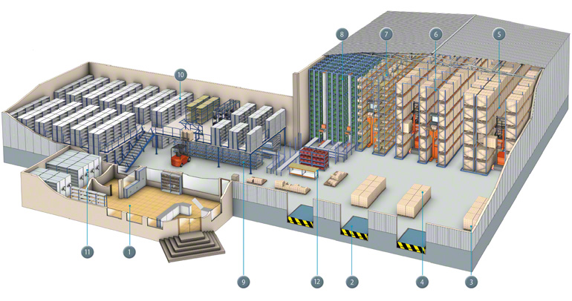


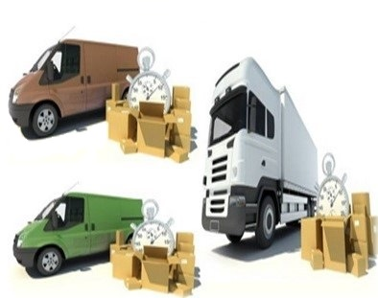

PROBLEM DESCRIPTION
ORDERS
SATELLITE
DELIVERY
VEHICLES

Slide 4
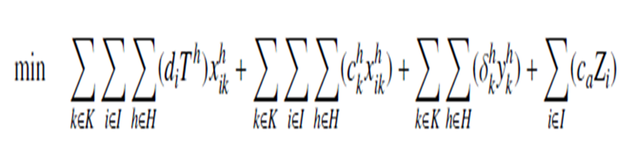

MATHEMATICAL MODEL
DEMAND X TARIFF OF SATELLITE IN TIMESLOT
VEHICLES FIXED COST IN TIMESLOT IF IS USED
VEHICLES COST PER STOP
COST OF THE EVENTUAL EXPRESS DELIVERY

Slide 5
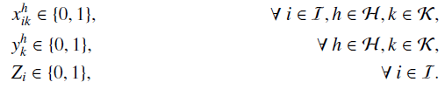








MATHEMATICAL MODEL
C1
C2
C3
C4
$$\sum_{i∈I}{\left(d_{i}x_{i}^{h}\right)}≤C_{h}$$
$$\sum_{i∈I}{\left(d_{i}x_{ik}^{h}\right)}≤V_{k}y_{k}^{h}$$
$$\sum_{h∈H}{x_{i}^{h}}+z_{i}=1$$
$$\sum_{k∈k}{x_{ⅈk}^{h}}=x_{i}^{h}$$
$$∀h∈H$$
$$∀h∈H,k∈k$$
$$∀ⅈ∈I$$
$$∀ⅈ∈I,h∈H$$

Slide 6
GREEDY SOLUTION DESCRIPTION
Input:
List Orders{ demand }
List Vehicles{ VType{ cost, volume }, List CostByStop }
List SatelliteInTimeSlot{ tarif, capacity}
Integer timeslots
Integer expressCost
Integer resultMin = 0
Output:

Slide 7
GREEDY SOLUTION DESCRIPTION
Begin
order Orders List by demand DESC
create List timeSlotOrdered{time, value}: ordered ASC by sum of cost by stop of the vehicles group by TimeSlot
order Vehicles by{
CostByStop(timeSlotOrdered(0)) ASC
VType.volume / VType.cost DESC
CostByStop(timeSlotOrdered(1.. Timeslots-1)) ASC
}
create List demandInTimeSlot //control of the constrain 1, satellite capacity by timeslot
create List List usedCapacityVehicleInTime //constrain 2, vehicle capacity by timeslot

Slide 8
GREEDY SOLUTION DESCRIPTION
for each index i, object order : orders do
bool orderIsSatisfied = false
for each object t : timeSlotOrdered do
Integer h = t.time
if ( demandInTimeSlot(h)) + order(i) < = SatelliteInTimeSlot(h).capacity )
for each index k, object vehicle : Vehicles do
if ( usedCapacityVehicleInTime[k][h] + order.demand < = vehicle.VType.volumen ) beging
resultMin += order.demand * SatelliteInTimeSlot(h).tarif
resultMin += vehicle.CostByStop(h)
if ( usedCapacityVehicleInTime[k][h] == 0 ) //First use of the vehicle k in the TimeSlot h
resultMin += vehicle.VType.cost
usedCapacityVehicleInTime[k][h] += order.demand
demandInTime[h] += order.demand
orderIsSatisfied = true
end if end for end for
if (orderIsSatisfied == false)
resultMin += expressCost end for

Slide 9
GREEDY SOLUTION DESCRIPTION
create Integer resultMinSecond = 0
create List demandInTimeSlotSecond //for controller the constrain 1
create List List usedCapacityVehicleInTimeSecond //for the constrain 2
order Vehicles by{
CostByStop(timeSlotOrdered(0.. Timeslots-1)) ASC
VType.volume / VType.cost DESC
}
Apply the Main Algorithm again and get the minimum value between resultMinSecond and resultMin

Slide 10
TIME | OF | OPTGAP | FILE | OUR TIME | OUR_OF | OUR_OPTGAP | DIFFERENCE | PERCENT
9733 | 19873 | 0.00005032 | 200_ITV1_REP2 | 0 | 19931 | 0.00291853 | 58 | 0.29185327
181515 | 125324 | 0.08337589 | 1000_ITV2_REP8 | 10 | 115074 | 0.081178801 | -10250 | -8.17880055
46522 | 49410 | 0.000026191 | 500_ITV1_REP1 | 8 | 49556 | 0.00295487 | 146 | 0.29548674
3151 | 19154 | 0.000079848 | 200_ITV1_REP3 | 0 | 19194 | 0.00208834 | 40 | 0.208833666
184236 | 114892 | 0.008860495 | 1000_ITV2_REP7 | 10 | 114030 | -0.0075027 | -862 | -0.75026982
180173 | 48341 | 0.001070248 | 500_ITV1_REP10 | 0 | 48411 | 0.00144805 | 70 | 0.14480462
7304 | 19044 | 0 | 200_ITV1_REP1 | 0 | 19144 | 0.005251 | 100 | 0.52509977
181428 | 114502 | 0.004082025 | 1000_ITV2_REP9 | 14 | 114184 | -0.00277724 | -318 | -0.27772441
180112 | 48940 | 0.001110203 | 500_ITV1_REP2 | 0 | 49092 | 0.00310584 | 152 | 0.31058439

Slide 11

Our solution is 0,3 percent worst in comparison with the CIPLEX’s solution

Slide 17
Our general solution is 0,36 percent better in comparison with the CIPLEX’s solution

Slide 19
END

