Slide 1
The Net

Slide 2
Sub Net
The Net
Web Server
Normal Host

Slide 3
other.domain.co.uk
The Net
alpha.centauri.com

Slide 4
mydomain.org
sub.mydomain.org
Possible starting place
The Net
Visit source
(possible starting place)
Running Web Server

Slide 5
1st degree
2nd degree
3rd degree
origin
Relations

Slide 7
Start URL
Relations
Relations
Relations
Relations
Relations
Relations
Result set of URLs

Slide 8
Find starting URL
filter
Find related URLs
filter
Apply rating function

Slide 9
URL filtering
Extractor
Refiner
XML Input
XML Data
XML Data
(further refiners)
Input filtering

Slide 10
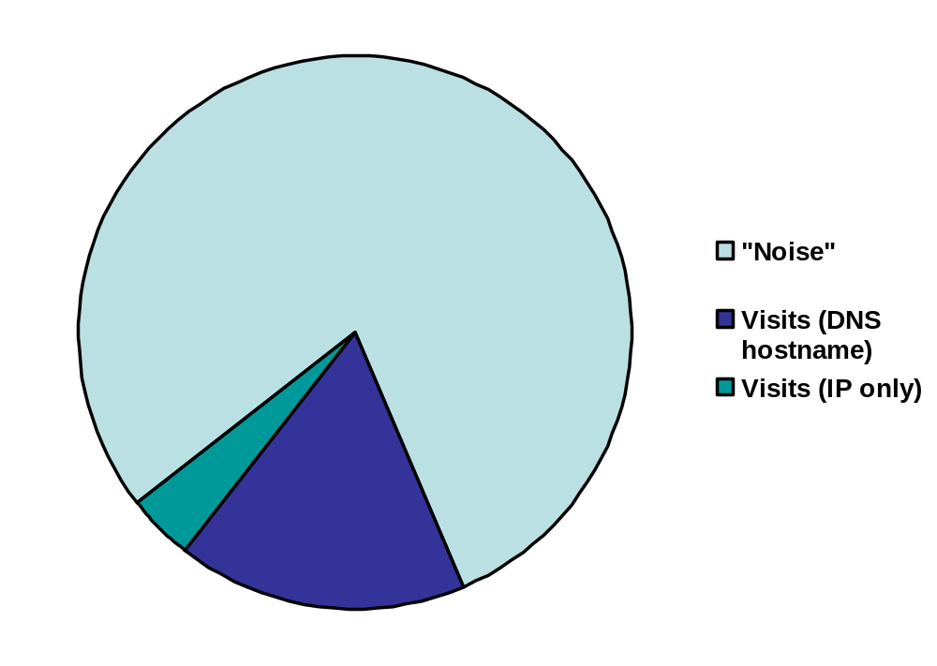

Slide 11
