Slide 1
https://www.devoxx.fr/agenda-2025/talk/vol-au-dessus-d-un-nid-de-vulnerabilites/
https://github.com/dlucasd/vol-au-dessus-d-un-nid-de-vulnerabilites?tab=readme-ov-file
Damien LUCAS

Slide 2
1. La conférence
…

Slide 3
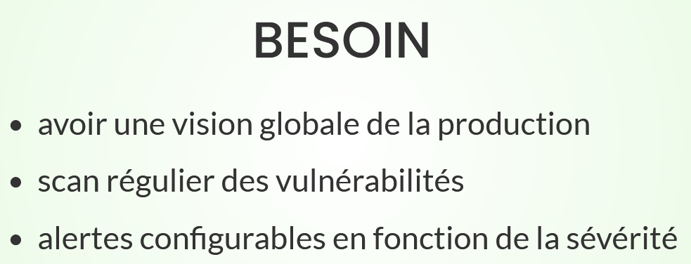
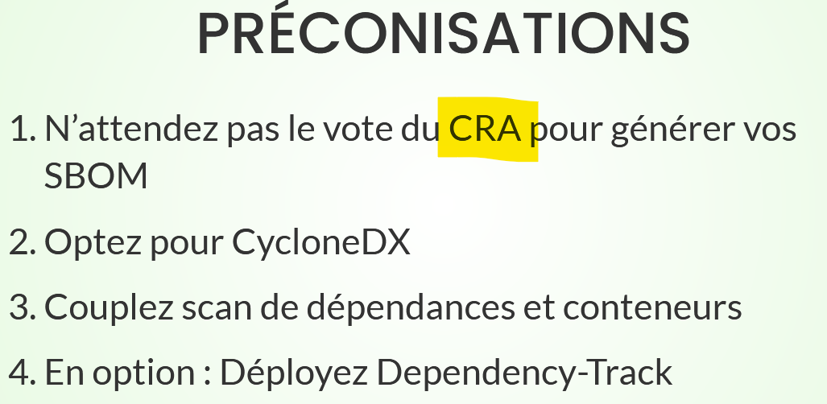
Pourquoi les SBOM
https://worklifenotes.com/2025/01/14/why-a-single-sbom-is-never-enough/
Cyber Resilience Act

Slide 4
2. Analyse, POC
… contexte BNP PF

Slide 5
SPDX
Vs
CycloneDX
https://scvs.owasp.org/bom-maturity-model/
https://nexusconnect.io/articles/spdx-cyclonedx-or-swid-navigating-the-sbom-standard-landscape
https://worklifenotes.com/2025/01/21/why-we-chose-cyclonedx-over-spdx/

Slide 6
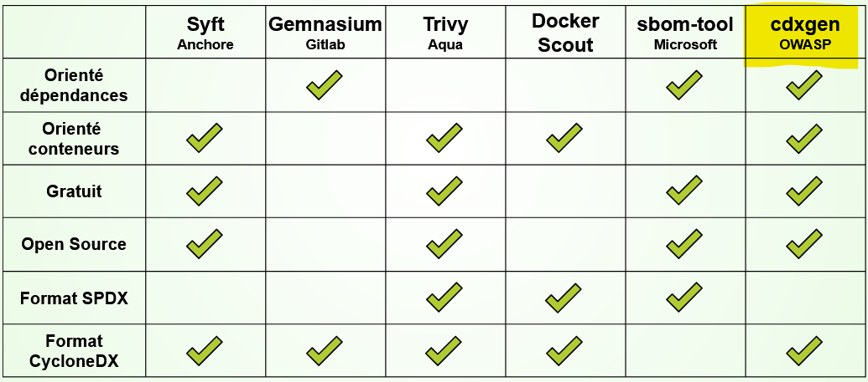
Contexte BNP PF → GitLab, gitlab-ci
Reproductibilité → Docker

Slide 7
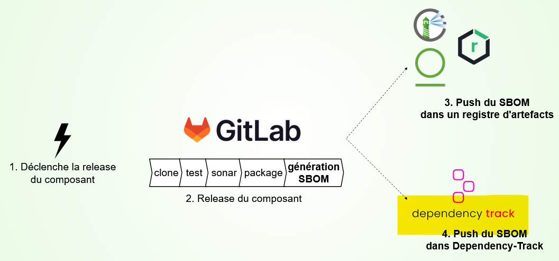
Dependency-Track does not store raw SBOMs.
“Audit requirements – this is when we need to “go back in time” and request SBOM for a specific older version of our project capturing older states. This may happen for any reason, in example, European CRA is going to make this a legal requirement.”
https://worklifenotes.com/2025/01/14/why-a-single-sbom-is-never-enough/

Slide 8
curl localhost
GitLab.com
Gitlab runner
Dependency track
2
1
cdxgen server
Listens on localhost only

Slide 9
API
docker run -p 80:8080 docker.swagger.io/swaggerapi/swagger-ui
http://localhost/
http://138.68.93.168:8080/api/openapi.json
Exemple : https://gitlab.com/sbom-demo/dependency-track-export
https://docs.dependencytrack.org/integrations/rest-api/

Slide 10
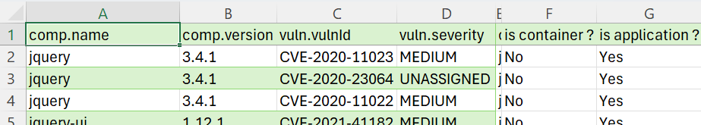
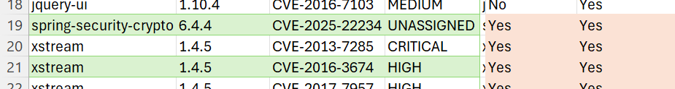

Scans de dépendances vs scans de conteneurs
« application BOM »
…
« application BOM »
ET (!)
« container BOM »
…
« container BOM »
→ préco, séparer et faire les deux (?)

Slide 11
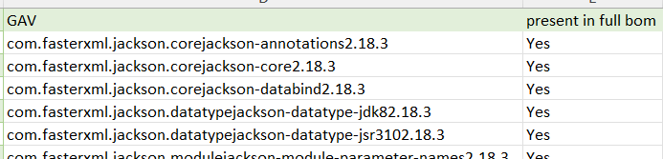
Dev dependencies vs production dependencies
https://github.com/CycloneDX/cdxgen
With the argument --required-only, you can limit the SBOM only to include packages with the scope "required", commonly called production or non-dev dependencies. (Combine with --no-babel to limit this list to only non-dev dependencies based on the dev attribute being false in the lock files.)
100% present
→ préco, séparer et faire les deux (?)

Slide 12
Another observation I made in practice – when using common tools, you are frequently not getting the same result when generating an SBOM from the source code vs generating it from a container image built on top of the source code.
So a practical choice would be to build a bill of materials from the source code and another one from container. It is further possible to split the source code SBOM into several parts – for example, one including test dependencies and the one without those.
https://worklifenotes.com/2025/01/14/why-a-single-sbom-is-never-enough/

Slide 13
! SBOM vs « formulation »
Formulation (new to CycloneDX v1.5): Describes how something was deployed or manufactured
(src)

Slide 14
? SBOM vs OBOM ?
https://cyclonedx.org/capabilities/obom/

Slide 15
Dependency-Track, use cases…

Slide 16
2. Prérequis (!)
… contexte BNP PF

Slide 17

En amont, il faut générer les SBOM pour tous les tags candidats à MEP
Risque : alimentation excessive du dependency-track, avec des SBOM qui n’ont jamais atteint la production
→ Il faut une rigueur dans les workflows de dév. Merge sur master + tag quand on est certain d’aller en prod (au « dernier moment »)
→ Il faut une gestion des environnements, pour savoir quelle version est déployée dans quel env (dont prod)

