Slide 1
Earthquake Prediction
(Kaggle Competition)
Anuj Verma, Nisarg Patel, and Max Kenworthy

Slide 2
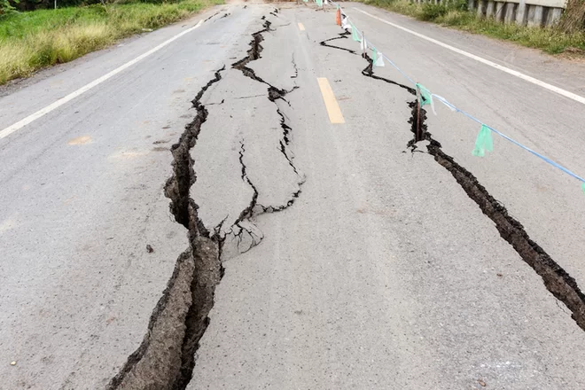
Objective
Forecast when the next laboratory earthquake will take place based on the acoustic/seismic data

Slide 3
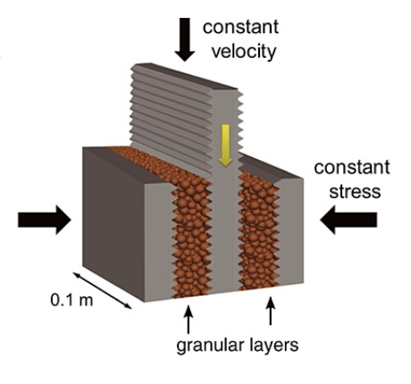
Overview Dataset
Dataset available on Kaggle, currently an open competition
Over 600 million time series data points
Two variables: acoustic_data (seismic) and time_to_failure
The amplitude of seismic wave is recorded at 4MHz for a continuous 0.0375 seconds.

Slide 4
Understanding Seismic signal
a) Sheer stress and dynamic strain encompassing two failure events.
b) type 1 strain: dynamic strain when failure is in distant future
c) type 2 strain: classic, impulsive acoustic emission observed in critically stressed regions just preceding failure

Slide 5
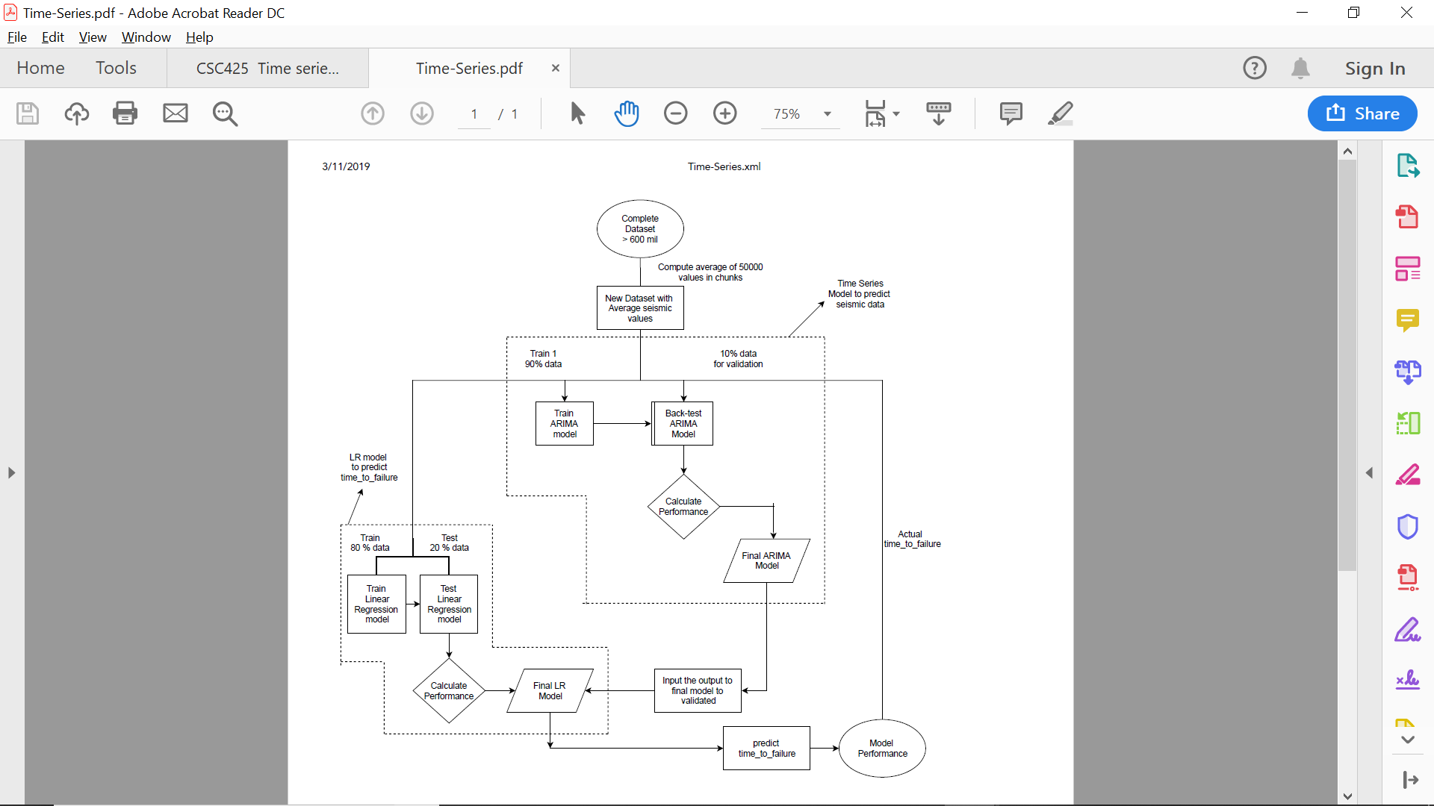
Methodology

Slide 6
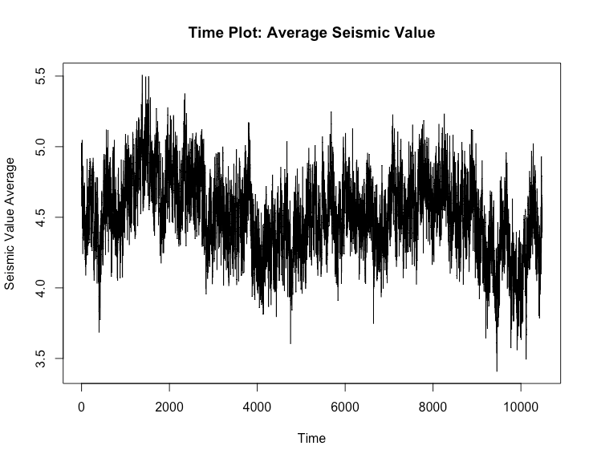
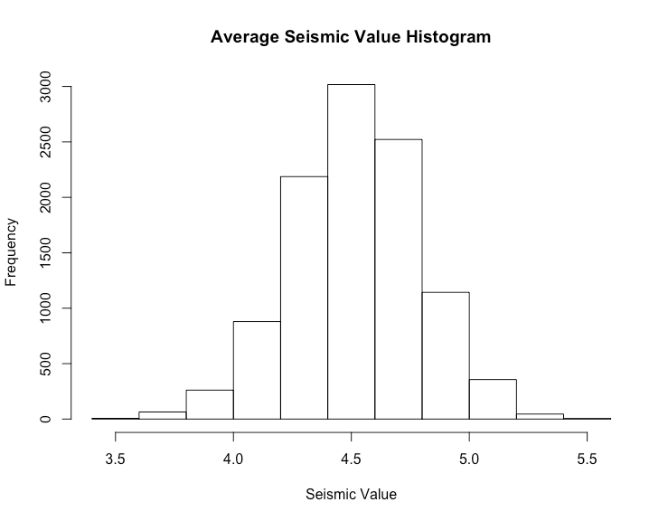
Descriptive Statistics

Slide 7
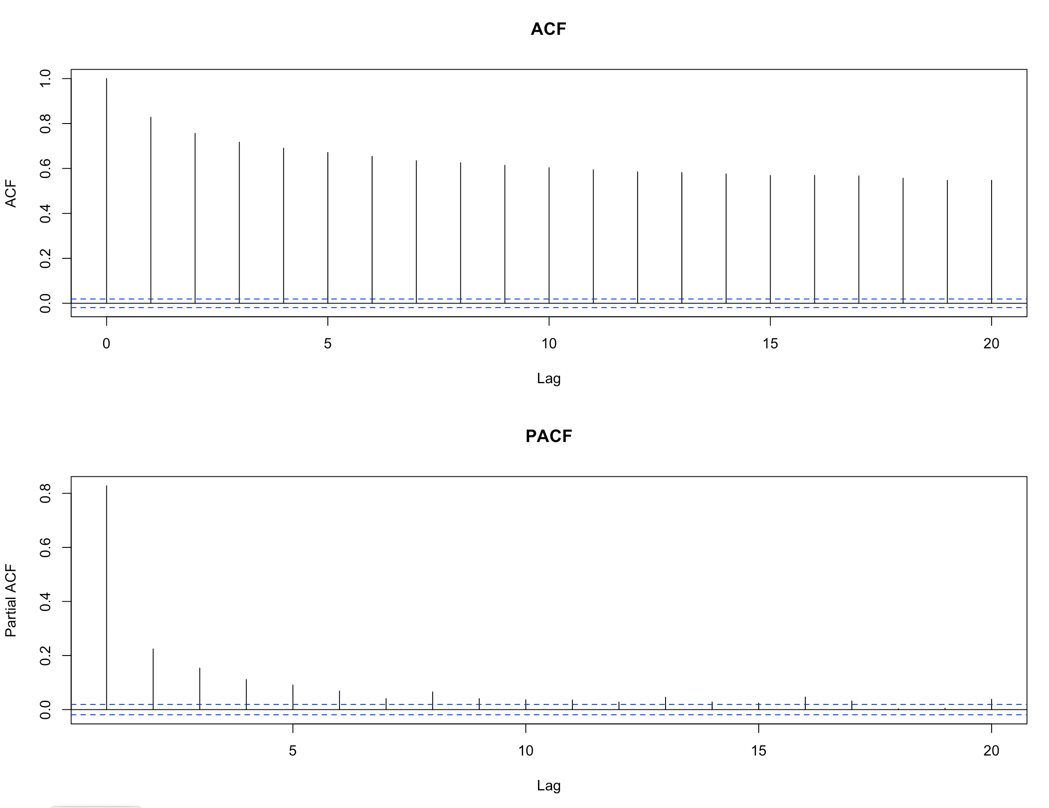
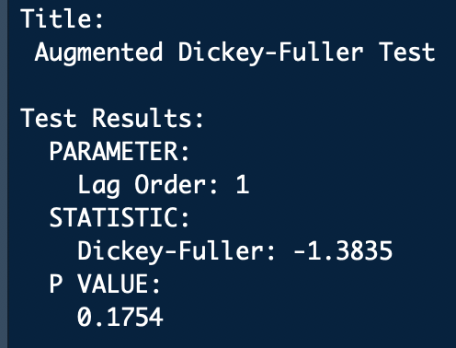
ACF & PACF
ACF looks non-stationary
ADF test confirms time series is non-stationary:

Slide 8
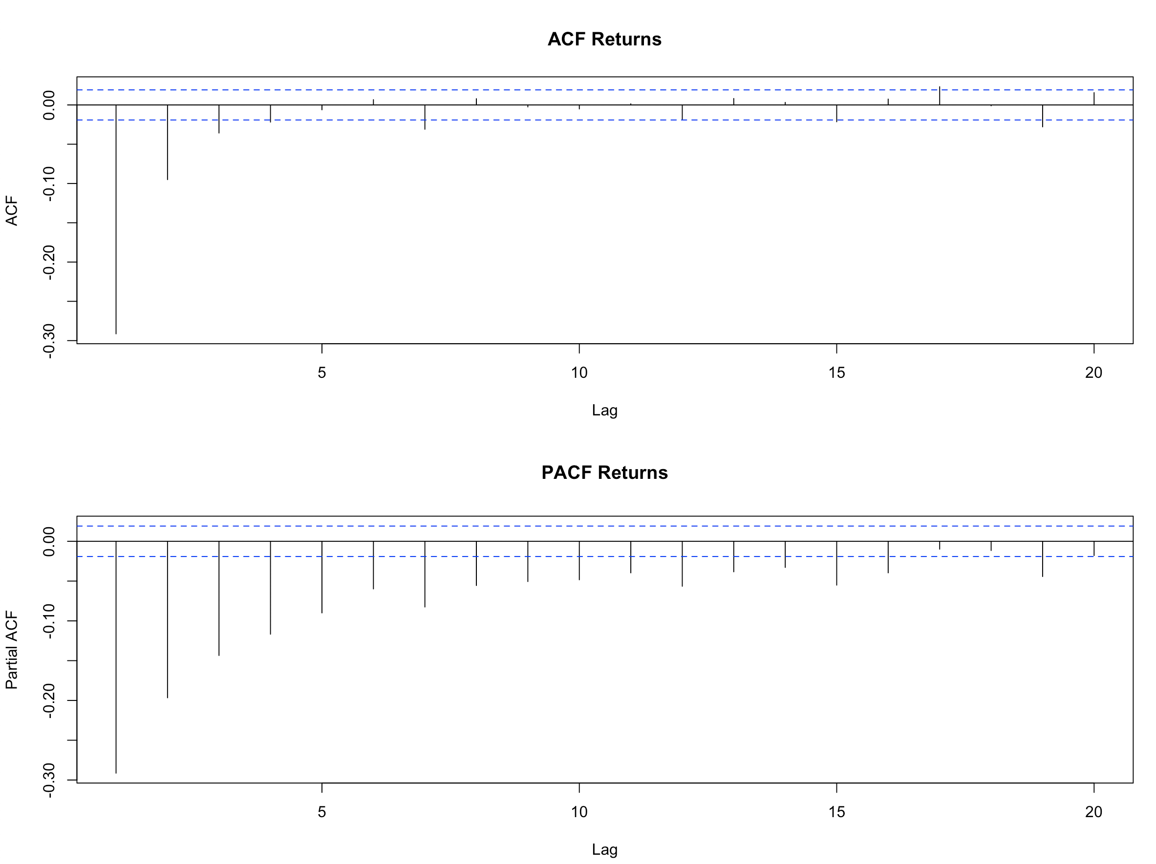
Serial Correlation Returns

Slide 9
Model evaluation
Model | Backtest MAE | Residual Analysis
 |  | Box-Ljung Test | JB Normality Test
ARIMA(1,1,1) | 0.113 | p=0.01 | p=0.28
ARIMA(4,1,4) – Auto | 0.112 | p=0.89 | p=0.25
ARIMA(2,1,1) – EACF | 0.113 | p=0.72 | p=0.27
ARIMA(2,1,2) - Coef | 0.113 | p=0.97 | p=0.23

Slide 10
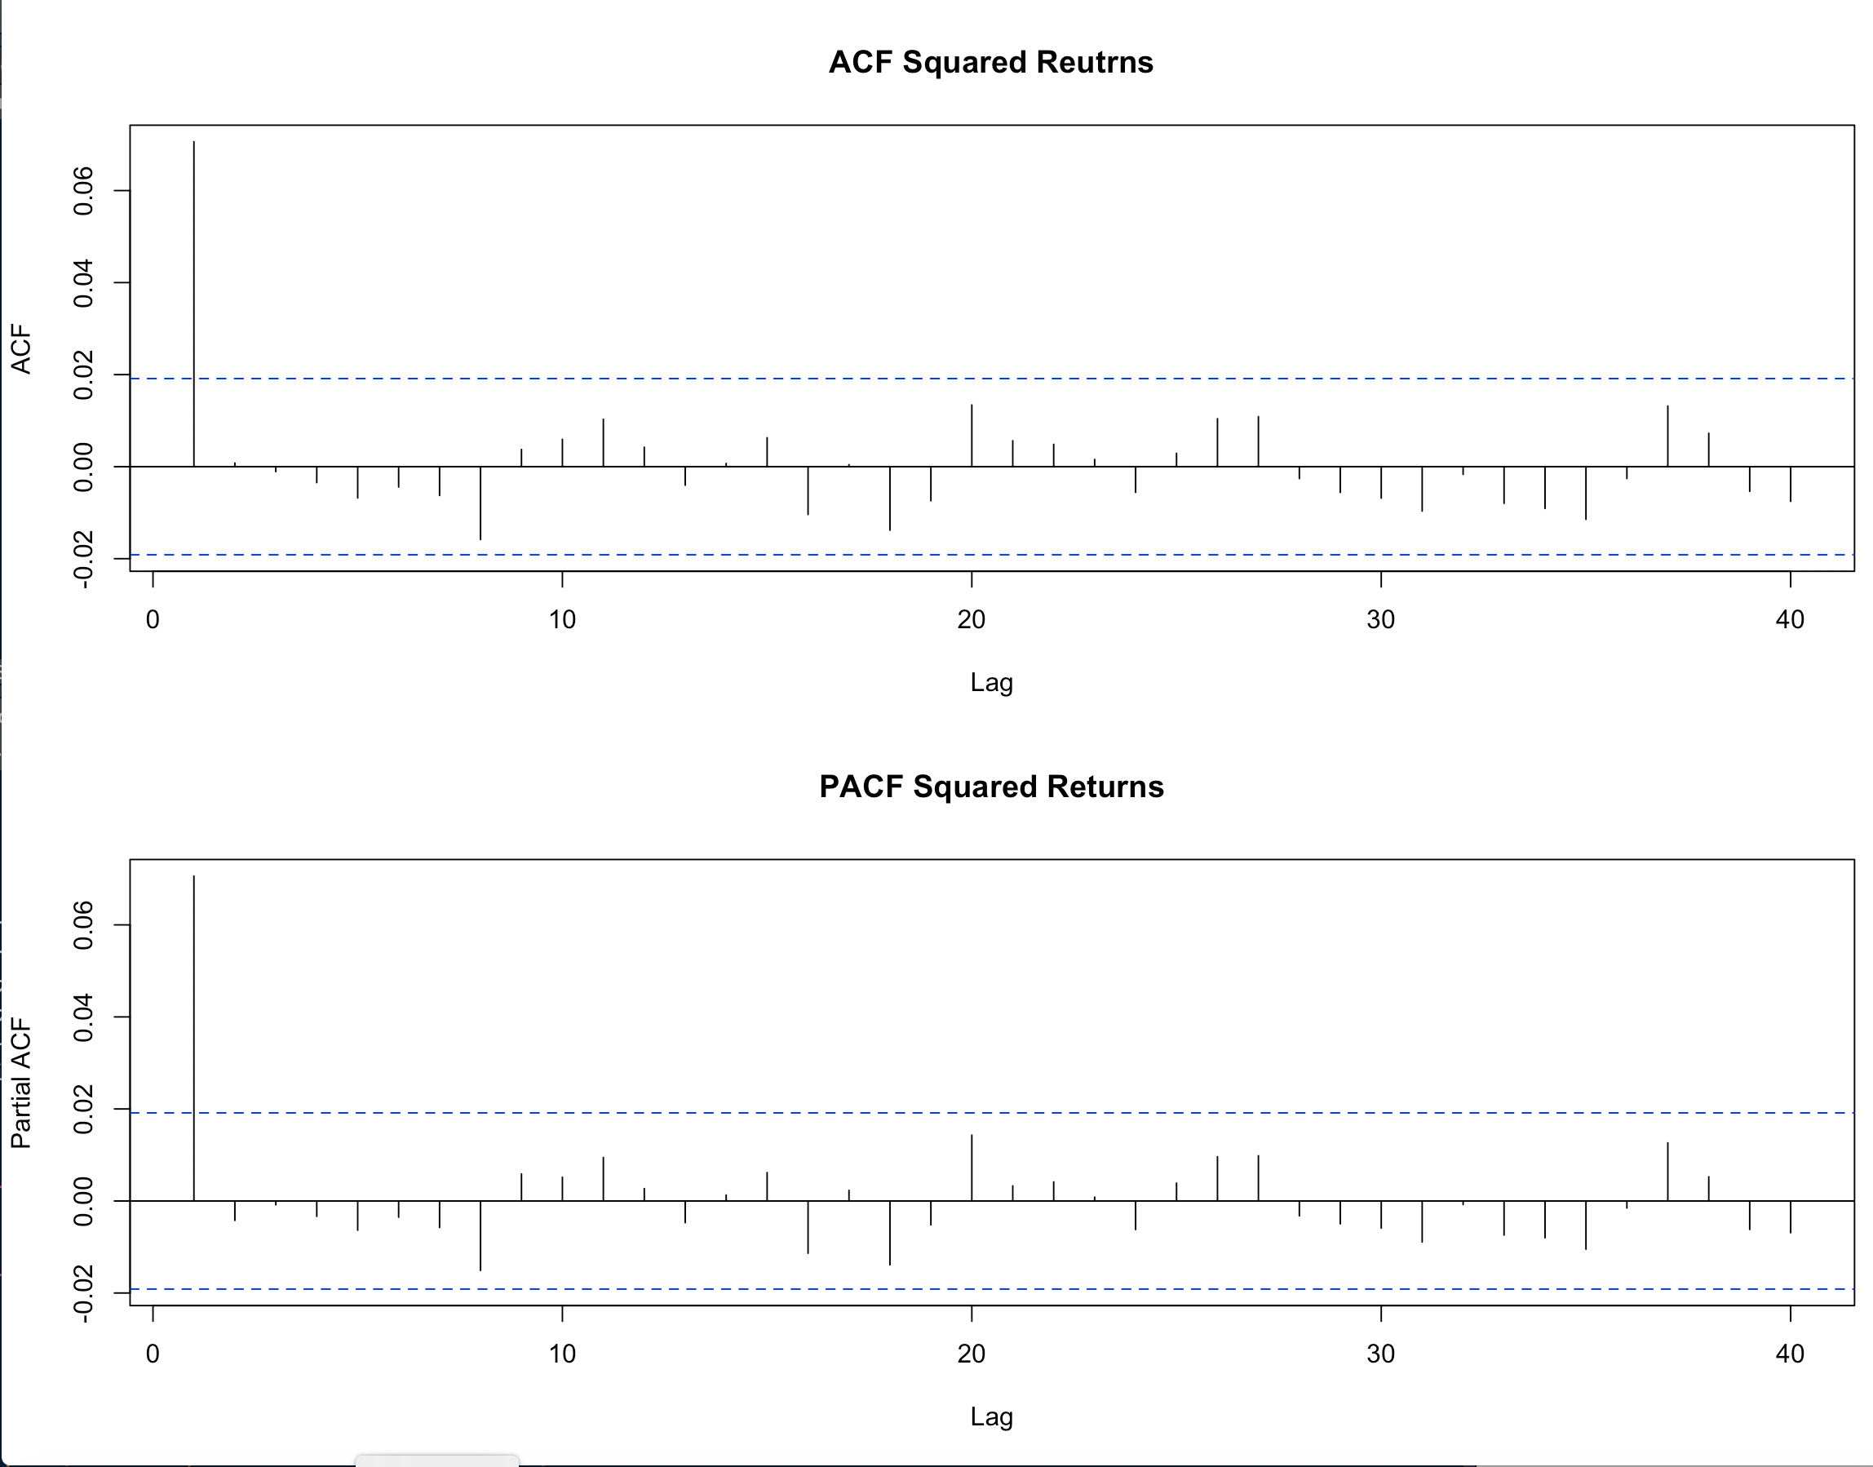
ARCH / GARCH
Squared returns of earthquake data had no autocorrelation, so ARCH modeling would not be especially useful
ARMA-GARCH(1,1)s
MAE = 0.115

Slide 11
Model Evaluation (contd...)
Model | MAE |  | Residual Analysis
 |  |  | Box-Ljung Test |  | JB Normality Test
Time Series Regression ARMA(1,0) | 3.24 |  | p=0.84 |  | p=0.25
Linear Regression | 4.98 |  | NA
SVM | 4.97 |  | NA
Random Forest | 5.08 |  | NA

Slide 12
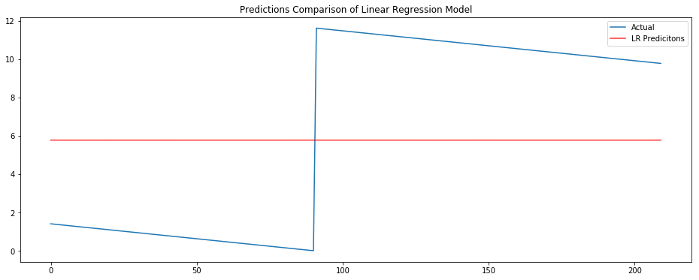
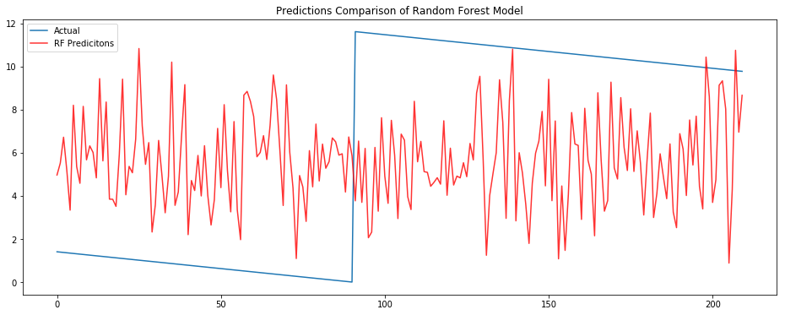
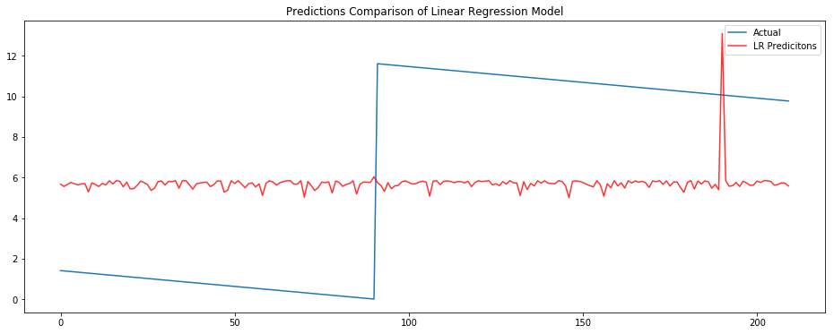
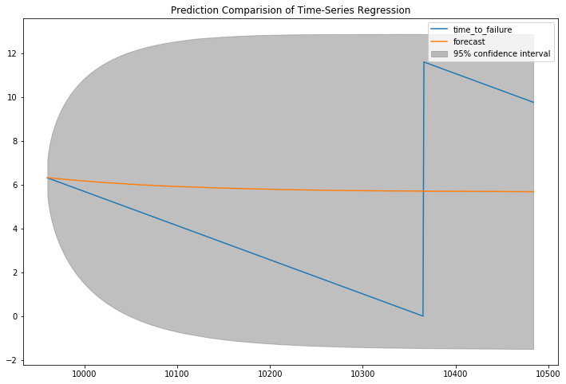
Forecast Plots

Slide 13
Results/Limitation
Model Summary
ARIMA(1,1,1) model selected as best fit model as it is more parsimonious than ARIMA(2,1,2).
AIC value for the model : -10338.76
MAE performance for the Linear Regression model : 4.98
Limitations of study
Our dataset have one time dependent feature(seismic_data) that is used to predict the non-time dependent feature (time_to_failure)
We are using just 10500 cases out of 600 million data.
Future Work:
Get good prediction accuracy in the ongoing Kaggle Competition.
Try Neural Network architecture or ensembles to get better predictions.

