Slide 1
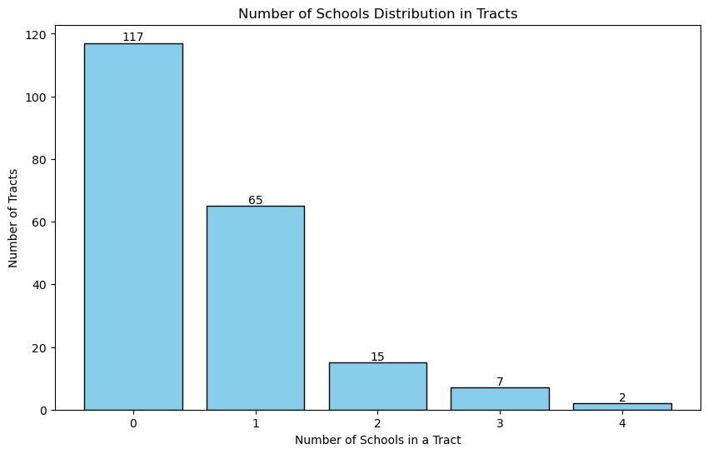
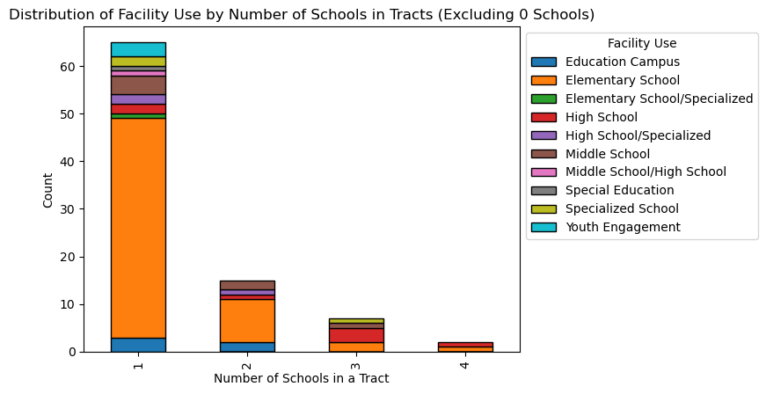
Analysis of Public Schools in the District of Columbia in ArcPy
- Akshay Verma

Slide 2
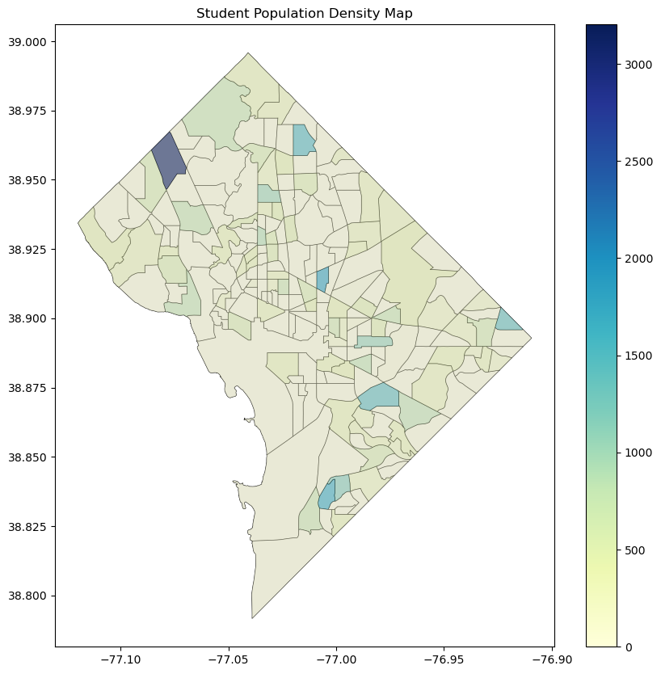
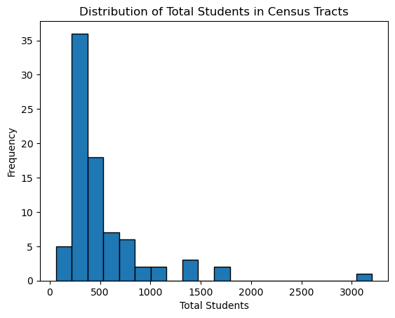
Total Student Population per Tract
Used arcpy.analysis.Statistics to calculate the total student population per census tract from the “TOTAL_STUD” field which contained the student population of each school

Slide 3
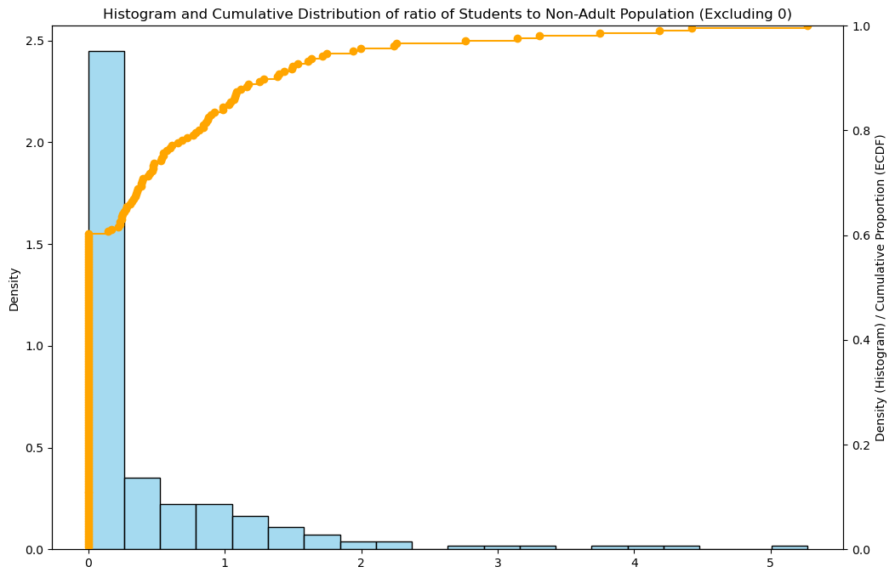
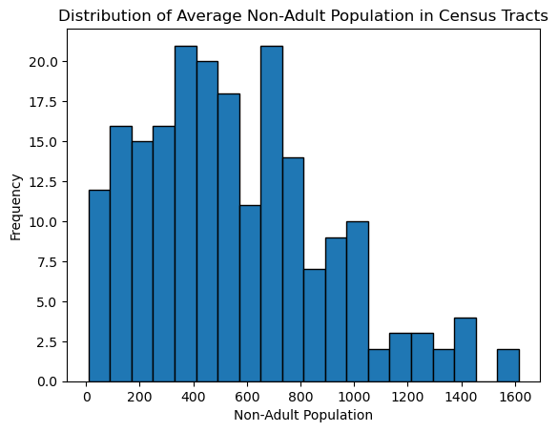
Non Adult Population per Tract
Calculated the non adult population using CalculateField_management through subtracting 18+ population field with the total population field.
Used the same function calculate the ratio of Student population to Non Adult population

Slide 4
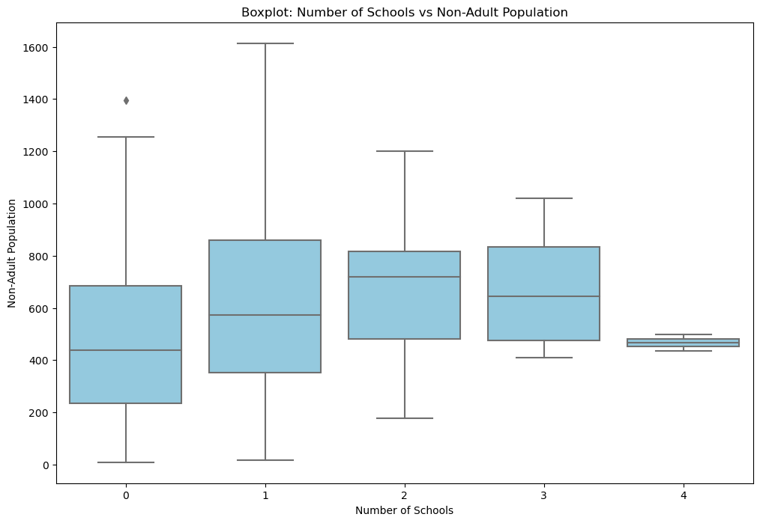
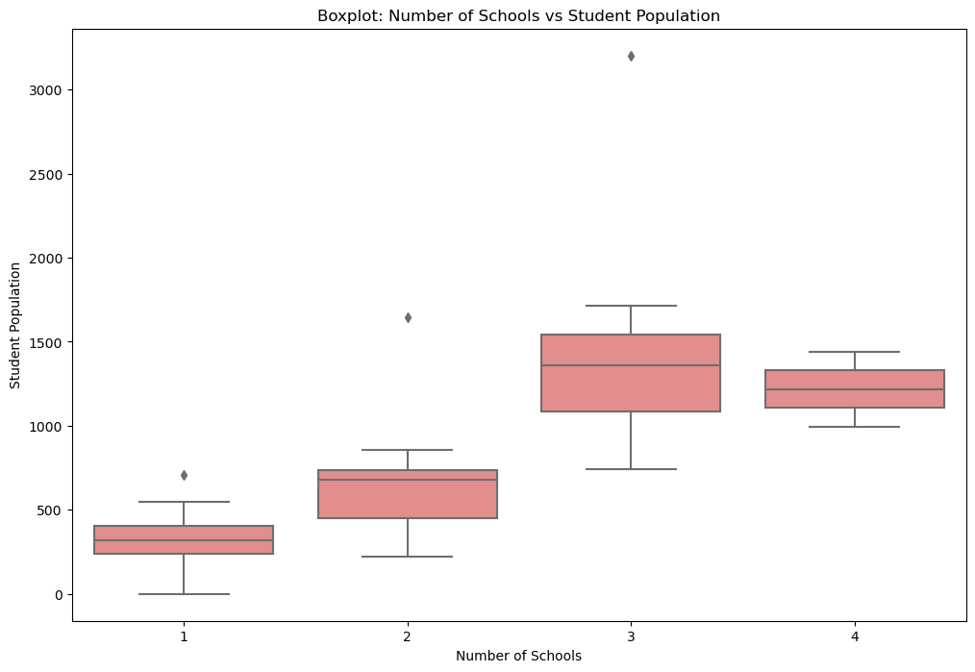
Whisker Plots for Number of schools vs Non Adult Population and Student Population

Slide 5
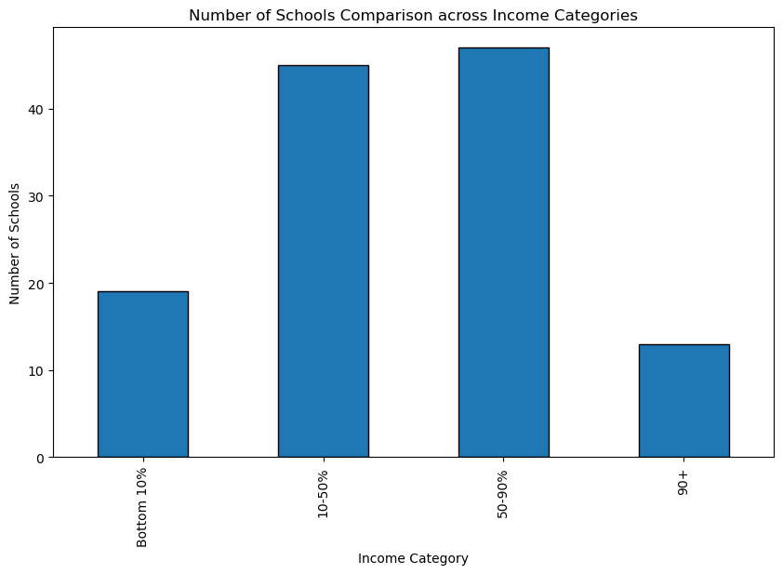
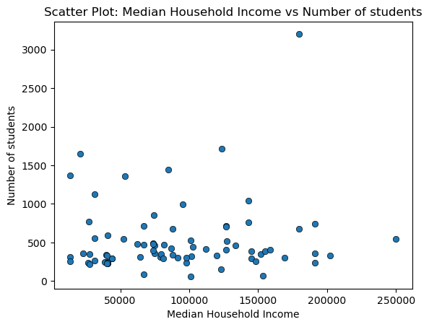
Median Household Income
Used SelectLayerByAttribute_management and SQL Queries to Calculate Income categories by percentile.
Will go over the code in next slide

Slide 6
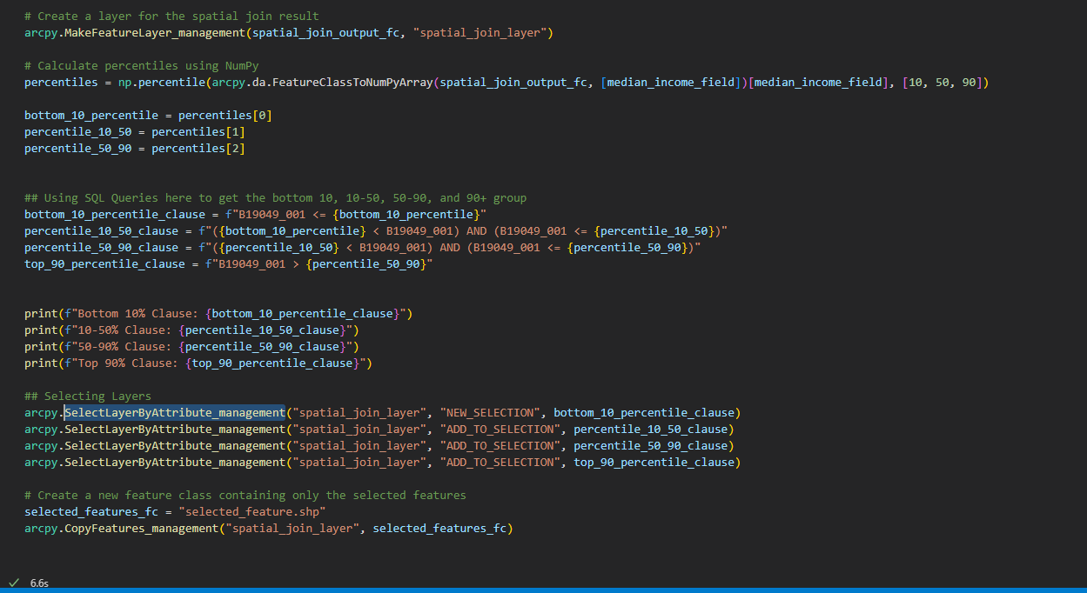
Code to Calculate Income Percentile

Slide 7
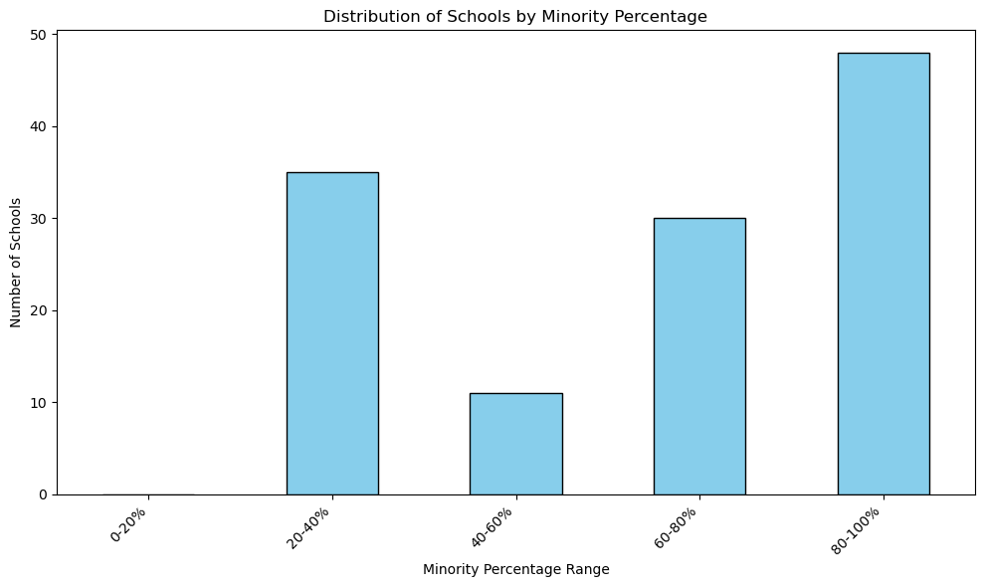
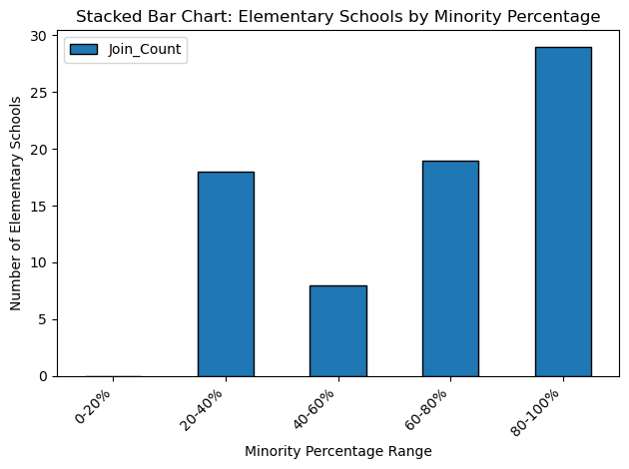
Distribution of schools by Minority Percentage in Census Tract
Again, I have used arcpy.management.CalculateField to calculate the minority % in each census tract.

Slide 8
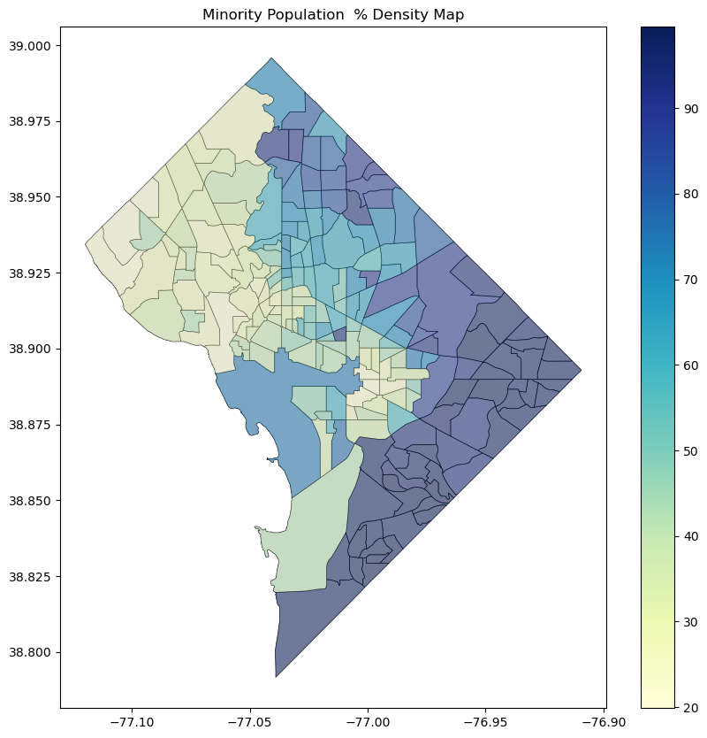
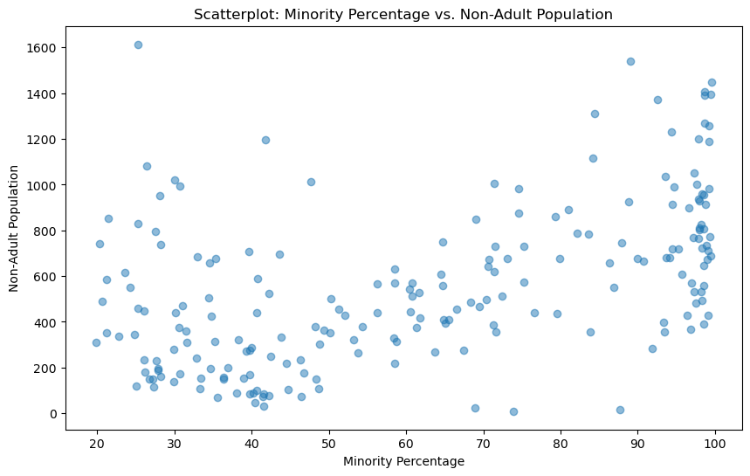
More Graphs and Map for Minority %
Just created a scatter plot between the minority % and Non Adult Population to check whether area with higher minority percentages are younger. Also created a choropleth map to see the spatial distribution of minority percentage.

Slide 9
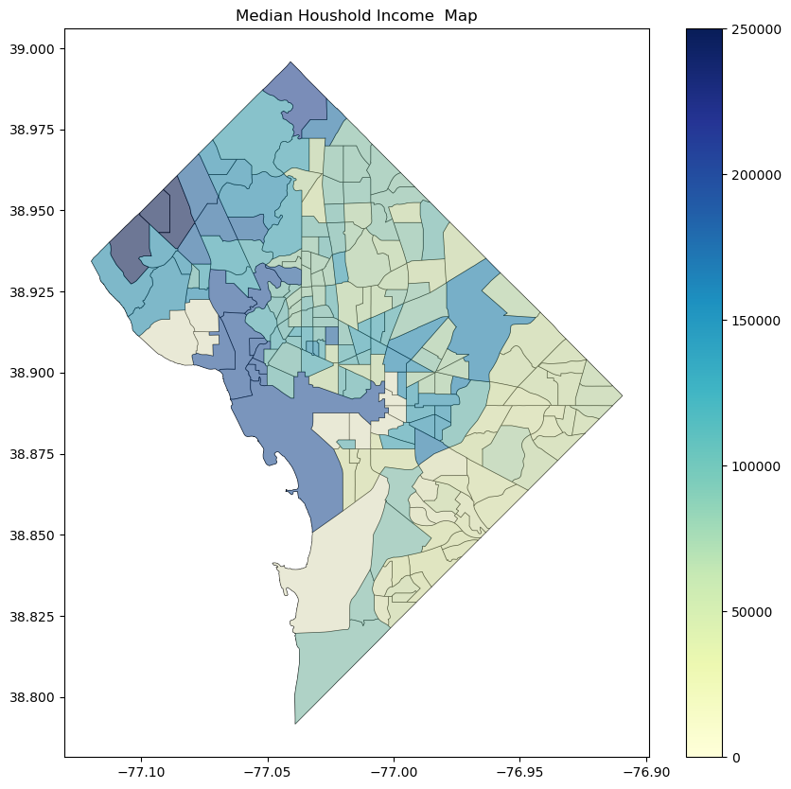
Last Map and Thank You!!
This is the last visualization to see the spatial distribution of median household incomes. I have tried to minimize my use of Pandas and Geopandas as much as I can during this project. GeoPandas was only used to create these choropleth maps at the last moment. Pandas was only used in creating stacked bar charts. Thank you for teaching GeoSpatial Programming – It was fun and new and interesting!

