Slide 1
Restaurant Reservations Database
CSC 4500 · Homework 3 · Group presentation
Nathan · Andre · Christian
Notes:
Presenter: Member A
Hi, I'm ____, and with me are ____ and ____.

Slide 2
What we built
A
Member A
One MySQL database and Java app that track who is coming, where they sit, when they arrive and how many people they bring
50
30
75
customers
dining tables
reservations
Loaded from the group’s Customer.csv, DiningTable.csv and ReservationTable.csv
Notes:
Presenter: Member A
For this project we built a database for a restaurant's reservations: who is coming in, which table they sit at, when they arrive, and how many people they bring.

Slide 3
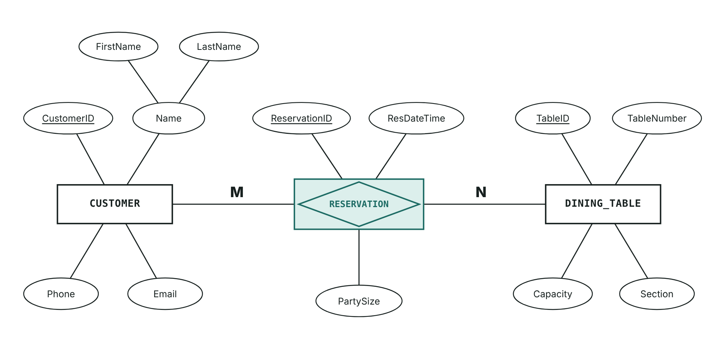
Designing the database
A
Member A
Two things to track: customers and dining tables
Many-to-many: a customer books many tables, and a table hosts many customers
Reservation sits in the middle with the date/time and party size
Notes:
Presenter: Member A
We started by drawing the design. A restaurant keeps track of two main things: its customers and its dining tables. A customer can book many tables over time, and a table gets booked by many different customers. That's a many-to-many relationship, so in the middle we added a reservation table. Each reservation connects one customer to one table and records the date, the time and the party size.

Slide 4
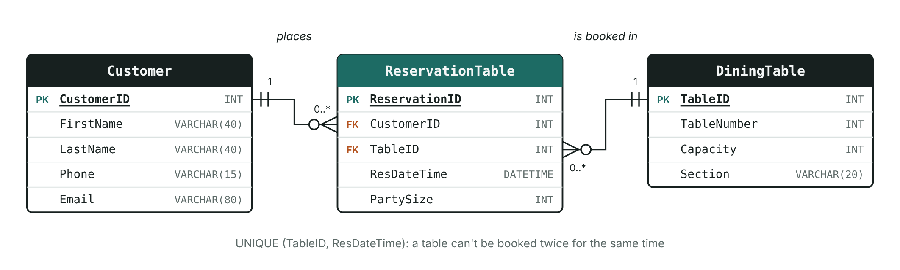
From diagram to three MySQL tables
A
Member A
ReservationTable holds two foreign keys, so every booking links one customer to one table
Notes:
Presenter: Member A
For the technical audience: in MySQL that's three tables, with ReservationTable holding foreign keys to Customer and DiningTable.

Slide 5
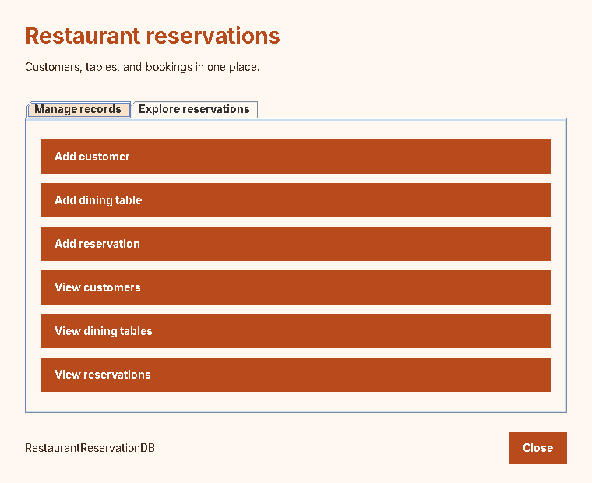
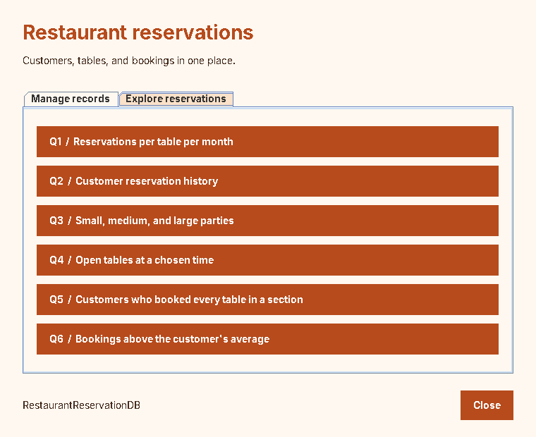
One app for records and questions
A
Member A
Manage records add and view data
Explore reservations run Q1–Q6
Notes:
Presenter: Member A
This is our Java program. The first tab, Manage records, is where staff add customers, dining tables and reservations, or view what's already saved. The second tab, Explore reservations, runs our six questions. Each of us will show one form and two questions.

Slide 6
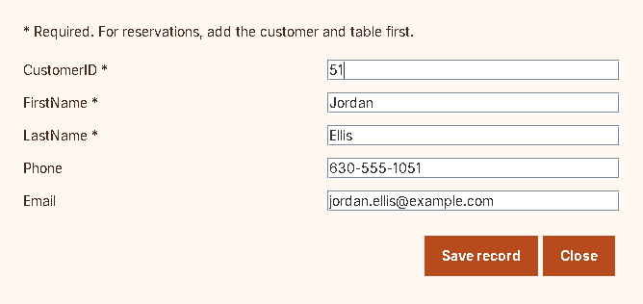
Customers
A
Member A
50
customers loaded from Customer.csv
Name and ID are required; phone and email are optional
A duplicate CustomerID is refused, and the app shows why
Add customer form with the demo values (CustomerID 51)
Notes:
Presenter: Member A
My table is Customer. It stores each customer's ID, first and last name, phone number and email. We loaded fifty customers from a CSV file.
Here's how a new customer gets added. I'll enter customer ID 51, a name, a phone number and an email, and click Save record. The app confirms it was saved. The fields with a star are required. If I try to save another customer with ID 51, the database refuses because that ID is already taken, and the app shows the reason instead of crashing. Behind the scenes, the form builds a parameterized INSERT statement and sends it through JDBC.

Slide 7
Q1 The SQL
A
Member A
SELECT d.TableNumber, d.Section,
DATE_FORMAT(r.ResDateTime, '%Y-%m') AS ResMonth,
COUNT(*) AS Reservations,
SUM(r.PartySize) AS TotalGuests
FROM DiningTable d
JOIN ReservationTable r ON r.TableID = d.TableID
GROUP BY d.TableNumber, d.Section,
DATE_FORMAT(r.ResDateTime, '%Y-%m')
ORDER BY ResMonth, d.TableNumber;
WHAT IT DOES
Shows how busy each table was each month: how many bookings it had and how many guests it served
TECHNICALLY
Joins DiningTable and ReservationTable, then GROUP BY table and month with COUNT(*) and SUM(PartySize)
GROUP BY
2 tables
Notes:
Presenter: Member A
(Code slide: show this while you introduce the query. Your script continues on the next slide.)
If asked to explain the code: Joins DiningTable and ReservationTable, then GROUP BY table and month with COUNT(*) and SUM(PartySize).

Slide 8
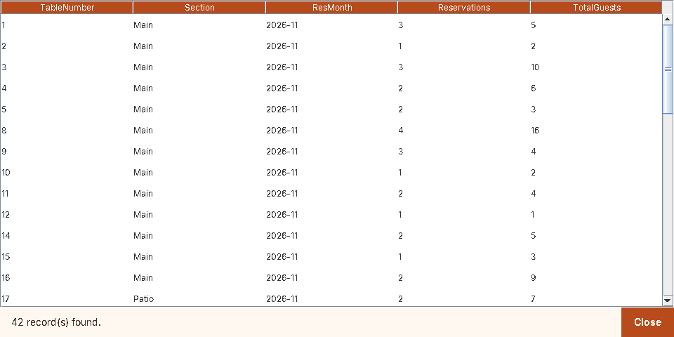
Q1 How busy is each table?
A
Member A
THE QUESTION
How busy is each table, month by month?
17 guests
Bar table 28 in November, from 4 bookings, the most of any table
HOW IT WORKS
Joins DiningTable and ReservationTable; GROUP BY table and month with COUNT and SUM
42 table-month rows; click a heading to sort
Notes:
Presenter: Member A
My first query answers a manager's question: how busy is each table, month by month? It counts the reservations and adds up the guests for every table in every month. In November, table 28 in the bar, which seats eight, had four bookings and seventeen guests, the most of any table. Table 8 in the main room was right behind it with four bookings and sixteen guests. Technically, this joins DiningTable and ReservationTable and uses GROUP BY on the table and the month, with COUNT and SUM.

Slide 9
Q2 The SQL
A
Member A
SELECT c.FirstName, c.LastName, c.Phone,
r.ResDateTime, d.TableNumber, d.Section,
r.PartySize
FROM Customer c
JOIN ReservationTable r ON r.CustomerID = c.CustomerID
JOIN DiningTable d ON d.TableID = r.TableID
WHERE c.LastName = ? OR c.Phone = ?
ORDER BY r.ResDateTime;
WHAT IT DOES
Type a customer’s last name or phone number to see every reservation they have made
TECHNICALLY
Joins three tables; the typed text fills both ? markers in WHERE LastName = ? OR Phone = ?
User input
3 tables
Notes:
Presenter: Member A
(Code slide: show this while you introduce the query. Your script continues on the next slide.)
If asked to explain the code: Joins three tables; the typed text fills both ? markers in WHERE LastName = ? OR Phone = ?.

Slide 10
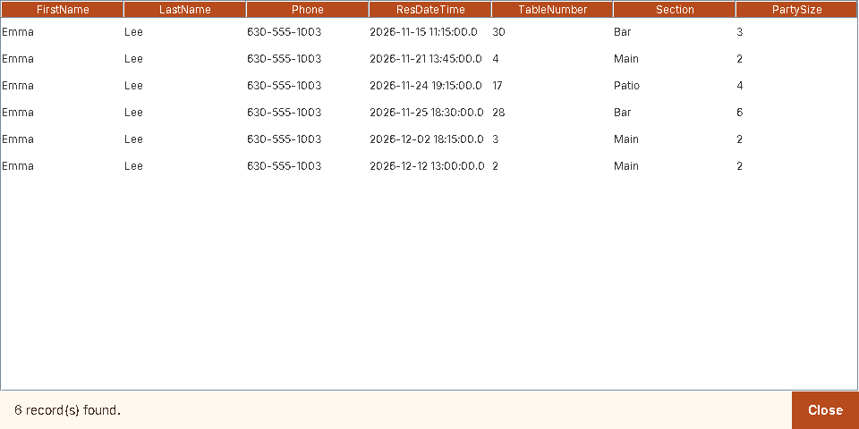
Q2 A customer’s history
A
Member A
THE QUESTION
What has this customer booked?
6
reservations for Emma Lee, found by last name or phone number
HOW IT WORKS
Joins all three tables; WHERE LastName = ? OR Phone = ? with the typed search text
Search text: Lee (her phone, 630-555-1003, gives the same list)
Notes:
Presenter: Member A
My second query is for when a customer calls and asks what they have booked. I can type a last name or a phone number. I'll type Lee, and it shows all six of Emma Lee's reservations. Typing her phone number, 630-555-1003, gives the same list. Technically, it joins all three tables and checks the search text against both the last name and the phone number, passed in as query parameters.
Next, ____ will show how we store the restaurant's tables.

Slide 11
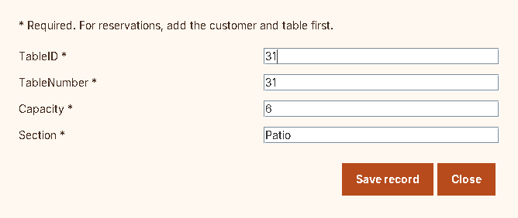
Dining tables
B
Member B
Seats must be a positive whole number
Two tables can’t share a table number (UNIQUE)
Notes:
Presenter: Member B
Thanks, ____. I'm ____, and I worked on the dining tables part of our database.
Every restaurant has a floor plan. Our DiningTable table stores each table's ID, the number on the table, how many people it seats, and its section. We have thirty tables: sixteen in the main room, nine on the patio and five in the bar, seating anywhere from two to eight people.
Here's how the restaurant would add a new table. I'll enter table ID 31, table number 31, six seats, and the Patio section, then click Save record. The app checks my input first: if I type zero or a negative number for the seats, it asks for a positive whole number. And the database won't let two tables share the same table number. If I try to add another table numbered 5, it refuses and the app shows why. Technically, the form sends a parameterized INSERT through JDBC, and the database enforces a UNIQUE constraint on TableNumber and CHECK constraints on the numbers.

Slide 12
Q3 The SQL
B
Member B
SELECT ReservationTable.ReservationID,
ReservationTable.PartySize,
DiningTable.TableNumber,
DiningTable.Capacity,
CASE
WHEN ReservationTable.PartySize <= 2 THEN 'Small'
WHEN ReservationTable.PartySize <= 4 THEN 'Medium'
ELSE 'Large'
END AS PartyCategory
FROM ReservationTable
JOIN DiningTable
ON ReservationTable.TableID = DiningTable.TableID
ORDER BY ReservationTable.ReservationID
WHAT IT DOES
Labels every reservation as a small, medium or large party, next to the size of the table it is at
TECHNICALLY
Joins ReservationTable and DiningTable; a CASE on PartySize gives Small (1–2), Medium (3–4) or Large (5+)
CASE
2 tables
Notes:
Presenter: Member B
(Code slide: show this while you introduce the query. Your script continues on the next slide.)
If asked to explain the code: Joins ReservationTable and DiningTable; a CASE on PartySize gives Small (1–2), Medium (3–4) or Large (5+).

Slide 13

Q3 Small, medium and large parties
B
Member B
THE QUESTION
How big is each party, and what size table is it at?
43 · 24 · 8
small, medium and large parties out of 75 bookings
HOW IT WORKS
Joins ReservationTable and DiningTable; CASE on PartySize sets the category beside the table’s capacity
Small = 1–2 guests, Medium = 3–4, Large = 5+
Notes:
Presenter: Member B
Now my questions. Q3 looks at every reservation and labels the group as small, medium or large: one or two guests is small, three or four is medium, and five or more is large. It also shows the size of the table each party is sitting at. Out of seventy-five bookings, forty-three are small parties, twenty-four are medium and eight are large. Some small parties end up at big tables: reservation 1 is a single guest at table 7, which seats six. That tells a manager to seat couples at smaller tables. For the technical folks: this joins the reservation and dining table tables and uses a CASE expression on PartySize to pick the label.

Slide 14
Q4 The SQL
B
Member B
SELECT DiningTable.TableID,
DiningTable.TableNumber,
DiningTable.Capacity,
DiningTable.Section
FROM DiningTable
WHERE DiningTable.Capacity >= ?
AND DiningTable.TableID NOT IN (
SELECT ReservationTable.TableID
FROM ReservationTable
WHERE ReservationTable.ResDateTime = ?
)
ORDER BY DiningTable.Capacity, DiningTable.TableNumber
WHAT IT DOES
Given a date, time and party size, lists the tables that are big enough and not booked at that time
TECHNICALLY
Keeps tables with Capacity >= ?, then a NOT IN subquery removes any table booked at that exact ResDateTime
Subquery
User input
2 tables
Notes:
Presenter: Member B
(Code slide: show this while you introduce the query. Your script continues on the next slide.)
If asked to explain the code: Keeps tables with Capacity >= ?, then a NOT IN subquery removes any table booked at that exact ResDateTime.

Slide 15

Q4 Find an open table
B
Member B
THE QUESTION
Which tables fit my party at a given time?
19 of 21
tables seating 4+ are free; tables 4 and 13 are booked at exactly 11:00
HOW IT WORKS
Capacity >= ? plus a NOT IN subquery on reservations at that date/time; inputs are party size, then date/time
Input: 2026-12-06 11:00:00, party size 4
Notes:
Presenter: Member B
My second query is the one a host would use: find an open table. I enter a date and time, December 6th at 11 a.m., and a party size of four. Twenty-one of our tables seat four or more, but tables 4 and 13 are already booked at exactly that time, so the result shows the other nineteen. Technically, it filters DiningTable by capacity and uses a NOT IN subquery to remove any table that has a reservation at that date and time. The values I typed are passed in as query parameters: party size first, then the date and time.
So that's how we track tables and find open seats. Now ____ will show how reservations work.

Slide 16
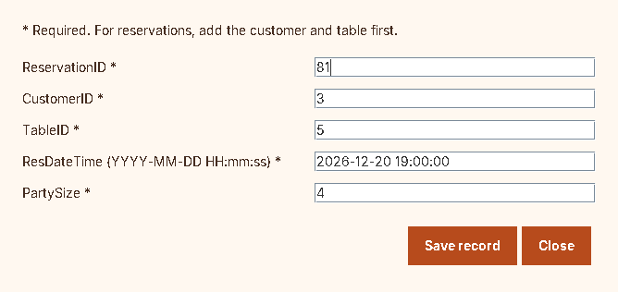
Reservations
C
Member C
Customer 3
Emma Lee
Reservation 81
Dec 20, 7:00 p.m. · 4 guests
Table 5
Main room · seats 4
Add reservation form with the demo values (ReservationID 81)
Customer and table must exist first: customer 99 is refused by the foreign key
Notes:
Presenter: Member C
Thanks, ____. I'm ____, and I worked on the reservations table, the piece that ties everything together.
Every row in this table is one booking: which customer, which table, what date and time, and how many guests. Our data covers bookings from mid-November to mid-December. Every reservation has to point to a real customer and a real table, and the party size has to be at least one. Technically, those are two foreign keys and a CHECK constraint.
Here's how a booking gets made. As the form reminds us, the customer and the table have to exist first. I'll enter reservation ID 81, customer 3, which is Emma Lee, table 5, December 20th at 7 p.m., and four guests. I click Save record and it's booked. Now watch what happens if I enter a customer ID that doesn't exist, like 99. The database refuses it, because there's no customer 99 for the reservation to belong to, and the app shows the error. Technically, that's the foreign key constraint doing its job, and the date has to be typed in the YYYY-MM-DD HH:mm:ss format or the app asks you to fix it.

Slide 17
Q5 The SQL
C
Member C
SELECT Customer.CustomerID, Customer.FirstName,
Customer.LastName
FROM Customer
WHERE NOT EXISTS (
SELECT 1
FROM DiningTable
WHERE DiningTable.Section = ?
AND NOT EXISTS (
SELECT 1
FROM ReservationTable
WHERE ReservationTable.CustomerID =
Customer.CustomerID
AND ReservationTable.TableID = DiningTable.TableID
)
)
WHAT IT DOES
Pick a section to find the customers who have reserved every table in it
TECHNICALLY
Relational division: a double NOT EXISTS keeps customers with no table in the section left unbooked
Division
User input
3 tables
Notes:
Presenter: Member C
(Code slide: show this while you introduce the query. Your script continues on the next slide.)
If asked to explain the code: Relational division: a double NOT EXISTS keeps customers with no table in the section left unbooked.

Slide 18
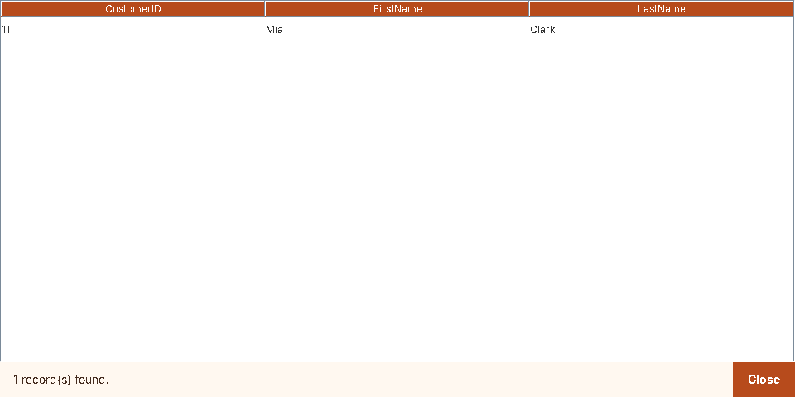
Q5 Who has sat at every bar table?
C
Member C
THE QUESTION
Who has reserved every table in a section?
Mia Clark
the only customer who has booked all 5 bar tables
HOW IT WORKS
Relational division with a double NOT EXISTS; the section is user input
With the 5 test bookings from Q5_test_reservations.sql; without them, no rows
Notes:
Presenter: Member C
My first query finds a restaurant's true regulars. I choose a section, here the bar, and it lists customers who have reserved every single table in that section. The bar has five tables, and one customer has sat at all five: Mia Clark. That's someone you might offer a loyalty reward. For the technical audience: this is a division query. It uses a double NOT EXISTS: show customers for whom there is no bar table they haven't booked.
IF YOU DID NOT ADD THE Q5 TEST ROWS, SAY THIS INSTEAD:
Right now the result is empty: nobody has booked every table in any section yet. The closest is Emma Lee, with three of the sixteen main-room tables. An empty result is still an answer, and as soon as someone books every bar table, they'll show up here.

Slide 19
Q6 The SQL
C
Member C
SELECT ReservationTable.ReservationID,
Customer.CustomerID,
Customer.FirstName,
Customer.LastName,
ReservationTable.TableID,
ReservationTable.ResDateTime,
ReservationTable.PartySize
FROM ReservationTable
JOIN Customer
ON ReservationTable.CustomerID = Customer.CustomerID
WHERE ReservationTable.PartySize > (
SELECT AVG(CustomerReservations.PartySize)
FROM ReservationTable AS CustomerReservations
WHERE CustomerReservations.CustomerID =
ReservationTable.CustomerID
)
ORDER BY Customer.CustomerID, ReservationTable.ResDateTime;
WHAT IT DOES
Finds reservations where a customer brought more people than they usually do
TECHNICALLY
A correlated subquery averages PartySize over that same customer’s reservations (CustomerReservations) and keeps rows above it
Correlated subquery
2 tables
Notes:
Presenter: Member C
(Code slide: show this while you introduce the query. Your script continues on the next slide.)
If asked to explain the code: A correlated subquery averages PartySize over that same customer’s reservations (CustomerReservations) and keeps rows above it.

Slide 20
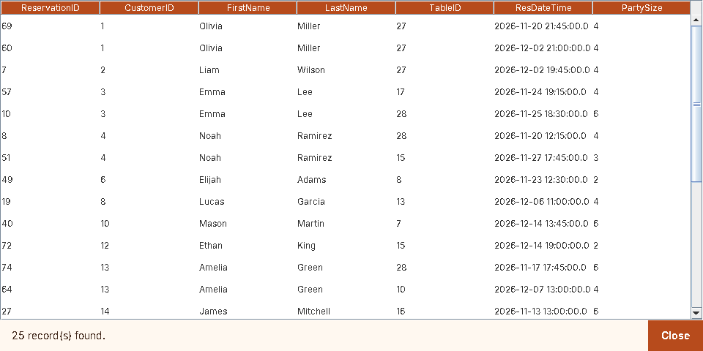
Q6 Bigger than usual
C
Member C
THE QUESTION
When does a customer bring more people than usual?
6 vs 3.3
Mason Martin’s Dec 14 booking vs his usual party size
HOW IT WORKS
Correlated subquery: each row compares PartySize to that customer’s own AVG(PartySize)
25 bookings are above that customer’s own average
Notes:
Presenter: Member C
My second query spots reservations where a customer is bringing more people than they normally do, which often means a birthday or a celebration the staff should know about. For example, Mason Martin usually comes with about three people, but on December 14th he booked for six. Emma Lee averages a little over three, and on November 25th she booked for six. Technically, it's a correlated subquery: for each reservation, it calculates that same customer's average party size and keeps the rows that are above it.
That covers how reservations are booked and what we can learn from them. ____ will wrap us up.

Slide 21
Three tables · three forms · six queries
Q1 Table use by month
GROUP BY
Q2 Customer history
User input
Q3 Party sizes
CASE
Q4 Open tables
Subquery + input
Q5 Every table in a section
Division
Q6 Bigger than usual
Correlated subquery
Thank you
Notes:
Presenter: Member A
So that's our project: three related tables, one program that adds and views records, and six queries that answer real questions a restaurant has, from how busy each table is to which tables are open at a certain time. Thanks for watching.

