Slide 1
In Containers We Trust? Building Trust In Containerized Environments
Avery Blanchard1, Gheorghe Almasi2, James Bottomley2 and Hubertus Franke2
1 Duke University 2 IBM Research
November 13th, 2023

Slide 2
Containers are ubiquitous and blindly trusted...

Slide 3
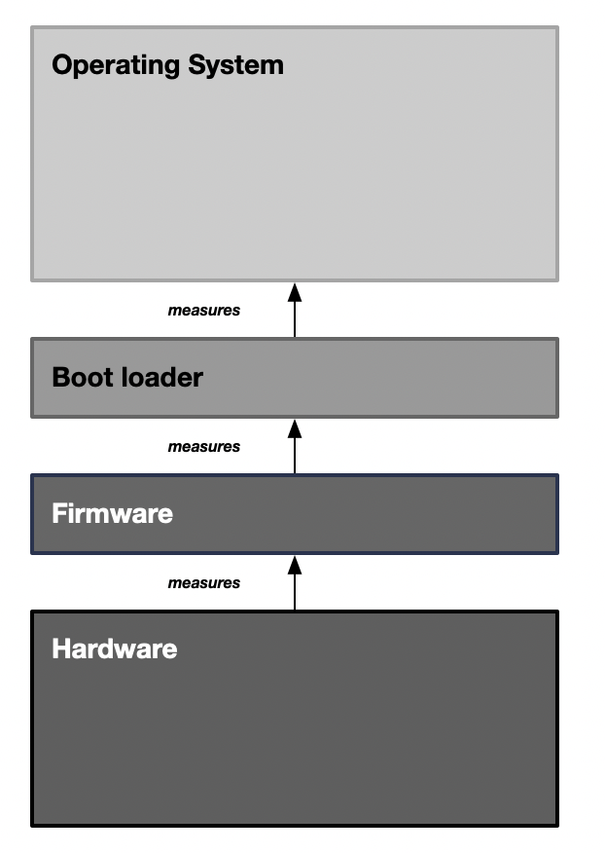
Measuring System Integrity

Slide 4
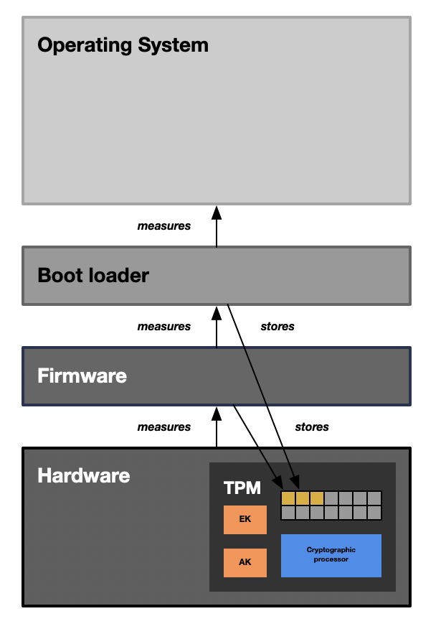
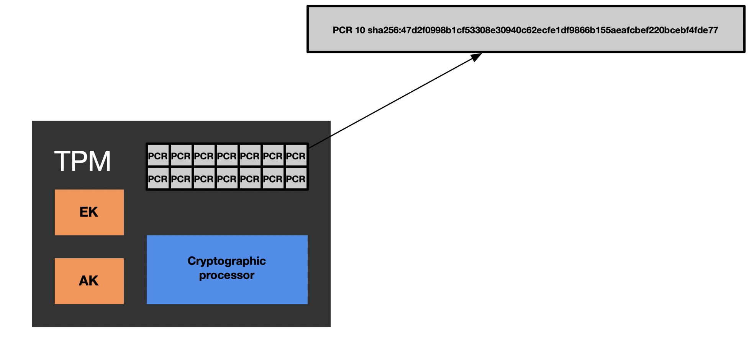
Rooting Measurements in Trusted Hardware

Slide 5
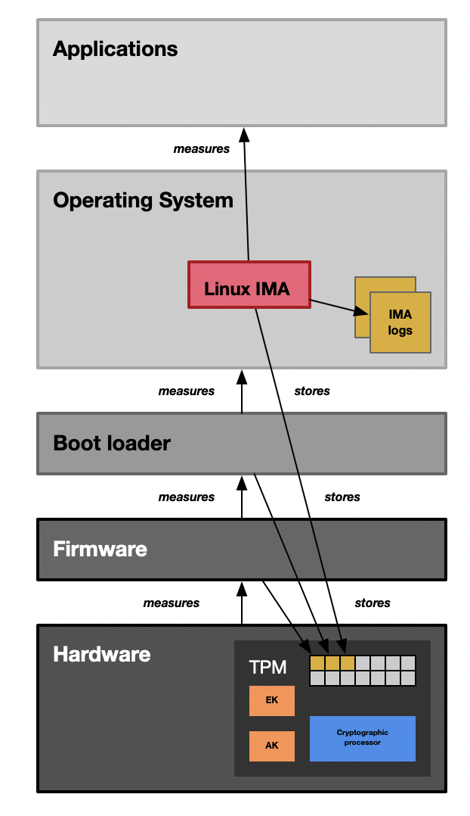
Extending Integrity Measurements Through Runtime

Slide 6
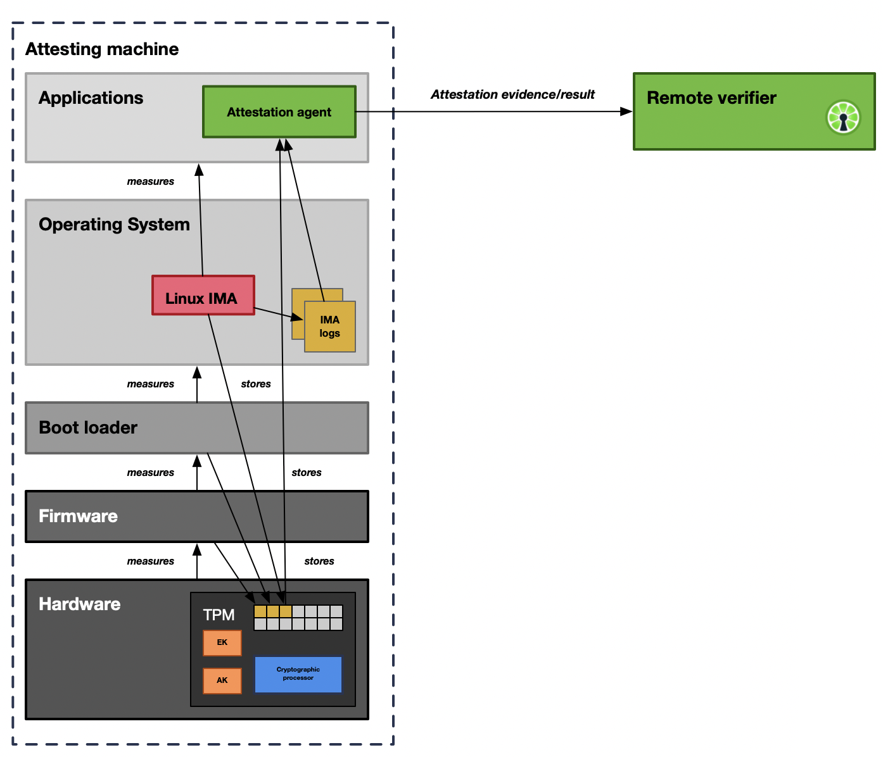
Building Trust in Remote Environments

Slide 7
Disconnect

Slide 8
Enabling Container Attestation: A Preliminary Approach

Slide 9
Kernel-less Kernel Development with eBPF

Slide 10
Extending Linux IMA to Containers using eBPF

Slide 11
Containers vs. Attestation

Slide 12
Container Image Measurement

Slide 13
Container Visibility from the Kernel

Slide 14
Monitoring Namespace Creation in the Kernel

Slide 15
Visibility Through the Unshare System Call

Slide 16
Container Image Integrity Measurement

Slide 17
Kernel-Verifiable Image Digests

Slide 18
Extending the IMA log with Image Digests

Slide 19
Evaluating Measurement Overhead

Slide 20
Demo Environment

Slide 21
Enabling Container Integrity Verification

Slide 22
avery.blanchard@duke.edu
https://github.com/avery-blanchard/container-ima
https://github.com/avery-blanchard/container-integrity-measurement

