Slide 1
In Containers We Trust? Building Trust In Containerized Environments
Avery Blanchard1, Gheorghe Almasi2, James Bottomley2 and Hubertus Franke2
1 Duke University 2 IBM Research
November 13th, 2023

Slide 2
Containers are ubiquitous and blindly trusted...

Slide 3
Applications
Operating System
measures
Boot loader
measures
Firmware
measures
Hardware

Slide 4
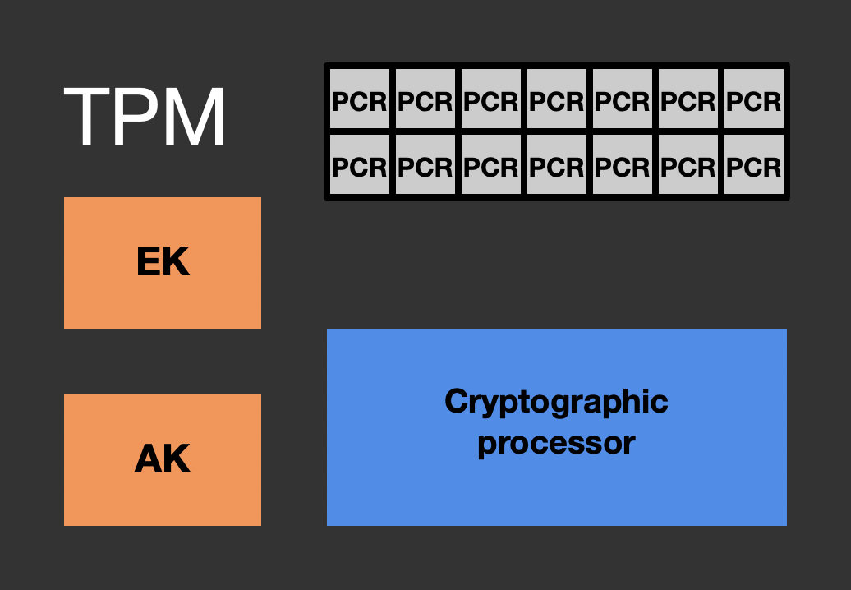
Applications
Operating System
measures
Boot loader
measures
stores
Firmware
measures
stores
Hardware

Slide 5
Applications
measures
Operating System
Linux IMA
IMA logs
measures
stores
Boot loader
measures
stores
Firmware
measures
stores
Hardware

Slide 6
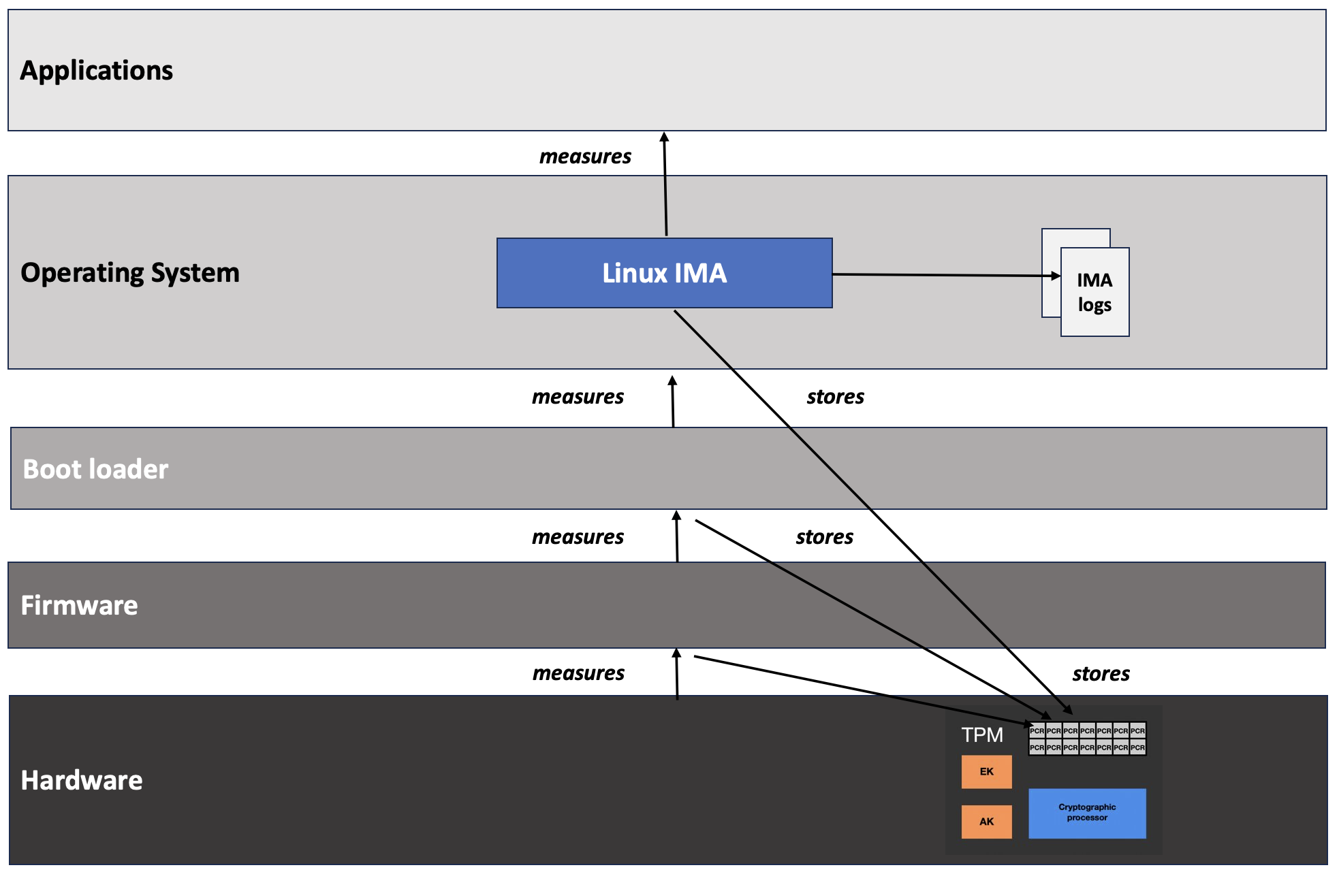
Attesting machine
Remote verifier
Attestation agent

Slide 7
Enabling Container Attestation: A Preliminary Approach

Slide 8
Kernel-less Kernel Development with eBPF

Slide 9
Extending Linux IMA to Containers using eBPF

Slide 10
Containers vs. Attestation

Slide 11
Container Image Measurement

Slide 12
Container Visibility from the Kernel

Slide 13
Monitoring Namespace Creation in the Kernel

Slide 14
Visibility Through the Unshare System Call

Slide 15
Container Image Integrity Measurement

Slide 16
Kernel-Verifiable Image Digests

Slide 17
Extending the IMA log with Image Digests

Slide 18
Evaluating Measurement Overhead

Slide 19
Demo Environment

Slide 20
Enabling Container Integrity Verification

Slide 21
avery.blanchard@duke.edu
https://github.com/avery-blanchard/container-ima
https://github.com/avery-blanchard/container-integrity-measurement

