Slide 1
In Containers We Trust? Building Trust In Containerized Environments
Avery Blanchard1, Gheorghe Almasi2, James Bottomley2 and Hubertus Franke2
1 Duke University 2 IBM Research
November 13th, 2023

Slide 2
Containers are ubiquitous and blindly trusted...

Slide 3
Defining Trust: Measurement
Userspace
Operating System
measures
Boot loader
measures
Hardware

Slide 4
Defining Trust: Measurement
Userspace
Operating System
measures
sha256:b94d27b9934d3e08a52e52d7da7dabfac484efe37a5380ee9088f7ace2efcde9
Boot loader
measures
sha256:a97b84e295de545881d2915211fe240589b2475d90025e61acf7206a2c17a057
Hardware

Slide 5
Building Trust from Hardware
Userspace
Operating System
measures
stores
Boot loader
measures
stores
Hardware
TPM
PCRs
Cryptographic Processor
EK
AK

Slide 6
Extending Integrity Measurements in Runtime
Userspace
Application A
measures
Operating System
Linux IMA
IMA logs
measures
stores
Boot loader
measures
stores
Hardware
TPM
PCRs
Cryptographic Processor
EK
AK

Slide 7
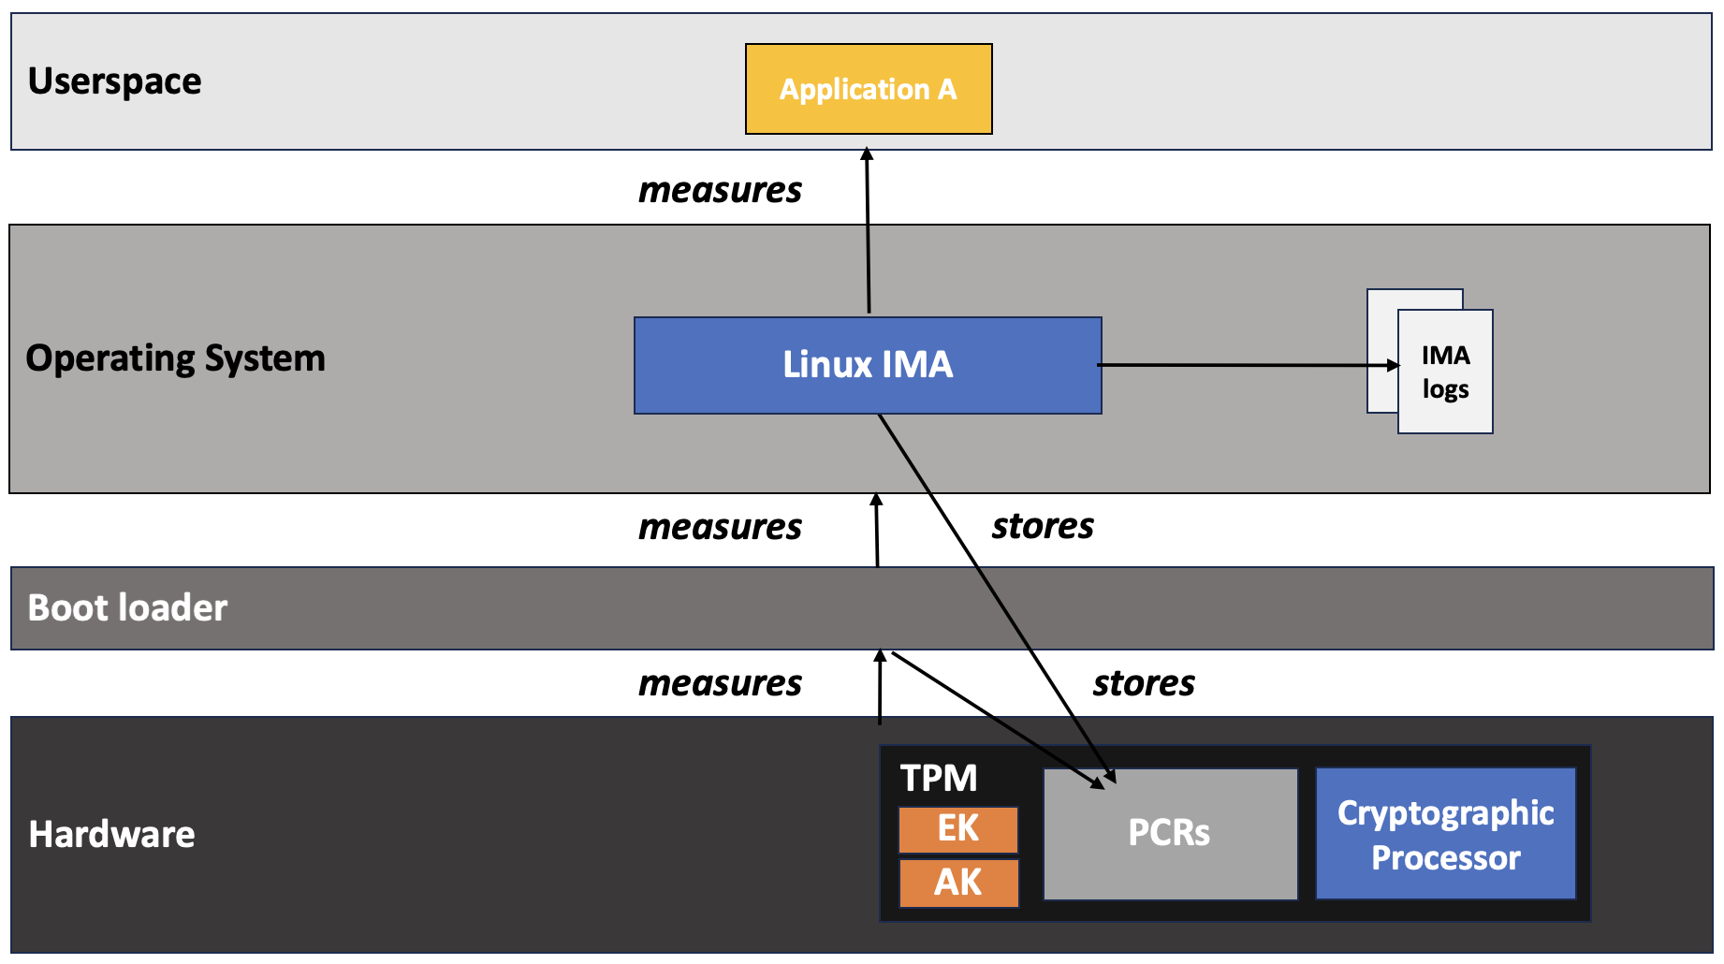
Building Trust in Remote Environments
Attesting machine
Attestation agent
Remote verifier
allowlist.txt
b8688ae5820a434b7dcc325e083d9216630418c38a5754e8f523d3464d264f27b8688ae5820a434b7dcc325e083d9216630418c38a5754e8f523d3464d264f2

Slide 8
Container Present a Gap in Trust and Integrity
Userspace
Container A
Container B
Container C
measures ?
measures ?
Operating System
Linux IMA
IMA logs
measures
stores
Boot loader
measures
stores
Hardware
TPM
PCRs
Cryptographic Processor
EK
AK

Slide 9
Enabling Container Attestation: A Preliminary Approach

Slide 10

Extending IMA to Containers using eBPF
Userspace
Container A
Container B
Container C
measures
measures
Operating System
LSM hook: mmap_file
Container IMA
kernel module
IMA logs
measures
stores
Boot loader
measures
stores
Hardware
TPM
PCRs
Cryptographic Processor
EK
AK

Slide 11
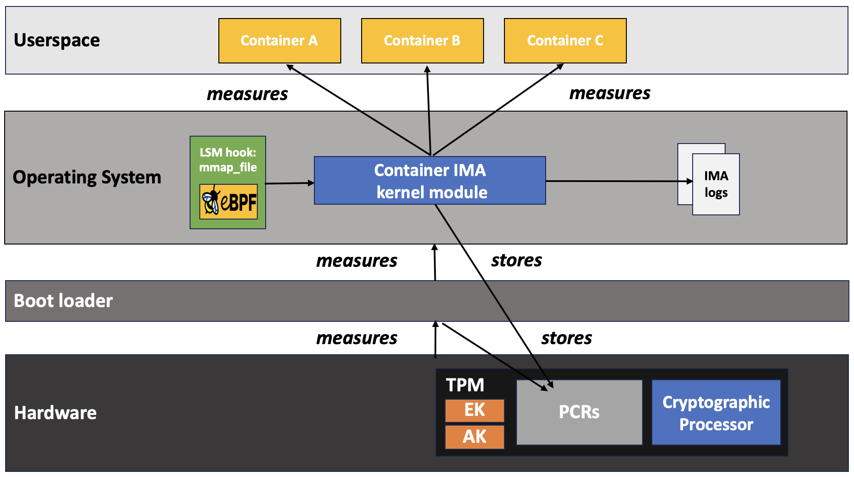
Attesting Container File Integrity
Attesting machine
Attestation agent
Remote verifier
allowlist.txt
b8688ae5820a434b7dcc325e083d9216630418c38a5754e8f523d3464d264f27b8688ae5820a434b7dcc325e083d9216630418c38a5754e8f523d3464d264f2
allowlist.txt
b8688ae5820a434b7dcc325e083d9216630418c38a5754e8f523d3464d264f27b8688ae5820a434b7dcc325e083d9216630418c38a5754e8f523d3464d264f2
allowlist.txt
b8688ae5820a434b7dcc325e083d9216630418c38a5754e8f523d3464d264f27b8688ae5820a434b7dcc325e083d9216630418c38a5754e8f523d3464d264f2
allowlist.txt
b8688ae5820a434b7dcc325e083d9216630418c38a5754e8f523d3464d264f27b8688ae5820a434b7dcc325e083d9216630418c38a5754e8f523d3464d264f2

Slide 12

Attestation vs. Containers
Attesting machine
Attestation agent
Remote verifier
Attestation agent
allowlist.txt
b8688ae5820a434b7dcc325e083d9216630418c38a5754e8f523d3464d264f27b8688ae5820a434b7dcc325e083d9216630418c38a5754e8f523d3464d264f2
allowlist.txt
b8688ae5820a434b7dcc325e083d9216630418c38a5754e8f523d3464d264f27b8688ae5820a434b7dcc325e083d9216630418c38a5754e8f523d3464d264f2
allowlist.txt
b8688ae5820a434b7dcc325e083d9216630418c38a5754e8f523d3464d264f27b8688ae5820a434b7dcc325e083d9216630418c38a5754e8f523d3464d264f2
allowlist.txt
b8688ae5820a434b7dcc325e083d9216630418c38a5754e8f523d3464d264f27b8688ae5820a434b7dcc325e083d9216630418c38a5754e8f523d3464d264f2
allowlist.txt
b8688ae5820a434b7dcc325e083d9216630418c38a5754e8f523d3464d264f27b8688ae5820a434b7dcc325e083d9216630418c38a5754e8f523d3464d264f2
allowlist.txt
b8688ae5820a434b7dcc325e083d9216630418c38a5754e8f523d3464d264f27b8688ae5820a434b7dcc325e083d9216630418c38a5754e8f523d3464d264f2
allowlist.txt
b8688ae5820a434b7dcc325e083d9216630418c38a5754e8f523d3464d264f27b8688ae5820a434b7dcc325e083d9216630418c38a5754e8f523d3464d264f2
allowlist.txt
b8688ae5820a434b7dcc325e083d9216630418c38a5754e8f523d3464d264f27b8688ae5820a434b7dcc325e083d9216630418c38a5754e8f523d3464d264f2
allowlist.txt
b8688ae5820a434b7dcc325e083d9216630418c38a5754e8f523d3464d264f27b8688ae5820a434b7dcc325e083d9216630418c38a5754e8f523d3464d264f2

Slide 13
Measuring Container Image Integrity in the Kernel

Slide 14
Container Image Integrity
Goal: allow of attestation of container images
Userspace
Container A
Container B
Operating System
Hardware

Slide 15
Container Image Integrity
Goal: allow of attestation of container images
Userspace
Container A
Container B
Isolated by Linux namespaces and cgroups
Operating System
Hardware

Slide 16
Visibility of Container Creation in the Kernel
Userspace
Container A
Container B
Unshare disassociates parts of the current process's execution context (namespaces, file systems, …)
Operating System
unshare
Hardware
TPM
PCRs
Cryptographic Processor
EK
AK

Slide 17
Visibility Through the Unshare System Call
Userspace
$ podman run …
runc
Container engine
Operating System
unshare
Hardware
TPM
PCRs
Cryptographic Processor
EK
AK

Slide 18
Visibility Through the Unshare System Call
Userspace
$ podman run …
runc
Container engine
Operating System
LSM hook: cred_prepare
Container image measurement kernel module
IMA log
unshare
Hardware
TPM
PCRs
Cryptographic Processor
EK
AK

Slide 19
Measuring Container Images From the Kernel
Userspace
New Container
runc
Container engine
Operating System
LSM hook: cred_prepare
Container image measurement kernel module
IMA log
unshare
Hardware
TPM
PCRs
Cryptographic Processor
EK
AK

Slide 20
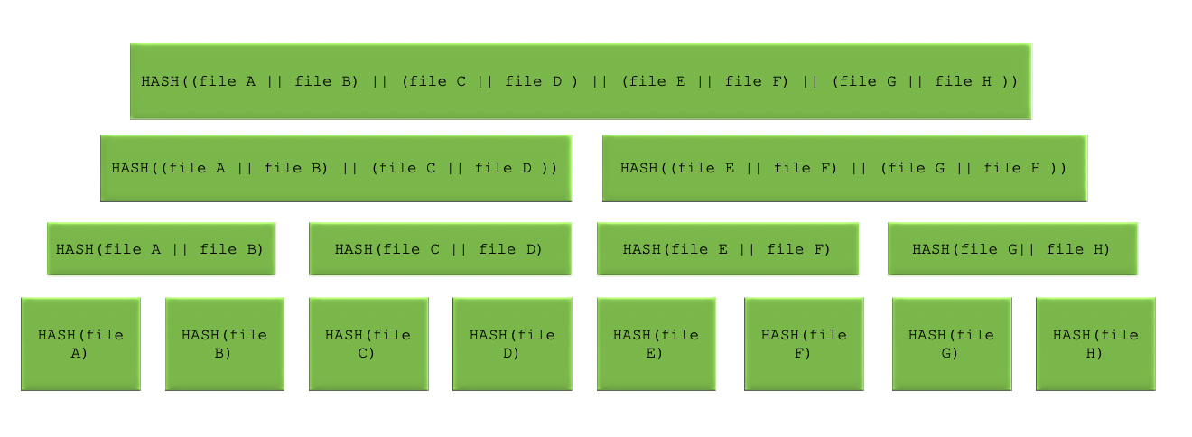
Kernel-Verifiable Image Digests

Slide 21
Extending the IMA log with Image Digests
TODO

Slide 22
Evaluating Measurement Overhead
EVALS TODO

Slide 23
Demo Environment
TODO

Slide 24
Enabling Container Integrity Verification
Current image digests are dependent on images layers, manifest files, image ids, ...
Kernel-verifiable digests need to be provided to extend the chain of trust from hardware up to each container instance

Slide 25
Building trust in containers through image integrity measurements leveraging trusted hardware.
avery.blanchard@duke.edu
https://github.com/avery-blanchard/container-ima
https://github.com/avery-blanchard/container-integrity-measurement

Slide 26
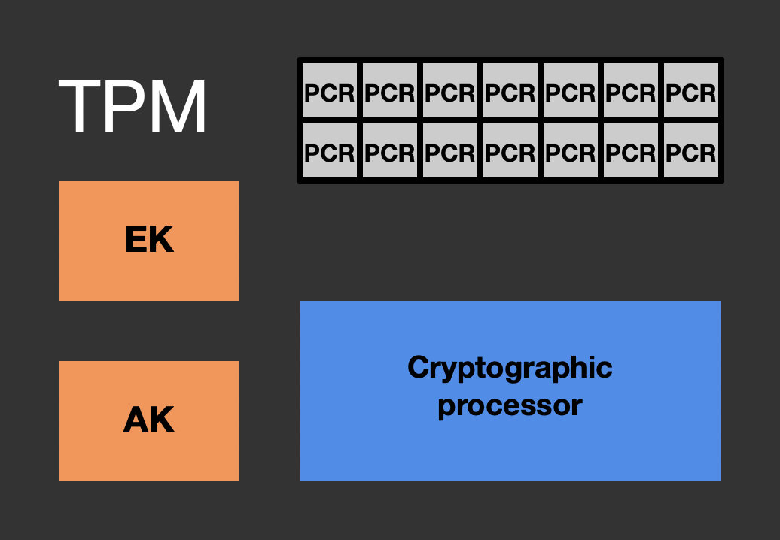
Applications
Operating System
measures
Boot loader
measures
stores
Firmware
measures
stores
Hardware

Slide 27
Applications
measures
Operating System
Linux IMA
IMA logs
measures
stores
Boot loader
measures
stores
Firmware
measures
stores
Hardware

Slide 28
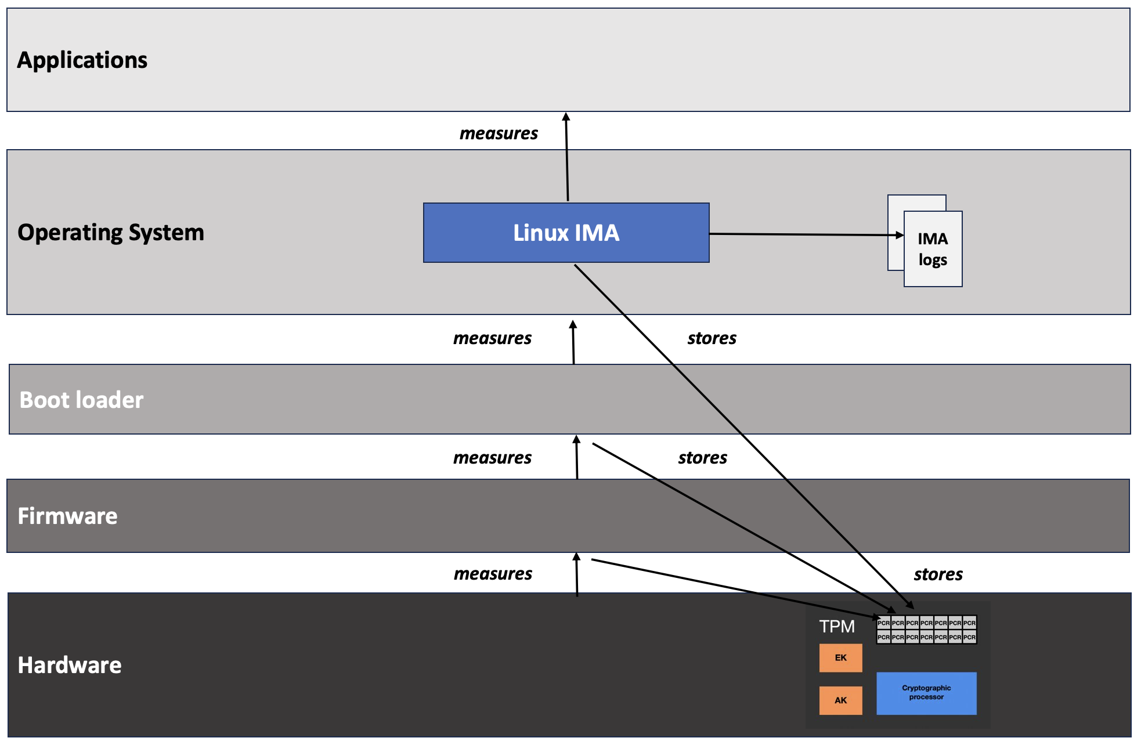
Attesting machine
Remote verifier
Attestation agent
whitelist.txt
b8688ae5820a434b7dcc325e083d9216630418c38a5754e8f523d3464d264f27b8688ae5820a434b7dcc325e083d9216630418c38a5754e8f523d3464d264f2

Slide 29
Applications
Container A
Container B
Container C
measures
Operating System
Linux IMA
IMA logs
measures
stores
Boot loader
measures
stores
Firmware
measures
stores
Hardware

Slide 30
Applications
Container A
Container B
Container C
measures?
measures?
measures?
Operating System
Linux IMA
IMA logs
measures
stores
Boot loader
measures
stores
Firmware
measures
stores
Hardware

Slide 31
Applications
Container A
Container B
Container C
measures
measures
measures
Operating System
LSM hook: mmap_file
Container IMA
kernel module
IMA logs
measures
stores
Boot loader
measures
stores
Firmware
measures
stores
Hardware

Slide 32
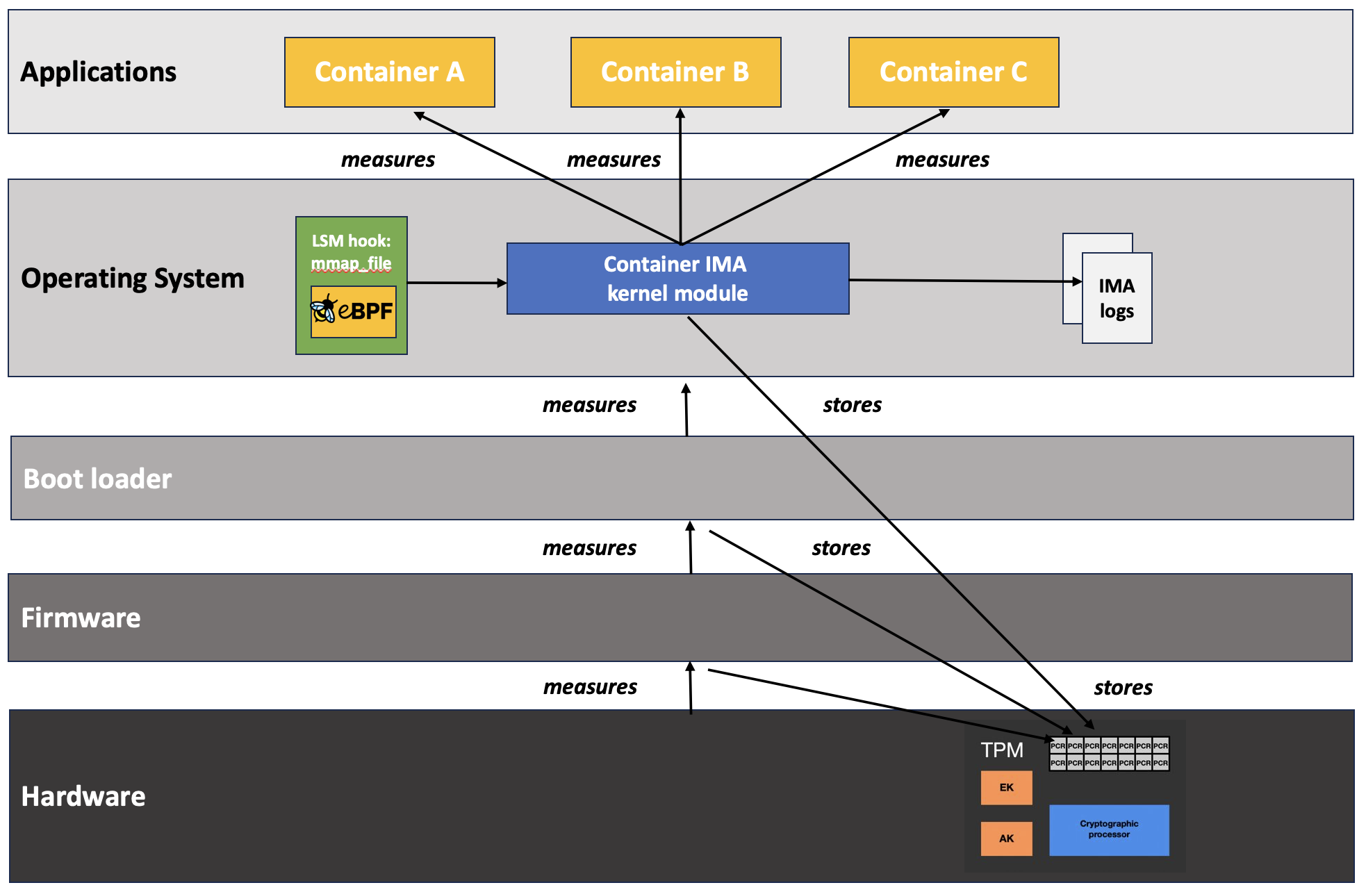
Attesting machine
Attestation agent
Remote verifier
allowlist.txt
b8688ae5820a434b7dcc325e083d9216630418c38a5754e8f523d3464d264f27b8688ae5820a434b7dcc325e083d9216630418c38a5754e8f523d3464d264f2
allowlist.txt
b8688ae5820a434b7dcc325e083d9216630418c38a5754e8f523d3464d264f27b8688ae5820a434b7dcc325e083d9216630418c38a5754e8f523d3464d264f2
allowlist.txt
b8688ae5820a434b7dcc325e083d9216630418c38a5754e8f523d3464d264f27b8688ae5820a434b7dcc325e083d9216630418c38a5754e8f523d3464d264f2
allowlist.txt
b8688ae5820a434b7dcc325e083d9216630418c38a5754e8f523d3464d264f27b8688ae5820a434b7dcc325e083d9216630418c38a5754e8f523d3464d264f2

Slide 33

Attesting machine
Attestation agent
Remote verifier
whitelist.txt
b8688ae5820a434b7dcc325e083d9216630418c38a5754e8f523d3464d264f27b8688ae5820a434b7dcc325e083d9216630418c38a5754e8f523d3464d264f2
whitelist.txt
b8688ae5820a434b7dcc325e083d9216630418c38a5754e8f523d3464d264f27b8688ae5820a434b7dcc325e083d9216630418c38a5754e8f523d3464d264f2
whitelist.txt
b8688ae5820a434b7dcc325e083d9216630418c38a5754e8f523d3464d264f27b8688ae5820a434b7dcc325e083d9216630418c38a5754e8f523d3464d264f2
whitelist.txt
b8688ae5820a434b7dcc325e083d9216630418c38a5754e8f523d3464d264f27b8688ae5820a434b7dcc325e083d9216630418c38a5754e8f523d3464d264f2
whitelist.txt
b8688ae5820a434b7dcc325e083d9216630418c38a5754e8f523d3464d264f27b8688ae5820a434b7dcc325e083d9216630418c38a5754e8f523d3464d264f2
whitelist.txt
b8688ae5820a434b7dcc325e083d9216630418c38a5754e8f523d3464d264f27b8688ae5820a434b7dcc325e083d9216630418c38a5754e8f523d3464d264f2
whitelist.txt
b8688ae5820a434b7dcc325e083d9216630418c38a5754e8f523d3464d264f27b8688ae5820a434b7dcc325e083d9216630418c38a5754e8f523d3464d264f2
whitelist.txt
b8688ae5820a434b7dcc325e083d9216630418c38a5754e8f523d3464d264f27b8688ae5820a434b7dcc325e083d9216630418c38a5754e8f523d3464d264f2
whitelist.txt
b8688ae5820a434b7dcc325e083d9216630418c38a5754e8f523d3464d264f27b8688ae5820a434b7dcc325e083d9216630418c38a5754e8f523d3464d264f2
whitelist.txt
b8688ae5820a434b7dcc325e083d9216630418c38a5754e8f523d3464d264f27b8688ae5820a434b7dcc325e083d9216630418c38a5754e8f523d3464d264f2
whitelist.txt
b8688ae5820a434b7dcc325e083d9216630418c38a5754e8f523d3464d264f27b8688ae5820a434b7dcc325e083d9216630418c38a5754e8f523d3464d264f2

Slide 34
Containers vs. Attestation

Slide 35
Container Image Measurement

Slide 36
Container Visibility from the Kernel

Slide 37
Monitoring Namespace Creation in the Kernel

Slide 38
Visibility Through the Unshare System Call

Slide 39
Container Image Integrity Measurement

Slide 40
Kernel-Verifiable Image Digests

Slide 41
Extending the IMA log with Image Digests

Slide 42
Evaluating Measurement Overhead

Slide 43
Demo Environment

Slide 44
Enabling Container Integrity Verification

Slide 45
avery.blanchard@duke.edu
https://github.com/avery-blanchard/container-ima
https://github.com/avery-blanchard/container-integrity-measurement

