Slide 1
Extending Non-Repudiable Logs with eBPF
Avery Blanchard1, Gheorghe Almasi2, James Bottomley2 and Hubertus Franke2
1 Duke University 2 IBM Research
November 13th, 2023

Slide 2

Visibility into System State with eBPF
Userspace
Application
bytecode
bpf()
Operating System
Verifier
event!
JIT compiler
eBPF programs
Boot loader
Hardware

Slide 3
Visibility into System State with eBPF
Userspace
Application
bytecode
bpf()
maps
Operating System
Verifier
event!
JIT compiler
eBPF programs
Boot loader
Hardware

Slide 4
Logging System State
Userspace
Application
bytecode
bpf()
maps
Operating System
Verifier
event!
Can we trust this?
JIT compiler
eBPF programs
Boot loader
Hardware

Slide 5
Visibility into System State with eBPF
Userspace
Application
bytecode
bpf()
Ring buffer
Operating System
Verifier
event!
JIT compiler
eBPF programs
Boot loader
Hardware

Slide 6
Logging System State
Userspace
Application
bytecode
bpf()
Ring buffer
Operating System
Verifier
event!
How about this?
JIT compiler
eBPF programs
Boot loader
Hardware

Slide 7
Non-repudiable Logging
Userspace
Application
bytecode
bpf()
Ring buffer
Operating System
Verifier
event!
The addition of non-repudiable logging to eBPF allows for the remote attestation of workload/environment specific data.
JIT compiler
eBPF programs
Boot loader
Hardware

Slide 8
Building a Chain of Trust
Userspace
Application
bytecode
bpf()
Operating System
Verifier
event!
JIT compiler
eBPF programs
measures
Boot loader
measures
Hardware

Slide 9
Building a Chain of Trust
Userspace
Application
bytecode
bpf()
Operating System
Verifier
event!
JIT compiler
eBPF programs
sha256:b94d27b9934d3e08a52e52d7da7dabfac484efe37a5380ee9088f7ace2efcde9
measures
Boot loader
measures
sha256:a97b84e295de545881d2915211fe240589b2475d90025e61acf7206a2c17a057
Hardware

Slide 10
Rooting Trust in Hardware
Userspace
Application
bytecode
bpf()
Operating System
Verifier
event!
JIT compiler
eBPF programs
measures
stores
Boot loader
measures
stores
Hardware
TPM
PCRs
Cryptographic processor
EK
AK

Slide 11
Extending Measurements Through Runtime
Userspace
Application A
Application B
bytecode
bpf()
measures
Operating System
Verifier
event!
Linux IMA
eBPF programs
IMA
log
JIT compiler
measures
stores
stores
Boot loader
measures
stores
Hardware
TPM
PCRs
Cryptographic processor
EK
AK

Slide 12
eBPF Programs
Userspace
Application A
Application B
Attestation agent
bytecode
bpf()
measures
Operating System
Verifier
event!
Linux IMA
eBPF programs
IMA
log
JIT compiler
measures
stores
stores
Boot loader
measures
stores
Hardware
TPM
PCRs
Cryptographic processor
EK
AK

Slide 13
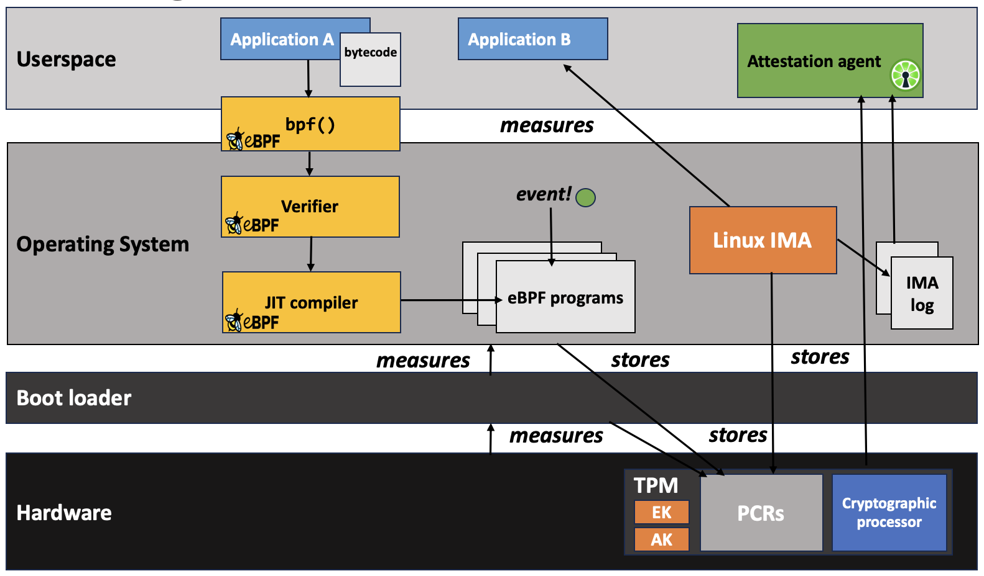
Building Trust in Environments
Attesting Machine
Attestation evidence
Remote Verifier

Slide 14
Attesting System Properties
Relying Party
Verifier
Attesting Machine
request
Attestation
agent
evidence
challenge
evidence
result
Policy engine
Policy engine
response

Slide 15
Non-repudiable Logging in eBPF Programs
Userspace
Application A
bytecode
bpf()
Operating System
Verifier
event!
Measurement and
logging interface
eBPF programs
IMA
log
JIT compiler
measures
stores
stores
Boot loader
measures
stores
Hardware
TPM
PCRs
Cryptographic processor
EK
AK

Slide 16
Measurement Interface
Operating System
Kernel module
Measurement
bpf_process_measurement()
Format log entry
eBPF programs
Append log
Log
event!
Extend PCR
Hardware
TPM
PCRs
Cryptographic processor
EK
AK

Slide 17
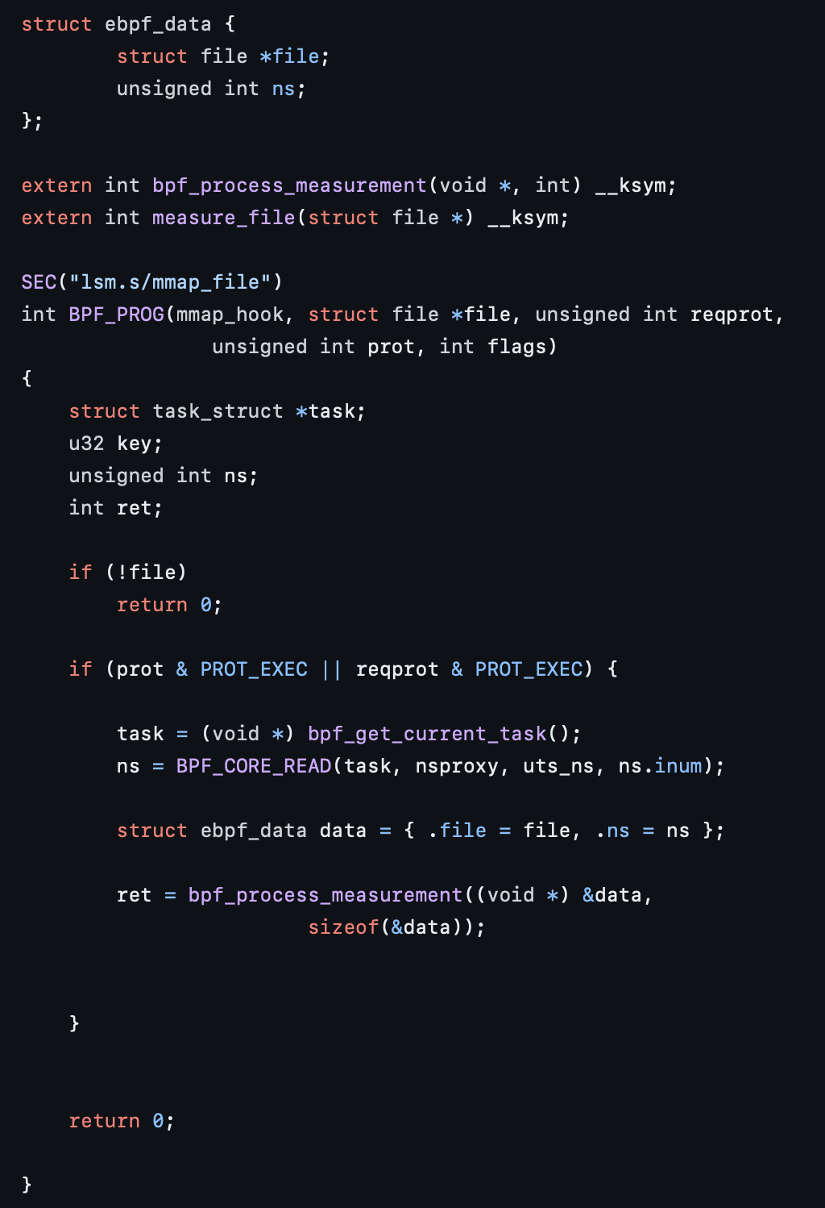
From the eBPF side
Available to sleepable eBPF programs
Programs can provoke the measurement and storage of formatted data and files

Slide 18
Example Use Case
Userspace
Application A
Application B
bytecode
bpf()
measures
Operating System
Verifier
event!
Linux IMA
eBPF programs
IMA
log
JIT compiler
measures
stores
stores
Boot loader
measures
stores
Hardware
TPM
PCRs
Cryptographic processor
EK
AK

Slide 19
Extending Linux IMA to Containers
Userspace
Application A
Container A
bytecode
Application
bpf()
measures
Operating System
Verifier
event!
Linux IMA
eBPF programs
IMA
log
JIT compiler
measures
stores
stores
Boot loader
measures
stores
Hardware
TPM
PCRs
Cryptographic processor
EK
AK

Slide 20
Extending Linux IMA to Containers
Userspace
Application A
Container A
Isolated through namespaces and cgroups
bytecode
Application
bpf()
measures
Operating System
Verifier
event!
Linux IMA
eBPF programs
IMA
log
JIT compiler
measures
stores
stores
Boot loader
measures
stores
Hardware
TPM
PCRs
Cryptographic processor
EK
AK

Slide 21
Adding Namespace Support to IMA
Userspace
Application A
Container A
bytecode
Application
bpf()
measures
Operating System
Verifier
mmap_file
Measurement and
logging interface
eBPF programs
IMA
log
JIT compiler
measures
stores
stores
Boot loader
measures
stores
Hardware
TPM
PCRs
Cryptographic processor
EK
AK

Slide 22
Resulting IMA Log

Slide 23
Evalution

Slide 24
Enabling attestation of workload/platform specific system properties using eBPF.
avery.blanchard@duke.edu
https://github.com/avery-blanchard/container-ima

