Slide 1
Cellular Automata & Moore Neighborhood
Avery Follett
12/12/2019

Slide 2
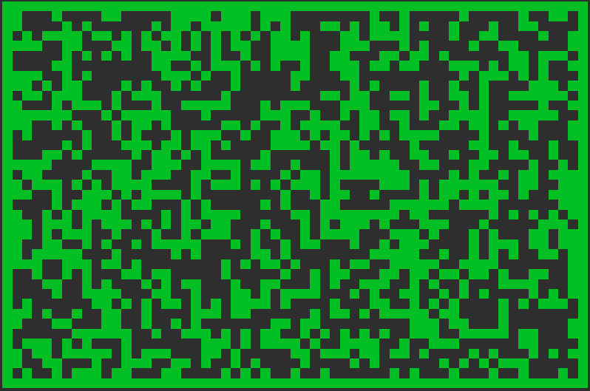
What is Cellular Automata?
Random discrete state (ON/OFF)
Seed
Follows a rule (Fill percentage)
Can use other rules (Edges are ON)

Slide 3

What is Moore’s Neighborhood?
Uses cell neighbors
Threshold to turn cell ON/OFF
Can be looped n times
Greater n = smoother result

Slide 4
Smoothing example

Slide 5
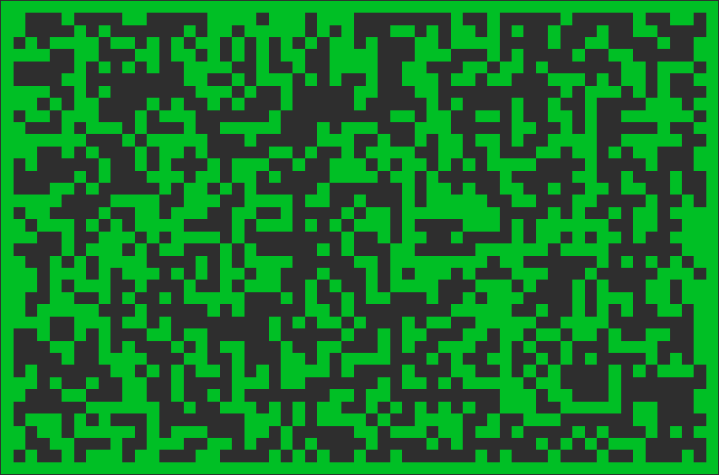
Smooth count 0

Slide 6
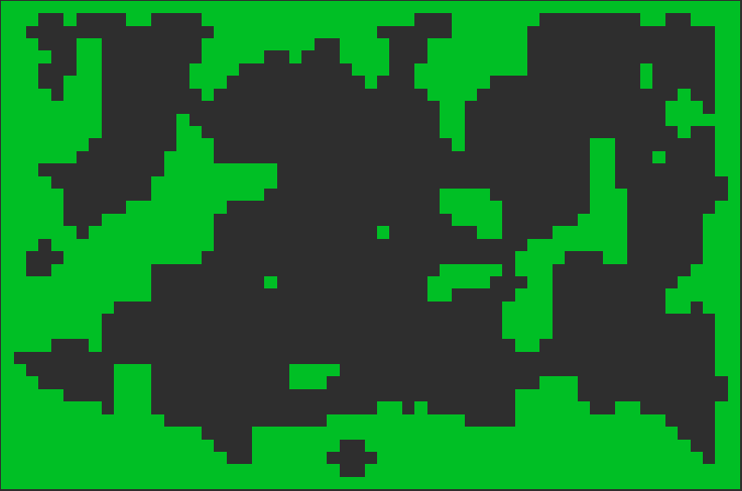
Smooth count 1

Slide 7

Smooth count 2

Slide 8

Smooth count 3

