Slide 1
News Data App
Part II of XML, JSON and AJAX

Slide 2
Today
ONA Report
Bloomberg
Big Weekend
News with XML

Slide 3
NCAA Announcement
Editor / News Director calls you into his office. He tells you that in the next few hours there is going to an announcement about UNC scandal by the NCAA. It has been since May since any news has come out. Prepare an interactive about the scandal.
As and interactive journalist, what should we start doing?
What do people want to know?
What do they remember?

Slide 4
What is needed
Good Data!
Accurate
Complete
Relevant
Photos
Design

Slide 5
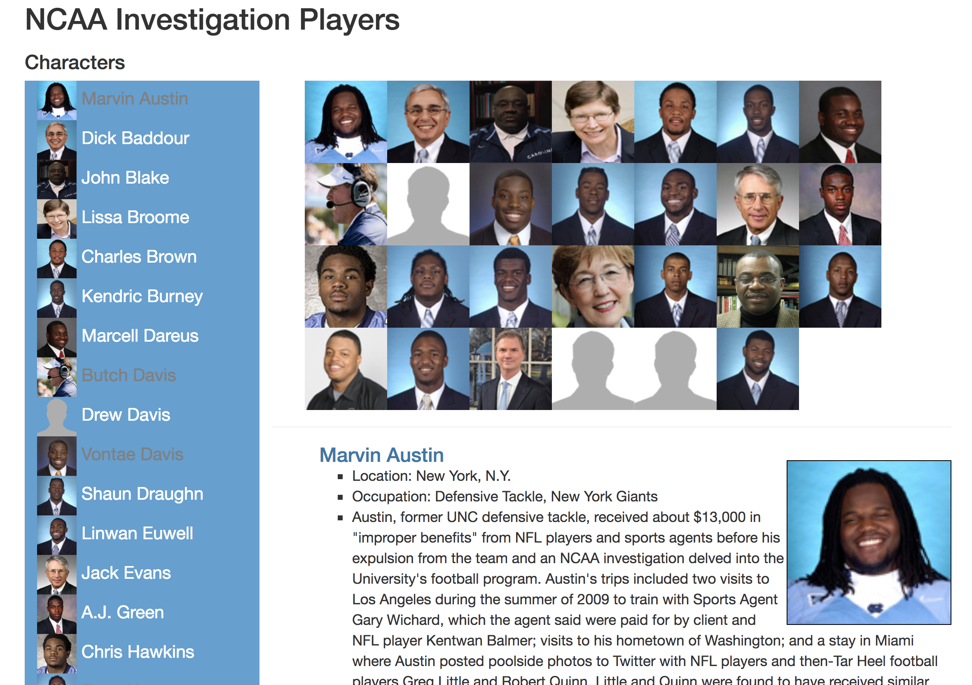

Slide 6
Getting Started
Download Today’s Files
Setup Dev Environment
Open Terminal
cd to the folder
Run python server
Python –m SimpleHTTPServer or python3 -m http.server
Test at localhost:8000

Slide 7
Review
AJAX request
Attribute
$(this).attr("last")
Node
$(this).find("occupation").text()
Node loop
$(xml).find("person").each(function(index) {}

