Slide 1
Image Co-segmentation using Graph Convolution Neural Network
Yuanliang Ju 2022/12/22

Slide 2

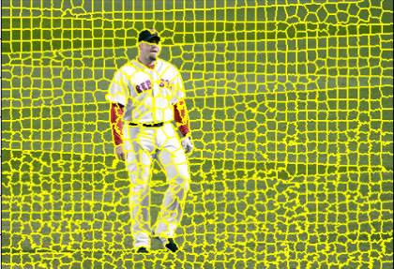
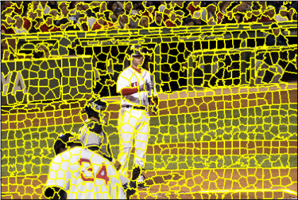
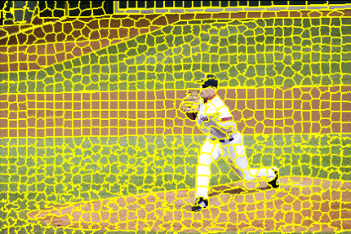
Pipeline

Slide 3
Experiments

