Slide 1
Only when width > mod

Slide 2

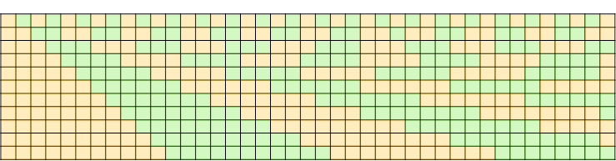

Slide 4
0
x
x%x
2x%x
3x%x
Note that:
The values at each line are always zero
The values are equivalent for every triangle (between any 2 zero lines)
It is possible to conceive of a modulo that is not restricted to integers
Imagine wrapping a string of length 10.5 around a circle with diameter 9.7
The modulo is the remainder past the starting point, which would be 0.8

Slide 5

Integer-only modulo vs continuous

Slide 6
Note how the triangles are equivalent if sheared appropriately

Slide 7
Note the relative values – as long as there are no line crossings, c is always the minimum, while b is the maximum
Todo: figure out rules for open/closed
a
b
c
d

Slide 8
Single line crossing – black arrows mark the possible max values
Note: horizontal arrow is a max where the output interval is [0, max], whereas the vertical arrow is an output interval from [?, max)
To verify: the output interval for the horizontal arrow is always left closed, and is right closed iff x is right closed and y is left closed (given x%y) since this includes the degenerate interval at the top right corner.
Cross at diagonal
Cross at bottom
To verify: the output interval for the vertical arrow is right closed iff the bottom right corner is closed AND in the first triangle
Cross at right

Slide 9
Insight
Because the inside of the rectangle is from one or more triangles that are all linear equipotential fields, any value inside the rectangle must also lie along at least one of the 4 edges of the rectangle (ignoring open/closedness for now)
Therefore it is possible to decompose the interval-interval modulo into 2x interval-number modulos + 2x number-interval modulos + up to 4x number-number modulos (where a number is about the same as a degenerate interval)

Slide 10
Because the equipotential lines go through the rectangle and are slanted
We only need to check if the bottom left and top right points are closed
It is sufficient to travel across the bottom and then up across the right
(todo: check this) We can stop if we hit a second zero-line because that intersection is always >= subsequent intersections with zero-lines
This means an interval-interval modulo decomposes into:
Up to 2x point checks (use a number-number modulo)
One interval-number modulo (already implemented)
One number-interval modulo (todo)

Slide 11
Diagram of previous slide
Only if top and right are closed
Every value in this box is on that line, and vice versa – so the bottom right corner is always pseudo-closed and the lines are too
Only if left and bottom are closed OR if it’s in the first triangle and left closed

Slide 12
Special cases
The maximum value for [x0,x1]%[y0,y1] is always [0,y1)
Meaning a multi-interval modulo can contain a lot of no-ops
[anything containing infinity]%y always returns [0,y1)
[x0,x1]%[anything > x1 (e.g. inf)] is [x0,x1] + [x0,x1]%[y && [0,x1]]
(todo: check) With no line crossings, the max is [0,y0)
There are some cases involving negatives – already done in the code
Zero mod interval is zero
Interval mod zero should be zero (since it’s the remainder and not the quotient)

Slide 13
>=2 line cases (only need first 2 lines)
[0,y1)
[0,y1)
[0,z)
+
[x0%y1,y1)
z
z==y1
z==y0
[0,z2)
+
[x0%y1,z)
If x1>y1 else
[x0,x1]
[0,z2)
+
[x0%y1,y1)
[0,y0)
z2
z2
Z can be inferred using
z = x1 / (1 + floor(x1 / y1))
z2 = x1 / (2 + floor(x1 / y1))
z
z==y1

Slide 14
Remaining cases
[x0%y1,x1%y0]
[x0%y1,y1)
+
[0,x1%y0]
[x0%y1,y1)
+
[0,x1%y0]
[x0%y1,y1)
+
[0,x1%y0]
z==y1
[0, x1%y0]
+
[x0%y1,z)
If x1>y1 else
[x0,x1]
z==y0
[x0%y1,y0)
z
Z can be inferred using
z = x1 / (1 + floor(x1 / y1))

Slide 15
>=2 line cases (only need first 2 lines)
z2
Z can be inferred using
z1 = x1 / (1 + floor(x1 / y1))
z2 = x1 / (2 + floor(x1 / y1))
And Z only exists if y0 <= Z <= y1
Note that this includes Z at corners, which can overlap with W
z1
w1
w2
W can be inferred using
w1 exists iff: floor(x1 / y1) - floor(x0 / y1) >= 1
w2 exists iff: floor(x1 / y1) - floor(x0 / y1) >= 2
Note that special cases are needed to catch W at a corner

Slide 16
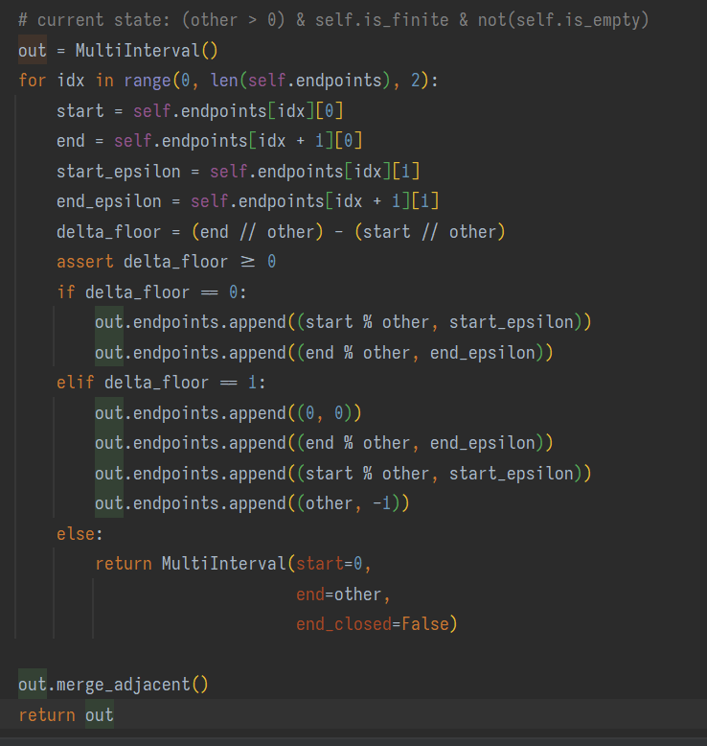

Current implementation of interval%number

Slide 17
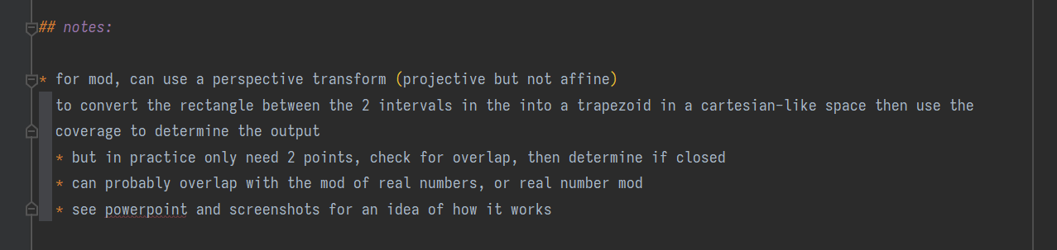
Current notes for interval mod

