Slide 1
Online Spelling Correction for Query Completion
Huizhong Duan, UIUC
Bo-June (Paul) Hsu, Microsoft
WWW 2011
March 31, 2011

Slide 2
Background
Query misspellings are common (>10%)
Typing quickly
exxit
mis[s]pell
Inconsistent rules
concieve
conceirge
Keyboard adjacency
imporyant
Ambiguous word breaking
silver_light
New words
kinnect
Notes:
Fat-finger syndrome

Slide 3
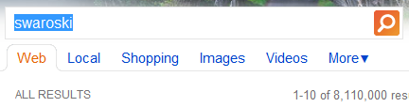


Spelling Correction
Goal: Help users formulate their intent
Offline: After entering query
Online: While entering query
Inform users of potential errors
Help express information needs
Reduce effort to input query

Slide 4


Motivation
Existing search engines offer limited online spelling correction
Offline Spelling Correction (see paper)
Model: (Weighted) edit distance
Data: Query similarity, click log, …
Auto Completion with Error Tolerance (Chaudhuri & Kaushik, 09)
Poor model for phonetic and transposition errors
Fuzzy search over trie with pre-specified max edit distance
Linear lookup time not sufficient for interactive use
Goal: Improve error model & Reduce correction time
Notes:
Need to shorten

Slide 5
Outline
Introduction
Model
Search
Evaluation
Conclusion

Slide 6

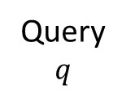
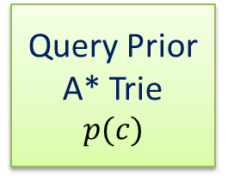
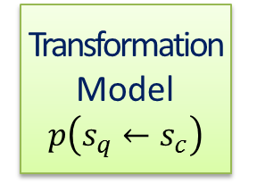
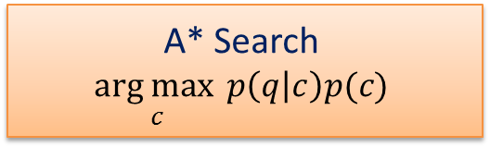



Offline Spelling Correction
Query
Correction Pairs
Query
Histogram
faecbok ← facebook
kinnect ← kinect
…
facebook 0.01
kinect 0.005
…
Transformation
Model
$$p\left(s_{q}←s_{c}\right)$$
Query Prior
A* Trie
$$p(c)$$
a
0.4
Training
ec ← ec 0.1
nn ← n 0.2
…
$
0.4
b
0.2
c
0.2
$
0.2
c
0.1
$$\text{\$}$$
0.2
Decoding
$$\text{\$}$$
0.1
c
0.1
$$\text{\$}$$
0.1
Query
$$q$$
A* Search
$$\underset{c}{arg max}{p\left(q | c\right)p(c)}$$
Correction
$$c$$
elefnat
elephant

Slide 7

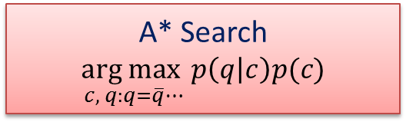

Online Spelling Correction
Query
Correction Pairs
Query
Histogram
faecbok ← facebook
kinnect ← kinect
…
facebook 0.01
kinect 0.005
…
Transformation
Model
$$p\left(s_{q}←s_{c}\right)$$
Query Prior
A* Trie
$$p(c)$$
a
0.4
Training
ae ← ea 0.1
nn ← n 0.2
…
$
0.4
b
0.2
c
0.2
$
0.2
c
0.1
$$\text{\$}$$
0.2
Decoding
$$\text{\$}$$
0.1
c
0.1
$$\text{\$}$$
0.1
Partial Query
$$\overline{q}$$
A* Search
$$\underset{c, q:q=\overline{q}⋯}{arg max}{p\left(q | c\right)p(c)}$$
Completion
$$c$$
elefn
elephant

Slide 8

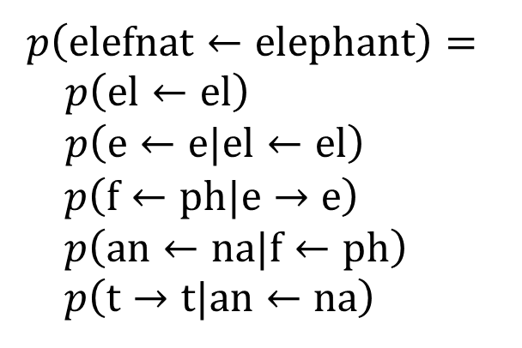

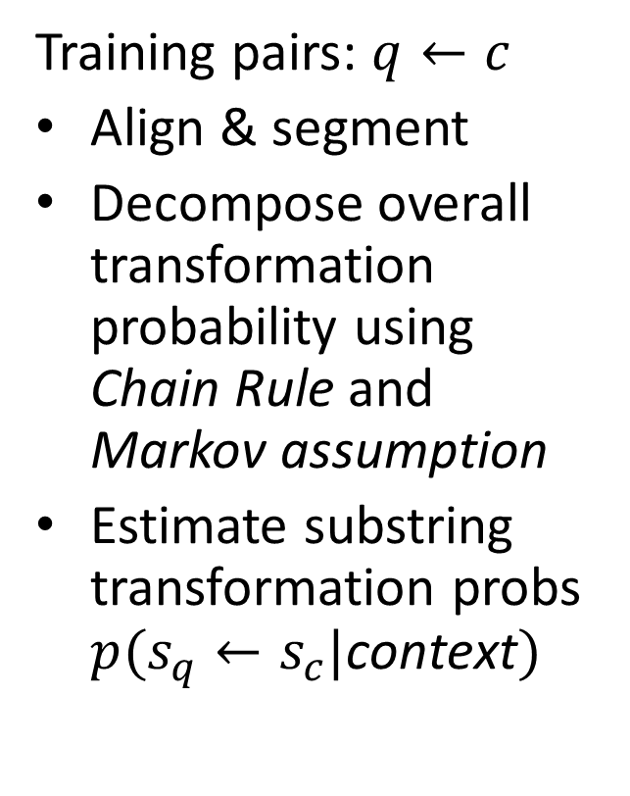
Transformation Model: $p(s_{q}←s_{c})$
e l e f $ε$ n a t
e l e p h a n t
Training pairs: $q←c$
Align & segment
Decompose overall transformation probability using Chain Rule and Markov assumption
Estimate substring transformation probs $p(s_{q}←s_{c}|\text{context})$
$p\left(\text{elefnat}←\text{elephant}\right)=$
$p\left(\text{e}\text{l}←\text{e}\text{l}\right)$
$p\left(\text{e}←\text{e}\text{|}\text{el}←\text{el}\right)$
$p\left(\text{f}←\text{ph}|\text{e}→\text{e}\right)$
$p\left(\text{an}←\text{na}|\text{f}←\text{ph}\right)$
$p\left(\text{t}→\text{t}\text{|}\text{an}←\text{na}\right)$

Slide 9
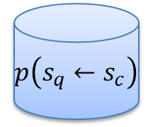

Transformation Model: $p(s_{q}←s_{c})$
Joint-sequence modeling (Bisani & Ney, 08)
Learn common error patterns from spelling correction pairs without segmentation labels
Adjust correction likelihood by interpolating model with identity transformation model
Expectation Maximization
$$q←c$$
$$p\left(s_{q}←s_{c}\right)$$
E-step
M-step
Pruning
Smoothing

Slide 10

Query Prior: $p(q)$
Estimate from empirical query frequency
Add future score for A* search
a
a
0.4
Query | Prob
a | 0.4
ab | 0.2
ac | 0.2
abc | 0.1
abcc | 0.1
$
0.4
$
0.4
b
b
0.2
c
Query
Log
c
0.2
$
0.2
$
0.2
c
c
0.1
$$\text{\$}$$
0.2
$$\text{\$}$$
0.2
$$\text{\$}$$
0.1
$$\text{\$}$$
0.1
c
c
0.1
$$\text{\$}$$
0.1
$$\text{\$}$$
0.1

Slide 11
Outline
Introduction
Model
Search
Evaluation
Conclusion
Notes:
Higher level goal

Slide 12





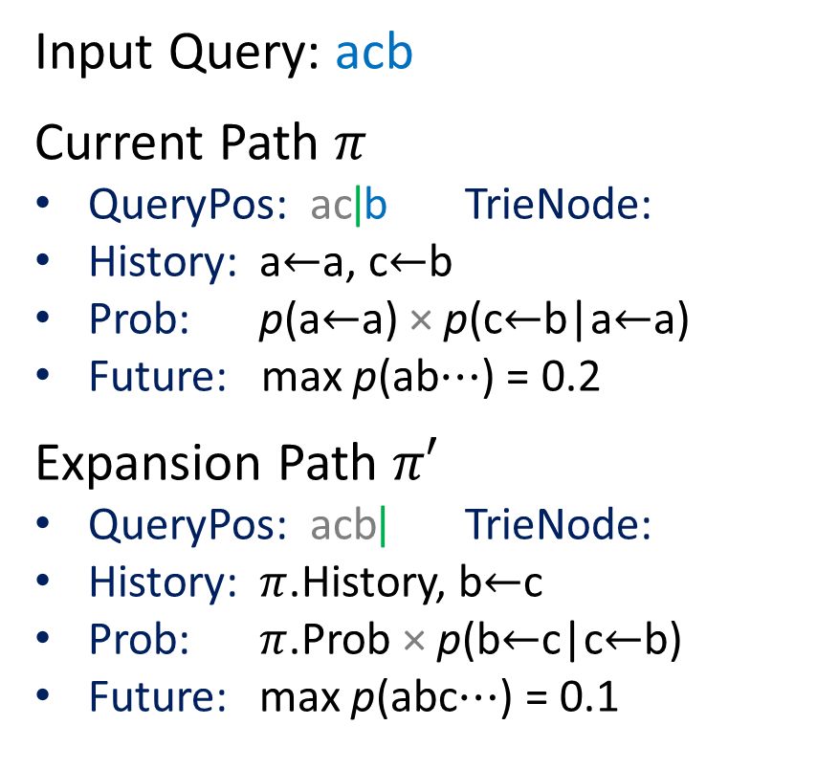

A* Search: $\underset{c, q:q=\overline{q}⋯}{arg max}{p\left(q | c\right)p(c)}$
a
Input Query: acb
Current Path $π$
QueryPos: ac|b TrieNode:
History: a$←$a, c$←$b
Prob: p(a$←$a) × p(c$←$b|a$←$a)
Future: max p(ab$⋯$) = 0.2
Expansion Path $π′$
QueryPos: acb| TrieNode:
History: $π$.History, b$←$c
Prob: $π$.Prob × p(b$←$c|c$←$b)
Future: max p(abc$⋯$) = 0.1
a
0.4
$
0.4
$
0.4
b
b
0.2
c
c
0.2
b
0.2
$
0.2
$
0.2
c
c
0.1
$$\text{\$}$$
0.1
$$\text{\$}$$
0.2
$$\text{\$}$$
0.2
$$\text{\$}$$
0.1
c
c
0.1
c
0.1
$$\text{\$}$$
0.1
$$\text{\$}$$
0.1
Notes:
Change example to one that is intuitively obvious.
* Consider using elephant.
* Draw partial tree to demonstrate idea.
Use left-arrow.
Animation
Consider completions in a separate slide.

Slide 13
Outline
Introduction
Model
Search
Evaluation
Conclusion

Slide 14

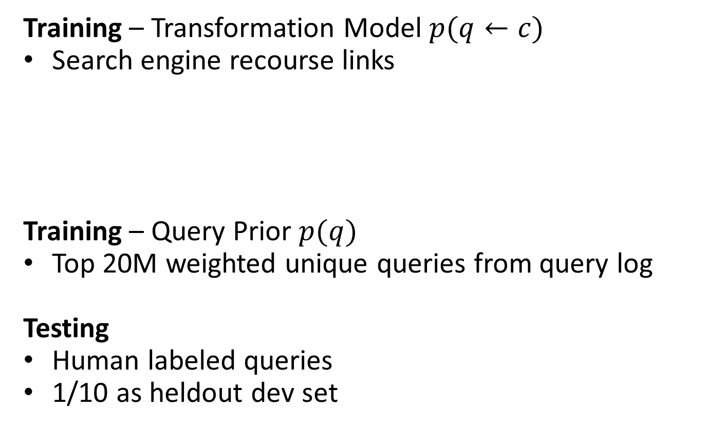
Data Sets
Training – Transformation Model $p(q←c)$
Search engine recourse links
Training – Query Prior $p(q)$
Top 20M weighted unique queries from query log
Testing
Human labeled queries
1/10 as heldout dev set
 | Correctly Spelled | Misspelled | Total
Unique | 101,640 (70%) | 44,226 (30%) | 145,866
Total | 1,126,524 (80%) | 283,854 (20%) | 1,410,378
 | Correctly Spelled | Misspelled | Total
Unique | 7585(76%) | 2374(24%) | 9959
Notes:
Offline vs. Online

Slide 15
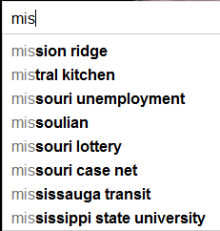
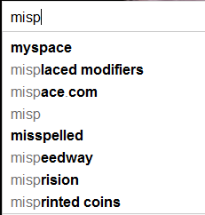
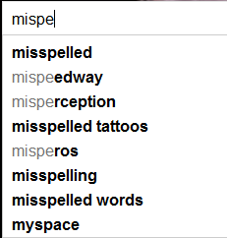
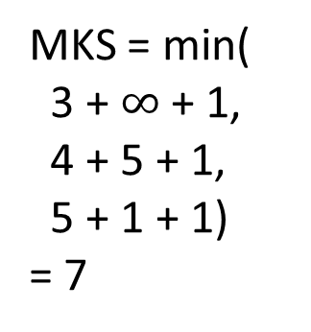
Metrics
Recall@K – #Correct in Top K / #Queries
Precision@K – (#Correct / #Suggested) in Top K
Offline
MinKeyStrokes (MKS)
# characters + # arrow keys + 1 enter key
Penalized MKS (PMKS)
MKS + 0.1 × # suggested queries
Online
MKS = min(
3 + $∞$ + 1,
4 + 5 + 1,
5 + 1 + 1)
= 7

Slide 16
Results
 | All Queries |  |  | Misspelled Queries
 | R@1 | R@10 | MKS | R@1 | R@10 | MKS
Proposed | 0.918* | 0.976 | 11.86* | 0.677* | 0.900* | 11.96*
Edit Dist | 0.899 | 0.973 | 13.39 | 0.579 | 0.887 | 14.53
Google | N/A | N/A | 13.01 | N/A | N/A | 13.49
Baseline: Weighted edit distance (Chaudhuri and Kaushik, 09)
Outperforms baseline in all metrics (p < 0.05) except R@10
Google Suggest (August 10)
Google Suggest saves users 0.4 keystrokes over baseline
Proposed system further reduces user keystrokes by 1.1
1.5 keystroke savings for misspelled queries!

Slide 17
Risk Pruning
Apply threshold to preserve suggestion relevance
Risk = geometric mean of transformation probability per character in input query
Prune suggestions with many high risk words
Pruning high risk suggestions lowers recall and MKS slightly, but improves precision and PMKS significantly
 | All Queries
 | R@1 | R@10 | P@1 | P@10 | MKS | PMKS
No Pruning | 0.918 | 0.976 | 0.920 | 0.262 | 11.86 | 19.60
With Pruning | 0.916 | 0.969 | 0.927 | 0.304 | 11.87 | 19.42

Slide 18
Beam Pruning
Prune search paths to speed up correction
Absolute – Limit max paths expanded per query position
Relative – Keep only paths within probability threshold of best path per query position

Slide 19
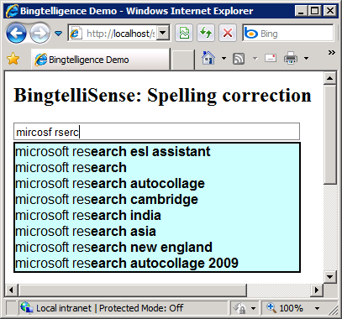
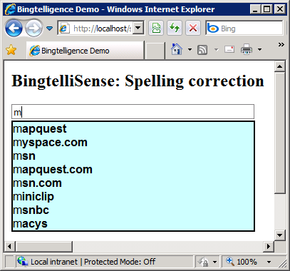
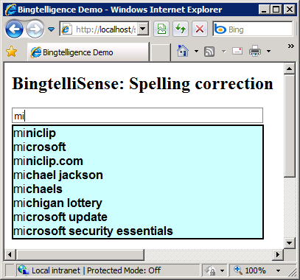
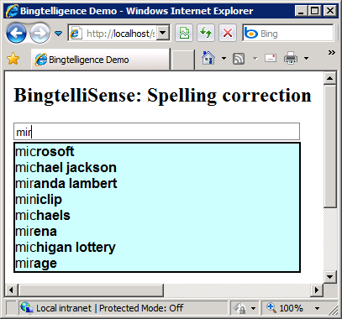
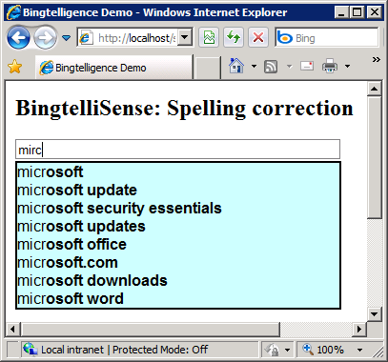

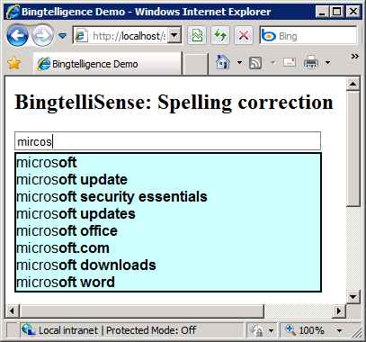

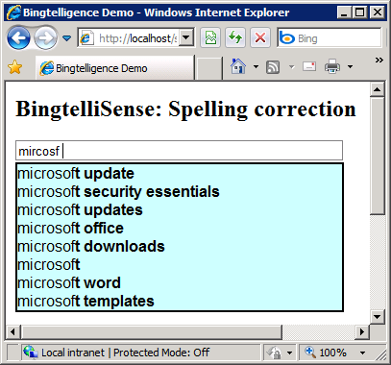
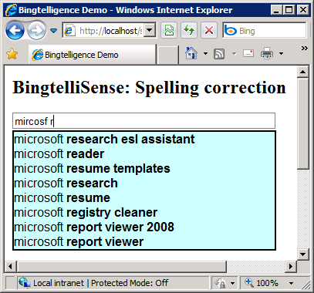
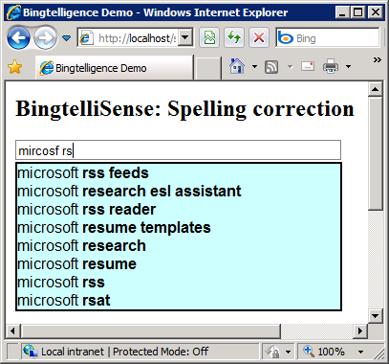
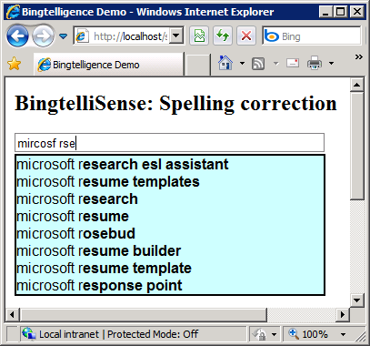
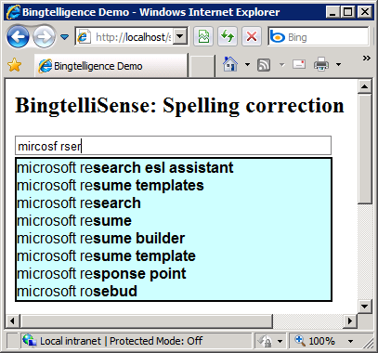
Example

Slide 20
Outline
Introduction
Model
Search
Evaluation
Conclusion

Slide 21
Summary
Modeled transformations using unsupervised joint-sequence model trained from spelling correction pairs
Proposed efficient A* search algorithm with modified trie data structure and beam pruning techniques
Applied risk pruning to preserve suggestion relevance
Defined metrics for evaluating online spelling correction
Future Work
Explore additional sources of spelling correction pairs
Utilize n-gram language model as query prior
Extend technique to other applications

