Slide 1
File System
Notes:
Video Module 8-01

Slide 2

Overview
Objectives
Review the mass storage (disk) structure and issues.
Learn and understand the disk scheduling.
Learn and understand the disk allocation methods
Requirements
Basics from Computer Organization principles (COMP 3350 or equivalent)
Familiar with file interface.
Complete reading assignments:
Overview Mass Storage
Disk structure
Disk scheduling
(Disk) allocation methods

Slide 3
Disk Structure
Objectives
Describe the physical structure of secondary storage
Understand the effects of the structure
Present the performance characteristics
Read (From Textbook))
Overview of Mass-Storage Structure
Disk Structure

Slide 4
Overview of Mass Storage Structure
Magnetic disks provide bulk of secondary storage of modern computers
Drives rotate at 60 to 250 times per second
Transfer rate is rate at which data flow between drive and computer
Positioning time (random-access time) is time to move disk arm to desired cylinder (seek time) and time for desired sector to rotate under the disk head (rotational latency)
Head crash results from disk head making contact with the disk surface -- That’s bad
Disks can be removable
Drive attached to computer via I/O bus
Busses vary, including EIDE, ATA, SATA, USB, Fibre Channel, SCSI, SAS, Firewire
Host controller in computer uses bus to talk to disk controller built into drive or storage array

Slide 5
Moving-head Disk Mechanism

Slide 6
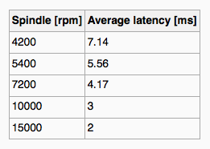
Hard Disks
Platters range from .85” to 14” (historically)
Commonly 3.5”, 2.5”, and 1.8”
Range from 30GB to 3TB per drive
Performance
Transfer Rate – theoretical – 6 Gb/sec
Effective Transfer Rate – real – 1Gb/sec
Seek time from 3ms to 12ms – 9ms common for desktop drives
(Worst) Latency based on spindle (rotational) speed
Time to perform one rotation
Convert speed from per minute to per second: w /60
Find the time to perform one rotation: 1/(w/60)
Average latency = ½ worst latency
Example: what is the average latency if spindle rotational speed is 15000 rpm
Step 1: convert speed to rotation per second: rps = 15000/60 = 250 rotations per second
Step 2: worst latency = time to complete one rotation = 1 second/250 = 4 ms
Step 3: average latency = ½ worst latency = ½ 4ms = 2ms
(From Wikipedia)

Slide 7
Hard Disk Performance
Average access time = average seek time + average latency
For fastest disk 3ms + 2ms = 5ms
For slow disk 9ms + 5.56ms = 14.56ms
Recall:
seek time is related to head moves
latency related to platter/disk rotation
Access time is only the time to position the head at the beginning of a sector
We must add transfer time and disk controller overhead
Average I/O time = average access time + transfer time + controller overhead
transfer time = (amount to transfer / transfer rate)
For example to transfer a 4KB block on a 7200 RPM disk with a 5ms average seek time, 1Gb/sec transfer rate with a .1ms controller overhead =
5ms + 4.17ms + transfer time + 0.1ms =
Transfer time = 4KB / 1Gb/s * 8Gb = 0.032 ms
Average I/O time for 4KB block = 9.27ms + .032ms = 9.302ms

Slide 8
Solid-State Disks
Nonvolatile memory used like a hard drive
Many technology variations
Can be more reliable than HDDs
More expensive per MB
Maybe have shorter life span
Less capacity
But much faster
Busses can be too slow -> connect directly to PCI for example
No moving parts, so no seek time or rotational latency

Slide 9
Magnetic Tape
Was early secondary-storage medium
Evolved from open spools to cartridges
Relatively permanent and holds large quantities of data
Access time slow
Random access ~1000 times slower than disk
Mainly used for backup, storage of infrequently-used data, transfer medium between systems
Kept in spool and wound or rewound past read-write head
Once data under head, transfer rates comparable to disk
140MB/sec and greater
200GB to 1.5TB typical storage
Common technologies are LTO-{3,4,5} and T10000

Slide 10
Disk Structure
Disk drives are addressed as large 1-dimensional arrays of logical blocks, where the logical block is the smallest unit of transfer
Low-level formatting creates logical blocks on physical media
The 1-dimensional array of logical blocks is mapped into the sectors of the disk sequentially
Sector 0 is the first sector of the first track on the outermost cylinder
Mapping proceeds in order through that track, then the rest of the tracks in that cylinder, and then through the rest of the cylinders from outermost to innermost
Logical to physical address should be easy
Except for bad sectors
Non-constant # of sectors per track via constant angular velocity
I-dimensional array

Slide 11
Disk Scheduling (1/3)
Objective
Minimize seek time
How to minimize seek time?
Sort block requests to minimize head moves
“Sorting” is scheduling
Disk Scheduling Policies
First Come First Serve
Shortest Seek Time First
SCAN
C-SCAN
LOOK
C-LOOK
Read “Disk Scheduling” Section
Notes:
Video Module 8-02

Slide 12
Disk Scheduling
The operating system is responsible for using hardware efficiently — for the disk drives, this means having a fast access time and disk bandwidth
Minimize seek time
Seek time ≈ seek distance

Slide 13
Disk Scheduling (Cont.)
There are many sources of disk I/O request
OS
System processes
Users processes
I/O request includes input or output mode, disk address, memory address, number of sectors to transfer
OS maintains queue of requests, per disk or device
Idle disk can immediately work on I/O request, busy disk means work must queue
Optimization algorithms only make sense when a queue exists

Slide 14
Disk Scheduling (Cont.)
Note that drive controllers have small buffers and can manage a queue of I/O requests (of varying “depth”)
Several algorithms exist to schedule the servicing of disk I/O requests
The analysis is true for one or many platters
We illustrate scheduling algorithms with a request queue (0-199)
98, 183, 37, 122, 14, 124, 65, 67
Head pointer is at Position 53

Slide 15
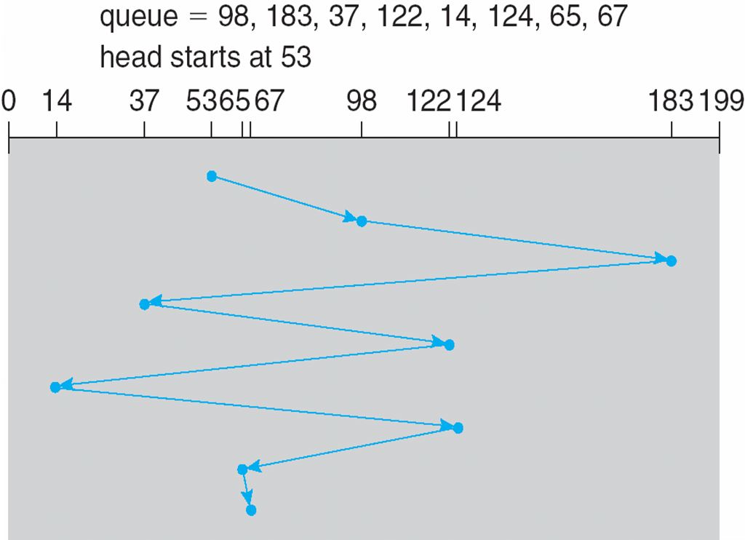
FCFS
Illustration shows total head movement of 640 cylinders
45 = 98-53
85 = 183-98
146 = 183-37
85 = 122-37
108 = 122-14
110 = 124-14
59 = 124-65
2 = 67 -65
45 + 85 + 146 + 85 + 108 + 110 + 59 + 2 = 640

Slide 16
FCFS
Illustration shows total head movement of 640 cylinders
45 = 98-53
85 = 183-98
146 = 183-37
85 = 122-37
108 = 122-14
110 = 124-14
59 = 124-65
2 = 67 -65
45 + 85 + 146 + 85 + 108 + 110 + 59 + 2 = 640

Slide 17
Disk Scheduling (2/3)
Objective
Minimize seek time
How to minimize seek time?
Sort requests to minimize head moves
“Sorting” is scheduling
Disk Scheduling Policies
First Come First Serve
Shortest Seek Time First
SCAN
C-SCAN
LOOK
C-LOOK
Read “Disk Scheduling” Section
Notes:
Video Module 8-03

Slide 18
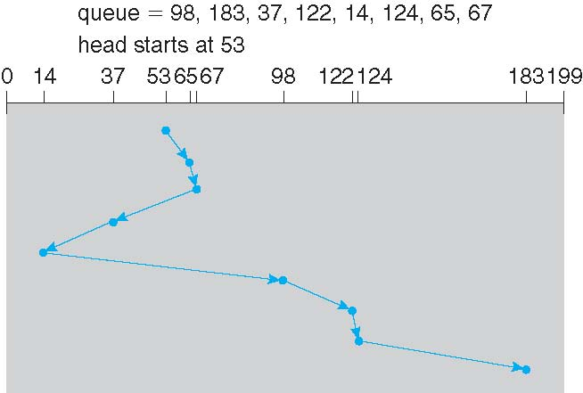
SSTF
Shortest Seek Time First selects the request with the minimum seek time from the current head position
SSTF scheduling is a form of SJF scheduling; may cause starvation of some requests
Illustration shows total head movement of 236 cylinders
12 = 65-53
2 = 67-65
30 = 67-37
23 = 37-14
84 = 98-14
24 = 122-98
2 = 124-122
59 = 183-124

Slide 19
SSTF
Shortest Seek Time First selects the request with the minimum seek time from the current head position
SSTF scheduling is a form of SJF scheduling; may cause starvation of some requests
Illustration shows total head movement of 236 cylinders
12 = 65-53
2 = 67-65
30 = 67-37
23 = 37-14
84 = 98-14
24 = 122-98
2 = 124-122
59 = 183-124

Slide 20
SCAN
The disk arm starts at one end of the disk, and moves toward the other end, servicing requests until it gets to the other end of the disk, where the head movement is reversed and servicing continues.
SCAN algorithm Sometimes called the elevator algorithm
Illustration shows total head movement of 208 cylinders
But note that if requests are uniformly dense, largest density at other end of disk and those wait the longest

Slide 21
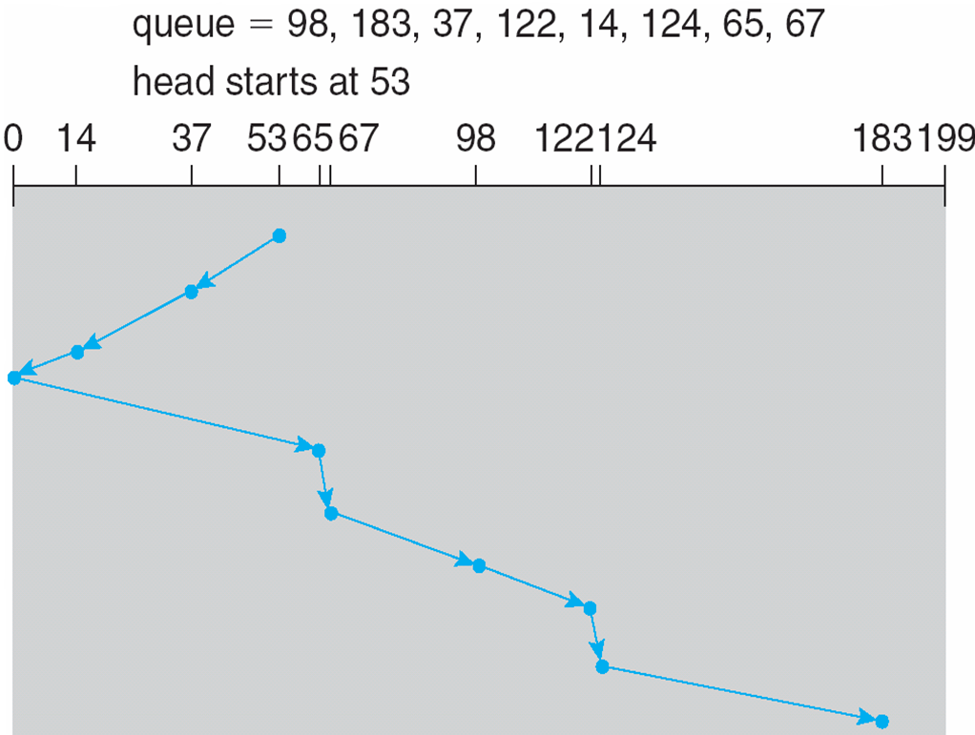
SCAN (Cont.)
53 = 53-0
183 = 183-0
Total Head Moves = 53 + 183 = 236

Slide 22
Disk Scheduling (3/3)
Objective
Minimize seek time
How to minimize seek time?
Sort requests to minimize head moves
“Sorting” is scheduling
Disk Scheduling Policies
First Come First Serve
Shortest Seek Time First
SCAN
C-SCAN
LOOK
C-LOOK
Read “Disk Scheduling” Section
Notes:
Video Module 8-04

Slide 23
C-SCAN
Provides a more uniform wait time than SCAN
The head moves from one end of the disk to the other, servicing requests as it goes
When it reaches the other end, however, it immediately returns to the beginning of the disk, without servicing any requests on the return trip
Treats the cylinders as a circular list that wraps around from the last cylinder to the first one

Slide 24
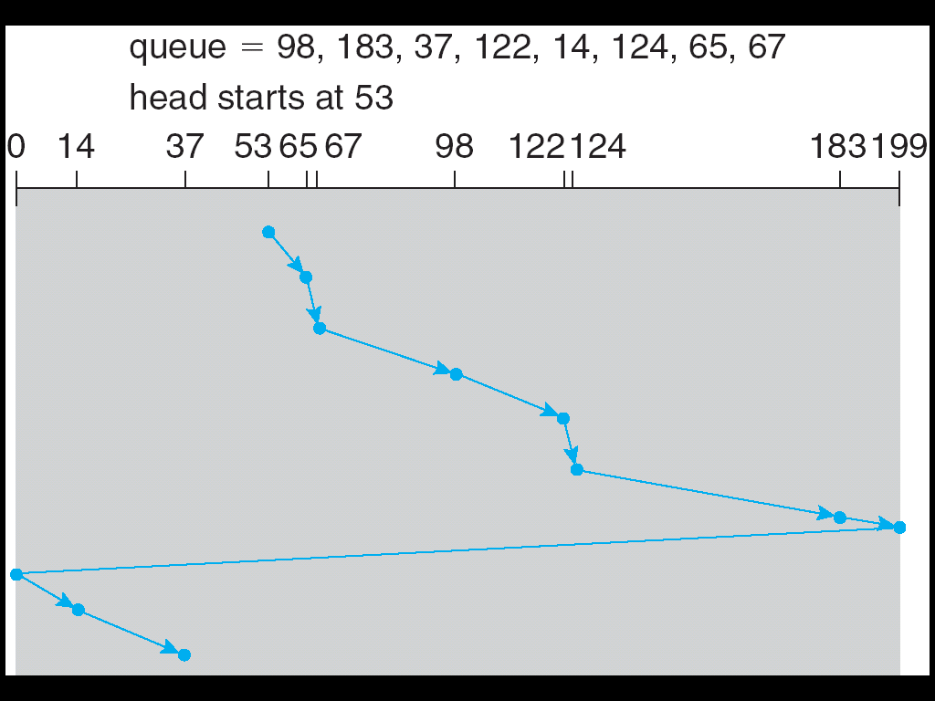
C-SCAN (Cont.)
146 = 199-53
199 = 199-0
37 = 37-0
Total Head Moves = 146 + 199 + 37 = 382

Slide 25
LOOK
Improvement of SCAN
Problem with SCAN?
Unnecessary moves of the head to extremeties
LOOK: Arm only goes as far as the last request in each direction, then reverses direction immediately, without first going all the way to the end of the disk
Total number of cylinders?

Slide 26
C-LOOK
Arm only goes as far as the last request in each direction, then reverses direction immediately, without first going all the way to the end of the disk
…. and serves requests only in one direction (like C-SCAN)

Slide 27
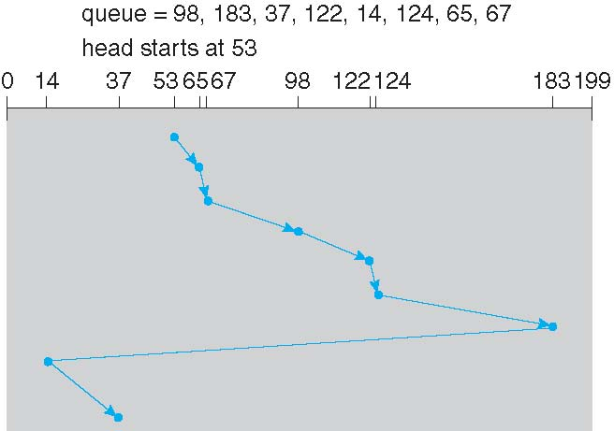
C-LOOK (Cont.)
130 = 183-53
169 = 183-14
23 = 37-14
Total Head Moves = 130 + 169 + 23 = 322

Slide 28
Selecting a Disk-Scheduling Algorithm
SSTF is common and has a natural appeal
SCAN and C-SCAN perform better for systems that place a heavy load on the disk
Less starvation
Performance depends on the number and types of requests
Requests for disk service can be influenced by the file-allocation method
And metadata layout
The disk-scheduling algorithm should be written as a separate module of the operating system, allowing it to be replaced with a different algorithm if necessary
Either SSTF or LOOK is a reasonable choice for the default algorithm
What about rotational latency?
Difficult for OS to calculate
How does disk-based queueing effect OS queue ordering efforts?

Slide 29
Allocation Methods
Objective
How to allocate blocks for a file?
Allocation Methods
Contiguous allocation
Linked allocation
File Allocation Table (FAT)
Indexed allocation
Combined (indexed) scheme: Unix file system
Read “Allocation Methods” Section
Notes:
Video Module 8-05

Slide 30
Allocation Methods - Contiguous
An allocation method refers to how disk blocks are allocated for files:
Contiguous allocation – each file occupies set of contiguous blocks
Best performance in most cases
Simple – only starting location (block #) and length (number of blocks) are required
Problems include finding space for file, knowing file size, external fragmentation, need for compaction off-line (downtime) or on-line
Is this allocation method good for sequential and random access?

Slide 31
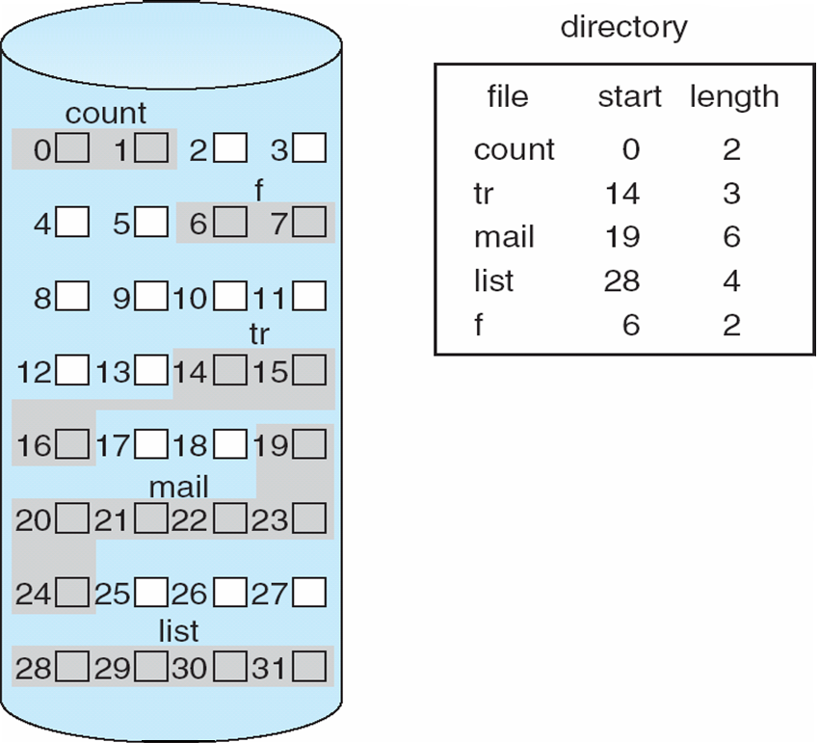
Contiguous Allocation
Mapping from logical to physical (LA is Logical Address)
Q (quotient
LA/512
R (remainder)
Block to be accessed = Q + starting address
Displacement into block = R

Slide 32
Extent-Based Systems
Many newer file systems (i.e., Veritas File System) use a modified contiguous allocation scheme
Extent-based file systems allocate disk blocks in extents
An extent is a contiguous block of disks
Extents are allocated for file allocation
A file consists of one or more extents

Slide 33
Allocation Methods - Linked
Linked allocation – each file a linked list of blocks
File ends at nil pointer
No external fragmentation
Each block contains pointer to next block
No compaction, external fragmentation
Improve efficiency by clustering blocks into groups but increases internal fragmentation
Reliability can be a problem
Locating a block can take many I/Os and disk seeks
Is this allocation method good for sequential and random access?

Slide 34
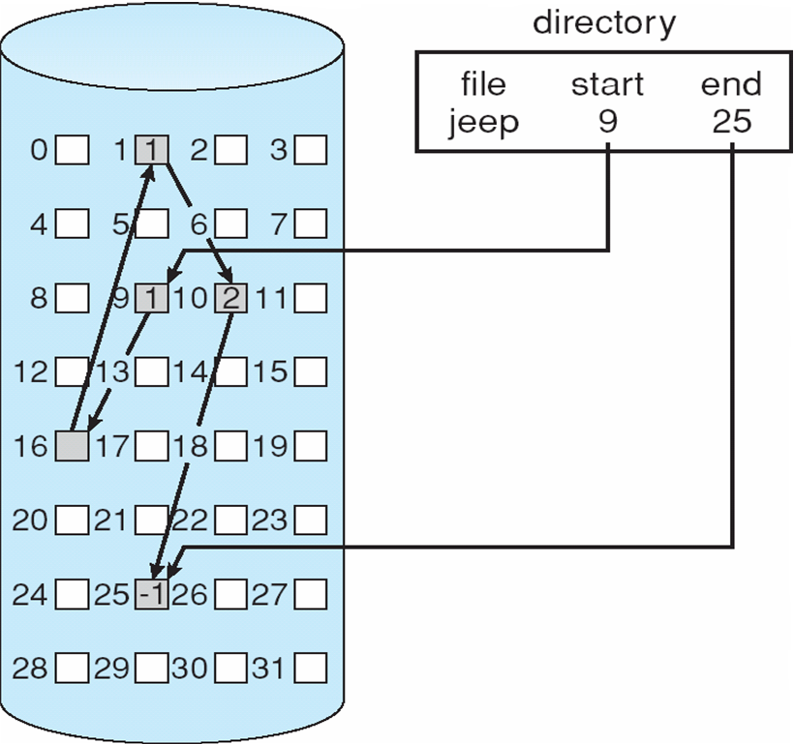
Linked Allocation

Slide 35
Linked Allocation
Each file is a linked list of disk blocks: blocks may be scattered anywhere on the disk
block =
pointer to next
Data (508 bytes)
Mapping from logical to physical (LA is Logical Address)
Q
LA/508
R
Block to be accessed is the Qth block in the linked chain of blocks representing the file.
Key issue: each block must be read until block found
Displacement into block = R + 4 (jump the pointer)

Slide 36
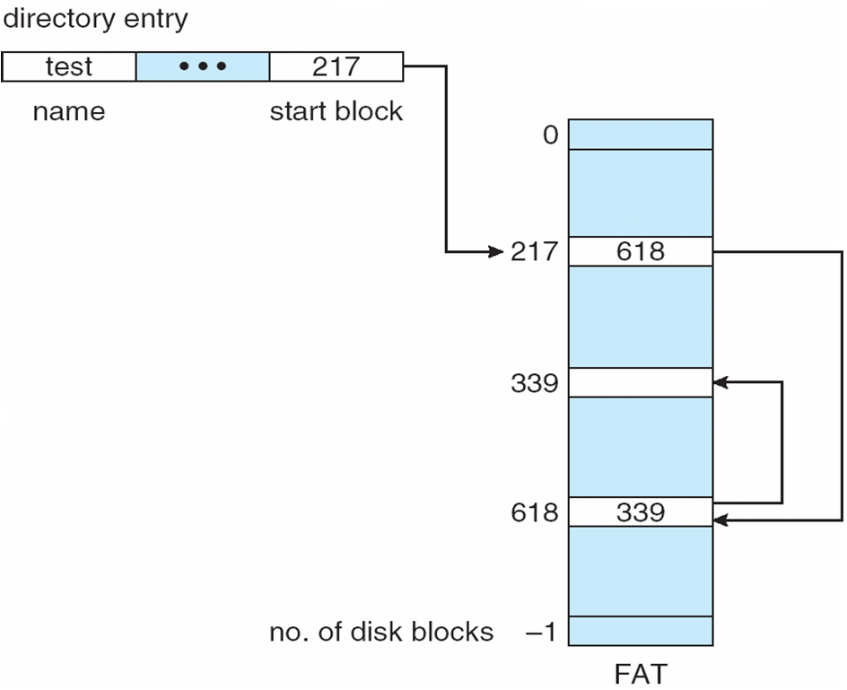
File Allocation Table (FAT)– (Linked Allocation Variation)
FAT (File Allocation Table) variation
Beginning of volume has table, indexed by block number
Much like a linked list, but faster on disk and cacheable
New block allocation simple

Slide 37
File Allocation Table (FAT)– (Linked Allocation Variation)
FAT (File Allocation Table) variation
Beginning of volume has table, indexed by block number
Much like a linked list, but faster on disk and cacheable
New block allocation simple

Slide 38
Allocation Methods
Objective
How to allocate blocks for a file?
Allocation Methods
Contiguous allocation
Linked allocation
File Allocation Table (FAT)
Indexed allocation
Combined (indexed) scheme: Unix file system
Read Section “Allocation Methods” Section
Notes:
Video Module 8-06

Slide 39
Allocation Methods - Indexed
Indexed allocation
Each file has its own index block(s) of pointers to its data blocks
Logical view

Slide 40
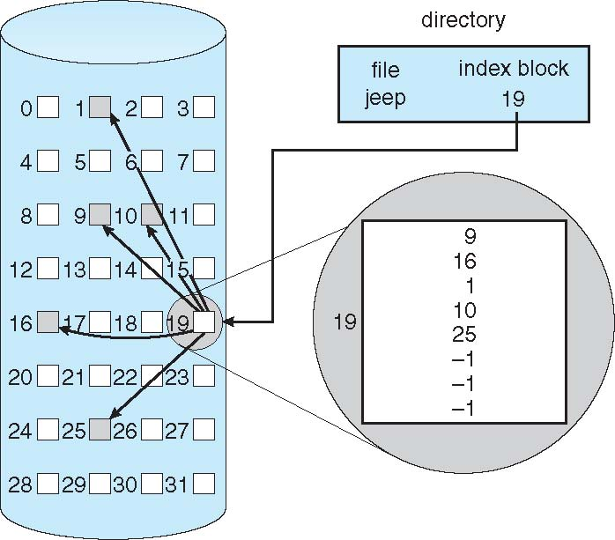
Example of Indexed Allocation

Slide 41
Indexed Allocation (Cont.)
Need index table
Random access
Dynamic access without external fragmentation, but have overhead of index block
Is this allocation method good for sequential and random access?
Mapping from logical to physical
Example: block size = 512 bytes, File maximum size : 64 KB. Index table takes one block.
A 64KB contains 64KB/512 blocks = 2¹⁶/2⁹ blocks = 2⁷ blocks = 128 blocks
Each block pointer takes 4 bytes
You need 4*128 bytes to store 128 pointers = 512 bytes = 1 block
Q
LA/512
R
Q = displacement into index table
R = displacement into block

Slide 42
Indexed Allocation
Simple indexed allocation
Multilevel indexed allocation
Combined scheme (direct and multilevel): Unix file system

Slide 43
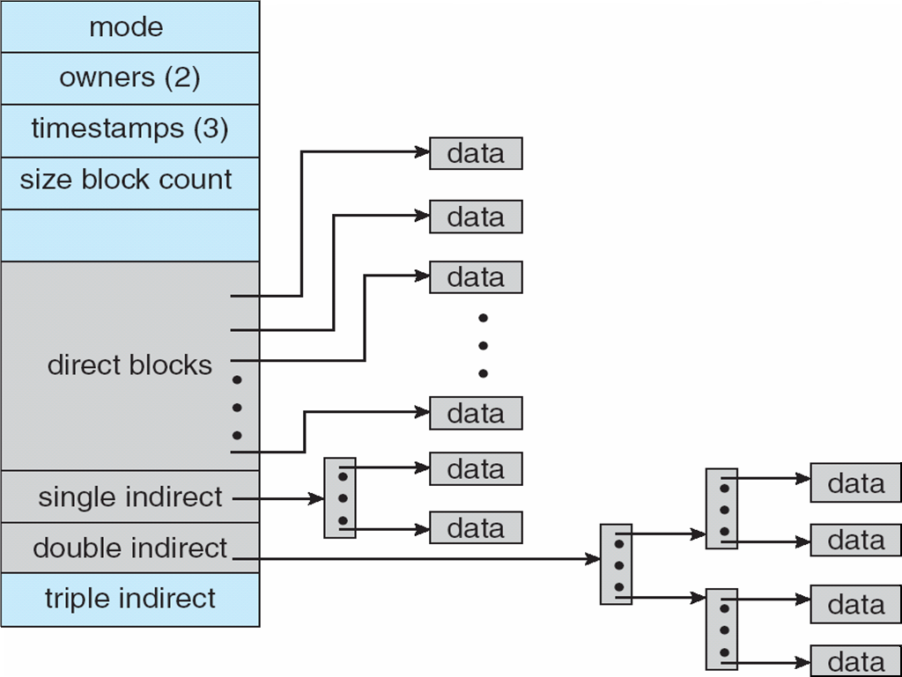
Combined Scheme: UNIX UFS
4K bytes per block, 32-bit addresses
More index blocks than can be addressed with 32-bit file pointer

Slide 44
Performance
Best method depends on file access type (random or sequential)
Contiguous great for sequential and random
Linked good for sequential, not random
Declare access type at creation -> select either contiguous or linked
Indexed more complex
Single block access could require 2 index block reads then data block read
Clustering can help improve throughput, reduce CPU overhead

Slide 45
Wrap Up
Review the mass storage (disk) structure and issues.
Platters, arm, head…
Relationship structure and access time
seek time, average latency
Learn and understand the disk scheduling to hierarchical memory.
FCFS
SSTF
SCAN, C-SCAN
LOOK, C-LOOK
Describe, discuss and evaluate the disk space allocations methods.
Contiguous
Linked
Indexed
Simple
Multilevel
Combined
Notes:
Video Module 8-07

