Slide 1
Virtual Memory
Notes:
Video Module 7-01

Slide 2

Overview
Objectives
Review the objectives, constraints, and “helpers” of Memory Management.
Learn and understand the design guiding principles to hierarchical memory.
Describe, discuss and evaluate the virtual memory (Demand Paging).
Learn and understand Page Replacement Policies.
Learn and Understand Frame Allocation Policies.
Requirements
Basics from Computer Organization principles (COMP 3350 or equivalent)
Read Sections 1.8.3, 8.1 through 8.6.
Section 8.3 is not covered by this presentation

Slide 3
Memory Management Objectives, Constraints, and “Helpers”
Objectives
Offer what a user/programmer wants
a flat, fast, inexpensive, and infinite space starting at Address 0
Maximize the number of processes in the memory
Minimize the access time to memory
Constraints
Faster memory costs much more
“Helpers”
Only a small part of a program (code, data, and stack) is needed in memory
Temporal locality
Spatial locality
(re) Read Section 1.8.3

Slide 4
Objectives
The user/programmer wants fast, inexpensive, unbounded, convenient memory space;
convenience of a flat and simple space is offered using the logical space (OS and memory management unit take care of the messy details and realities of the physical space)
fast : it would be easy if the user gave up inexpensive
inexpensive: it would be easy if the user can live with a slow system
unbounded: easy if the user gave up inexpensive
….... What to do?
The OS must keep the CPU busy→ must keep as many ready processes as possible in the system…. (need large memory)

Slide 5
Constraints : Faster Costs More
Static RAM (SRAM)
0.5ns – 2.5ns, $2000 – $5000 per GB
Dynamic RAM (DRAM)
50ns – 70ns, $20 – $75 per GB
Flash
25μs – 50μs, $0.40 – $1 per GB
Magnetic disk
5ms – 20ms, $0.20 – $2 per GB
50 to 100 more expensive

Slide 6
Helpers
Only a small part of a program (code, data, and stack) is needed in memory
At the extreme, we need only space for one instruction and its operands
Most (well designed) programs exhibit temporal and spatial locality:
Temporal locality: a referenced item will be soon referenced again
Spatial locality : neighbors of a recently referenced item are often also referenced right after
Conclusion : keep in the memory only a small part of a program, especially that part often used! If small…. costs less...
Then the memory could be PHYSICALLY ......

Slide 7
Hierarchical Memory
Build a memory such that:
the most used part of a program remains in a fast storage closest to the CPU
The closest storage does not have to be large because the CPU does not need the full program at once
(re) Read Section 1.8.3
Notes:
Video Module 7-02

Slide 8
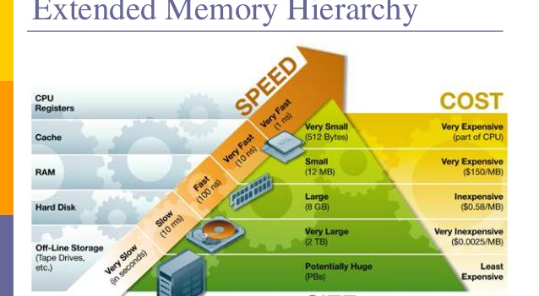
Hierarchical Memory

Slide 9
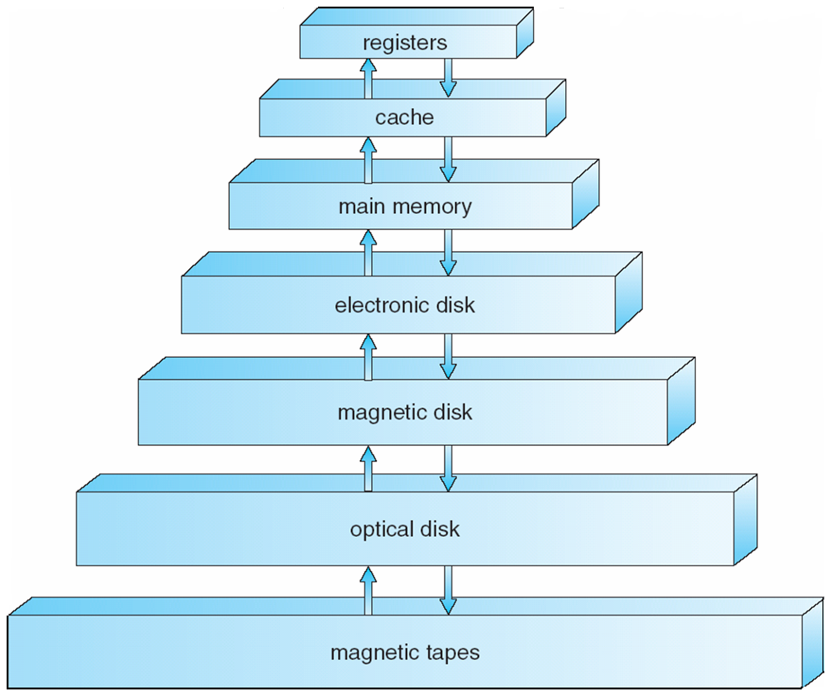
Memory System Hierarchy
Transfers governed by programmer/compiler
Transfers governed by hardware
Transfers governed by OS/User
Access Time
Cost per byte
Size
Disk

Slide 10
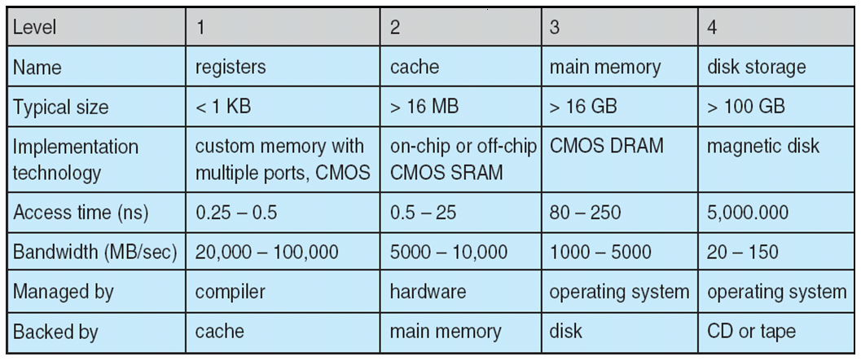
Performance of Various Levels of Storage
Movement between levels of storage hierarchy can be explicit or implicit
Price
?
?
?
?

Slide 11
Objective of Virtual Memory
ILLUSION: (achieved by the OS helped by the MMU)
Make the user/programmer believe that the physical space is flat and homogeneous (while it is hierarchical and implemented with heteroclite technologies)
Separation of user logical space from physical memory
Very large logical (virtual) memory
Efficient use of physical memory consisting of
the main memory and
the secondary storage secondary
Implementation
Demand paging: only bring in a page when it is demanded (data or instruction referenced)

Slide 12
Demand Paging
How does Demand Paging work?
What happens when a page in not in the main memory?
Answer: a page fault occurs?
How to handle a page fault?
Read Sections 8.2 Introduction and 8.2.1
Notes:
Video Module 7-03

Slide 13
On Demand Paging
0
1
2
3
4
5
A
0
1
2
3
4
5
v
D
1
B
E
0
1
2
3
F
B
i
A
A
C
3 v
D
i
C
C
F
E
i
F
0 v
Main
Memory
Page Table
Logical
Space
Secondary storage
What happens when we refer Page # 2?
If the main memory was always sufficiently large to accommodate the logical space
then we would stop here….
What happens when we refer Page # 1?

Slide 14
On Demand Paging
0
1
2
3
4
5
A
0
1
2
3
4
5
v
D
1
B
E
0
1
2
3
F
B
i
A
A
C
3 v
D
i
C
C
F
E
i
F
0 v
Main
Memory
Page Table
Logical
Space
Secondary storage
What happens when we refer Page # 2?
If the main memory was always sufficiently large to accommodate the logical space
then we would stop here….
What happens when we refer Page # 1?

Slide 15
Handling a Memory reference ( with potential Page Fault)
CPU generates a memory reference for data or instruction
Check the process’ page table to see if the page is in main memory.
If it is in the main memory, access it as usual
If it is not, a page fault occurs, interrupt to OS (trap)
a) Suspend (not block) the (offending) process
b) Locate a free frame in memory (how?)
c) Locate the missing page from disk.
5. Bring in the missing page into memory (meanwhile, other
processes may use the CPU, How/Why/Who?)
6. Update page table
a) Reset the process’s PC so that we restart with the offending instruction.
b) Change the status of process from “suspended” to “ready”
Hardware

Slide 16
Some Issues…
Is this time efficient?
- Here we go again, the system checks first in the main memory and may have to check in the secondary storage…
How do we find a free frame in the main memory when none is left?
- We may have to swap out another page? How to select it (victim)?
How to restart a offending instruction that already modified other addresses?
Some solutions:
Determine if there would be a page fault before any modification occurs
Hold results temporarily until it is certain there is no page fault. Then, proceed with modification.

Slide 17
Time Performance of Demand Paging (Effective Access Time)
What is the effective (average) access time taken by a memory access ?
Let us derive it:
Ma : (average) time for a memory access without page fault (e.g. ma = 100 ns)
Page fault penalty time:(average) time taken by a page fault:
O.S. service time when a page fault is detected 100 μs
Time by disk to read the page into memory 25 milliseconds
Time to restart the process (around 100 μs)
We can approximate the total of page fault time as about 25,000,000 ns
Let p be the page fault rate: probability that a page fault occurs when a memory reference
is made
Effective Access Time = (1-p)*ma + p*page fault penalty time
= ma – p.ma + p*page fault time
= 0.100 – 0.1p + 25,000 p (μs)
≈ 0.100 + 25,000 p (μs)

Slide 18
Time Performance of Demand Paging (Effective Access Time)
Effective Access Time ≈ 0.100 + 25,000 p (μs)
As software OS designers: what is our power to reduce the effective access time?
The 0.100 constant is the access time to the main memory (Can we do anything?)
The 25,000 comes from the access time to the disk…. (Can we do anything?)
Answer: the only parameter in our reach isp: the page fault rate p.
e.a.t (μs)
25
0.125
250 slower
0.100
0
10⁻⁶
10⁻³
p

Slide 19
Policies Affecting The Page Fault Rate p
Main Memory Management:
Memory allocation: How many frames to allocate to each process?
How do we manage the process pool of frames when a page fault occurs? In other words, hwo do we choose a page to swap out when a page fault occurs and we must bring in a page?
This is called page replacement.

Slide 20
Page Replacement Policies
What is page replacement?
Page replacement policies:
First In First Out (FIFO)
Optimal
Least Recently Used (LRU)
LRU-approximation implementation
Read Section 8.4.1-8.4.3
Notes:
Video Module 7-04

Slide 21
Page Replacement
Page replacement is the process to select a page to replace in order to free a frame.
After a page fault, the OS will locate a free frame as follows:
if a frame is available, then pick it
otherwise, find a page to swap out: page replacement consists of selecting a ‘victim’.
Consequences:
If the victim is referenced just after being replaced, this makes the page fault worse…
Replacement policies:
FIFO: First In First Out
OPTIMAL
LRU: Least Recently Used:

Slide 22
FIFO Page Replacement Policy
FIFO (First In First Out)
replace the page which came earliest
Pages
Referenced
7
0
1
2
0
3
0
4
2
3
-
7
7
7
2
2
2
2
4
4
4
Memory
State
-
-
0
0
0
0
3
3
3
2
2
-
-
-
1
1
1
1
0
0
0
3
Page
Fault ?
y
y
y
y
n
y
y
y
y
y
Page Fault Rate = Number of page faults/Number of references = 9/10 = 0.9

Slide 23
Optimal Page Replacement Algorithm
FIFO does not work well:
FIFO does not consider the pattern of the reference. FIFO is blind to the pattern access..
The Optimal algorithm (OPT)
Replace the page that will not be used for the longest time (psychic !!!)
OPT looks when the page is to be used.

Slide 24
OPT vs FIFO
pfr= 6/10
7
7
7
2
2
2
2
2
2
2
O
P
T
F
I
F
O
-
0
0
0
0
0
0
4
4
4
-
-
1
1
1
3
3
3
3
3
y
y
y
y
n
y
n
y
n
n
7
0
1
2
0
3
0
4
2
3
7
7
7
2
2
2
2
4
4
4
-
0
0
0
0
3
3
3
2
2
pfr= 9/10
-
-
1
1
1
1
0
0
0
3
y
y
y
y
n
y
y
y
y
y
Optimal (OPT) delivers the minimal page fault rate
But, OPTcannot be implemented as future references cannot be predicted with certainty
What to do?
Use the fact that programs, in general, exhibits a good temporal locality
Recall: temporal locality means that an item just referenced will referenced soon.
This rule translates into: replace the Least Recently Used (LRU) page in the past.

Slide 25
Least Recently Used
What is LRU?
LRU approximates OPTIMAL policy
Implementation of strict LRU is cumbersome…
Look at approximate implementation of LRU
Read Sections 8.4.4-8.4.5
Notes:
Video Module 7-05

Slide 26
Least Recently Used (LRU)
OPT needs the knowledge of future references
Reasonable Assumption:
If good temporal locality then a page recently used is likely to be used in the near future.
A page unused recently is unlikely to be used in the near future.
This assumption leads to a good solution approximation
The Least Recently Used Algorithm (LRU):
Replace the page that has not been used for the longest period.

Slide 27
OPT versus LRU
pfr= 6/10
7
7
7
2
2
2
2
2
2
2
O
P
T
L
R
U
-
0
0
0
0
0
0
4
4
4
-
-
1
1
1
3
3
3
3
3
y
y
y
y
n
y
n
y
n
n
7
0
1
2
0
3
0
4
2
3
7
7
7
2
2
2
2
4
4
4
-
0
0
0
0
0
0
0
0
3
pfr= 8/10
-
-
1
1
1
3
3
3
2
2
y
y
y
y
n
y
n
y
y
y
Optimal (OPT) delivers the minimal page fault rate
But, OPTcannot be implemented as future references cannot be predicted with certainty
What to do?
Use the fact that programs, in general, exhibits a good temporal locality
Recall: temporal locality means that an item just referenced will referenced soon.
This rule translates into: replace the Least Recently Used (LRU) page in the past.

Slide 28
Implementations of LRU
Implementation I: Time-of-use register in every entry of page table.
Implementation II: Stack of page numbers
Reference string :
7 0 7 1 0 1 2 1 2 7 1 2
These two implementations are not easy in hardware
What to do?
Approximate!
Page i
Frame base address
Time-of-use
2
1
0
7
4
7
2
1
0
4

Slide 29
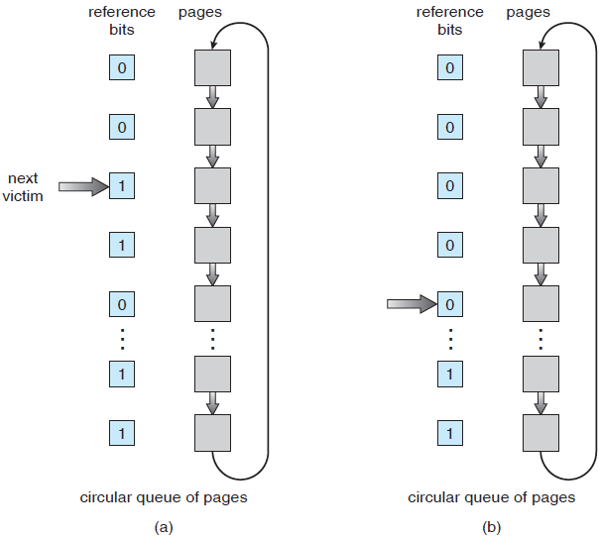
Approximating LRU
Second-chance (clock) algorithm
Each entry in page table has a reference bit.
Whenever a page is referenced, the reference bit is set.
Whenever a page is selected as a victim, we use this:
if reference bit == 1
then set reference bit to 0 and pointe to next as a potential victim
else replace page and pointe to the next page as a potential victim
Replaced

Slide 30
Allocation Policies
How many frames should be allocated to a process?
Minimum and maximum allocation
Warning: Belady’s Anomaly
Static allocation
What is the optimal degree of multiprogramming?
Trashing
Dynamic Allocation
Read Sections 8.5 and 8.6
Notes:
Video Module 7-06

Slide 31
Allocation Algorithms
Problem : determine how many frames to allocate to a process
Let M =total number of frames in the physical memory
Di = the number of frames allocated to Process Pi
Si = the number of pages in the virtual memory of Pi
Minimum number of frames:
Di : maximum number of frames involved in an instruction. (CPU dependent)
Maximum number of frames:
Di ≤ min(M, Si)

Slide 32
Comparing Allocating 3 versus 4 frames
FIFO : replace the page which comes earliest
pages allocated to a process =3
Page
Ref.
1
2
3
4
1
2
5
1
2
3
4
5
1
1
1
4
4
4
5
5
5
5
5
5
Me.
State
-
2
2
2
1
1
1
1
1
3
3
3
-
-
3
3
3
2
2
2
2
2
4
4
Page
Fault ?
y
y
y
y
y
y
y
n
n
y
y
n
Page fault rate = 9/12

Slide 33
Page Replacement Algorithms
FIFO : replace the page which comes earliest
pages allocated to a process =4
Page
Ref.
1
2
3
4
1
2
5
1
2
3
4
5
1
1
1
1
1
1
5
5
5
5
4
4
Me.
State
-
2
2
2
2
2
2
1
1
1
1
5
-
-
3
3
3
3
3
3
2
2
2
2
-
-
-
4
4
4
4
4
4
3
3
3
Page
Fault ?
y
y
y
y
n
n
y
n y
n y
y
y
n y
Page fault rate = 10/12 !!! While the number of pages increased, the p.f.r
increases as well ! This is called Belady’s anomaly !

Slide 34
Static and Dynamic Allocation Policies
Static allocation
What is the optimal degree of multiprogramming?
Trashing
Dynamic Allocation
Read Sections 8.5 and 8.6
Notes:
Video Module 7-07

Slide 35
Static Allocation Algorithm
Equal algorithm : Di = M/n where n is the number of processes.
Proportional algorithm
Di = M *Si/S, where S = Sum Si

Slide 36
Determining the Degree of Multiprogramming
Monitoring the CPU utilization
If CPU utilization is too low, increase n (degree of multiprograming)
If CPU utilization is too high, reduce n.’
Problem ?
Will increasing n always result in increasing CPU utilization ?
A process is trashing if it is spending more time paging than executing
A system is trashing if increasing the degree of multi-programming reduces CPU utilization.
CPU
Use
Trashing !!!
Degree of Multi-Programming

Slide 37
Prevention of Trashing
Allocate sufficient number of frames to each process in memory.
Increasing the degree of multi-programming only if the current processes have had enough frames and CPU utilization is still low.

Slide 38
How many frames are enough to a process ?
Working set rationale: based on temporal locality : the most recent accessed frames will be used again
Working set definition: The working set of a process is the set of most recent Δ page references. It varies as the process executes.
….2 6 1 5 7 7 7 7 5 1 6 2 3 4 1 2 3 4 4 4 4 3 4 3 4 4 4 1 3 2 3 4 4 4 3..
Δ
Δ
t2
t1
WS(t1) ={1,2,5,6,7}
WS(t2)={3,4}

Slide 39
Dynamic Allocation Algorithm
Di = Wsi(t, )
If we can select Δ properly and the process has locality behavior, then keeping Wsi pages for the process will prevent its trashing.

Slide 40
Wrap Up
Review the objectives, constraints, and “helpers” of Memory Management.
Learn and understand the design guiding principles to hierarchical memory.
Describe, discuss and evaluate the virtual memory (Demand Paging).
Learn and understand Page Replacement Policies.
Learn and Understand Frame Allocation Policies.
Responsible for reading Sections 1.8.3, 8.1 through 8.6.
Notes:
Video Module 7-08

