Slide 1
COMP 3500 Introduction to Operating Systems Race Condition--2
Dr. Xuechao Li
Auburn University

Slide 2
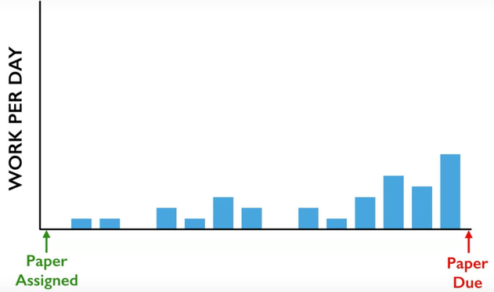




Slide 3
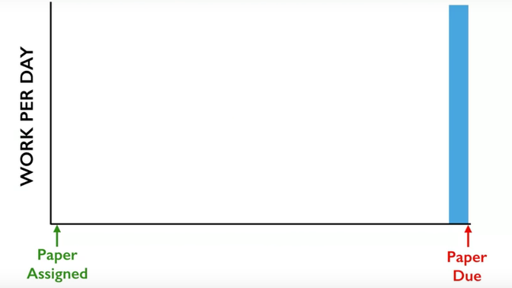



Slide 4
Recap: Three Terms in Concurrent Computing
Race Condition
Critical Section
Mutual Exclusion
Problem
Programming
Solution

Slide 5
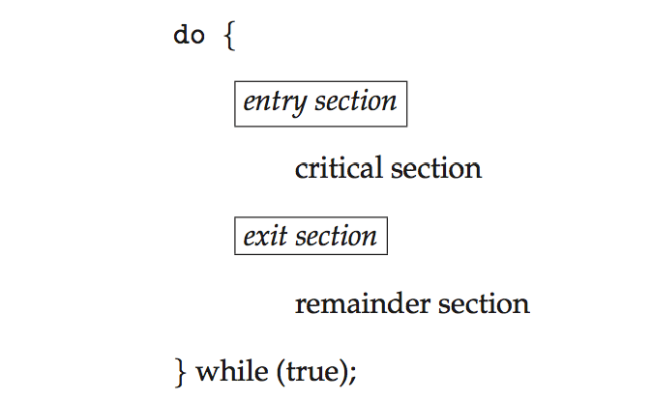
Recap: General Structure of a Process P_{i}
Mutual Exclusion
Solution

Slide 6
Exercise Which variable is a shared one?
Process i
do {
while (turn == j);
critical section;
turn = j;
remainder section
} while (true);
Process j
do {
while (turn == i);
critical section;
turn = i;
remainder section
} while (true);

Slide 7
A. Process i is not in the critical section. B. Process j is not in the critical section. C. It is Process i’s turn now. D. It is Process j’s turn now.
Exercise What does Flag[j] = false mean?
do {
flag[i] = true;
turn = j;
while (flag[j] && turn = = j);
critical section
flag[i] = false;
remainder section
} while (true);
do {
flag[j] = true;
turn = i;
while (flag[i] && turn = = i);
critical section
flag[j] = false;
remainder section
} while (true);

Slide 8
A. The turn should be switched now. B. It is another process’s turn now. C. It is Process i’s turn now. D. It is Process j’s turn now.
Exercise The following statements explain the meaning of turn = j . Which statement is incorrect?
do {
flag[i] = true;
turn = j;
while (flag[j] && turn = = j);
critical section
flag[i] = false;
remainder section
} while (true);
do {
flag[j] = true;
turn = i;
while (flag[i] && turn = = i);
critical section
flag[j] = false;
remainder section
} while (true);

Slide 9
Exercise What is NOT a problem with interrupt disabling?
The efficiency of execution could be noticeably degraded.
This approach will not work in a multiprocessor architecture.
This approach can’t enforce mutual exclusion.
This approach can’t be applied to real-time systems.
Disadvantages
the efficiency of
execution could be
noticeably degraded
this approach will not
work in a
multiprocessor
architecture
Interrupt Disabling
uniprocessor system
disabling interrupts
guarantees mutual
exclusion

Slide 10
Solution to Critical-section Problem Using Locks
do {
acquire lock
critical section
release lock
remainder section
} while (TRUE);

Slide 11
The test_and_set Instruction
Exercise What does this function do?
boolean test_and_set (boolean *target)
{
boolean rv = *target;
*target = TRUE;
return rv;
}
Executed atomically
Returns the original value of passed parameter
Set the new value of passed parameter to “TRUE”.

Slide 12
How to use test_and_set()?
Shared Boolean variable lock, initialized to FALSE
do { while (test_and_set(&lock))
; /* do nothing */
/* critical section */
lock = false;
/* remainder section */
} while (true);
TRUE means it is locked!
Who locks this section?
Unlocked it!

Slide 13
The compare_and_swap Instruction
int compare_and_swap(int *value, int expected, int new_value) {
int temp = *value;
if (*value == expected)
*value = new_value;
return temp;
}
Executed atomically
Returns the original value of passed parameter “value”
Set the variable “value” the value of the passed parameter “new_value” but only if “value” ==“expected”. That is, the swap takes place only under this condition.

Slide 14
How to use compare_and_swap?
Shared integer “lock” initialized to 0;
do { while (compare_and_swap(&lock, 0, 1) != 0 )
; /* do nothing */
/* critical section */
lock = 0;
/* remainder section */
} while (true);
It is locked!
Who locks this section?
Unlocked it!

Slide 15
Bounded-waiting Mutual Exclusion
do { waiting[i] = true; key = true; while (waiting[i] && key)
key = test_and_set(&lock);
waiting[i] = false;
/* critical section */
j = (i + 1) % n;
while ((j != i) && !waiting[j])
j = (j + 1) % n;
if (j == i)
lock = false;
else
waiting[j] = false;
/* remainder section */
} while (true);
i is waiting now
i waits and locked
Unlocked but what?
i is not waiting
Nobody is waiting
Find the next waiting process
Let j enter. How?
Notes:
You have n processes, process i is currently executing, when it enters the critical section, it sets its waiting to false.
Now, what happens when process i has finished ? Process i will look for an index j (process j) that is waiting to run in critical section. In other words, we are looking for a process that is waiting to enter the critical section that is different from the current process that ran in critical section.
if (i==j), then no such process exists, we set lock to false. Otherwise, we set the process that is waiting to run and prevent starvation. And this way you satisfy Bounded Waiting.
This is achieved because you do a circular search, you first check processes
i+1, i+2, .... n, 0, 1, ... ,(i-1)

