Slide 1
COMP 3500 Introduction to Operating Systems Chapter8: Memory Management
Dr. Xuechao Li
Auburn University
Notes:
Fall’18
20 Min: Slides 1-11
Next lecture: Slides 12-23
Fall’16
3 Min: Careers and Skills
25 Min: job scheduling excise
20 Min: 10b2-Project 4-3 Adding System Calls
5 Min: slides 1-5
Fall’15
25 Min: job scheduling excise
25 Min: slides 1-23
Learning objectives of memory management:
To provide a detailed description of various ways of organizing memory hardware
To discuss various memory-management techniques, including paging and segmentation
To provide a detailed description of the Intel Pentium, which supports both pure segmentation and segmentation with paging

Slide 2
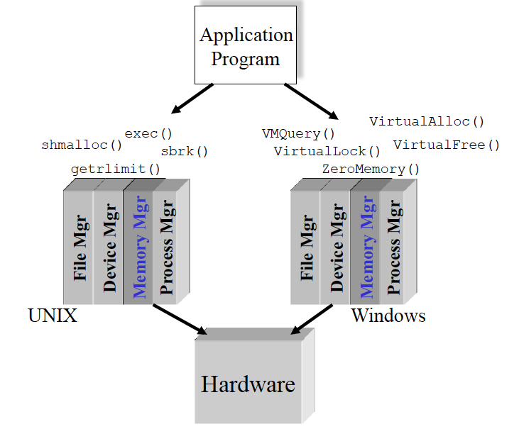
The External View of the Memory Manager
Slide courtesy of Dr. Gary Nutt
Notes:
While surveying the various mechanisms and policies associated with memory management, it is helpful to keep in mind the requirements that memory management is intended to satisfy. These requirements include the following:
• Relocation
• Protection
• Sharing
• Logical organization
• Physical organization

Slide 3
Basic Memory Hierarchy Please rank and compare registers, primary memory, and disks in terms of capacity and speed.
CPU Registers
Less Frequently Used Information
Primary Memory
(Executable Memory)
e.g. RAM
Faster access
Larger storage
More Frequently Used Information
Secondary Memory
e.g. Disk or Tape
Speed?
Capacity?
Slide courtesy of Dr. Gary Nutt
Notes:
While surveying the various mechanisms and policies associated with memory management, it is helpful to keep in mind the requirements that memory management is intended to satisfy. These requirements include the following:
• Relocation
• Protection
• Sharing
• Logical organization
• Physical organization

Slide 4
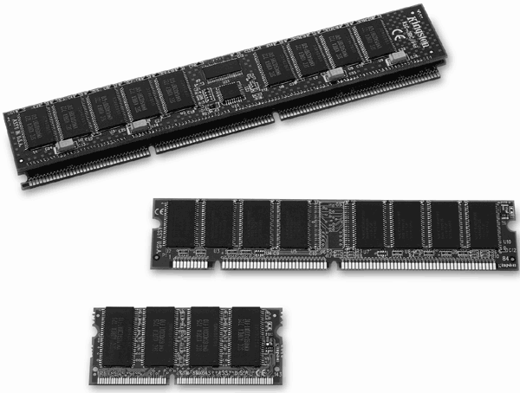
Memory Management Requirements List two or three functionalities of the memory management
Relocation
Protection
Sharing
Logical organization
Physical organization
Notes:
While surveying the various mechanisms and policies associated with memory management, it is helpful to keep in mind the requirements that memory management is intended to satisfy. These requirements include the following:
• Relocation
• Protection
• Sharing
• Logical organization
• Physical organization

Slide 5
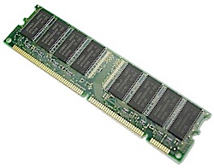
Address Space vs. Primary Memory
Hardware Primary Memory
Process Address Space
Mapped to object
other than memory
Breaking Bad is the greatest TV drama of all-time
Notes:
In a multiprogramming system, the available main memory is generally shared among a number of processes. Typically, it is not possible for the programmer to know in advance which other programs will be resident in main memory at the time of execution of his or her program. In addition, we would like to be able to swap active processes in and out of main memory to maximize processor utilization by providing a large pool of ready processes to execute. Once a program is swapped out to disk, it would be quite limiting to specify that when it is next swapped back in, it must be placed in the same main memory region as before. Instead, we may need to relocate the process to a different area of memory.
Breaking Mad

Slide 6
Creating an Executable Program
Source
code
Library
code
Other
objects
Secondary
memory
C
Reloc
Object
code
Link
Edit
Primary
memory
Compile time: Translate elements
Link time: Combine elements
Loader
Process
address
space
Load time:
Allocate primary memory
Adjust addresses in address space
Copy address space from secondary to primary memory
Notes:
Dynamic Linking
Linking postponed until execution time
Small piece of code, stub, used to locate the appropriate memory-resident library routine
Stub replaces itself with the address of the routine, and executes the routine
Operating system needed to check if routine is in processes’ memory address
Dynamic linking is particularly useful for libraries

Slide 7
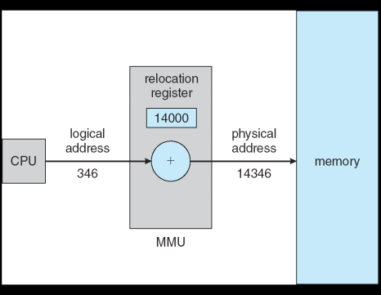
Dynamic Relocation using a Relocation Register
Hardware device that maps virtual to physical address
The value in the relocation register is added to every address generated by a user process at the time it is sent to memory
The user program deals with logical addresses; it never sees the real physical addresses

Slide 8
Static Memory Partitioning
Unused
Operating
System
In Use
Used in several variations in some now-obsolete operating systems
Does not involve virtual memory
Process 3
p_{i}
Process 0
Issue:
Need a mechanism/policy for loading p_{i}’s address space into primary memory
Process 2
Process 1
Notes:
The principal operation of memory management is to bring processes into main memory for execution by the processor. In almost all modern multiprogramming systems, this involves a sophisticated scheme known as virtual memory. Virtual memory is, in turn, based on the use of one or both of two basic techniques: segmentation and paging. Before we can look at these virtual memory techniques, we must prepare the ground by looking at simpler techniques that do not involve virtual memory ( Table 7.2 summarizes all the techniques examined in this chapter and the next). One of these techniques, partitioning, has been used in several variations in some now-obsolete operating systems. The other two techniques, simple paging and simple segmentation, are not used by themselves. However, it will clarify the discussion of virtual memory if we look first at these two techniques in the absence of virtual memory considerations.

Slide 9
Static Memory Allocation
OS
OS
OS
OS
process 5
process 5
process 5
process 5
process 9
process 9
process 8
process 10
process 2
process 2
process 2
process 2
Hole – block of available memory; holes of various size are scattered throughout memory
When a process arrives, it is allocated memory from a hole large enough to accommodate it
Operating system maintains information about: a) allocated partitions b) free partitions (hole)

Slide 10
Fixed-Partition Memory Mechanism
Operating
System
p_{i} needs n_{i} units
Region 0
N₀
n_{i}
p_{i}
Region 1
N₁
Region 2
N₂
Region 3
N₃

Slide 11
Fixed-Partition Memory Mechanism-1
Best fit: The allocator places a process in the smallest block of unallocated memory in which it will fit.
Notes:
There are two difficulties with the use of equal-size fixed partitions:
• A program may be too big to fit into a partition. In this case, the programmer must design the program with the use of overlays so that only a portion of the program need be in main memory at any one time. When a module is needed that is not present, the user’s program must load that module into the program’s partition, overlaying whatever programs or data are there.
• Main memory utilization is extremely inefficient. Any program, no matter how small, occupies an entire partition. In our example, there may be a program whose length is less than 2 Mbytes; yet it occupies an 8-Mbyte partition whenever it is swapped in. This phenomenon, in which there is wasted space internal to a partition due to the fact that the block of data loaded is smaller than the partition, is referred to as internal fragmentation .

Slide 12
Fixed-Partition Memory Mechanism-2
First fit: There may be many holes in the memory, so the operating system, to reduce the amount of time it spends analyzing the available spaces, begins at the start of primary memory and allocates memory from the first hole it encounters large enough to satisfy the request.
Notes:
There are two difficulties with the use of equal-size fixed partitions:
• A program may be too big to fit into a partition. In this case, the programmer must design the program with the use of overlays so that only a portion of the program need be in main memory at any one time. When a module is needed that is not present, the user’s program must load that module into the program’s partition, overlaying whatever programs or data are there.
• Main memory utilization is extremely inefficient. Any program, no matter how small, occupies an entire partition. In our example, there may be a program whose length is less than 2 Mbytes; yet it occupies an 8-Mbyte partition whenever it is swapped in. This phenomenon, in which there is wasted space internal to a partition due to the fact that the block of data loaded is smaller than the partition, is referred to as internal fragmentation .

Slide 13
Fixed-Partition Memory Mechanism-3
Worst fit: The memory manager places a process in the largest block of unallocated memory available. The idea is that this placement will create the largest hold after the allocations, thus increasing the possibility that, compared to best fit, another process can use the remaining space.
Notes:
There are two difficulties with the use of equal-size fixed partitions:
• A program may be too big to fit into a partition. In this case, the programmer must design the program with the use of overlays so that only a portion of the program need be in main memory at any one time. When a module is needed that is not present, the user’s program must load that module into the program’s partition, overlaying whatever programs or data are there.
• Main memory utilization is extremely inefficient. Any program, no matter how small, occupies an entire partition. In our example, there may be a program whose length is less than 2 Mbytes; yet it occupies an 8-Mbyte partition whenever it is swapped in. This phenomenon, in which there is wasted space internal to a partition due to the fact that the block of data loaded is smaller than the partition, is referred to as internal fragmentation .

Slide 14
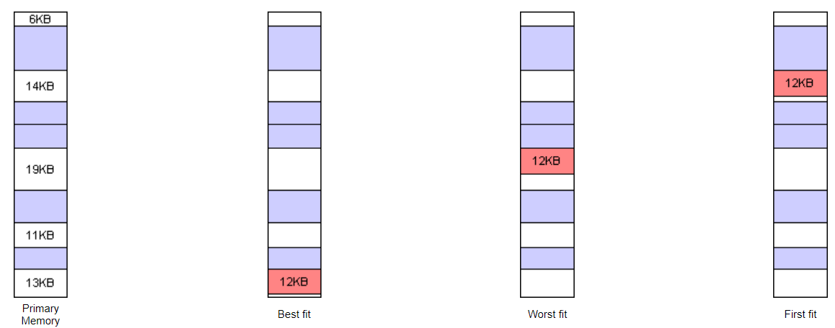
Fixed-Partition Memory Mechanism

Slide 15
Disadvantages
A program may be too big to fit in a partition
program needs to be designed with the use of overlays
Main memory utilization is inefficient
any program, regardless of size, occupies an entire partition
internal fragmentation
wasted space due to the block of data loaded being smaller than the partition
Notes:
There are two difficulties with the use of equal-size fixed partitions:
• A program may be too big to fit into a partition. In this case, the programmer must design the program with the use of overlays so that only a portion of the program need be in main memory at any one time. When a module is needed that is not present, the user’s program must load that module into the program’s partition, overlaying whatever programs or data are there.
• Main memory utilization is extremely inefficient. Any program, no matter how small, occupies an entire partition. In our example, there may be a program whose length is less than 2 Mbytes; yet it occupies an 8-Mbyte partition whenever it is swapped in. This phenomenon, in which there is wasted space internal to a partition due to the fact that the block of data loaded is smaller than the partition, is referred to as internal fragmentation .

Slide 16
Fragmentation
Fragmentation is a condition that occurs when we dynamically allocate the RAM to the processes, then many free memory blocks are available but they are not enough to load the process on RAM.

Slide 17
External Fragmentation
External fragmentation--available memory is broken up into lots of little pieces, none of which is big enough to satisfy the next memory requirement, although the sum total could.

Slide 18
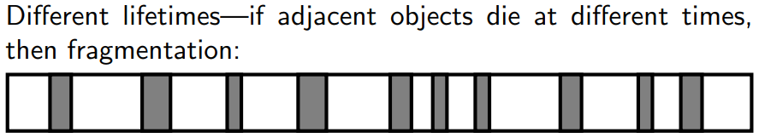
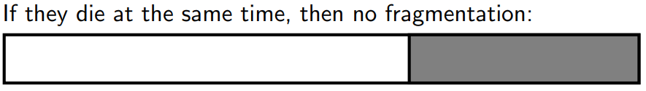
Internal Fragmentation
Internal fragmentation--occurs when fixed sized memory blocks are available and a process gets a block that is too much larger than the storage requirement of a process.(worst fit)

Slide 19
Paging
Partition memory into equal fixed-size chunks that are relatively small
Process is also divided into small fixed-size chunks of the same size
Pages
chunks of a process
Frames
available chunks of memory
Notes:
Both unequal fixed-size and variable-size partitions are inefficient in the use of memory; the former results in internal fragmentation, the latter in external fragmentation. Suppose, however, that main memory is partitioned into equal fixed-size chunks that are relatively small, and that each process is also divided into small fixed-size chunks of the same size. Then the chunks of a process, known as pages , could be assigned to available chunks of memory, known as frames , or page frames. We show in this section that the wasted space in memory for each process is due to internal fragmentation consisting of only a fraction of the last page of a process. There is no external fragmentation.

Slide 20
Paging
Address generated by CPU is divided into:
Page number (p) – used as an index into a page table which contains base address of each page in physical memory
Page offset (d) – combined with base address to define the physical memory address that is sent to the memory unit
For given logical address space 2^{m} and page size 2^{n}
Notes:
Both unequal fixed-size and variable-size partitions are inefficient in the use of memory; the former results in internal fragmentation, the latter in external fragmentation. Suppose, however, that main memory is partitioned into equal fixed-size chunks that are relatively small, and that each process is also divided into small fixed-size chunks of the same size. Then the chunks of a process, known as pages , could be assigned to available chunks of memory, known as frames , or page frames. We show in this section that the wasted space in memory for each process is due to internal fragmentation consisting of only a fraction of the last page of a process. There is no external fragmentation.

Slide 21

Paging
Notes:
Both unequal fixed-size and variable-size partitions are inefficient in the use of memory; the former results in internal fragmentation, the latter in external fragmentation. Suppose, however, that main memory is partitioned into equal fixed-size chunks that are relatively small, and that each process is also divided into small fixed-size chunks of the same size. Then the chunks of a process, known as pages , could be assigned to available chunks of memory, known as frames , or page frames. We show in this section that the wasted space in memory for each process is due to internal fragmentation consisting of only a fraction of the last page of a process. There is no external fragmentation.

Slide 22

Paging
Notes:
Both unequal fixed-size and variable-size partitions are inefficient in the use of memory; the former results in internal fragmentation, the latter in external fragmentation. Suppose, however, that main memory is partitioned into equal fixed-size chunks that are relatively small, and that each process is also divided into small fixed-size chunks of the same size. Then the chunks of a process, known as pages , could be assigned to available chunks of memory, known as frames , or page frames. We show in this section that the wasted space in memory for each process is due to internal fragmentation consisting of only a fraction of the last page of a process. There is no external fragmentation.

Slide 23
Frame vs. Page vs. Segment
Memory Management Terms
Notes:
In a uniprogramming system, main memory is divided into two parts: one part
for the operating system (resident monitor, kernel) and other part for the program
currently being executed. In a multiprogramming system, the “user” part of
memory must be further subdivided to accommodate multiple processes. The task
of subdivision is carried out dynamically by the operating system and is known as
memory management .
Effective memory management is vital in a multiprogramming system. If only
a few processes are in memory, then for much of the time all of the processes will be
waiting for I/O (input/output) and the processor will be idle. Thus memory needs to
be allocated to ensure a reasonable supply of ready processes to consume available
processor time.
Table 7.1 introduces some key terms for our discussion.

