Slide 1
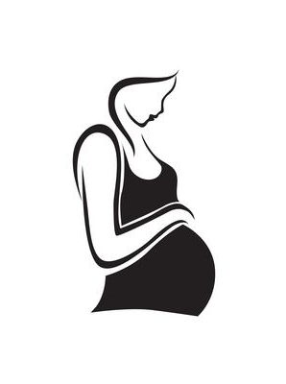

Week 10 (10/20): abortion
phil 1020 | Introduction to ethics sections 001, 004, 005, & 006 fall 2025
Notes:
Image source: https://www.vecteezy.com/free-vector/pregnant-silhouette

Slide 2
Objectives for today
Learn about the development of a human fetus during a pregnancy.
Define abortion.
Review some background information about abortion.
Understand the current state of the legality of abortion in the United States.
Evaluate Judith Jarvis Thomson’s argument that a woman’s right to control over her own body makes it morally permissible to abort a fetus.

Slide 3
Development of the human fetus
Conception happens when a sperm cell fertilizes an egg.
A fertilized egg is called a zygote. At first, the zygote is a single cell consisting of 23 chromosomes from the mother and 23 chromosomes from the father. It then undergoes rapid cell division, and eventually turns into a blastocyst (Shafer-Landau 2024: §11.1; Cleveland Clinic 2024).
After a few days, the blastocyst becomes implanted in the lining of the mother’s uterus. 3 weeks after conception, the blastocyst becomes an embryo.
An embryo is the growing offspring in the stage of pregnancy roughly 3-8 weeks after conception. The embryo is at first invisible to the naked eye. After 1 month, it is the size of a grain of rice.
Notes:
References:
Russ Shafer-Landau, Living Ethics: An Introduction with Readings, Third Edition (Oxford University Press, 2024).
Cleveland Clinic, “Fetal Development” (last reviewed 03/19/2024). https://my.clevelandclinic.org/health/articles/7247-fetal-development-stages-of-growth

Slide 4
Development of the human fetus
A fetus is the growing offspring in the stage of pregnancy from roughly 9-10 weeks after conception until birth.
At 9-10 weeks, a fetus is about 1 inch long and weighs 1/30th of an ounce. It has a heartbeat, and has begun to develop bones and limbs (Sullivan 2022).
By the end of the first trimester (a period of 3 months), all of a healthy fetus’s organs are present.
In discussions of abortion, it’s common to depart from strict medical usage, and use the term “fetus” to refer to a fetus, embryo, or zygote.
Notes:
References:
Russ Shafer-Landau, Living Ethics: An Introduction with Readings, Third Edition (Oxford University Press, 2024).
Mark Timmons, Disputed Moral Issues: A Reader, Fifth Edition (Oxford University Press, 2020).
Cleveland Clinic, “Fetal Development” (last reviewed 03/19/2024). https://my.clevelandclinic.org/health/articles/7247-fetal-development-stages-of-growth
Kaitlin Sullivan, “’Heartbeat bills’: Is there a fetal heartbeat at six weeks of pregnancy?” NBC News (April 17, 2022). https://www.nbcnews.com/health/womens-health/heartbeat-bills-called-fetal-heartbeat-six-weeks-pregnancy-rcna24435

Slide 5
Development of the human fetus
Viability is the point at which a fetus can survive outside of the mother’s womb.
Medical consensus places the earliest point of viability at 20 weeks after conception. However, most fetuses born this early will die, and most who survive will have serious impairments (Shafer-Landau 2024: §11.1).
There is also a broad scientific consensus that fetuses cannot have conscious experiences, including pain, until 24-28 weeks after conception (which is the beginning of the 3rd trimester) (Koch 2009 ; Royal College of Obstetricians and Gynaecologists 2022).
Scientific studies of fetal consciousness are based on knowledge about the parts of the brain and nervous system responsible for conscious experiences in infants and young children. These parts are not sufficiently developed in the human fetus until the beginning of the 3rd trimester.
Notes:
References:
Christof Koch, “When Does Consciousness Arise in Babies,” Scientific American (September 1, 2009). https://www.scientificamerican.com/article/when-does-consciousness-arise/
Royal College of Obstetricians & Gynaecologists, “Fetal Awareness: Updated review of Research and Recommendations for Practice” (December 2022).

Slide 6
What is abortion?
An abortion is the deliberate termination of a pregnancy, which results in the death of a zygote, embryo, or fetus (Shafer-Landau 2024: §11.1).
Surgical abortion involves surgery to remove the fetus (Timmons 2020: 415).
Medical abortion results from taking a combination of drugs—most commonly mifepristone and misoprostol. The drugs work by expelling the fetus from the uterus.
Notes:
References:
Russ Shafer-Landau, Living Ethics: An Introduction with Readings, Third Edition (Oxford University Press, 2024).
Mark Timmons, Disputed Moral Issues: A Reader, Fifth Edition (Oxford University Press, 2020).

Slide 7
Facts & Findings About Abortion
Medical abortion is now the most common method of abortion in the United States.
In 2023, it accounted for 63 percent of all abortions in the U.S. healthcare system (Jones & Friedrich-Karnik 2024).
The medications used in medical abortions are deemed safe by the World Health Organization. They are approved by the U.S. Food and Drug Administration for the purpose of ending pregnancy. And, they can be obtained online (Choi & Mullery 2024; Honderich & Schraer 2024).
Notes:
References:
Mark Timmons, Disputed Moral Issues: A Reader, Fifth Edition (Oxford University Press, 2020).
Rachel K. Jones and Amy Friedrich-Karnik, “Medication Abortion Accounted for 63% of All US Abortions in 2023—An Increase from 53% in 2020,” Guttmacher Institute (March 19, 2024). https://www.guttmacher.org/2024/03/medication-abortion-accounted-63-all-us-abortions-2023-increase-53-2020
Annette Choi and Way Mullery, “How safe is the abortion pill compared with other common drugs?” CNN (June 13, 2024). https://www.cnn.com/health/abortion-pill-safety-dg/index.html
Holly Honderich & Rachel Schraer, “What is the abortion pill mifepristone and is it safe?” BBC (13 June 2024). https://www.bbc.com/news/world-us-canada-64981719
World Health Organization, “WHO launches new guideline to help health-care workers ensure safe medical abortion care” (8 January 2019). https://www.who.int/news/item/08-01-2019-new-guideline-to-help-health-care-workers-ensure-safe-medical-abortion-care

Slide 8
Facts & Findings About Abortion
Surgical and medical abortions are safe.
Abortions performed under professional medical care are safer than childbirth. According to U.S. study, only one woman in 167,000 dies from abortions conducted under medical care. By comparison, “women were about 14 times more likely to die during or after giving birth to a live baby than to die from complications of an abortion” (Pittman 2012; Raymond & Grimes 2012).
Researchers at the University of San Francisco found that people are more likely to have health complications as a result of a wisdom tooth removal or a tonsillectomy than because of an abortion (Oaklander 2014; Upadhyay et al. 2015).
The abortion medication mifepristone has a lower death rate among users than users of penicillin and Viagra. Misoprostol, the other common abortion medication, has been widely prescribed for decades to treat stomach ulcers and postpartum haemorrhaging (Choi & Mullery 2024; Honderich & Schraer 2024; Walker et al. 2024).
Notes:
References:
Genevra Pittman, “Abortion safer than giving birth: study,” Reuters (January 23, 2012). https://www.reuters.com/article/us-abortion/abortion-safer-than-giving-birth-study-idUSTRE80M2BS20120123/
Raymond, E. G., & Grimes, D. A. (2012). The comparative safety of legal induced abortion and childbirth in the United States. Obstetrics and gynecology, 119(2 Pt 1), 215–219. https://doi.org/10.1097/AOG.0b013e31823fe923
Upadhyay, Ushma D. PhD, MPH; Desai, Sheila MPH; Zlidar, Vera MHS; Weitz, Tracy A. PhD, MPA; Grossman, Daniel MD; Anderson, Patricia MPH; Taylor, Diana PhD, RNP. Incidence of Emergency Department Visits and Complications After Abortion. Obstetrics & Gynecology 125(1):p 175-183, January 2015. | DOI: 10.1097/AOG.0000000000000603
Annette Choi and Way Mullery, “How safe is the abortion pill compared with other common drugs?” CNN (June 13, 2024). https://www.cnn.com/health/abortion-pill-safety-dg/index.html
Amy Schoenfield Walker, Jonathan Corum, Malika Khurana, and Ashley Wu, “Are Abortion Pills Safe? Here’s the Evidence,” New York Times (March 25, 2024). https://www.nytimes.com/interactive/2023/04/01/health/abortion-pill-safety.html
Holly Honderich & Rachel Schraer, “What is the abortion pill mifepristone and is it safe?” BBC (13 June 2024). https://www.bbc.com/news/world-us-canada-64981719

Slide 9
Facts & Findings About Abortion
Studies have not found a higher frequency of long-term medical or psychological harm among women who’ve had medically safe abortions, compared to women who haven’t had them (Better Health Channel 2020; NASEM 2018).
In 2018, the National Academies of Sciences, Engineering, and Medicine (NASEM) published a literature review titled The Safety and Quality of Abortion Care in the United States.
In that report, NASEM concludes that “having an abortion does not increase a woman's risk of secondary infertility, pregnancy-related hypertensive disorders, abnormal placentation (after a D&E abortion), preterm birth, breast cancer, or mental health disorders (depression, anxiety, and PTSD)” (NASEM 2018).
Notes:
References:
Better Health Channel, Victoria State Government Department of Health, “Myths and facts about abortion” (12/04/2023). https://www.betterhealth.vic.gov.au/health/HealthyLiving/myths-and-facts-about-abortion
National Academies of Sciences, Engineering, and Medicine (NASEM); Health and Medicine Division; Board on Health Care Services; Board on Population Health and Public Health Practice; Committee on Reproductive Health Services: Assessing the Safety and Quality of Abortion Care in the U.S.. The Safety and Quality of Abortion Care in the United States. Washington (DC): National Academies Press (US); 2018 Mar 16. 4, Long-Term Health Effects. Available from: https://www.ncbi.nlm.nih.gov/books/NBK507237/

Slide 10
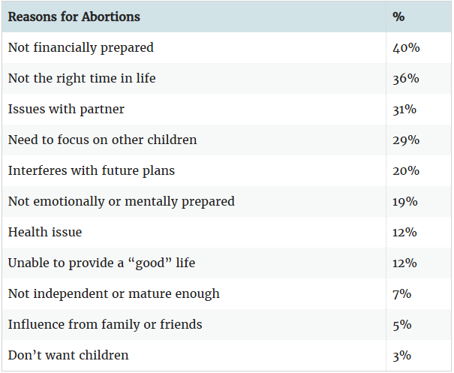
Facts & Findings About Abortion
In a survey of women in the United States who sought abortion services, the women identified the considerations listed in the adjacent table as the reasons for seeking an abortion (Stacey 2025; Biggs, Gould, & Greene Foster).
Notes:
References:
Dawn Stacy, “Why Do People Have Abortions,” verywellhealth (March 20, 2025). https://www.verywellhealth.com/reasons-for-abortion-906589
Biggs, M.A., Gould, H. & Foster, D.G. Understanding why women seek abortions in the US. BMC Women's Health 13, 29 (2013). https://doi.org/10.1186/1472-6874-13-29

Slide 11
Facts & Findings About Abortion
A study of hundreds of women in the U.S. who had an abortion between 2008 and 2010 found that 99% of those women did not regret it, and continued to think it was the right decision 3 years afterward (Rocca et al. 2015).
Another study found that among the women who did have negative emotions about their abortion years later, it was often due to perceived social disapproval of their decision coming from other people in their community (Biggs et al. 2020).
In contrast, women who reported more support from their community, family, and partner were much less likely to feel distress about their abortion (Ibid.).
Notes:
References:
Rocca, C. H., Kimport, K., Roberts, S. C., Gould, H., Neuhaus, J., & Foster, D. G. (2015). Decision Rightness and Emotional Responses to Abortion in the United States: A Longitudinal Study. PloS one, 10(7), e0128832. https://doi.org/10.1371/journal.pone.0128832
Biggs MA, Brown K, Foster DG. Perceived abortion stigma and psychological well-being over five years after receiving or being denied an abortion. PLoS One. 2020 Jan 29;15(1):e0226417. doi: 10.1371/journal.pone.0226417. PMID: 31995559; PMCID: PMC6988908.

Slide 12
Facts & Findings About Abortion
Researchers at the University of California, San Francisco conducted a study of the short- and long-term effects of unwanted pregnancy on women’s lives. Data from this study—known as the Turnaway Study—have been analyzed in dozens of peer-reviewed scientific publications (ANSIRH; Foster 2023).
Compared to women who sought and received abortions, women who were denied an abortion due to legal restrictions had worse health and financial outcomes, including (ANSIRH):
Four times greater odds of living below the federal poverty level;
More likely to experience serious health complications from the pregnancy, including eclampsia and death;
More likely to experience poor physical health for years after the pregnancy, including chronic pain and gestational hypertension;
More likely to stay tied to abusive partners;
More likely to suffer anxiety and loss of self-esteem in the short term.
Notes:
The Turnaway Study provoked a strong reaction from pro-life groups and some anti-abortion researchers. One paper that criticized the Turnaway Study’s methodology was published in the journal Frontiers in Psychology in 2022, but the paper was later retracted after the journal’s editors conducted a further review. See https://retractionwatch.com/2022/12/29/article-that-critiqued-high-profile-abortion-study-retracted/ .
References:
Advancing New Standards in Reproductive Health (ANSIRH), University of California, San Francisco. “The Turnaway Study.” https://www.ansirh.org/research/ongoing/turnaway-study
Diana Greene Foster, “What happens when we deny people abortions,” TEDWomen 2023. https://www.ted.com/talks/diana_greene_foster_what_happens_when_we_deny_people_abortions/transcript?subtitle=en

Slide 13
State of abortion in the u.s.
Before 1973, each state in the U.S. decided for itself whether to permit abortions.
In 1973, the Supreme Court ruled in Roe v. Wade that a woman had a constitutional right to have an abortion during the first two trimesters of pregnancy. Viability, which occurs 20 weeks after conception, was identified as a point in pregnancy at which the state may place restrictions on abortion access.
In 2022, the Supreme Court ruled in Dobbs v. Jackson Women’s Health Organization that the U.S. Constitution does not protect the right to an abortion. This returned the issue of deciding the legality of abortion to the states.
The New York Times tracks abortion laws in each state: “Tracking Abortion Bans Across the Country.”
Notes:
Reference: Allison McCann and Amy Schoenfield Walker, “Tracking Abortion Bans Across the Country,” The New York Times (updated October 7, 2024). https://www.nytimes.com/interactive/2024/us/abortion-laws-roe-v-wade.html

Slide 14
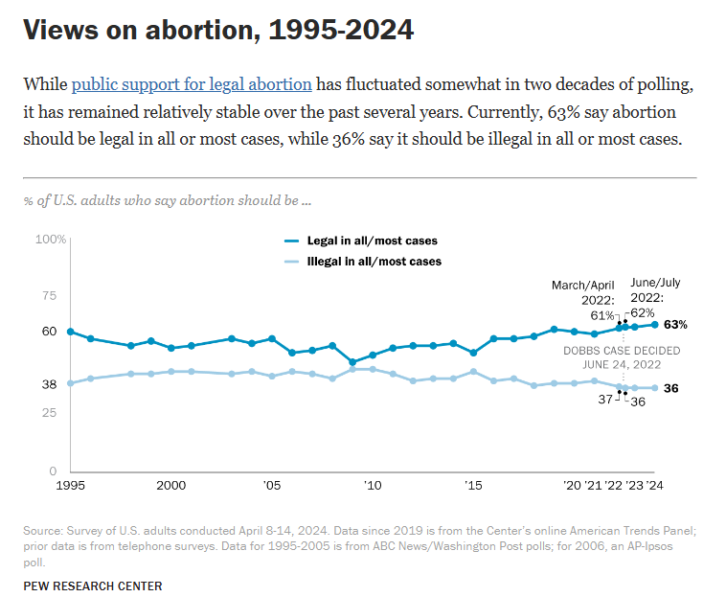
State of abortion in the u.s.
Notes:
Source: https://www.pewresearch.org/religion/fact-sheet/public-opinion-on-abortion/

Slide 15
State of abortion in the u.s.
Since the Roe ruling in 1973, the estimated number of abortions in the United States peaked at about 1.6 million in 1990, and then declined steadily over a period of nearly 30 years as people became better educated about birth control and access to contraception increased (Maddow-Zimet & Gibson 2024).
Then, in 2019-2020, the trend reversed somewhat, with estimated abortions rising to 930,000 in 2020. After Roe v. Wade was overturned in 2022, the estimated number of abortions continued to increase to over 1 million in 2024.
This increase has been attributed to greater availability of telehealth for medication abortions, increased financial support for abortions (including from donations), and policies enacted in some states improve access to abortions (Ibid.).
It’s estimated that 1 in 4 American women aged 15 to 44 in 2020 will have an abortion by the age of 45, if abortion rates from 2020 remain constant (Jones 2024; see also Guttmacher Institute 2025).
Notes:
References:
Isaac Maddow-Zimet, “Despite Bans, Number of Abortions in the United States Increased in 2023,” Guttmacher Institute (March 2024). https://www.guttmacher.org/2024/03/despite-bans-number-abortions-united-states-increased-2023
Rachel K. Jones. 2024. “An estimate of lifetime incidence of abortion in the United States using the 2021–2022 Abortion Patient Survey” Contraception, Volume 135, 110445. https://www.contraceptionjournal.org/article/S0010-7824(24)00108-2/fulltext
Guttmacher Institute. 2025. “Fact Sheet: Abortion in the United States.” https://www.guttmacher.org/fact-sheet/induced-abortion-united-states

Slide 16
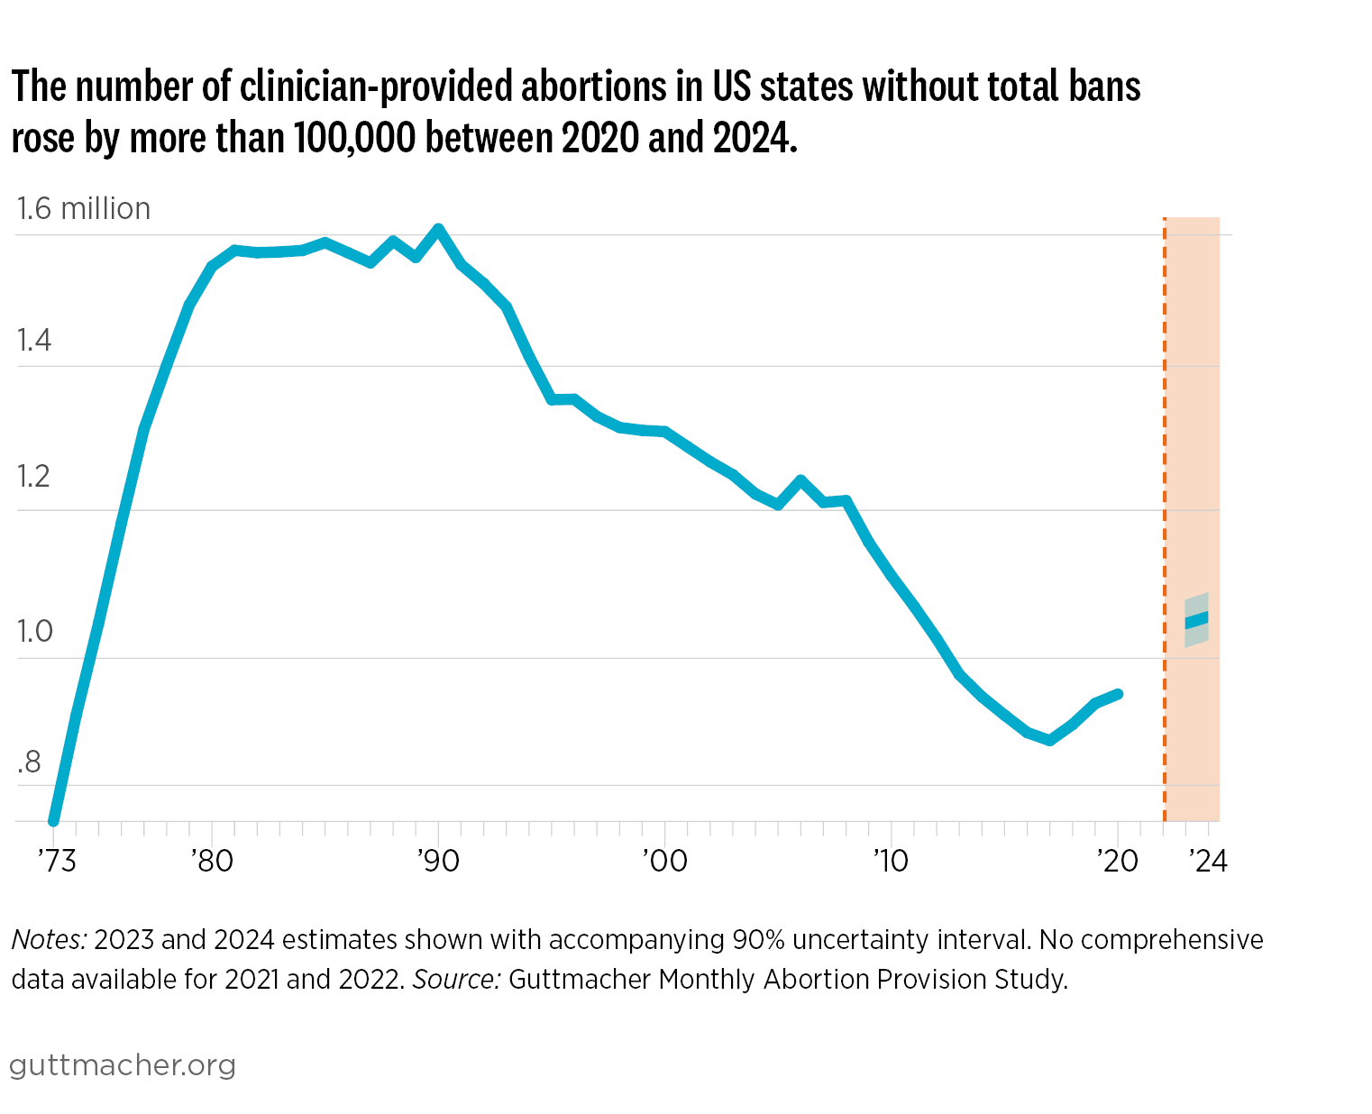
State of abortion in the u.s.
Notes:
Reference:
Isaac Maddow-Zimet and Emma Stoskopf-Ehrlich, “Fact Sheet: Abortion in the United States,” Guttmacher Institute (April 2025). https://www.guttmacher.org/fact-sheet/induced-abortion-united-states

Slide 17
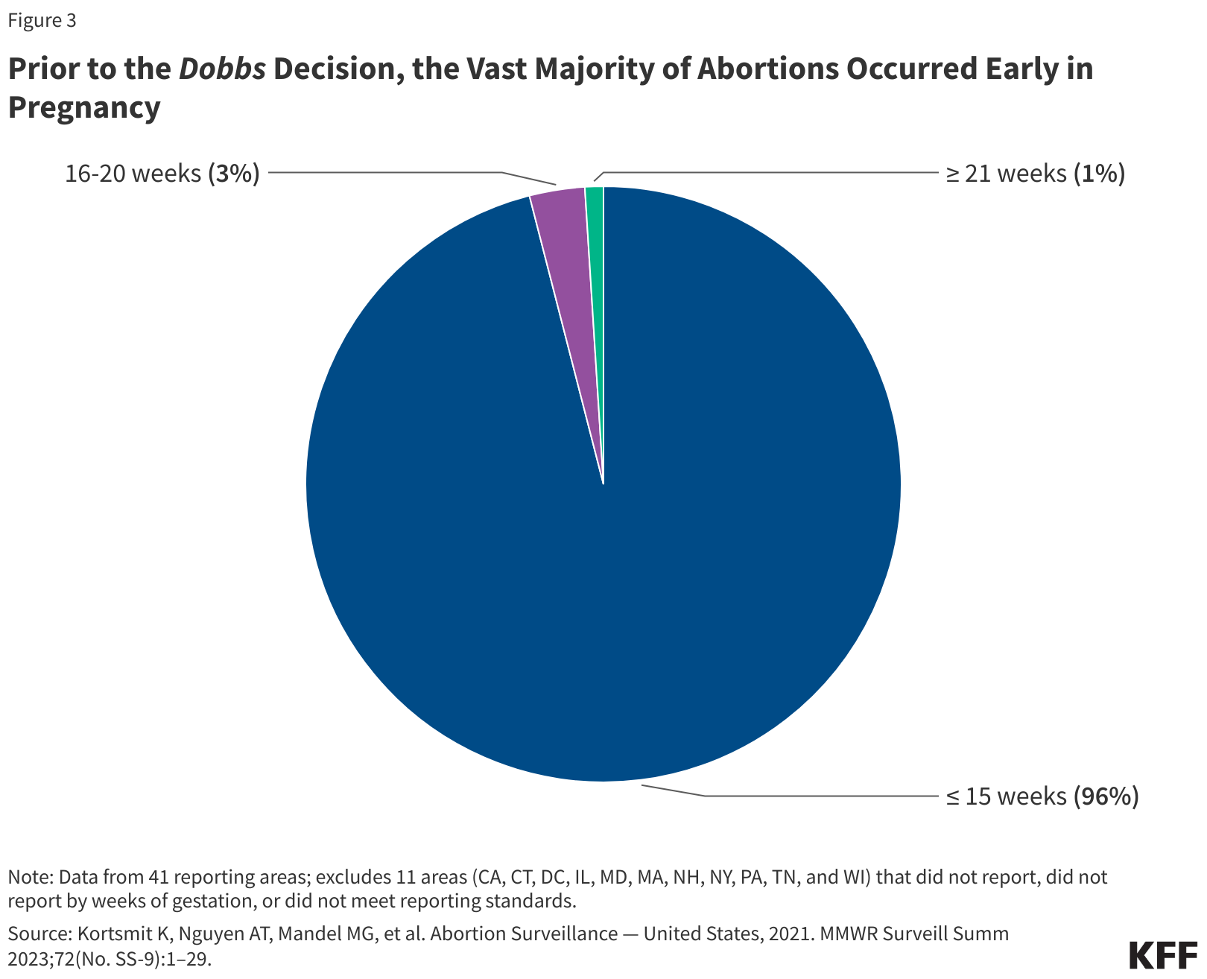
State of abortion in the u.s.
Notes:
Reference:
Ivette Gomez, Alina Salganicoff, and Laurie Sobel, “Abortions Later in Pregnancy in a Post-Dobbs Era,” KFF (February 21, 2024). https://www.kff.org/womens-health-policy/abortions-later-in-pregnancy-in-a-post-dobbs-era/

Slide 18
State of abortion in the u.s.
Much attention is now focused on what the consequences of abortion restrictions will be. Two studies published in JAMA reported that infant mortality increased in most U.S. states with abortion bans (Johns Hopkins 2025).
The researchers estimated that “infant deaths were 5.6% higher than they would have been in the 14 states with abortion bans had the bans not been enacted, resulting in an estimated 478 additional deaths” (Ibid.).
384 of these deaths were in Texas, which instituted one of the earliest and most restrictive abortion bans (Ibid.).
Infant mortality rates increased even more for infants with congenital anomalies, black and Hispanic infants, infants with younger parents, and infants whose parents lacked a college degree (Lapid 2025).
Suzanne Bell, one of the co-authors of the studies, said the findings “indicate that many pregnant people were unable to overcome barriers to access abortion services and instead were forced to continue an unwanted or unsafe pregnancy to term” (Johns Hopkins 2025).
Notes:
References:
Johns Hopkins Bloomberg School of Public Health, “Two New Studies Provide Broadest Evidence to Date of Unequal Impacts of Abortion Bans” (February 13, 2025). https://publichealth.jhu.edu/2025/two-new-studies-provide-broadest-evidence-to-date-of-unequal-impacts-of-abortion-bans
Nancy Lapid, “Infant mortality rises in states with abortion bans, study finds,” (February 13, 2025). https://www.reuters.com/world/us/infant-mortality-rises-states-with-abortion-bans-study-finds-2025-02-13/

Slide 19
State of abortion in the u.s.
Furthermore, statistical data have fueled concerns that abortion bans result in higher maternal mortality by making it more difficult for pregnant women to terminate high-risk pregnancies (see Zori et al. 2025).
For instance, an analysis published by the Gender Equity Policy Institute (GEPI) found, based on U.S. data from 2019-2023, that “[m]others living in states that banned abortion nearly 2x as likely to die during pregnancy, childbirth, or soon after giving birth, compared to mothers living in supportive states where abortion was legal and accessible” (GEPI 2025).
The GEPI report notes that after Texas introduced a statewide abortion ban in 2022, the maternal mortality rate increased by 56 percent. In 2023, maternal mortality was 36 percent higher after the ban.
Notes:
References:
Gender Equity Policy Institute, “Maternal Mortality in the United States After Abortion Bans,” (April 2025). https://thegepi.org/maternal-mortality-abortion-bans/#elementor-toc__heading-anchor-3
Zori G, Case S, Pyche C, Beckman L. The relationship between state-level abortion policy and maternal mortality in the United States: a scoping review. Health Aff Sch. 2025 Aug 14;3(8):qxaf146. doi: 10.1093/haschl/qxaf146. PMID: 40823007; PMCID: PMC12352390.

Slide 20

Judith jarvis Thomson (1929–2020)
American moral philosopher.
Made groundbreaking contributions to all areas of ethics. Her 1971 essay “A Defense of Abortion” is one of the most widely re-printed and cited works in applied ethics.
Spent most of her career as a philosophy professor at MIT. Held many academic honors, including being elected to the American Academy of Arts & Sciences, holding the Laurance S. Rockefeller Chair at MIT, and delivering the Tanner Lectures at Princeton University.
Notes:
Image source: https://www.nytimes.com/2020/12/03/us/judith-jarvis-thomson-dead.html

Slide 21
Thomson, “a defense of abortion”
In her article “A Defense of Abortion,” Judith Jarvis Thomson argues that abortion is morally permissible in virtually any circumstance, because a woman has the moral right to control what happens in her own body.
Thomson does not argue that human fetuses lack a moral right to life. Instead, Thomson’s main point is that regardless of whether or not fetuses have the moral right to life, they do not have the moral right to be kept alive by the mother’s internal organs against her will (see Thomson, in Shafer-Landau 2024: 172-173, 196). (Moral rights are defined in the notes section below.)
And because fetuses do not have this moral right, it would be morally permissible to abort a fetus whenever the mother is not willing to let her body be used for the fetus’s growth.
Notes:
Moral rights are moral entitlements or liberties that protect our interests and choices (Shafer-Landau 2024: Glossary). So, if one has a moral right to X, then other people (including the government) have a moral obligation to protect that person’s interest or choice regarding X.
Reference: Russ Shafer-Landau, Living Ethics: An Introduction with Readings, Third Edition (Oxford University Press, 2024).

Slide 22
Thomson, “a defense of abortion”
To support her conclusion, Thomson devises one of the most famous thought experiments in ethics. We can call it Thomson’s Violinist.
The passage where Thomson herself explains the violinist story occurs in Shafer-Landau 2024, page 173 (see also the notes under this slide).
This video nicely explains Thomson’s Violinist.
Notice that in the story, the violinist played no part in the plan to kidnap you and connect him to your kidneys. He was unconscious the whole time.
Notes:
“You wake up in the morning and find yourself back to back in bed with an unconscious violinist. A famous unconscious violinist. He has been found to have a fatal kidney ailment, and the Society of Music Lovers has canvassed all the available medical records and found that you alone have the right blood type to help. They have therefore kidnapped you, and last night the violinist’s circulatory system was plugged into yours, so that your kidneys can be used to extract poisons from his blood as well as your own. The director of the hospital now tells you, ‘Look, we’re sorry the Society of Music Lovers did this to you – we would never have permitted it if we had known. But still, they did it, and the violinist now is plugged into you. To unplug you would be to kill him. But never mind, it’s only for nine months. By then he will have recovered from his ailment, and can safely be unplugged from you.’ Is it morally incumbent on you to accede to this situation?” (Thomson, in Shafer-Landau 2024: 173)
Linked video: https://www.youtube.com/watch?v=Br59pD583Io

Slide 23
Thomson, “a defense of abortion”
Thomson seeks to draw an analogy between the story about the violinist and having an abortion. She relies on this analogy to support her position that abortion is morally permissible. Her argument may be summarized as follows (see Shafer-Landau 2024: §11.2):
Thomson’s Violinist Analogy
It is morally permissible to unplug from the violinist (even though it will cause his death).
If it is morally permissible to unplug from the violinist, then it is morally permissible to have an abortion.
(Conclusion) Therefore, it is morally permissible to have an abortion.

Slide 24
Thomson, “a defense of abortion”
Thomson takes premise 1 to be obviously true: surely it’s permissible to detach yourself from the violinist.
Thomson also uses premise 1 to support two broader points:
First: “…having a right to life does not guarantee having either a right to be given the use of or a right to be allowed continued use of another person’s body—even if one needs it for life itself” (Thomson, in Shafer-Landau 2024: 176).
It’s crucial to note that in Thomson’s Violinist story, the violinist is assumed to be a person with a full moral right to life. However, Thomson uses the story to demonstrate that even if someone has a moral right to life, they do not have a moral right to sustain their life by using another person’s body against the other person’s will.

Slide 25
Thomson, “a defense of abortion”
(continued from previous slide)
Second: “…nobody is morally required to make large sacrifices, of health, of all other interests and concerns, of all other duties and commitments, for nine years, or even for nine months, in order to keep another person alive” (Thomson, in Kuhse, Schüklenk, & Singer 2016: 45).
Thomson’s Violinist story is meant to show that it’s generally morally permissible not to make a large sacrifice to keep another person alive, just as it seems to be permissible not to make a large sacrifice to keep the violinist alive.
Notes:
Reference: Helga Kuhse, Udo Schüklenk, and Peter Singer, Bioethics: An Anthology, Third Edition (Wiley Blackwell, 2016).

Slide 26
Thomson, “a defense of abortion”
Thomson’s rationale for premise 2 is that the case of the violinist is similar in relevant respects to the situation of a woman who has an unwanted pregnancy.
As with the violinist, the fetus’s life depends on its use of the pregnant woman’s body. But as with the person who is unwillingly connected to the violinist, a woman who has an unwanted pregnancy is not willing to let the fetus use her body.
Therefore, just as there is no moral obligation to keep the violinist alive by making the large sacrifice of letting him use one’s body for nine months, there is likewise no moral obligation for a woman to keep a fetus alive by allowing it the use of her body for nine months.
And so, just as it’s morally permissible to detach from the violinist, it’s also morally permissible for a pregnant woman to have an abortion.
Notes:
Reference:

Slide 27
Thomson, “a defense of abortion”
Small-group discussion (1):
Do you agree with Thomson that it would be morally permissible to detach yourself from the famous violinist?
Do you agree with Thomson that if it’s morally permissible to detach yourself from the famous violinist, then it’s also morally permissible for a pregnant woman to get an abortion?
Please consider only cases where the pregnancy poses no risk to the health of the pregnant woman. These could include cases in which the woman becomes pregnant due to rape, or due to consensual sex.

Slide 28
Thomson, “a defense of abortion”
A common objection to Thomson’s argument is directed against premise 2.
In the Violinist Analogy, the Society of Music Lovers hooks the famous violinist up to your organs involuntarily—against your will. This might explain the intuition that it is morally permissible to disconnect from the violinist.
The violinist case might be similar to situations where women became pregnant due to rape—that is, where they were forced to have sex against their will. But, Thomson’s critics point out, the violinist case is not like cases of women seeking abortions after they became pregnant due to having consensual sex.
The objection suggests that even though it would be morally permissible for one not to keep the famous violinist alive, it may nevertheless not be morally permissible for a woman to abort a fetus, if she became pregnant as a result of having consensual sex with full knowledge that she could get pregnant (Shafer-Landau 2024: §11.2).

Slide 29
Thomson, “a defense of abortion”
Thomson anticipates this objection in her essay. Using a “person-plant” scenario, she argues that even if a woman becomes pregnant as a result of her own informed and voluntary choices, it is still morally permissible for her to have an abortion.
Here is Thomson’s description of the person-plant scenario:
“…suppose it were like this: people‐seeds drift about in the air like pollen, and if you open your windows, one may drift in and take root in your carpets or upholstery. You don’t want children, so you fix up your windows with fine mesh screens, the very best you can buy. As can happen, however, and on very, very rare occasions does happen, one of the screens is defective; and a seed drifts in and takes root. Does the person‐plant who now develops have a right to the use of your house? Surely not – despite the fact that you voluntarily opened your windows, you knowingly kept carpets and upholstered furniture, and you knew that screens were sometimes defective…” (Thomson, in Shafer-Landau 2024: 177)
Notes:
The full passage:
“And we should also notice that it is not at all plain that this argument really does go even as far as it purports to. For there are cases and cases, and the details make a difference. If the room is stuffy, and I therefore open a window to air it, and a burglar climbs in, it would be absurd to say, “Ah, now he can stay, she’s given him a right to the use of her house—for she is partially responsible for his presence there, having voluntarily done what enabled him to get in, in full knowledge that there are such things as burglars, and that burglars burgle.” It would be still more absurd to say this if I had had bars installed outside my windows, precisely to prevent burglars from getting in, and a burglar got in only because of a defect in the bars. It remains equally absurd if we imagine it is not a burglar who climbs in, but an innocent person who blunders or falls in. Again, suppose it were like this: people-seeds drift about in the air like pollen, and if you open your windows, one may drift in and take root in your carpets or upholstery. You don’t want children, so you fix up your windows with fine mesh screens, the very best you can buy. As can happen, however, and on very, very rare occasions does happen, one of the screens is defective; and a seed drifts in and takes root. Does the person-plant who now develops have a right to the use of your house? Surely not—despite the fact that you voluntarily opened your windows, you knowingly kept carpets and upholstered furniture, and you knew that screens were sometimes defective. Someone may argue that you are responsible for its rooting, that it does have a right to your house, because after all you could have lived out your life with bare floors and furniture, or with sealed windows and doors. But this won’t do—for by the same token anyone can avoid a pregnancy due to rape by having a hysterectomy, or anyway by never leaving home without a (reliable!) army.” (Thomson, in Schafer-Landau 2024: 177).

Slide 30
Thomson, “a defense of abortion”
The person-plant story is meant to draw an analogy to a woman who becomes pregnant as a result of a failure of contraception (or a failure to use contraception) in voluntary, consensual sex.
In many cases, women voluntarily have sex with full knowledge that there is a chance they will get pregnant (even if they use contraception). In these cases, women become pregnant at least in part through their informed and voluntary choices.
But in a similar way, a “person-plant” might take root in your house as a result of your informed and voluntary choices. You might have voluntarily opened your windows, despite knowing the risk of a “person-plant” seed floating inside through the mesh.
Nevertheless, even granting all the above, Thomson thinks it’s clear that the “person-plant” still has no moral right to grow inside your house against your will, and that you have no moral obligation to make the large sacrifice of living in a sealed house, just to keep the person-plant seeds out. And if that’s so, then it should likewise be true that a fetus has no moral right to grow inside a pregnant woman’s uterus against her will.

Slide 31
Thomson, “a defense of abortion”
Thomson’s analogy to person-plants can be summarized as follows (compare to Thomson, in Shafer-Landau 2024: 177):
Thomson’s Person-Plant Analogy
It is morally permissible to remove the person-plant (even though the person-plant would die as a result).
If it’s morally permissible to remove the person-plant, then it’s morally permissible for a woman to get an abortion, even when she became pregnant after having consensual sex with full knowledge that she could become pregnant.
(Conclusion) Therefore, it’s morally permissible for a woman to get an abortion, even when she became pregnant after having consensual sex with full knowledge that she could become pregnant.

Slide 32
Thomson, “a defense of abortion”
Whole-class discussion:
In my experience, students find the person-plant example difficult to understand. But there is a way to make the same point as this example through a slight adjustment on Thomson’s original violinist analogy.
Instead of supposing that you are unwillingly hooked up to the famous violinist, let’s imagine that you voluntarily consent to being attached to him. But soon after you are hooked up to the violinist, you change your mind, and you don’t want to be attached anymore.
Would it be immoral to detach yourself from the violinist in this adjusted case? If not, could it be argued that for similar reasons, it would be morally permissible for a woman to get an abortion after she had become pregnant through consensual sex?

Slide 33
The responsibility argument
Now, consider an argument that would go against the conclusion of Thomson’s Person-Plant Analogy (compare Shafer-Landau 2024: §11.2).
The Responsibility Argument Against Abortion After Consensual Sex
If a woman becomes pregnant due to having consensual sex, but she is unwilling to continue the pregnancy, then she bears responsibility for putting the fetus in a life-threatening situation.
If one bears responsibility for putting others in a life-threatening situation, then one is morally obligated to make a significant sacrifice in order to keep them alive.
(Conclusion) Therefore, if a woman becomes pregnant due to having consensual sex, then she is morally obligated to make a significant sacrifice in order to keep the fetus alive.
Notes:
Since an abortion would not keep a fetus alive, the conclusion of this argument implies that it would be morally wrong of the woman to get an abortion.

Slide 34
The responsibility argument
Small-group discussion (2):
The conclusion of the Responsibility Argument says: If a woman becomes pregnant due to having consensual sex, then she is morally obligated to make a significant sacrifice in order to keep the fetus alive.
Do you agree with this statement? Why or why not?
If you do agree, how significant a sacrifice is the woman morally obligated to make? Evaluate the following possibilities:
The woman is morally obligated to give up her life to keep the fetus alive.
The woman is morally obligated to sustain an irreversible but non-fatal impairment of a major bodily organ or function (e.g., the loss of a uterus or a kidney) to keep the fetus alive.
The woman is morally obligated to live in poverty so that the fetus may live.
The woman is morally obligated to sustain a major, unwanted disruption to her future plans to keep the fetus alive.

