Slide 1
Linear Regression

Slide 2
Agenda
Linear Vs Non-linear
Methods to identify linearity
Types of regression
Performance measures
Loss reduction strategies
Implementation

Slide 3
Methods to identify linearity
Linear
Polynomial degree of 1
dy/dx= constant
Non-linear
Polynomial degree >1
dy/dx <> constant

Slide 4
Check linearity
Scatter
Correlation
Heat maps
Pyplots/seaborn

Slide 5
Types
Simple Linear regression
Multiple Linear regression
Accuracy

Slide 6

Implementation
Straight line
Yi=m xi+c (simple LR)
Yi = m1 x1+m2 x2+c (multiple LR)
$$m=\frac{N(\sum{xy)−\sum{x \sum{y}}}}{N.\sum{x^{2}}−{(\sum{x)}}^{2}}$$
$$c=\frac{\sum{y−m.\sum{x}}}{N}$$

Slide 7
How to find m and c
Least squares method
Gradient descent method

Slide 8
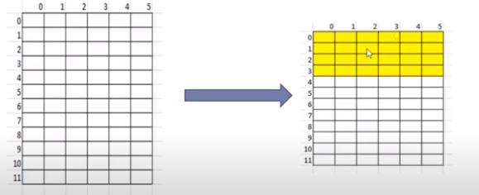
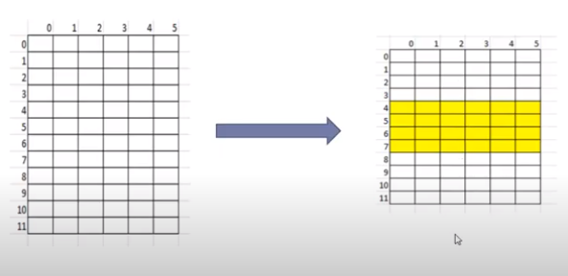
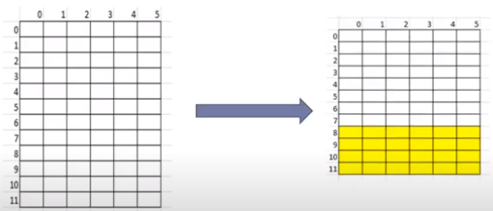
Cross Validation

Slide 9
All the rows has to be taken for training and testing
Cumulative average of all folds
Here 3-fold
In general K-fold

Slide 10
K?
K = n (all experiences)
K= 5 or 10 (by research)
K=m (m confirms representative experience of the dataset)
Stratified folding: representative experience should be present in all the folds (e.g 3 classes are there means then each fold should contain all 3 classes)

Slide 11
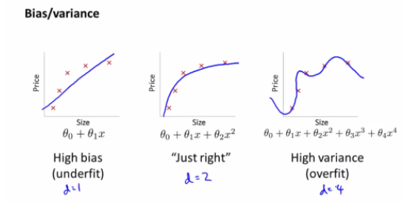

Slide 12
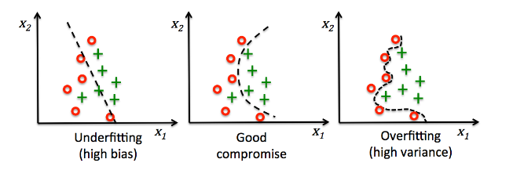

Slide 13
Bias is the error occurred due to our training
Variance is the error occurred due to our testing

