Slide 1
WEEK 06
WEB SECURITY &
VULNERABILITY TESTING
STEP-BY-STEP VAPT PRACTICAL
TARGET
Local DVWA
TOOLS
Burp Suite CE • OWASP ZAP
EVIDENCE
7 selected screenshots

Slide 2
Lab Setup & Workflow
Authorized local target only: http://127.0.0.1:8082
1 Start Docker and verify the DVWA container
2 Open DVWA and use Low security for the exercise
3 Test SQL Injection with baseline vs controlled input
4 Test Reflected XSS and Stored XSS separately
5 Inspect requests/responses in Burp HTTP history
6 Scan DVWA with ZAP and review alerts
7 Export report and save selected evidence
02

Slide 3
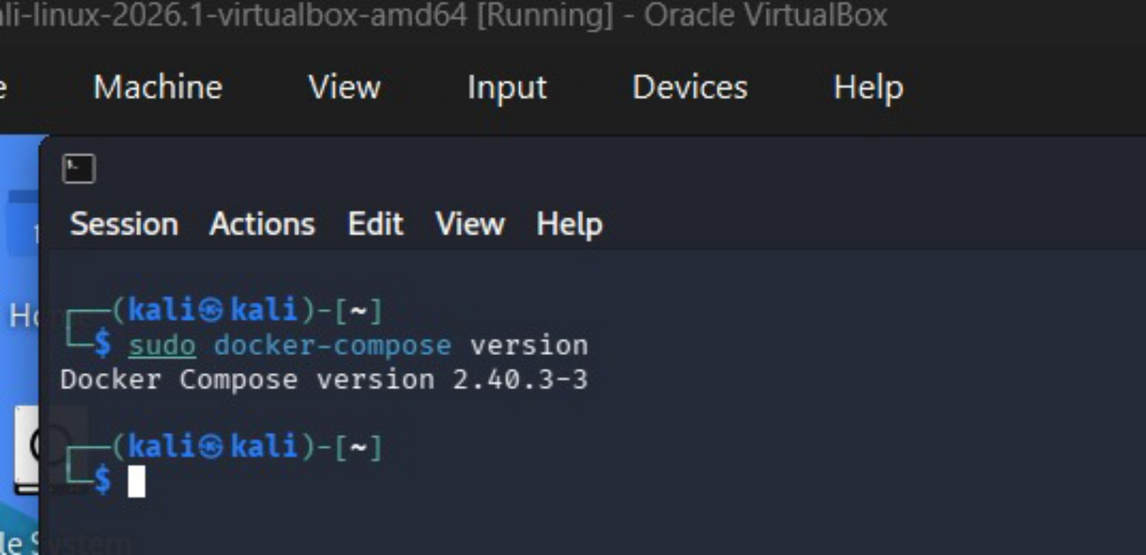
Step 1 — Prepare the Lab
Start Docker; confirm DVWA is local and reachable
Check the running container: sudo docker ps
Open http://127.0.0.1:8082 in the Kali browser
Initialize DVWA if requested; select Low for introductory tests
Keep the target bound to localhost — do not expose it publicly
Step 1 — Docker environment
03

Slide 4
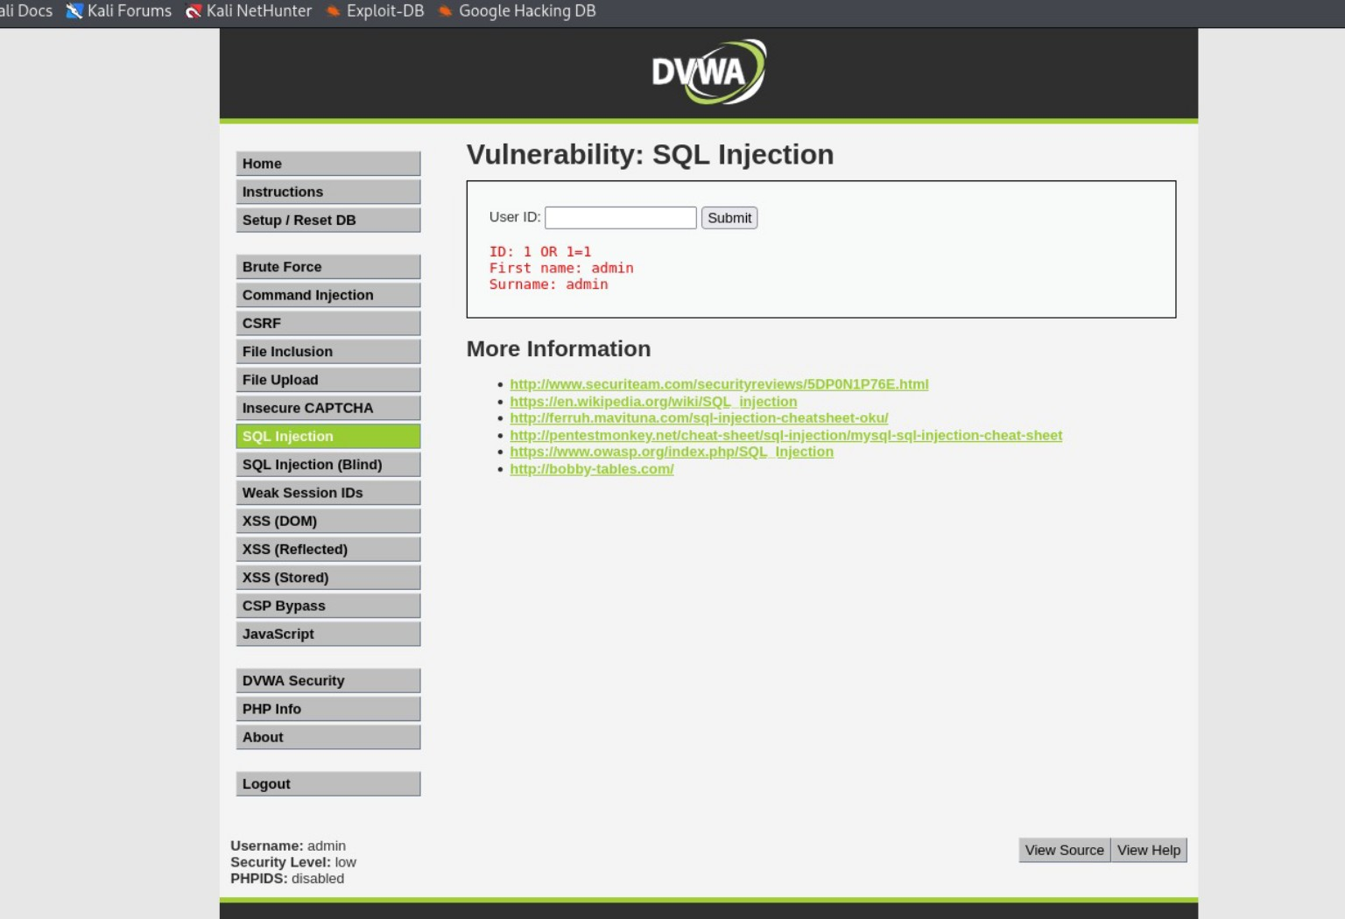
Step 2 — SQL Injection
Evidence: DVWA input changed the query result
Open Vulnerabilities → SQL Injection
Submit baseline ID: 1
Then test in the local lab: 1' OR '1'='1
Compare results and capture the output
Fix: prepared statements / parameterized queries
Selected SQL Injection evidence
04

Slide 5
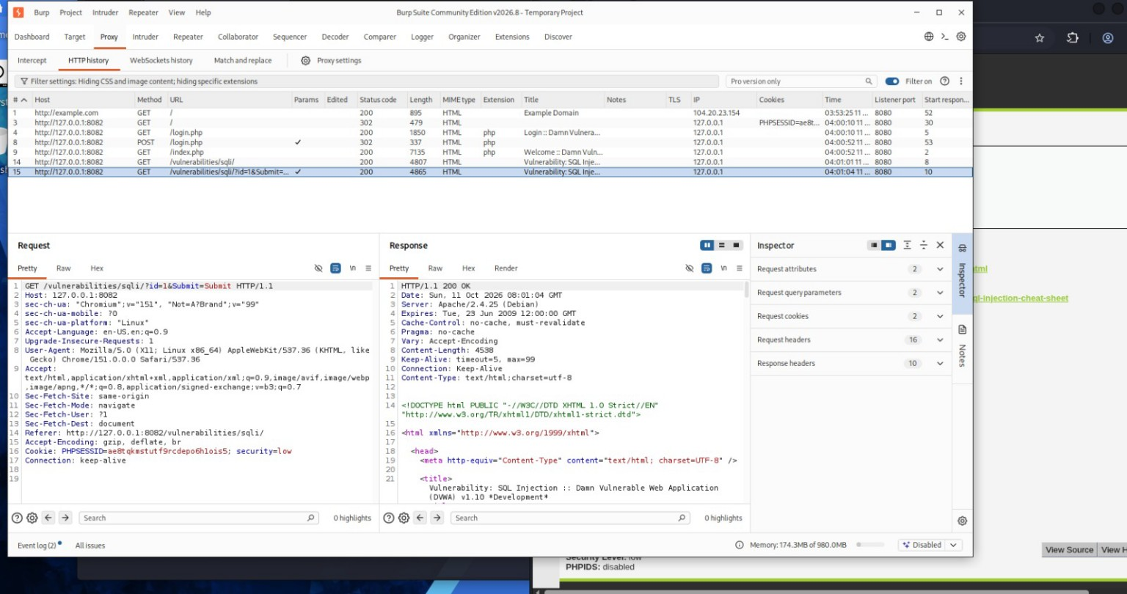
Step 3 — Burp Suite HTTP History
Inspect the actual request and response
Open Proxy → HTTP history
Select the request to the DVWA SQL Injection page
Inspect the Request and Response panes
Claim a payload was captured only if it is visible
Burp HTTP history screenshot
05

Slide 6
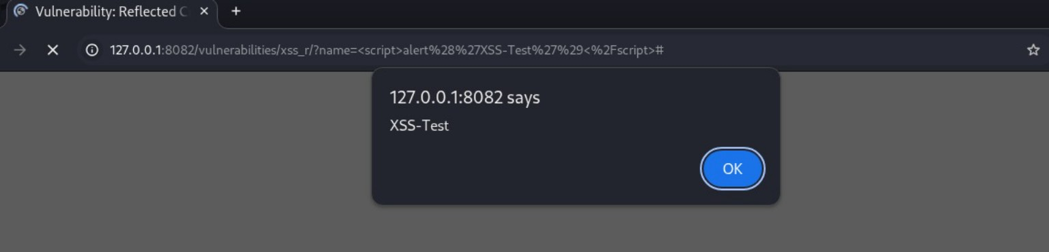
Step 4 — Reflected XSS
Browser alert supports script execution in the local lab
Open Vulnerabilities → XSS (Reflected)
Test a harmless baseline value first
Use the training alert payload only on local DVWA
Capture the browser alert and URL
Fix: context-aware output encoding; safe templating
Reflected XSS execution evidence
06

Slide 7
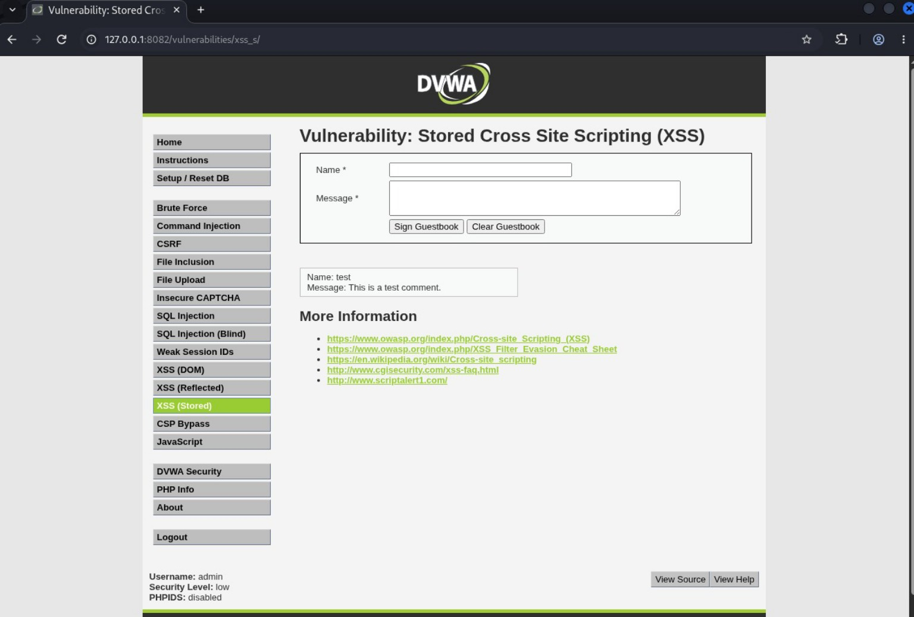
Step 5 — Stored XSS
Persistence and execution are different checks
Submit a labelled guestbook test entry
Refresh the page and check whether it remains
Capture any script alert separately
This screenshot supports stored-content activity; it alone does not prove execution
Fix: encode stored output; sanitize only when rich HTML is needed
Stored XSS guestbook evidence
07

Slide 8
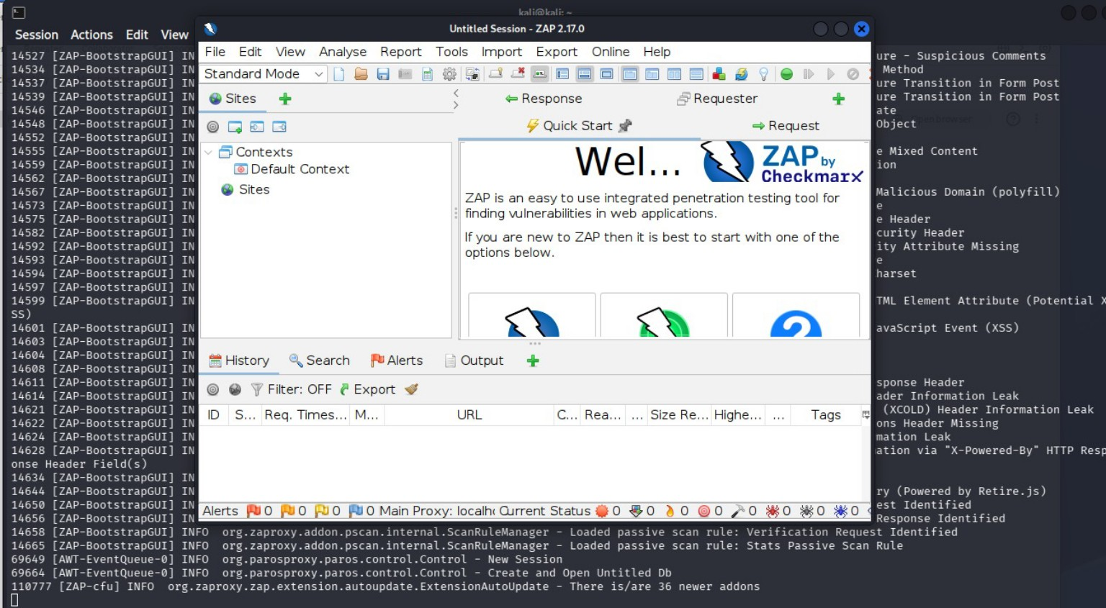
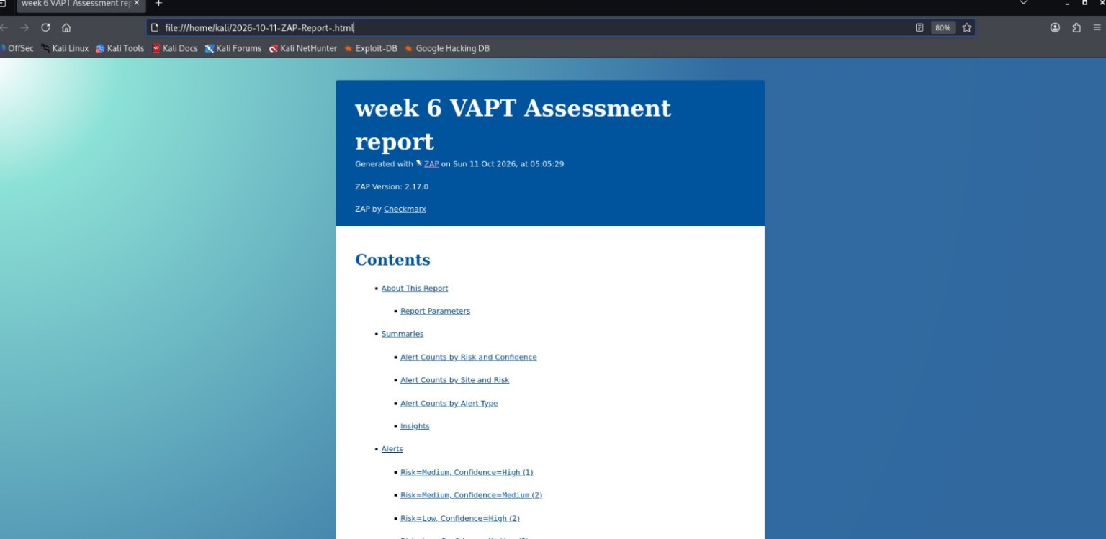
Step 6 — OWASP ZAP Scan
Review alerts manually; export the HTML report
Set target to http://127.0.0.1:8082
Run the scan and open Alerts
Review directory browsing, headers and cookie attributes
Treat informational/diagnostic alerts as leads, not confirmed vulnerabilities
Export and retain the HTML report
ZAP application evidence
ZAP report evidence
08

Slide 9
Findings & Remediation
Qualitative lab findings — not a production-system rating
SQL Injection
Parameterized queries; least privilege
Reflected XSS
Context-aware output encoding; CSP as extra layer
Stored XSS
Encode stored output; verify execution separately
Directory browsing
Disable directory listing
Headers / cookies
Review CSP, anti-clickjacking, nosniff, HttpOnly, Secure, SameSite
09

Slide 10
Conclusion & Submission Checklist
A complete VAPT workflow is scope → test → verify → report
Keep the report, PPT, selected screenshots and ZAP HTML report together
Use only claims supported by visible evidence
Add the four OWASP topic notes if the assignment requires them separately
Upload to GitHub after reviewing the final files
References: OWASP Top 10, OWASP Cheat Sheets, ZAP documentation, PortSwigger Web Security Academy
10

