Slide 1
Advanced Network Security Assessment & Traffic Investigation (Week 3)
Practical Reconnaissance, Deep Packet Forensics & Infrastructure Hardening
Presenter: Mohammed Avesh Shaikh (aveshshaikh05042005@gmail.com)
Track: Cybersecurity Foundation / SOC Analyst | DG Interns Hub | September 2026
This session focuses on practical reconnaissance techniques, deep forensics investigations, and critical infrastructure hardening strategies within a controlled laboratory environment.

Slide 2
Security Assessment Lifecycle & Objectives
Project Methodology & Compliance Standards
Assessment Phases
Discovery: Comprehensive host mapping to identify active devices.
Vulnerability Enumeration: Probing services to uncover weaknesses.
Wire Forensics: Deep packet inspection for traffic analysis.
Hardening: Implementation of defensive controls.
Verification: Validation of surface reduction effectiveness.
Compliance & Framework Standards
Network Environment: VirtualBox NAT & Host-Only configurations.
Protocol Standards:
• RFC 793 (TCP)
• RFC 792 (ICMP)
Threat Framework (MITRE ATT&CK):
• T1046: Network Service Discovery
• T1040: Network Sniffing
Security Assessment Lifecycle & Objectives | 2024

Slide 3
Lab Architecture & Technical Stack
Lab Architecture Details
Technical Tool Stack
Auditor Node: Kali Linux 2026.x
(IP: 10.0.2.15)
Gateway: 10.0.2.2
DNS Server: 10.0.2.3
Target System: scanme.nmap.org
(IP: 45.33.32.156)
Network Mapper: Nmap 7.94
Host discovery and deep enumeration
Packet Analyzer: Wireshark 4.6.6
Deep packet forensics
Defensive Controls: UFW
Host firewall implementation
Service Management: systemd
Service management and configuration
Lab Architecture & Technical Stack Overview | Technical Documentation 2026

Slide 4
Tasks 7 & 8: Network Discovery & Advanced Nmap Assessment
Section 1: Subnet Ping Sweep
nmap -sn 10.0.2.0/24
Execution for host identification without active port scanning.
Section 2: Deep Enumeration
nmap -sS -sV -O -p-
Detailed vulnerability enumeration using service version detection and OS fingerprinting.
Section 3: Port States
Section 4: Findings
Open: Active listening service
Closed: Accessible, no listener
Filtered: Blocked by firewall
Active services successfully identified:
Service active on Port 22
Service active on Port 80
Service active on Port 9999
Network Discovery & Assessment Report | Advanced Nmap Assessment Methodology

Slide 5
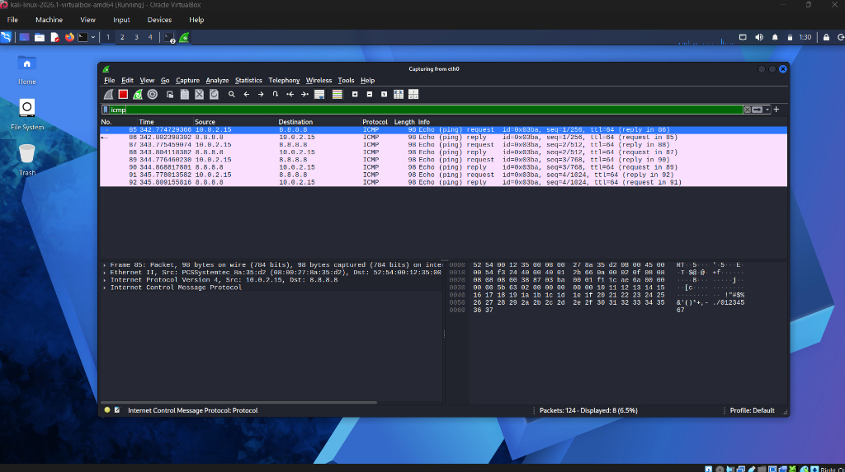
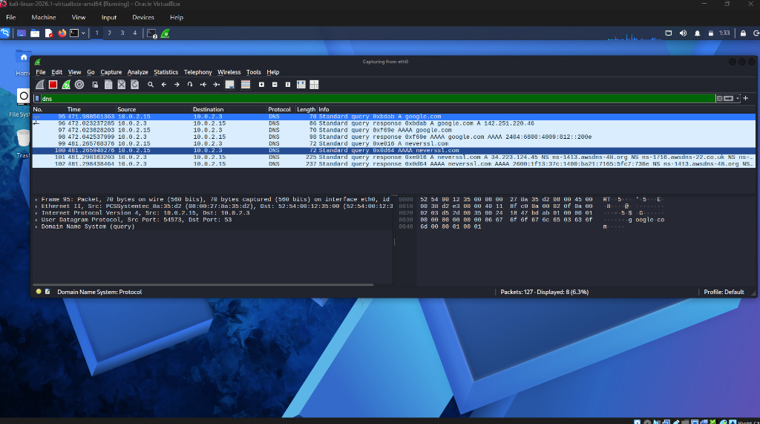
Task 9: Wireshark Traffic Capture – ICMP & DNS Protocol Analysis
ICMP Analysis
DNS Analysis
Discussion of ICMP Echo Request and Reply sequence. Packets 85-92 show communication between 10.0.2.15 and 8.8.8.8.
Specific DNS queries and responses for google.com and neverssl.com.
Task 9: Wireshark Traffic Capture | Protocol Analysis Report

Slide 6
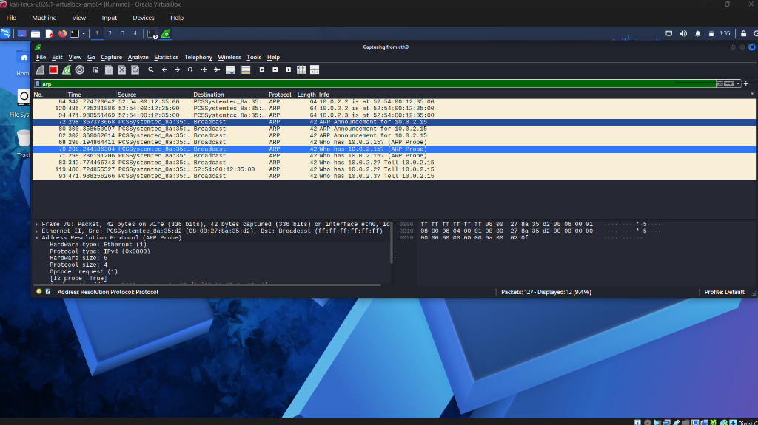
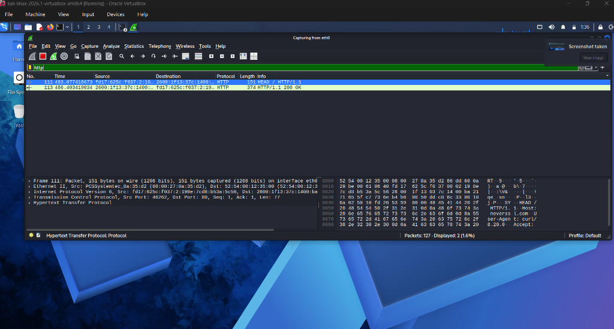
Task 9: Wireshark Traffic Capture – ARP & HTTP Protocol Analysis
ARP Analysis
HTTP Analysis
ARP Announcements for IP-to-MAC resolution.
Network probes identifying active hosts on the segment.
Identification of unencrypted HTTP traffic.
HEAD request and 200 OK response from neverssl.com on Port 80.
Network Traffic Forensics | Protocol Analysis & Capture

Slide 7
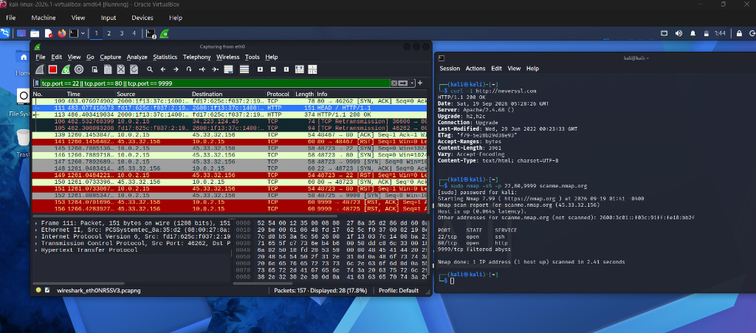
Task 10: Packet-Level Nmap Scan Forensics (Wire Investigation)
Correlates Nmap terminal output with Wireshark packet capture.
The Stealth Scan Lifecycle:
SYN: Auditor sends synchronization request.
SYN/ACK: Target acknowledges open port.
RST: Auditor immediately resets connection to evade application logging.
Forensic Sequence:
Highlights packets 145-156 as proof of the stealth handshake.
Reference: forensic_capture_01.pcap
Network Forensics Investigation | Task 10 Sequence Analysis

Slide 8
Task 11: Advanced Traffic Investigation & Anomaly Hunting
Top Host: 10.0.2.15 (Auditor workstation)
Port Sweeps: Systematically identifying active services across the target subnet.
Unencrypted Credentials: Plaintext transmission of authentication data detected in packet streams.
ARP Chatter: Excessive broadcasts suggesting automated network mapping and reconnaissance.
HTTP Basic Auth: Identification of decodable base64 credentials over plaintext channels.
TCP Connection Resets: High volume of RST packets indicating stealth scanning or denied connections.
Advanced Traffic Investigation | October 2023

Slide 9
Task 12: Vulnerability Assessment & Risk Prioritization
Insecure Telnet/FTP
Severity: Critical/High
Implication: Plaintext interception of sensitive credentials and data during transit.
Exposed MySQL
Severity: High
Implication: Potential for unauthorized database access, leading to data exfiltration or manipulation.
Permissive Host Firewall
Severity: High
Implication: Significantly expanded attack surface, allowing lateral movement across internal services.
Plaintext HTTP
Severity: Medium
Implication: Vulnerability to web eavesdropping and man-in-the-middle attacks on non-encrypted traffic.
Vulnerability Assessment & Risk Management | September 2024

Slide 10
Task 13: Security Hardening & Before vs After Verification
Hardening Implementation Controls
Purged FTP/Telnet: Eliminated plaintext exposure by removing legacy, unencrypted services.
UFW Default-Deny: Implemented strict firewall ingress rules, permitting only SSH on Port 22.
MySQL Loopback Binding: Configured database listener to localhost to prevent external network access.
80%
Surface Area Reduction
Reduction from 5 open ports to 1 hardened port
Infrastructure Security Hardening Report | September 2024

Slide 11

Task 14: Strategic Security Recommendations & Conclusion
Strategic Recommendations
Enforce Encryption (SSH/TLS for all traffic).
Least Privilege (Default-deny firewalling).
NIDS Implementation (Deploy Snort/Suricata).
Localhost Database Binding (Bind sensitive DBs to loopback).
Continuous Auditing (Regular SOC assessments).
Conclusion
Deep packet forensics is the essential baseline for effective SOC defense and threat hunting.
Strategic Security Analysis & Recommendations | SOC Defense Framework

