Slide 1
Exploring Customer Segments: Clustering Techniques and Insights

Slide 2
Data analyzed
Approximately 2240 purchasing decisions
Clustering algorithms with analysis
5 clear clusters roughly of equal size
Detailed data analysis
Apriori algorithm to find buying patterns
Link to raw data
Notes:
Set the stage a bit -- where is the data coming from? Be as transparent as possible. Explain to the audience what you were thinking about data collection in terms of what data was necessary and how that in turn shaped your thinking on the kind of analysis that would be most appropriate given the objective.

Slide 3
Research Question
How can clustering algorithms be utilized to identify distinct customer segments based on their purchasing patterns in different product categories.
Notes:
We are framing this problem in terms of a clear business need. And asking the question, what is this analysis actually going to do for our business, right? Remember, it’s our world, the statistics are just living in it!

Slide 4
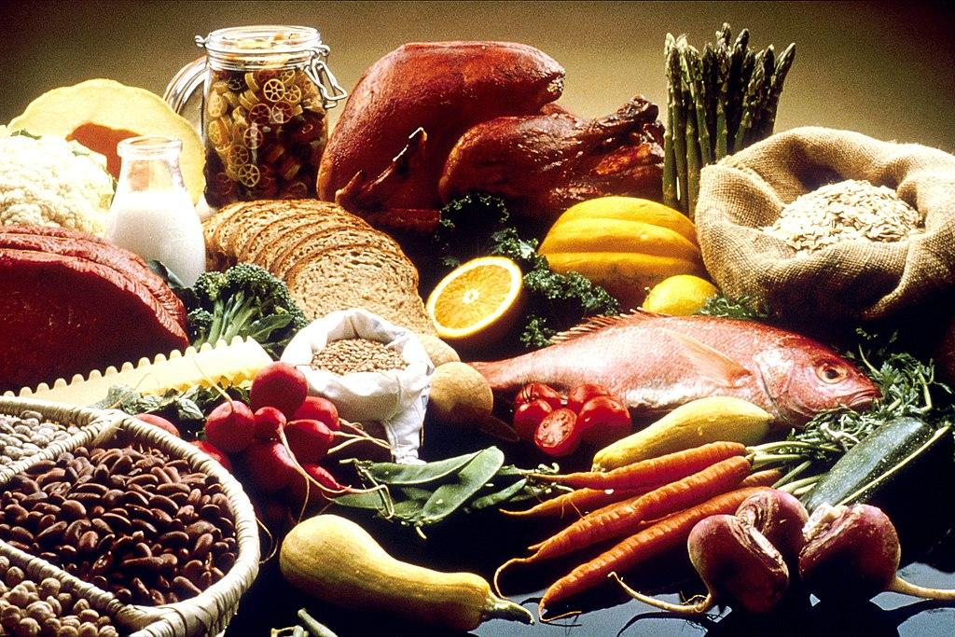
Potential model insights
The research will effectively reveal customer segments and their buying habits. Also will yield detailed analysis on sales in product categories.
Notes:
Moving from research question to some kind of hypothesis -- you want to use logic, theory and prior empirical evidence to move toward some hypotheses you can test. This is why domain expertise cannot be overlooked among data scientists.

Slide 5
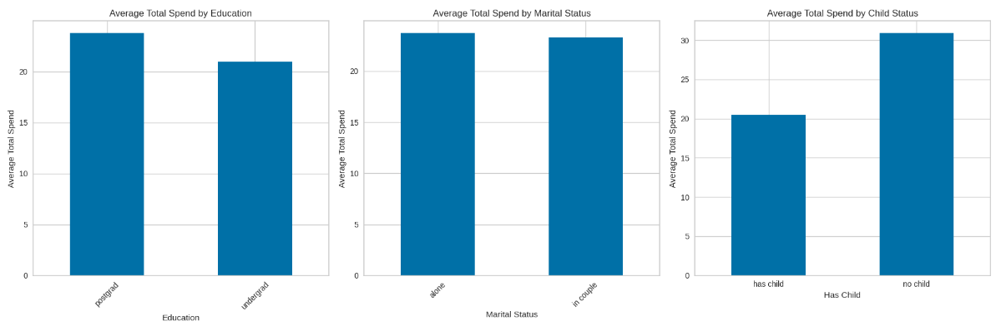
The features
On average postgraduates that have no children and live alone spend more
Notes:
A statistical method is not a story, but we can tell a story from the statistics. For example, using confidence intervals we can put into dollars what we think would happen if we make some business move, given the data that we have.
The words “t-test,” “normality,” “independent samples” etc did not come up at all in this explanation! Although someone who does know about this stuff can still have confidence in the results with the way you have laid out the story and the quantifiable results.

Slide 6
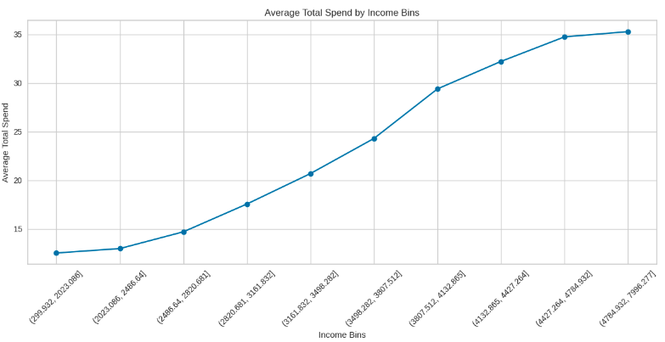
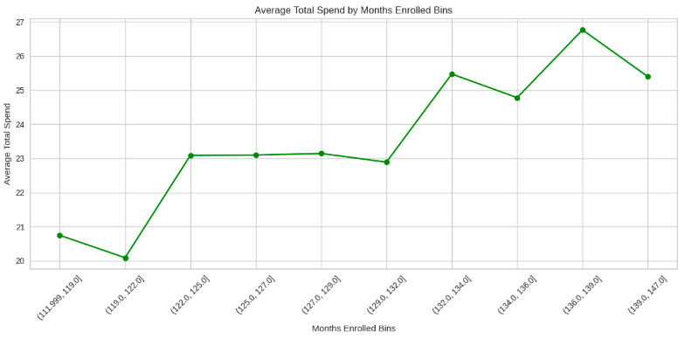
The features
Positive correlation between income and total spending and months enrolled and total spending
Notes:
A statistical method is not a story, but we can tell a story from the statistics. For example, using confidence intervals we can put into dollars what we think would happen if we make some business move, given the data that we have.
The words “t-test,” “normality,” “independent samples” etc did not come up at all in this explanation! Although someone who does know about this stuff can still have confidence in the results with the way you have laid out the story and the quantifiable results.

Slide 7
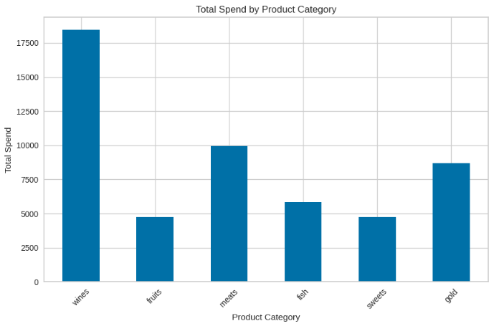
The features
Total spending by category suggests that wines make the most profit, over 70% more than the next best seller meats.
Notes:
A statistical method is not a story, but we can tell a story from the statistics. For example, using confidence intervals we can put into dollars what we think would happen if we make some business move, given the data that we have.
The words “t-test,” “normality,” “independent samples” etc did not come up at all in this explanation! Although someone who does know about this stuff can still have confidence in the results with the way you have laid out the story and the quantifiable results.

Slide 8
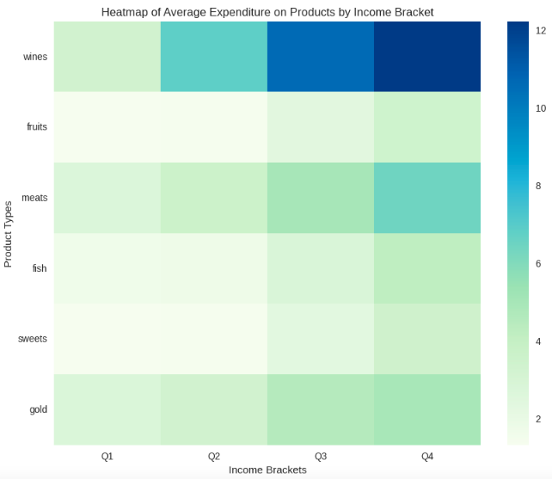
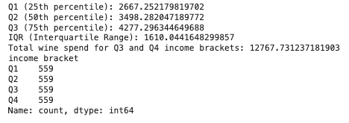
The features
The heatmap of income divided in quarters with total spending in product categories.
There seems to be a positive correlation in wines and meats categories as well
Notes:
A statistical method is not a story, but we can tell a story from the statistics. For example, using confidence intervals we can put into dollars what we think would happen if we make some business move, given the data that we have.
The words “t-test,” “normality,” “independent samples” etc did not come up at all in this explanation! Although someone who does know about this stuff can still have confidence in the results with the way you have laid out the story and the quantifiable results.

Slide 9
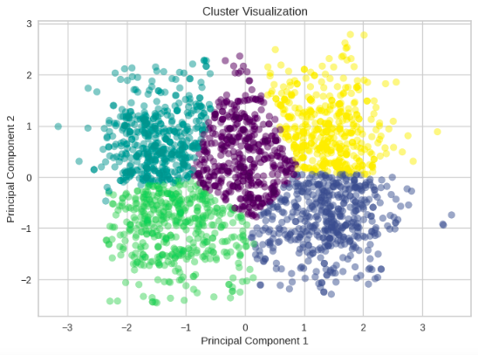
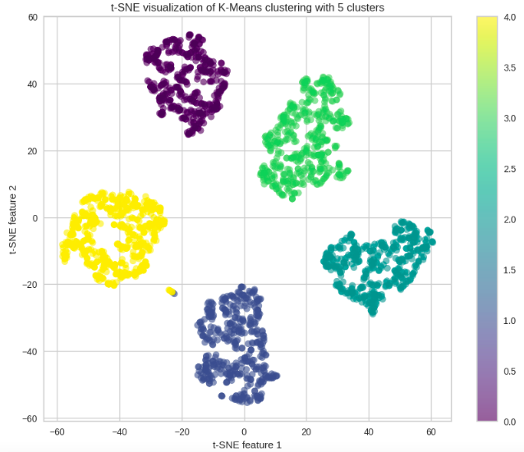
Clustering
After trying K-Means, Agglomerative and Gaussian Mixture clustering, K-Means showed the highest Silhouette score of 0.535 with clear clusters
Notes:
A statistical method is not a story, but we can tell a story from the statistics. For example, using confidence intervals we can put into dollars what we think would happen if we make some business move, given the data that we have.
The words “t-test,” “normality,” “independent samples” etc did not come up at all in this explanation! Although someone who does know about this stuff can still have confidence in the results with the way you have laid out the story and the quantifiable results.

Slide 10
Clustering
The clustering was done based on income, total spending and tenure.
5 cluster groups were formed Highest Spenders, High Spenders, Consistent Patrons, Average Spender and Lowest Spenders based on the three criteria.
Notes:
A statistical method is not a story, but we can tell a story from the statistics. For example, using confidence intervals we can put into dollars what we think would happen if we make some business move, given the data that we have.
The words “t-test,” “normality,” “independent samples” etc did not come up at all in this explanation! Although someone who does know about this stuff can still have confidence in the results with the way you have laid out the story and the quantifiable results.

Slide 11
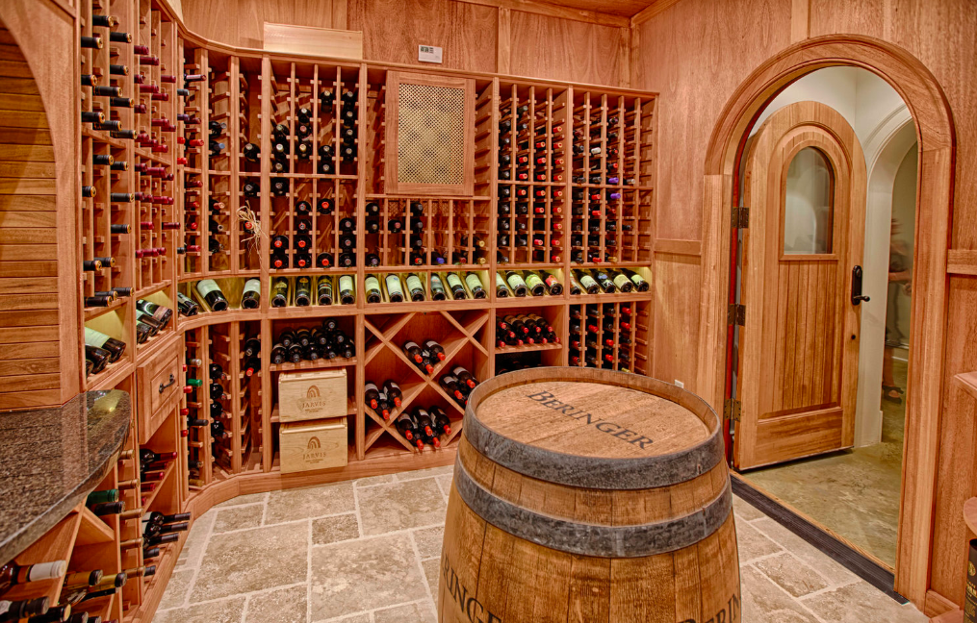
Notes:
A statistical method is not a story, but we can tell a story from the statistics. For example, using confidence intervals we can put into dollars what we think would happen if we make some business move, given the data that we have.
The words “t-test,” “normality,” “independent samples” etc did not come up at all in this explanation! Although someone who does know about this stuff can still have confidence in the results with the way you have laid out the story and the quantifiable results.

Slide 12
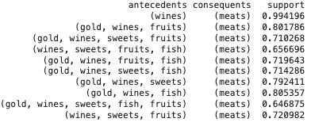
The Apriori Algorithm
99.4% of the time a customer that bought wine also bought meats, which confirms the positive correlation we found earlier.
Notes:
A statistical method is not a story, but we can tell a story from the statistics. For example, using confidence intervals we can put into dollars what we think would happen if we make some business move, given the data that we have.
The words “t-test,” “normality,” “independent samples” etc did not come up at all in this explanation! Although someone who does know about this stuff can still have confidence in the results with the way you have laid out the story and the quantifiable results.

Slide 13
Clusters
High spenders spend the most gold and sweets purchases, more than the highest spenders.
Consistent Patrons and Average spenders lead in deals purchases and accepting campaigns in different stages.
Notes:
A statistical method is not a story, but we can tell a story from the statistics. For example, using confidence intervals we can put into dollars what we think would happen if we make some business move, given the data that we have.
The words “t-test,” “normality,” “independent samples” etc did not come up at all in this explanation! Although someone who does know about this stuff can still have confidence in the results with the way you have laid out the story and the quantifiable results.

Slide 14
Weak points/ shortcomings
The one weak point in the clustering is that on average the clusters have similar characteristics although on different scale in terms of spending.
All the custers show high correlation in income, spending, more catalogue and store purchases and product categories similarly.
Notes:
A statistical method is not a story, but we can tell a story from the statistics. For example, using confidence intervals we can put into dollars what we think would happen if we make some business move, given the data that we have.
The words “t-test,” “normality,” “independent samples” etc did not come up at all in this explanation! Although someone who does know about this stuff can still have confidence in the results with the way you have laid out the story and the quantifiable results.

Slide 15
Conclusion
In conclusion, the cluster groups are clearly separated due to no overlap in income and spending and each of them has a little perk of its own.
Notes:
A statistical method is not a story, but we can tell a story from the statistics. For example, using confidence intervals we can put into dollars what we think would happen if we make some business move, given the data that we have.
The words “t-test,” “normality,” “independent samples” etc did not come up at all in this explanation! Although someone who does know about this stuff can still have confidence in the results with the way you have laid out the story and the quantifiable results.

Slide 16
Targeted Sales Strategies
Consistent patrons and Average spenders can be targeted for deals and campaigns due to higher acceptance rate.
High spenders and Highest spenders should be targeted for wine purchases, preferably with deal combinations with meats due to wine buyers also buying meats.
Notes:
A statistical method is not a story, but we can tell a story from the statistics. For example, using confidence intervals we can put into dollars what we think would happen if we make some business move, given the data that we have.
The words “t-test,” “normality,” “independent samples” etc did not come up at all in this explanation! Although someone who does know about this stuff can still have confidence in the results with the way you have laid out the story and the quantifiable results.

Slide 17
Questions?

Slide 18
THANK YOU

