Slide 1
Bachelor Thesis · TUM · Supervisor Review
Counterfactual Estimation of Tanker-Throughput
Disruption at the Strait of Hormuz
Forecasting and synthetic-control evidence from the 2026 episode
Mher Avetisyan · mher.avetisyan@tum.de · July 2026
Block inference + corroboration
293 tests passing
Frozen inputs + artifacts verified
Free, immutable open data
Notes:
[Sources]
reports/reproducibility_run_transcript.txt
docs/AUDIT_REMEDIATION_REGISTER.md (PROV-02, STALE-01)
[/Sources]

Slide 2
Research question & estimand
How large and persistent was the disruption-associated shortfall in observable daily tanker throughput through the Strait of Hormuz, relative to counterfactual paths estimated exclusively from pre-disruption data?
Why throughput, not freight rates
Bloomberg / Spark LNG freight access is unconfirmed.
Committed fallback: a free, fully reproducible throughput DV.
The LNG freight-rate outcome is additive upside if access arrives.
Estimand realignment is drafted and pending Prof. Li sign-off.
Primary outcome
Daily tanker transit count (IMF PortWatch n_tanker)
Robustness outcome
Daily deadweight capacity of transiting tankers
Estimand
Cumulative & mean-daily observed-minus-counterfactual gap
Reporting language
Disruption-associated counterfactual shortfall — not a causal ATT
Source: PENDING_ESTIMAND_REALIGNMENT_DRAFT.md · IMF PortWatch · proposal-vs-thesis reconciliation pending supervisor approval

Slide 3
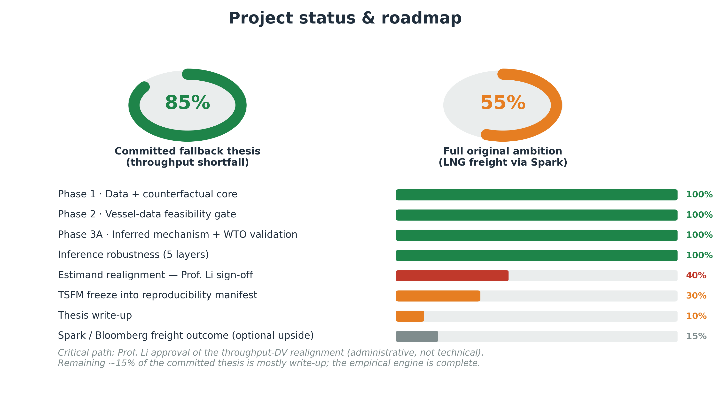
Where the project stands

Slide 4
Methodological discipline
1
Free, immutable data
PortWatch, EIA, FRED, Global Fishing Watch, WTO/AXSMarine — snapshotted and SHA-256 hashed.
2
Locked primary estimator
AR(1,7) with weekly seasonality, trained strictly on pre-disruption days. No post-treatment covariate can enter.
3
Leakage-safe validation
Chronological rolling-origin CV; cutoff fixed at 2026-02-28; later event dates are scoring windows only.
4
Identification, not fit
The claim rests on observed-minus-counterfactual + donor design — never on forecast accuracy. A better forecaster is not causal evidence.
Source: CLAUDE.md discipline rules · EVENT_CHRONOLOGY.md · src/lngfreight/{validation,baselines,inference}.py

Slide 5
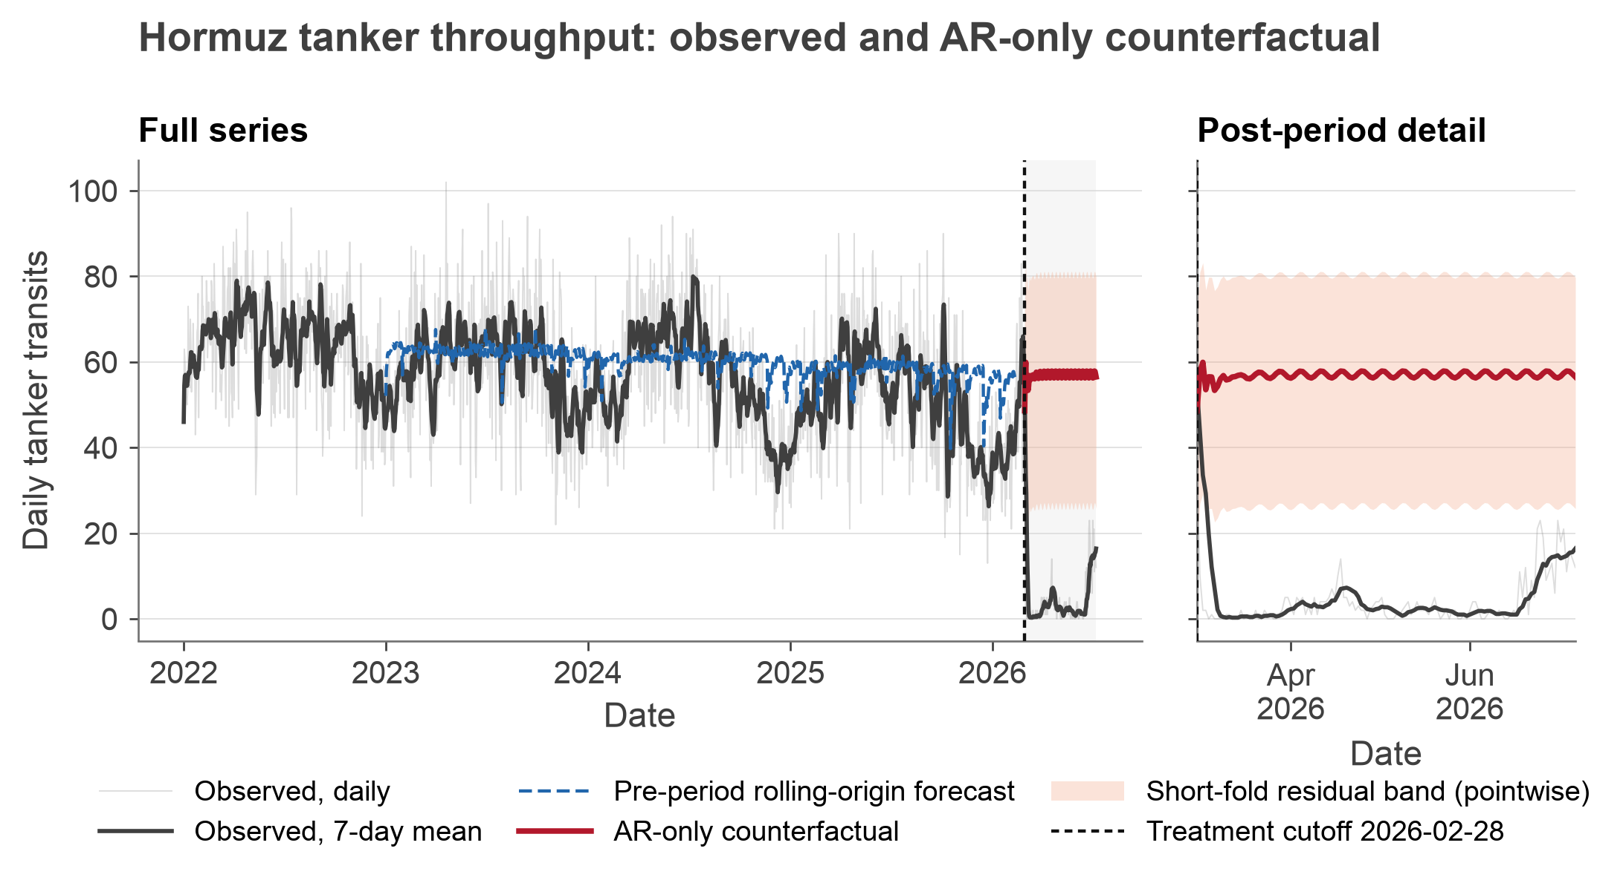
Headline result · the throughput collapse
6,869
transits below counterfactual (130 days)
52.8 / day
mean daily shortfall
−92.8%
observed below counterfactual throughput
AR-only counterfactual · IMF PortWatch n_tanker · disruption-associated descriptive shortfall · AIS-dark-vessel upper-bound risk · not LNG-specific freight
Notes:
[Sources]
data/processed/counterfactual_post_treatment_summary.csv
reports/figures/run_actual_vs_counterfactual.png
reports/run_output.md
[/Sources]

Slide 6
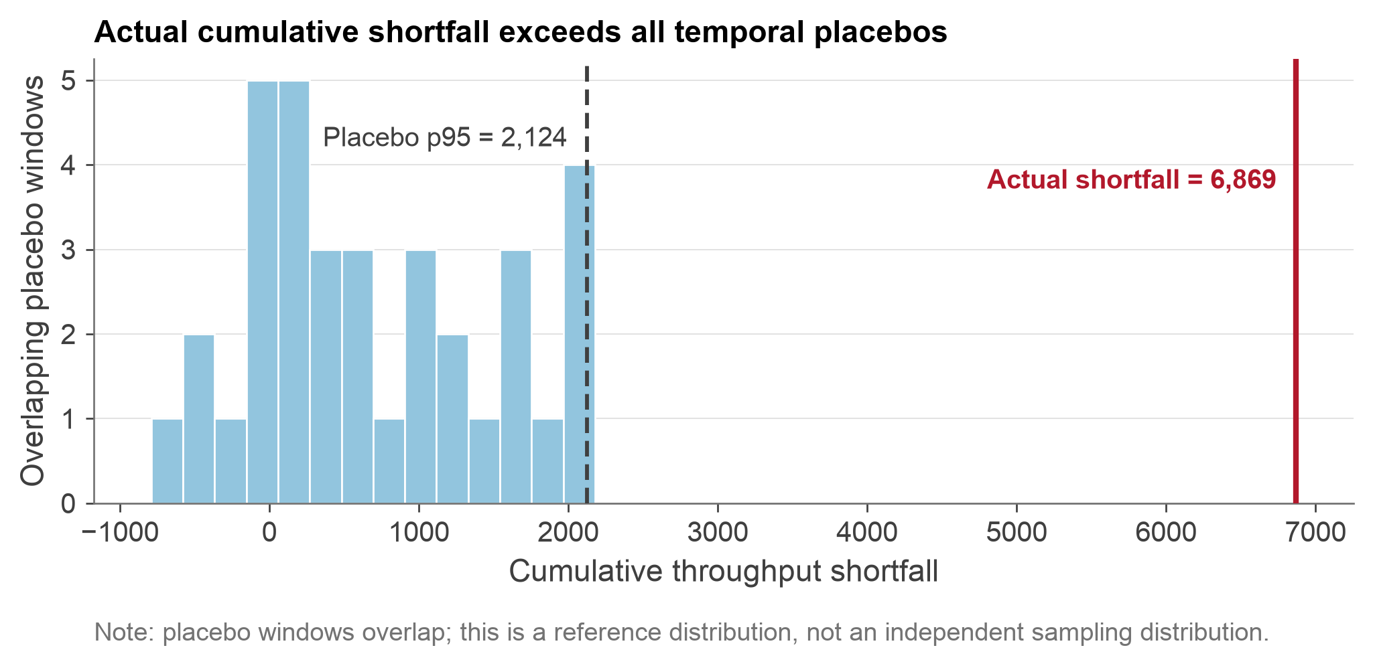
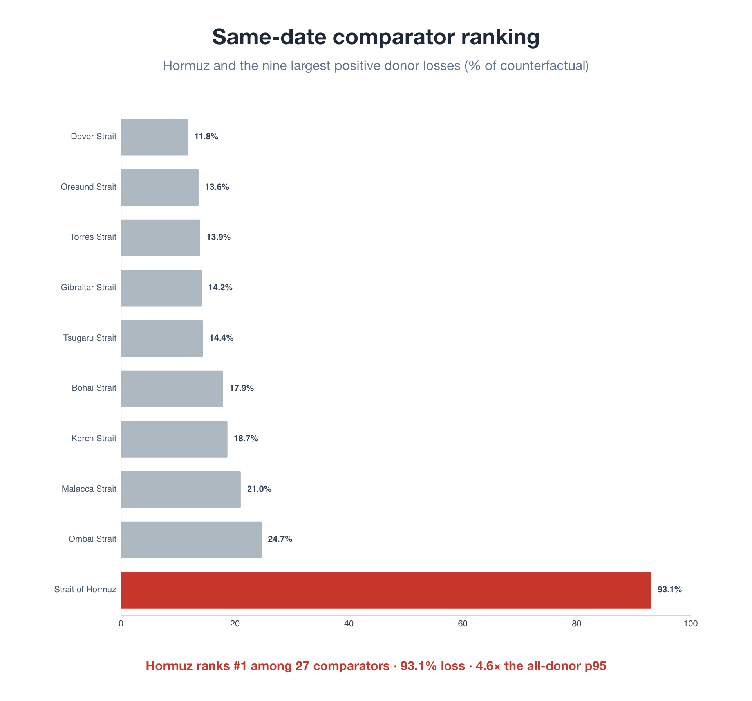
Diagnostics · placebo-in-time and placebo-in-space
Time: 7 disjoint blocks give rank p = 0.125; nominal 95% conformal interval is unbounded.
Space: Hormuz ranks #1; normalized loss is 93.1% and 4.6× the all-donor p95.
35 overlapping placebo windows are descriptive only (reference rank 1/36, not p) · normalized spatial loss leads because raw counts are scale-confounded
Notes:
[Sources]
data/processed/block_conformal_summary.csv
data/processed/placebo_time_summary.csv
data/processed/spatial_placebo_summary.csv
data/processed/spatial_placebo_effects.csv
reports/figures/run_placebo_distribution.png
[/Sources]

Slide 7
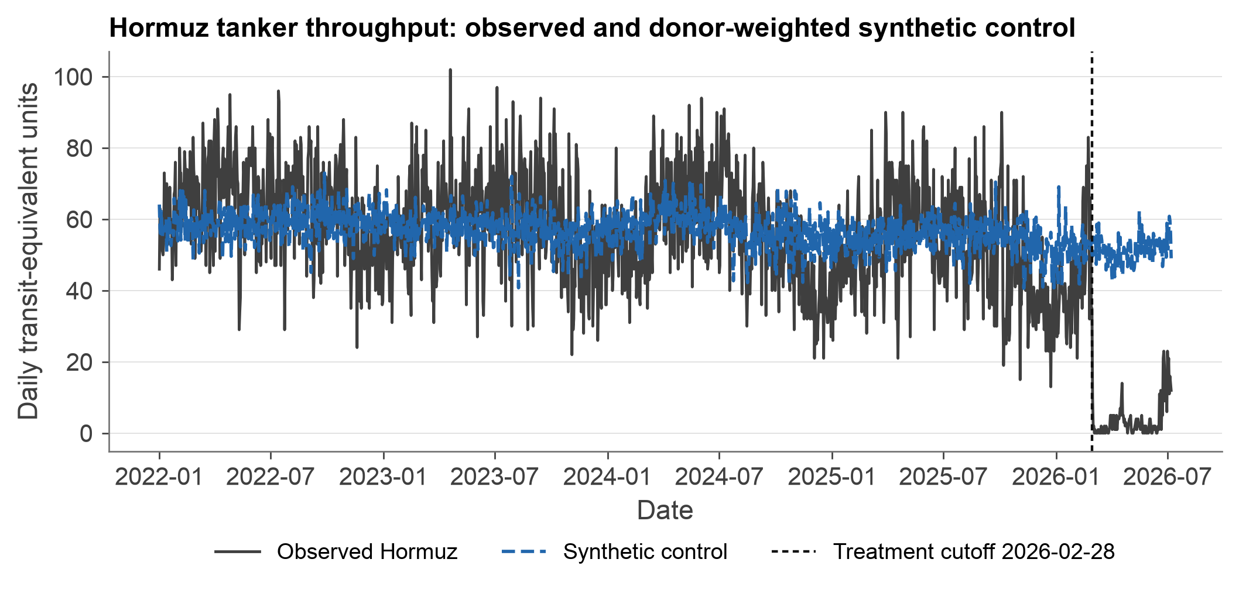
Corroboration · donor-weighted synthetic control
0.258
pre-period RMSPE (mean-scaled)
3.25
post / pre RMSPE ratio
2.17×
vs screened p95 · rank p = 0.067
2× pre-fit screen: 14/22 placebos eligible, 8 excluded · clean donor pool · mean-scaled shape match · corroboration, not an independent design
Notes:
[Sources]
data/processed/synthetic_control_summary.csv
reports/figures/run_synthetic_control_path.png
reports/run_output.md
[/Sources]

Slide 8
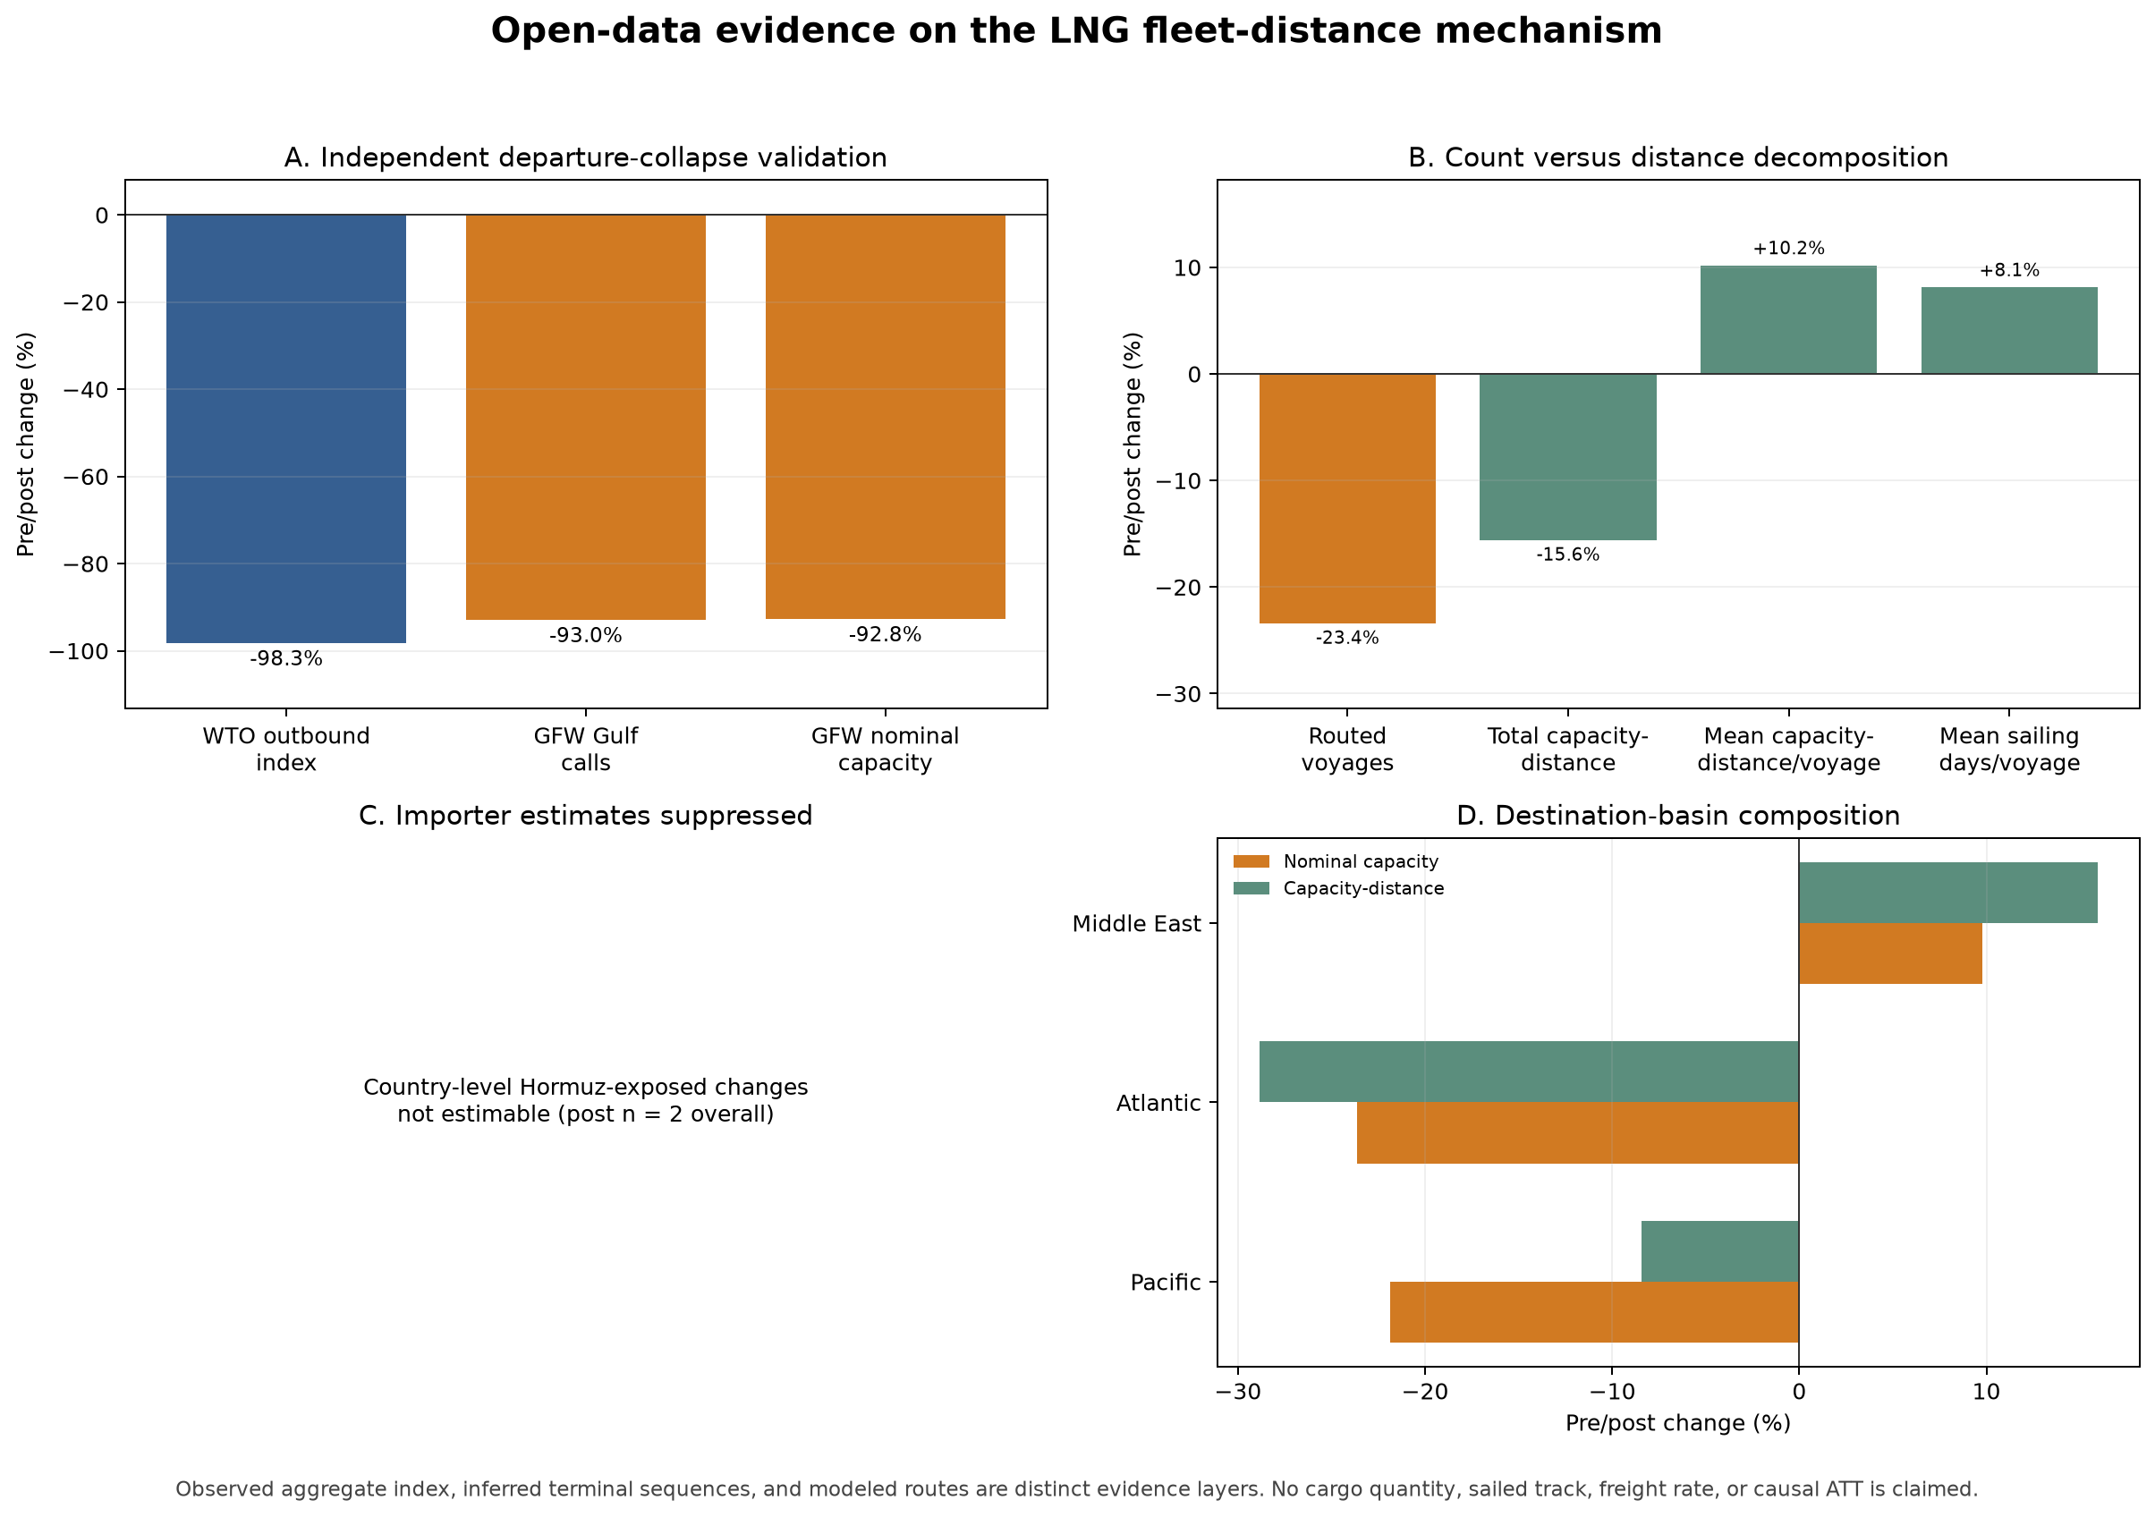
LNG mechanism · fewer voyages, longer each
Distinct descriptive cross-check
WTO/AXSMarine LNG outbound index: −98.3%
Inferred Gulf departure calls: −93.0%
Mean capacity-distance per voyage: +10.2%.
Observed aggregate index plus inferred terminal sequences and modeled routes — distinct layers, not cargo ton-miles, laden state, freight rates, or causal effects.
Source: data/processed/mechanism_evidence_summary.csv · reports/figures/mechanism_evidence_summary.png
Notes:
[Sources]
data/processed/mechanism_evidence_summary.csv
data/processed/inferred_capacity_nautical_miles_comparison.csv
reports/figures/mechanism_evidence_summary.png
[/Sources]

Slide 9
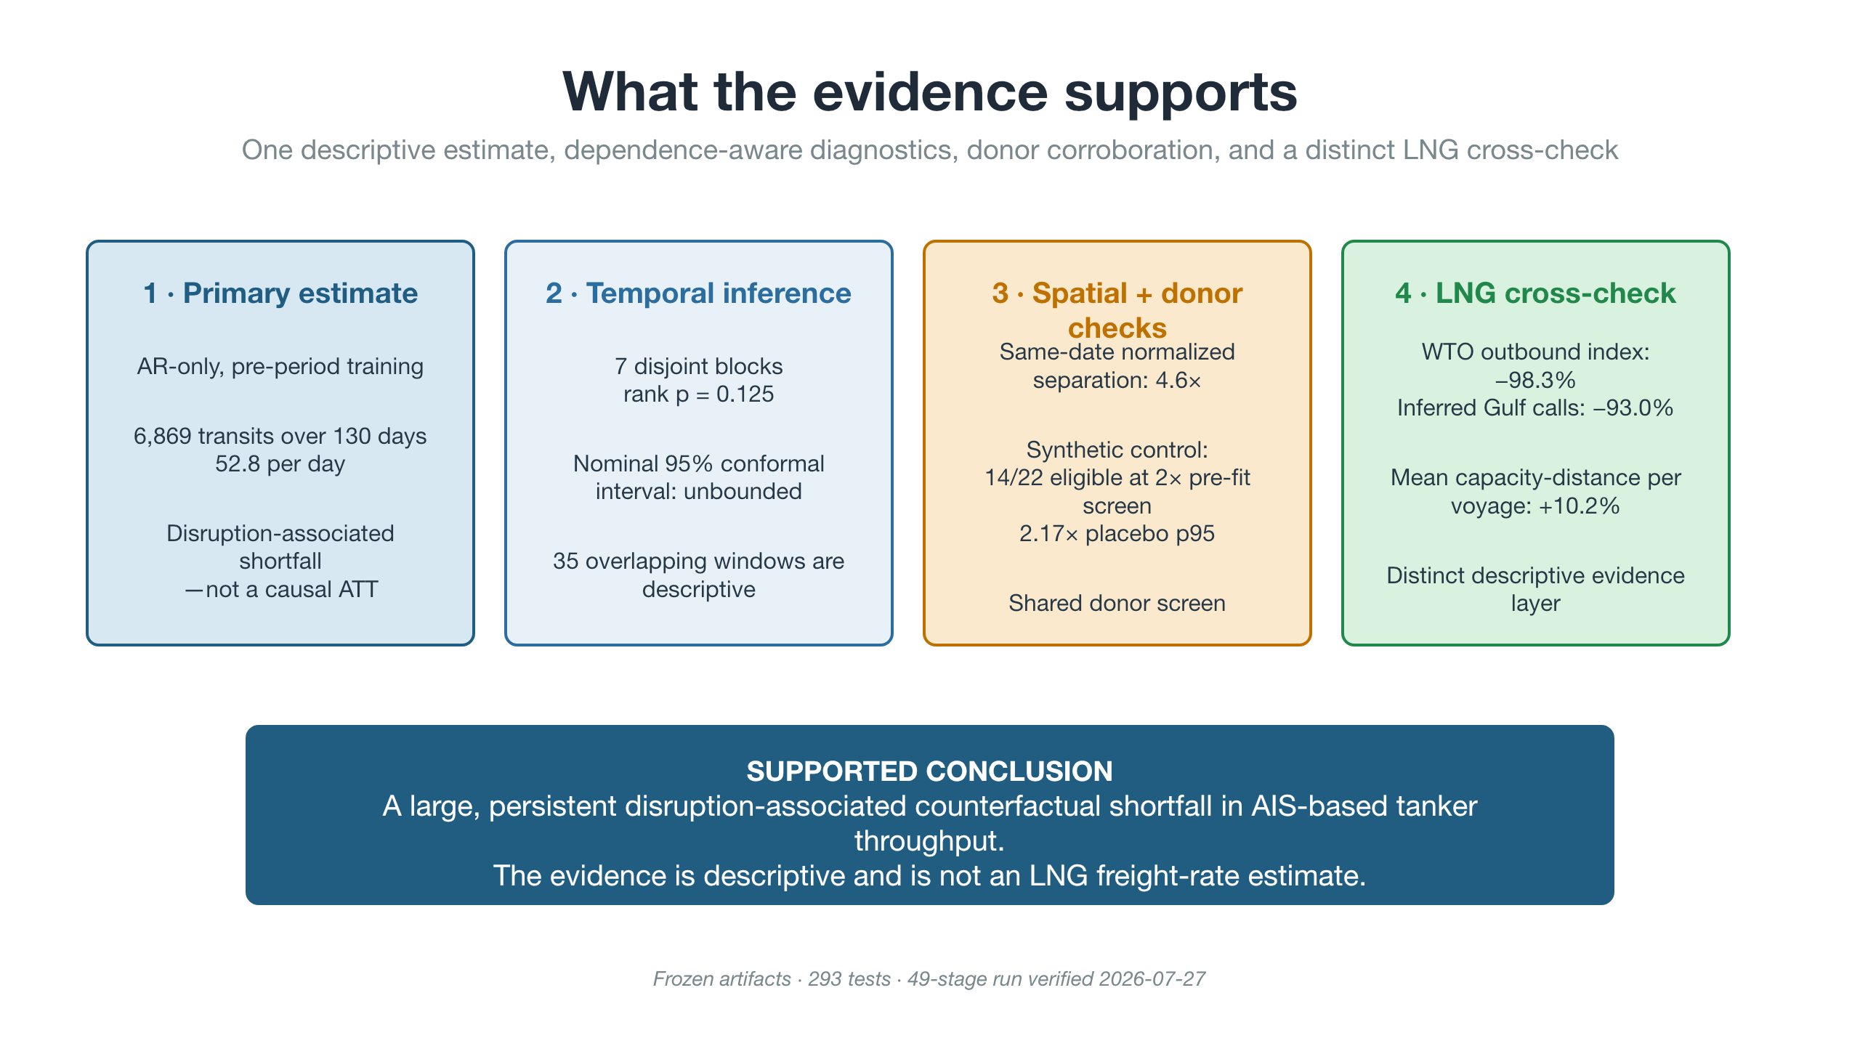
Notes:
[Sources]
reports/run_output.md
reports/current_results_summary.md
reports/reproducibility_run_transcript.txt
[/Sources]

Slide 10
Honest limitations & what's next
Stated plainly — these are defensible, not hidden
Limitations
Critical path & next steps
AIS-dark vessels may inflate the measured collapse → upper-bound risk.
7 disjoint blocks: rank p = 0.125; nominal 95% conformal interval unbounded.
Outcome is tanker throughput, not LNG-specific freight.
Mechanism evidence is descriptive, not causal.
Prof. Li or delegated-authority decision on the throughput-DV realignment.
Preserve the verified 49-stage run and frozen provenance contract.
Thesis write-up — empirical scope complete; claims remain descriptive.
Spark / Bloomberg freight outcome — optional, non-blocking upside.
Committed-scope empirical work complete · remaining critical path: governance decision, writing, and supervisor review.
Notes:
[Sources]
docs/AUDIT_REMEDIATION_REGISTER.md (GOV-01, INF-01, STALE-01)
reports/reproducibility_run_transcript.txt
[/Sources]

