Slide 1
Bachelor Thesis · TUM · Supervisor Review
Counterfactual Estimation of Tanker-Throughput
Disruption at the Strait of Hormuz
Forecasting and synthetic-control evidence from the 2026 episode
Mher Avetisyan · mher.avetisyan@tum.de · June 2026
2 independent anchors + corroboration
158 tests passing
Fully reproducible (SHA-256)
Free, immutable open data

Slide 2
Research question & estimand
How large and persistent was the disruption-associated shortfall in observable daily tanker throughput through the Strait of Hormuz, relative to counterfactual paths estimated exclusively from pre-disruption data?
Why throughput, not freight rates
Bloomberg / Spark LNG freight access is unconfirmed.
Committed fallback: a free, fully reproducible throughput DV.
The LNG freight-rate outcome is additive upside if access arrives.
Estimand realignment is drafted and pending Prof. Li sign-off.
Primary outcome
Daily tanker transit count (IMF PortWatch n_tanker)
Robustness outcome
Daily deadweight capacity of transiting tankers
Estimand
Cumulative & mean-daily observed-minus-counterfactual gap
Reporting language
Disruption-associated counterfactual shortfall — not a causal ATT
Source: PENDING_ESTIMAND_REALIGNMENT_DRAFT.md · IMF PortWatch · proposal-vs-thesis reconciliation pending supervisor approval

Slide 3
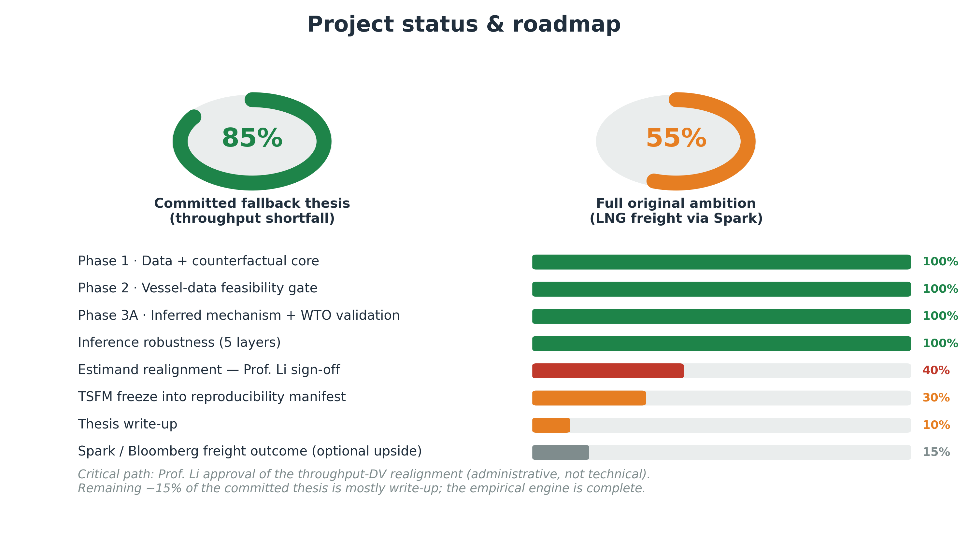
Where the project stands

Slide 4
Methodological discipline
1
Free, immutable data
PortWatch, EIA, FRED, Global Fishing Watch, WTO/AXSMarine — snapshotted and SHA-256 hashed.
2
Locked primary estimator
AR(1,7) with weekly seasonality, trained strictly on pre-disruption days. No post-treatment covariate can enter.
3
Leakage-safe validation
Chronological rolling-origin CV; cutoff fixed at 2026-02-28; later event dates are scoring windows only.
4
Identification, not fit
The claim rests on observed-minus-counterfactual + donor design — never on forecast accuracy. A better forecaster is not causal evidence.
Source: CLAUDE.md discipline rules · EVENT_CHRONOLOGY.md · src/lngfreight/{validation,baselines,inference}.py

Slide 5
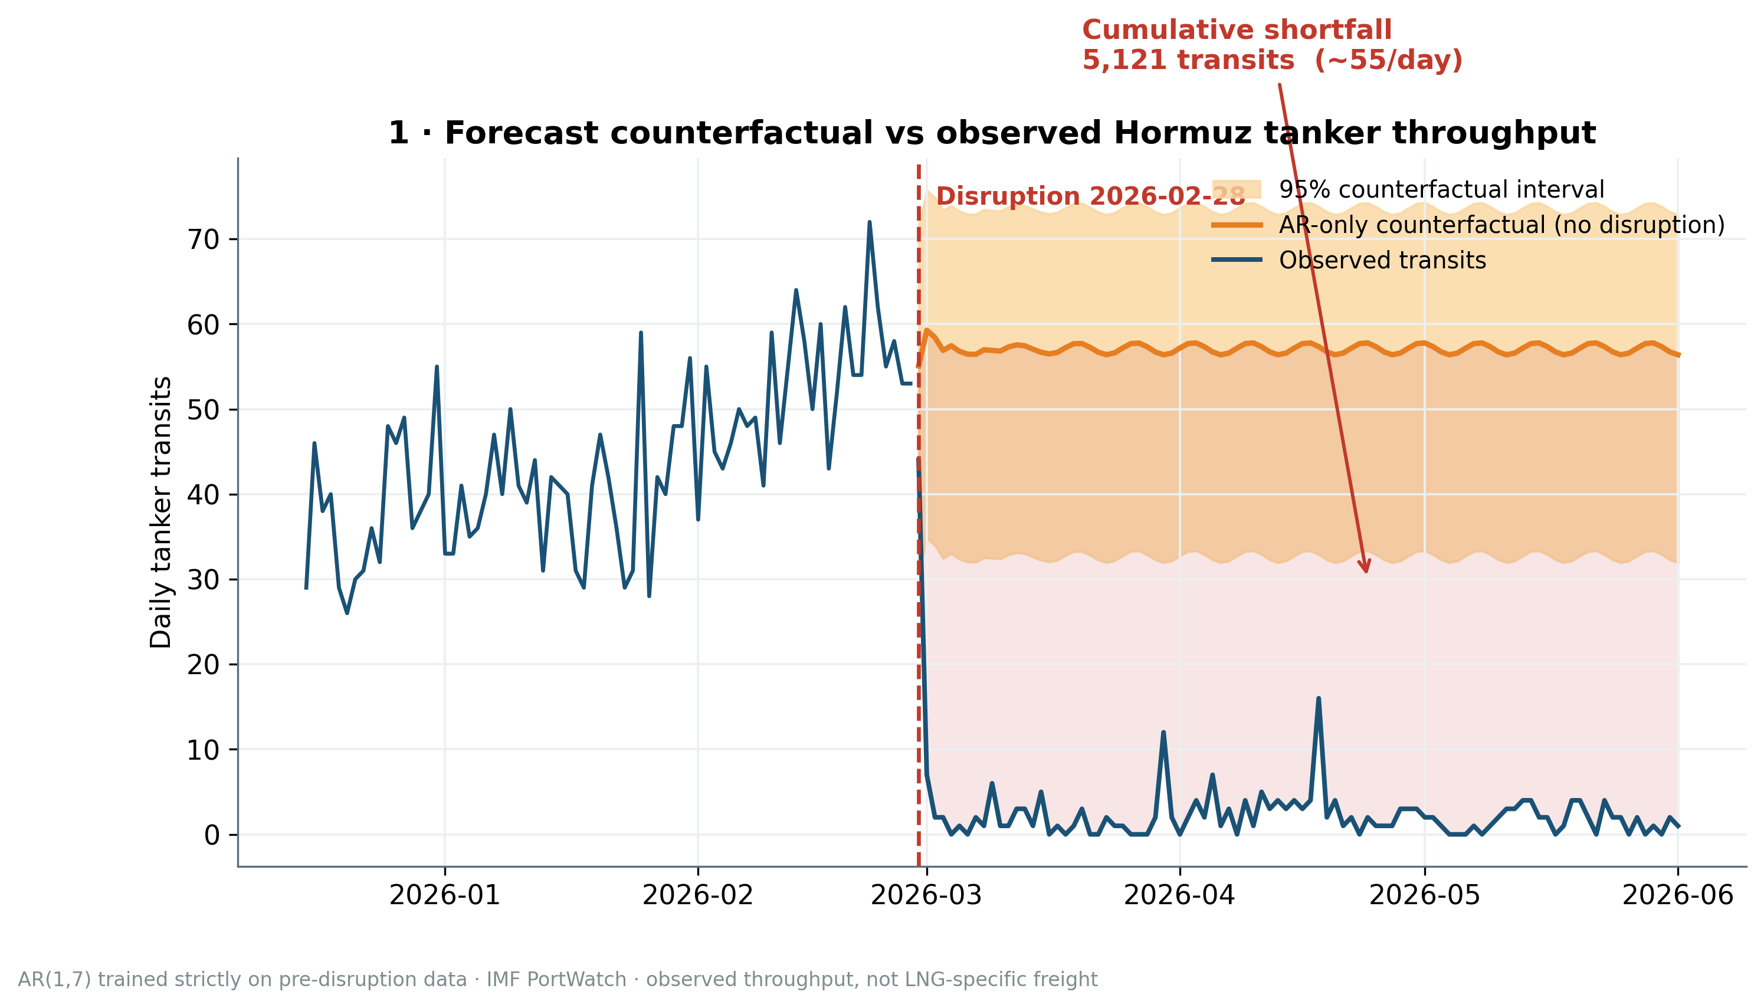
Headline result · the throughput collapse
5,121
tanker transits lost vs counterfactual (94 days)
~55 / day
mean daily shortfall
−96%
observed vs expected throughput
AR-only counterfactual, IMF PortWatch n_tanker · observed AIS-based throughput, an upper bound (vessels going dark) · not LNG-specific freight

Slide 6
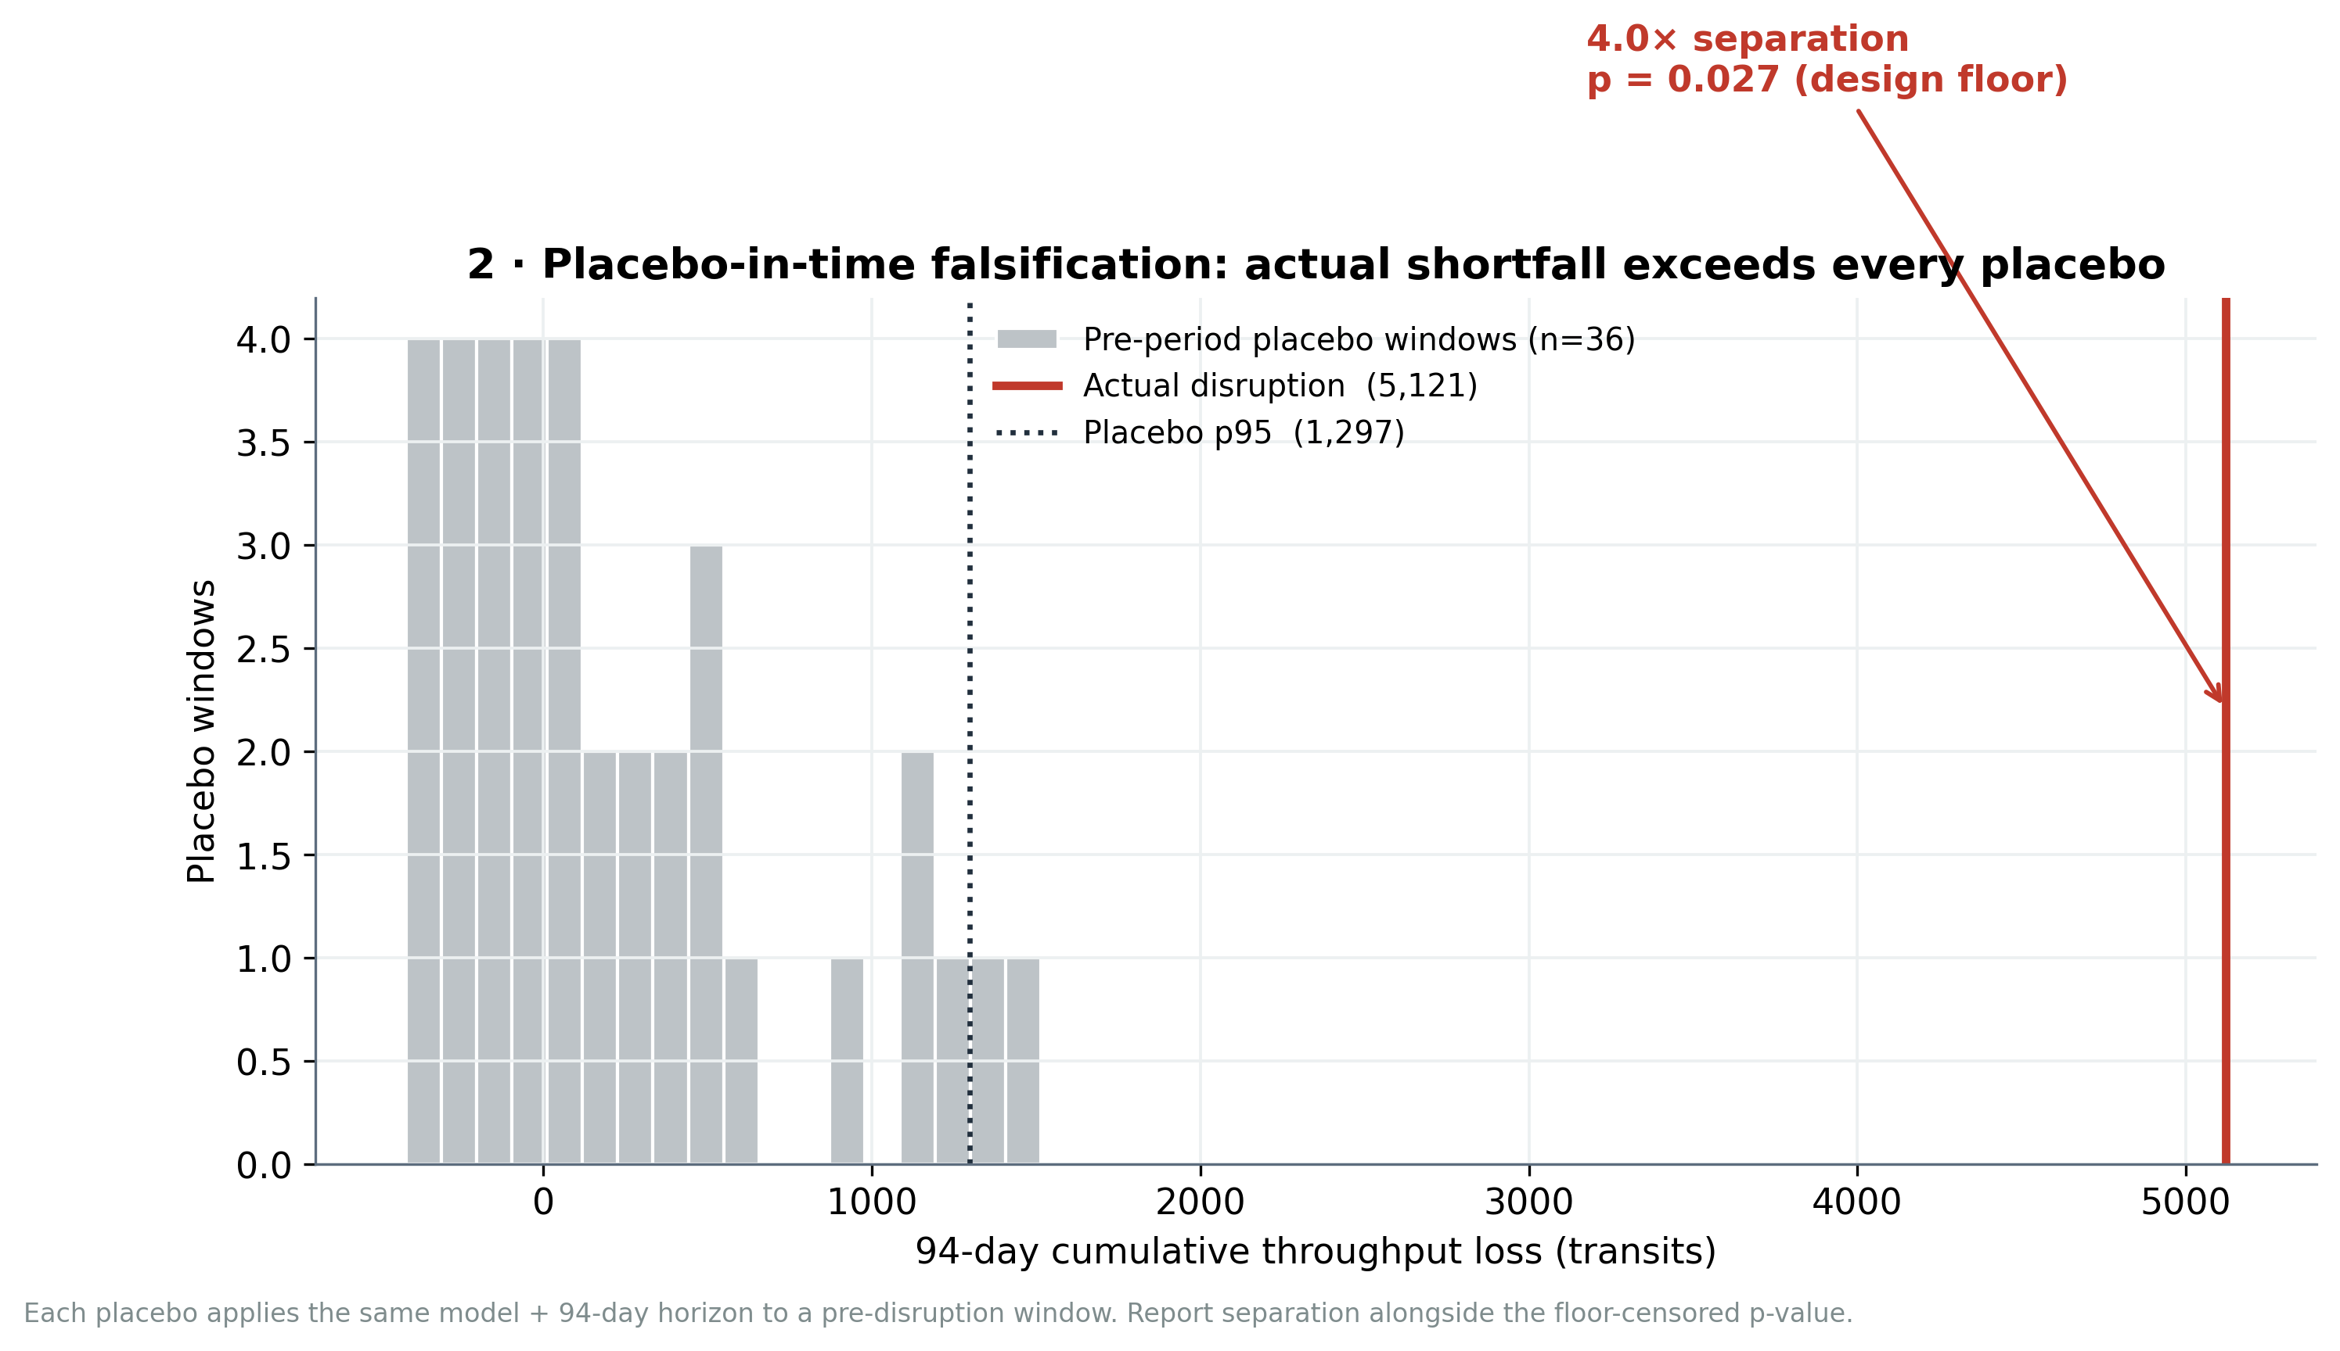
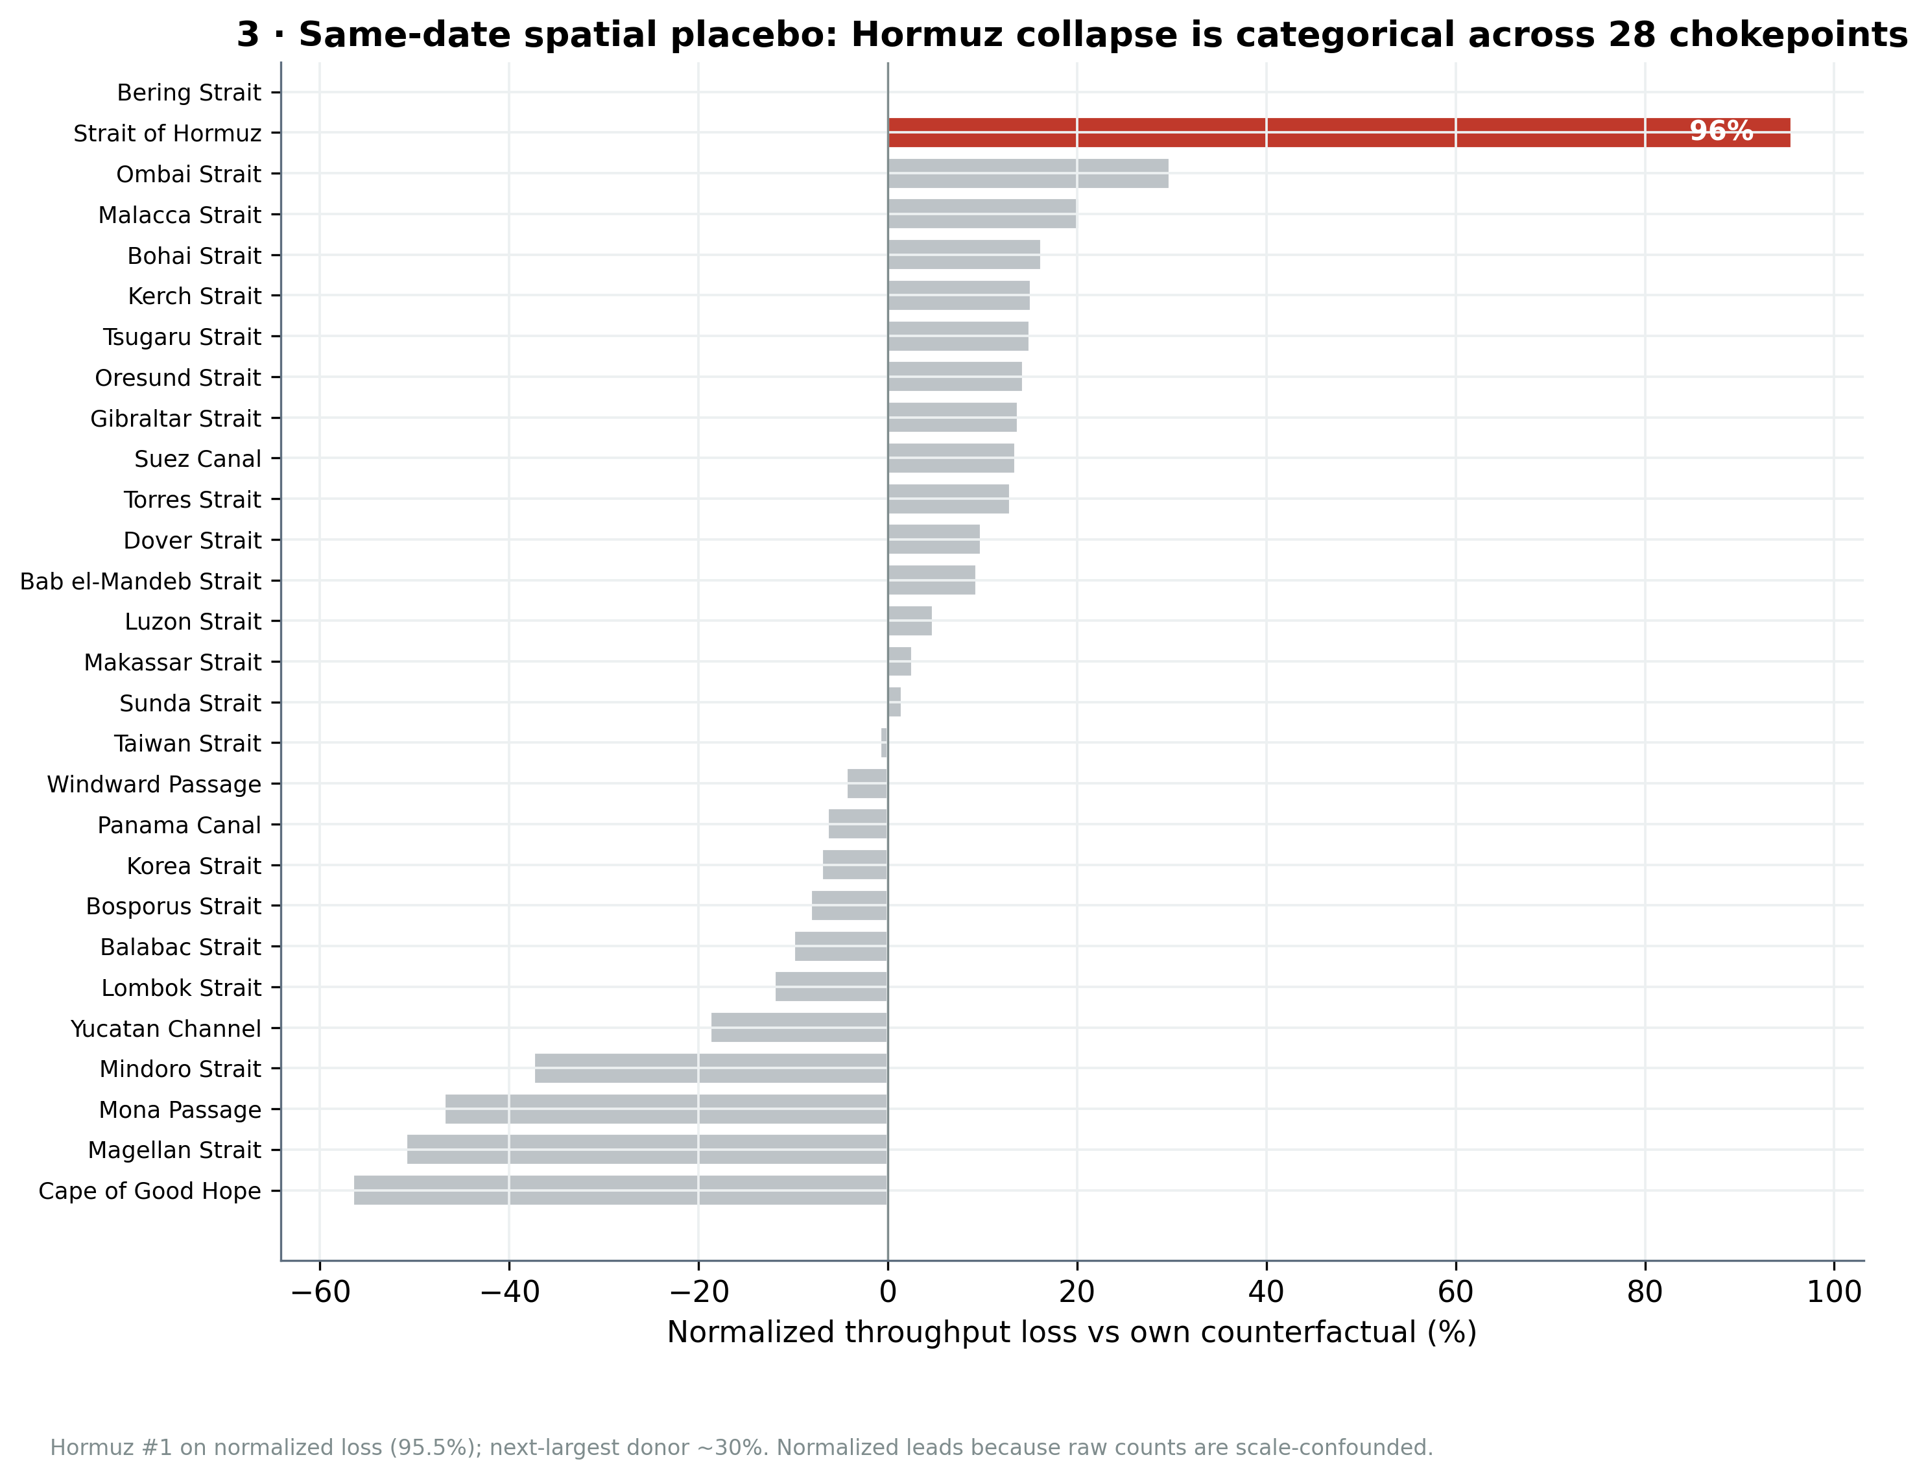
Falsification · placebo-in-time and placebo-in-space
Time: actual loss exceeds all 36 pre-period placebos — 4.0× separation, p = 0.027 (design floor).
Space: Hormuz ranks #1 of 28 chokepoints; collapse is categorical (95.5% vs next ~30%).
Lead with the separation ratio: ~9 non-overlapping horizon windows make the p-value floor-censored · normalized loss leads (raw counts scale-confounded)

Slide 7
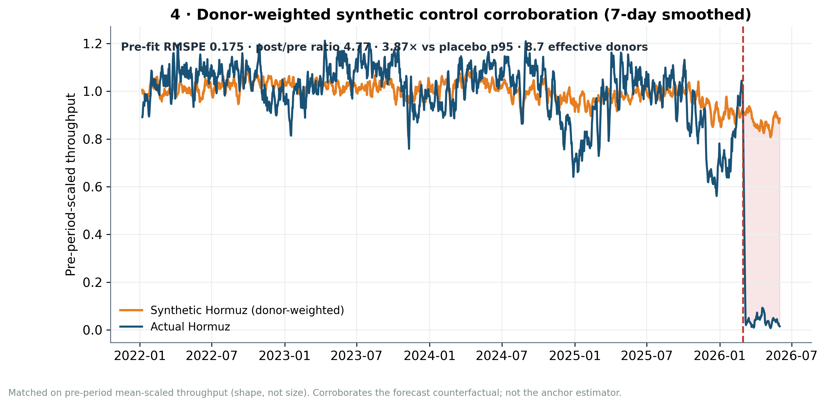
Corroboration · donor-weighted synthetic control
0.175
pre-period RMSPE (credible fit)
4.77
post / pre RMSPE ratio
3.87×
vs placebo p95 · p = 0.043
Clean donor pool (5 corridors excluded) · mean-scaled match (shape, not size) · corroboration · shares the contamination screen with the spatial placebo — not independent of it

Slide 8
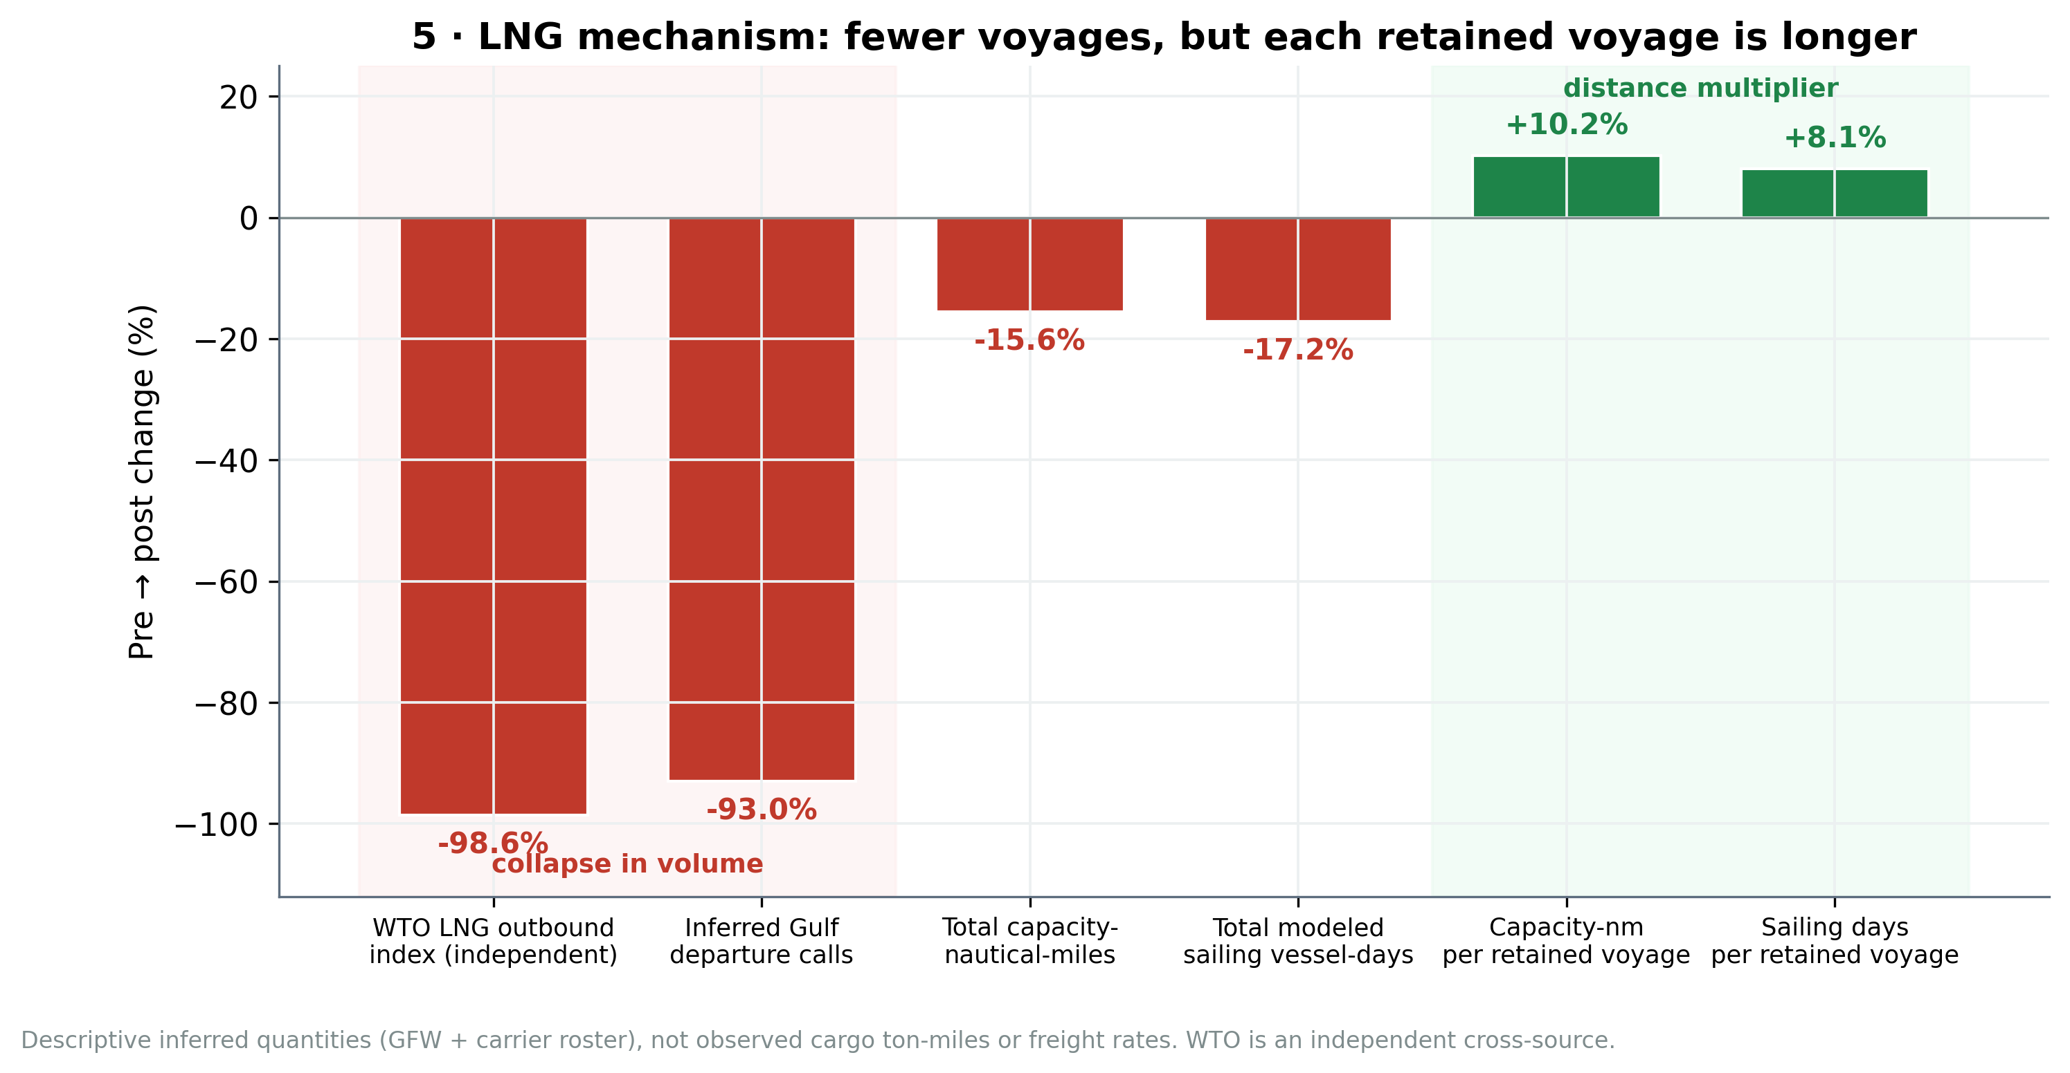
LNG mechanism · fewer voyages, longer each
Independent cross-check
WTO/AXSMarine LNG outbound index: −98.6%
Inferred Gulf departures: −93.0%
Two independent sources, no fitted scaling factor.
Descriptive inferred quantities (GFW + carrier roster) — not observed cargo ton-miles, laden state, or freight rates.
Source: mechanism_results_summary.md · GULF_DEPARTURE_WTO_VALIDATION_RESULTS.md

Slide 9
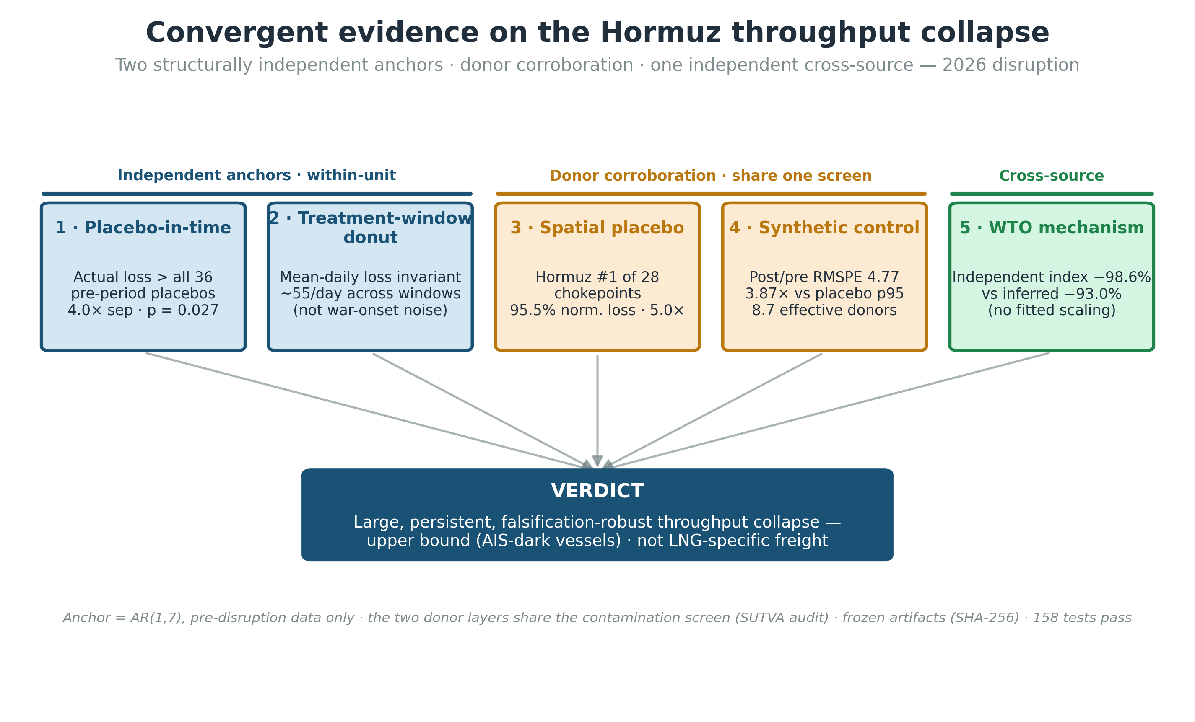

Slide 10
Honest limitations & what's next
Stated plainly — these are defensible, not hidden
Limitations
Critical path & next steps
Observed collapse is partly AIS-dark vessels → an upper bound.
p = 0.027 is a design floor; lead with the separation ratio.
Measures tanker throughput, not LNG-specific freight.
Mechanism layer is descriptive corroboration, not causal.
Prof. Li sign-off on the throughput-DV realignment (admin, not technical).
Freeze the TSFM benchmark run into the reproducibility manifest.
Thesis write-up — the empirical engine is complete.
Spark / Bloomberg freight outcome — optional, non-blocking upside.
Committed-scope thesis ~85% complete · empirical work done · remaining effort is mostly writing.

