Slide 1

JavaScript
Dr. Charles Severance
www.wa4e.com
http://www.wa4e.com/code/javascript
http://www.wa4e.com/code/javascript.zip
Notes:
https://www.destroyallsoftware.com/talks/wat

Slide 2


Time
Browser
Web Server
Database Server
DOM
Send
Request
Apache
MySql
Parse
Response
PHP
ind.php
PDO
JavaScript
http://www.wa4e.com/code/rrc/

Slide 3
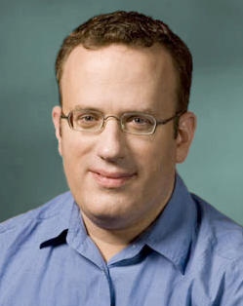
About JavaScript
Introduced in Netscape in 1995
Developed by Brandon Eich
Named to make use of Java market buzz
Standardized today as ECMAScript
http://en.wikipedia.org/wiki/Brendan_Eich

Slide 4

<html>
<head>
<title>Hello World</title>
</head>
<body>
<p>One Paragraph</p>
<script type="text/javascript">
document.write("<p>Hello World</p>")
</script>
<noscript>
Your browser doesn't support or has disabled JavaScript.
</noscript>
<p>Second Paragraph</p>
</body>
</html>
js-01.htm

Slide 5
Low-Level Debugging
When in doubt, you can always add an alert() to your JavaScript.
The alert() function takes a string as a parameter and pauses the JavaScript execution until you press “OK”.

Slide 6
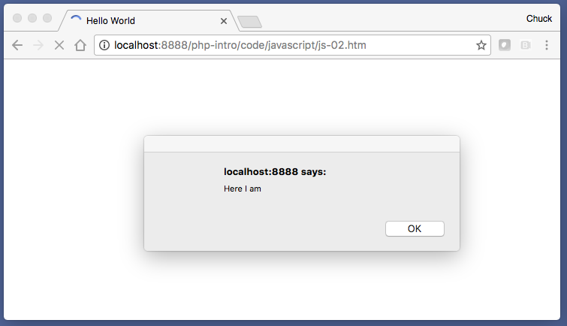
<html>
<head>
<title>Hello World</title>
</head>
<body>
<p>One Paragraph</p>
<script type="text/javascript">
alert("Here I am");
document.write("<p>Hello World</p>")
</script>
<noscript>
Your browser doesn't support or has disabled JavaScript.
</noscript>
<p>Second Paragraph</p>
</body>
</html>
js-02.htm

Slide 7
Including JavaScript
Three Patterns:
  Inline within the document
  As part of an event in an HTML tag
  From a file

Slide 8
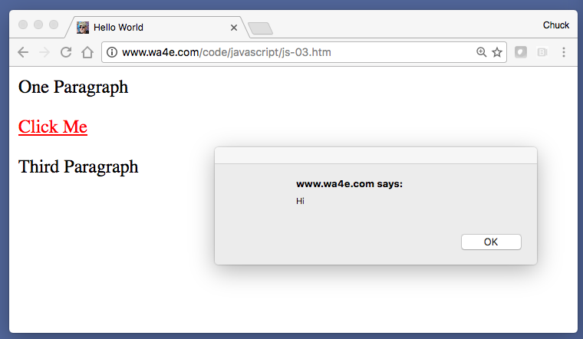
<html>
<head>
<title>Hello World</title>
</head>
<body>
<p>One Paragraph</p>
<p><a href="js-01.htm"
onclick="alert('Hi'); return false;">Click Me</a></p>
<p>Third Paragraph</p>
</body>
</html>
js-03.htm
JavaScript on a tag

Slide 9
<html>
<head>
<title>Hello World</title>
</head>
<body>
<p>One Paragraph</p>
<script type="text/javascript" src="script.js">
</script>
<p>Third Paragraph</p>
</body>
</html>
JavaScript in a separate file
script.js:
document.write("<p>Hello World</p>");
js-04.htm

Slide 10
Basic JavaScript

Slide 11
Syntax Errors
As in any language, we can make syntax errors
By default, browsers silently eat any kind of JavaScript error
But the code stops running in that file or script section

Slide 12
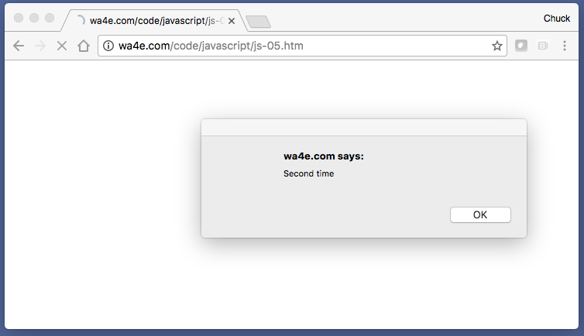
<p>One Paragraph</p>
<script type="text/javascript">
alert("I am broken');
alert("I am good");
</script>
<p>Two Paragraph</p>
<script type="text/javascript">
alert("Second time");
</script>
<p>Three Paragraph</p>
js-05.htm

Slide 13
Seeing the Error
Since the end user really cannot take any action to fix the JavaScript coming as part of a web page, the browser eats the errors.
As developers, we need to look for the errors - sometimes it takes a minute to even remember to check for a JS error.

Slide 14
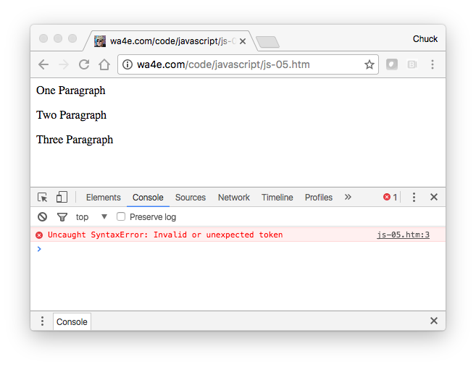
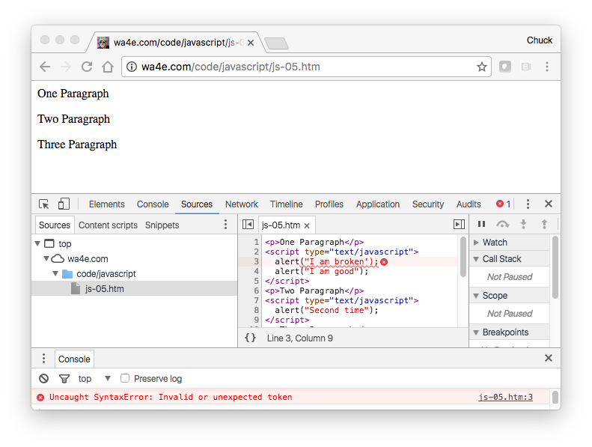
js-05.htm

Slide 15
Console Logging
Debugging using alert() can get tiring - sometimes you want to record what happens in case something goes wrong
console.log("String") - and many more functions
Note: Requires recent browsers

Slide 16
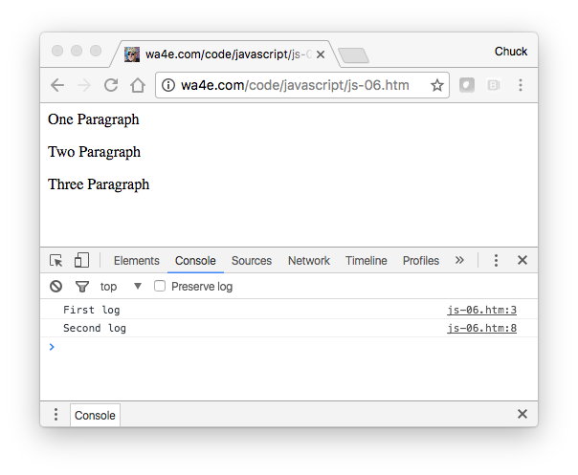
<p>One Paragraph</p>
<script type="text/javascript">
console.log("First log");
alert("YO");
</script>
<p>Two Paragraph</p>
<script type="text/javascript">
console.log("Second log");
</script>
<p>Three Paragraph</p>
js-06.htm

Slide 17
Console is Not Always There
Some browsers only define the console if a debugger is running.
window.console && console.log(...)
if (typeof console == "undefined") {
this.console = {log: function() {} }
}
http://stackoverflow.com/questions/3326650/console-is-undefined-error-for-internet-explorer

Slide 18
Using the Debugger (Chrome)
Get into a source view.
Click on a line of JavaScript to set a breakpoint.
Reload the page.

Slide 19
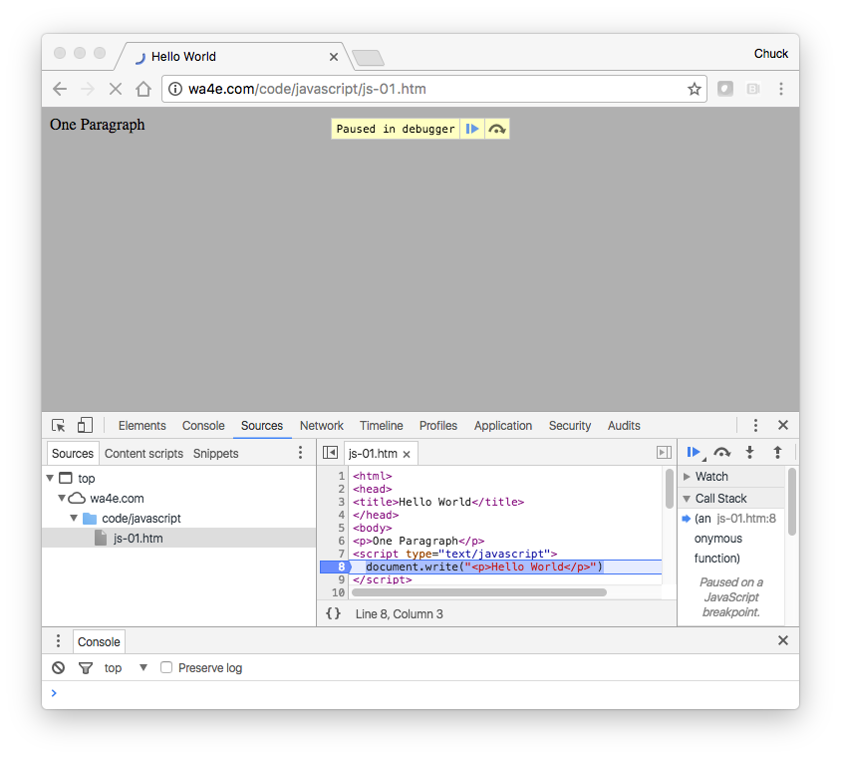

Slide 20
JavaScript – Core Language Features

Slide 21
Comments in JavaScript = Awesome
// This is a comment
/* This is a section of
multiline comments that will
not be interpreted */

Slide 22
Statements
White space and newlines do not matter.
Statements end with a semicolon ;
There are cases where you can leave the semicolon off, but don’t bother exploiting this feature - just add semicolons like in C, Java, PHP, C++, etc.

Slide 23
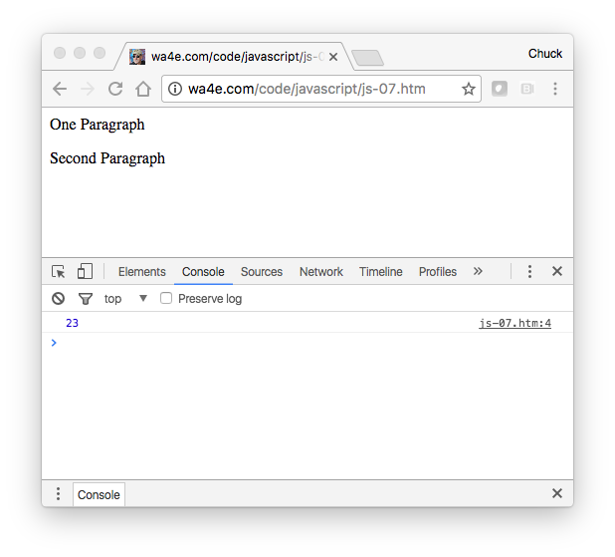
<p>One Paragraph</p>
<script type="text/javascript">
x = 3 +
5 * 4; console.log(
x);
</script>
<p>Second Paragraph</p>
js-07.htm

Slide 24
Variable Names
Valid Characters: a-z, A-Z, 0-9, _ and $
Must not start with a number
Names are case sensitive
Starting with a dollar sign is considered “tacky”

Slide 25
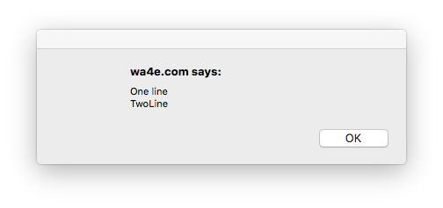
String Constants
js-08.htm
Double or Single Quotes - Single quotes are used typically in JavaScript and we let HTML use double quotes to keep our minds a little sane.
Escaping - done using the backslash character
<script type="text/javascript">
alert('One line\nTwoLine');
</script>

Slide 26
Numeric Constants
As you would expect…

Slide 27
JavaScript – Variables and Expressions

Slide 28
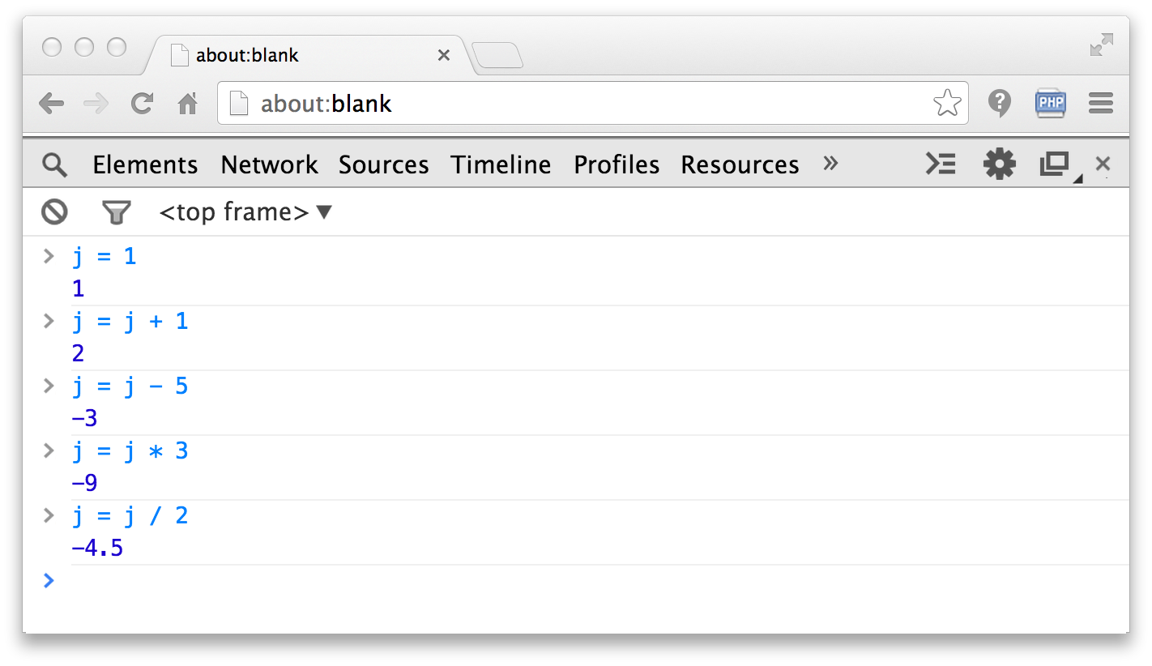
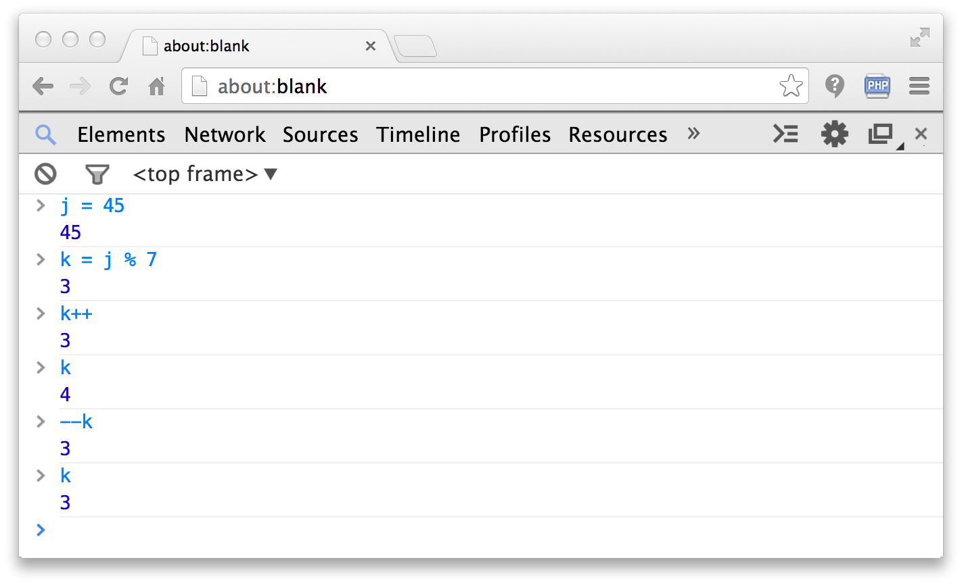
Operators

Slide 29
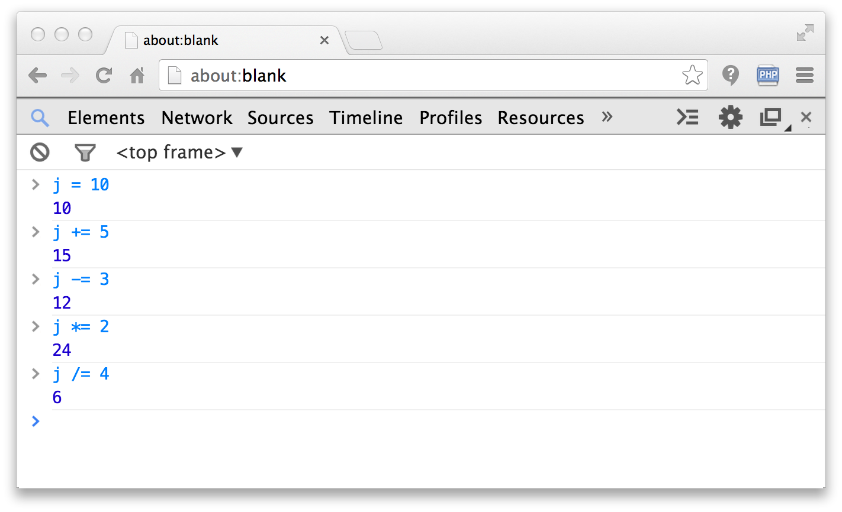
Assignment (side effect) Operators

Slide 30
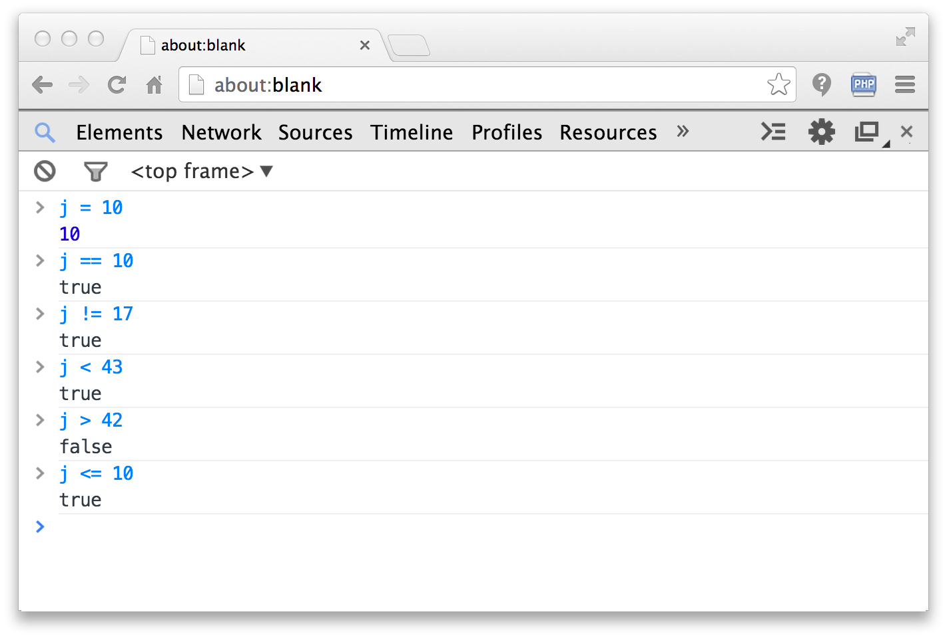
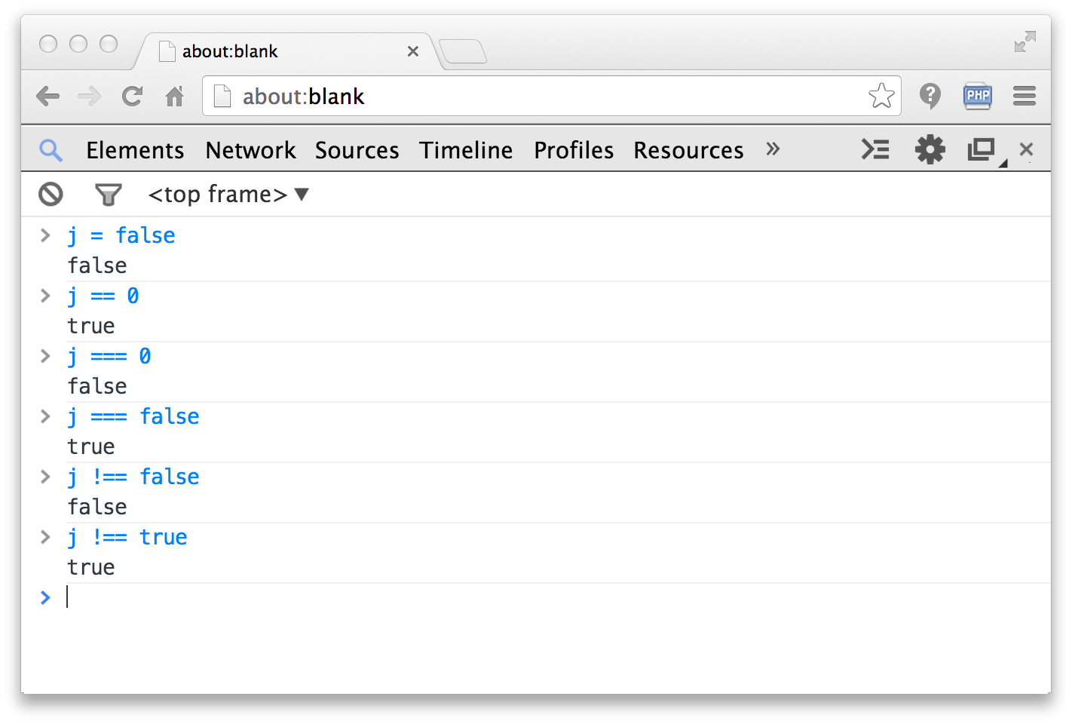
Comparison Operators

Slide 31
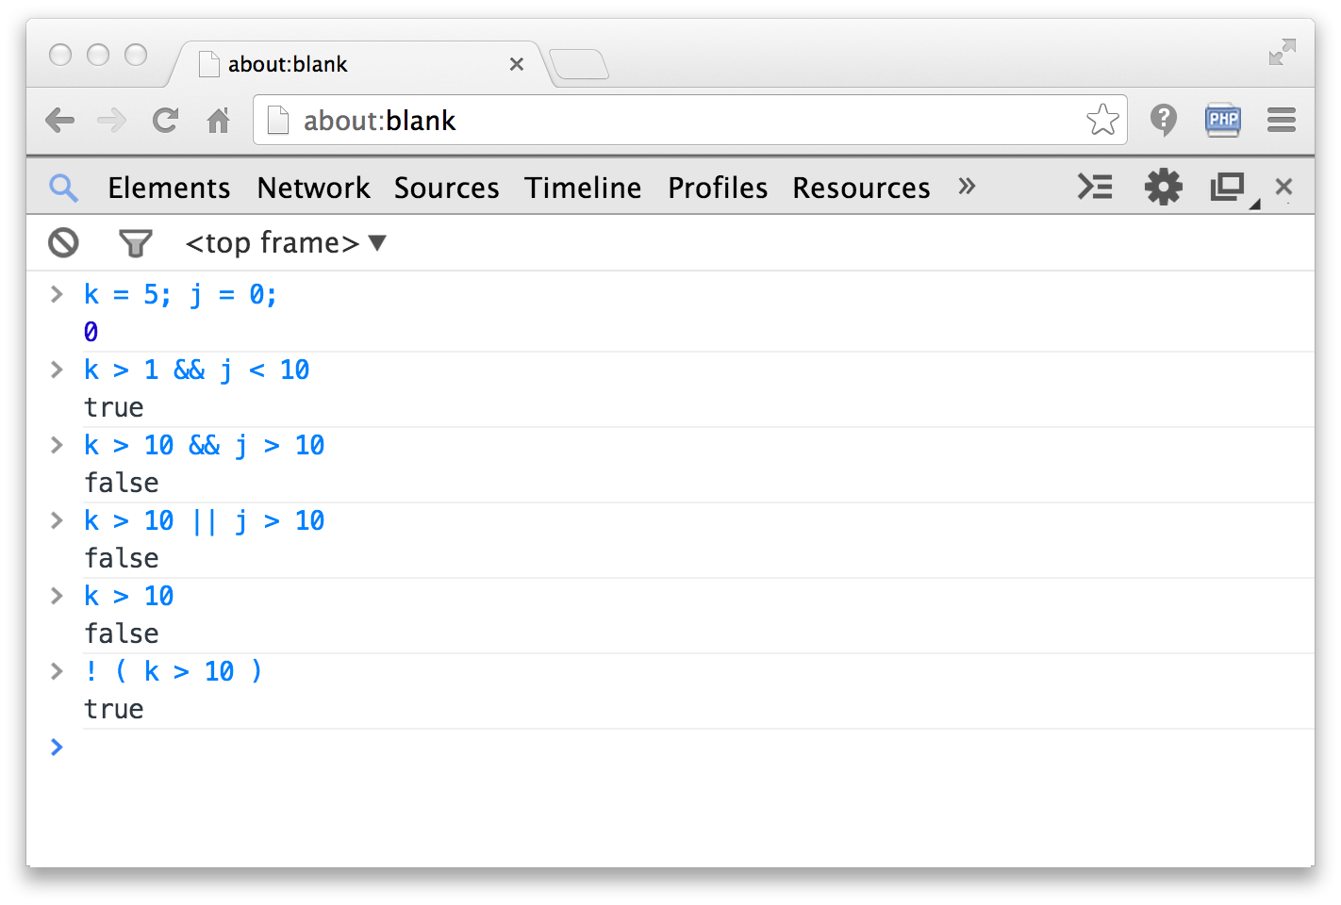
Logical Operators

Slide 32
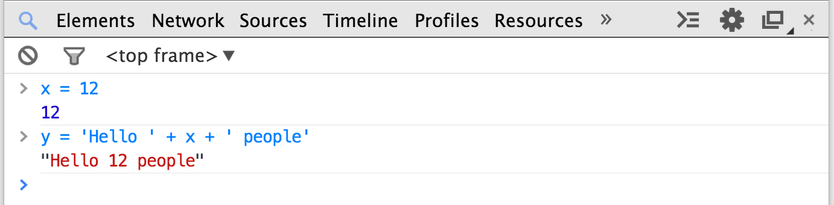
String Concatenation
JavaScript string concatenation is like Python and Java and uses “+”, versus PHP which uses “.”
Like the PHP “.” operator, it automatically converts non-string values to strings as needed.

Slide 33
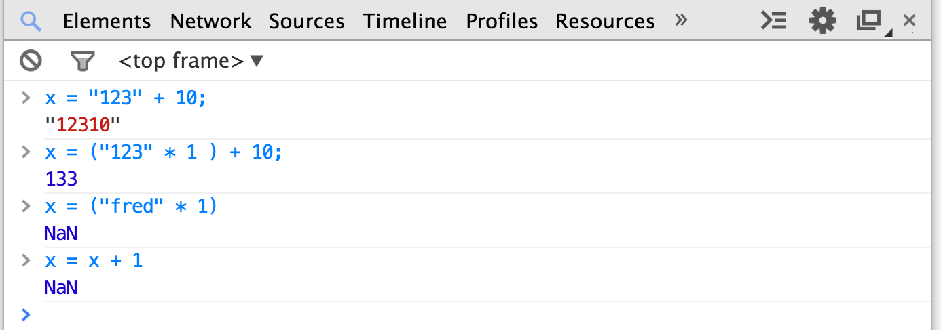
Variable Typing
JavaScript is a loosely typed language and does automatic type conversion when evaluating expressions.

Slide 34
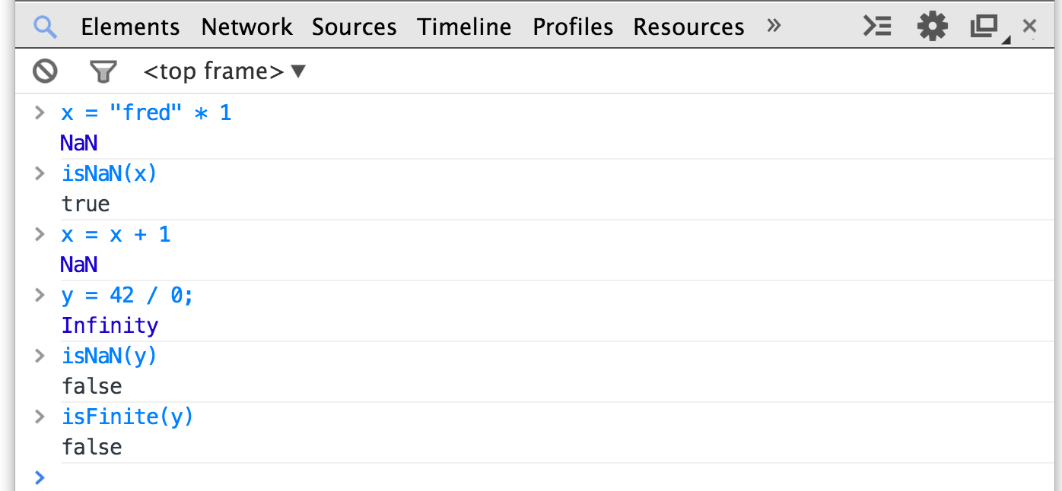
Variable Conversion
If a string cannot be converted to a number, you end up with “Not a Number” or “NaN”. It is a value, but it is sticky - all operations with NaN as a operand end up with NaN.

Slide 35
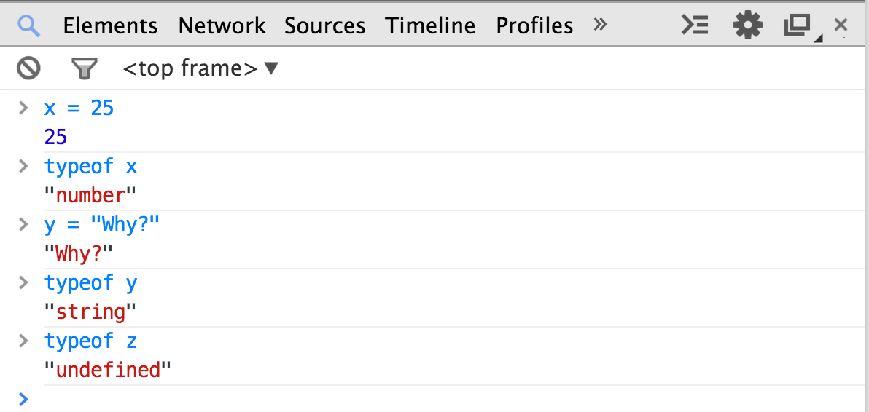
Determining Type
JavaScript provides a unary typeof operator that returns the type of a variable or constant as a string.

Slide 36
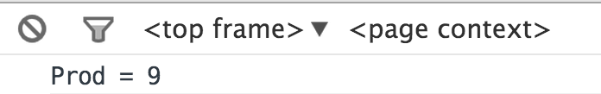
Functions
js-09.htm
Functions use a typical syntax and are indicated using the function keyword.
The return keyword functions as expected.
<script type="text/javascript">
function product(a,b) {
value = a + b;
return value;
}
console.log("Prod = "+product(4,5));
</script>

Slide 37
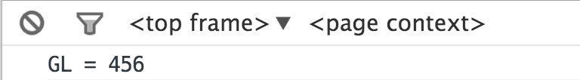
Scope - Global (default)
js-10.htm
Variables defined outside a function that are referenced inside of a function have global scope.
This is a little different than what we expect.
<script type="text/javascript">
gl = 123;
function check() {
gl = 456;
}
check();
window.console && console.log("GL = "+gl);
</script>

Slide 38
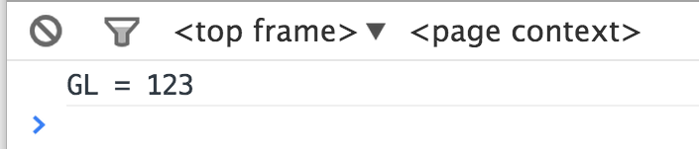
Making a Variable Local
js-11.htm
In a function, the parameters (formal arguments) are local and any variables we mark with the var keyword are local too.
<script type="text/javascript">
gl = 123;
function check() {
var gl = 456;
}
check();
window.console && console.log("GL = "+gl);
</script>

Slide 39
JavaScript – Arrays and Control Structures

Slide 40
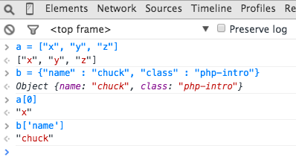
Arrays in JavaScript
JavaScript supports both linear arrays and associative structures, but the associative structures are actually objects.

Slide 41
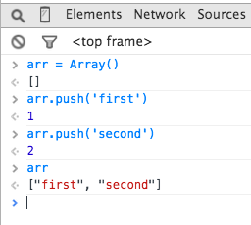
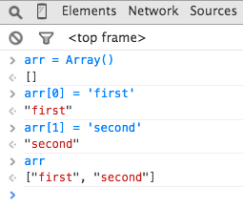
Linear Arrays

Slide 42
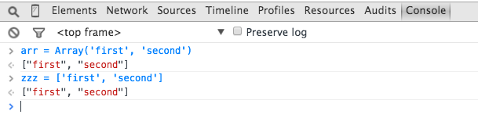
Array Constructor / Constants

Slide 43
Control Structures
We use curly braces for control structure.
Whitespace / line ends do not matter.
if statements are like PHP.
while loops are like PHP.
Counted for loops are like PHP – for( ; ; ) ...
In loops, break and continue are like PHP.

Slide 44
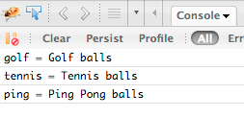
Definite Loops (for)
js-12.htm
balls = {"golf": "Golf balls",
"tennis": "Tennis balls",
"ping": "Ping Pong balls"};
for (ball in balls) {
console.log(ball+' = '+balls[ball]);
}

Slide 45
JavaScript -
Document Object Model

Slide 46
Time
Browser
Web Server
Database Server
DOM
Send
Request
Apache
MySql
Parse
Response
PHP
ind.php
PDO
JavaScript
http://www.wa4e.com/code/rrc/

Slide 47
Document Object Model
JavaScript can manipulate the current HTML document.
The “Document Object Model” tells us the syntax to use to access various “bits” of the current screen to read and/or manipulate.
You can even find pieces of the model by id attribute and change them.
We can read and write the DOM from JavaScript.
http://en.wikipedia.org/wiki/Document_Object_Model

Slide 48
DOMs are Not Identical
Not all browsers represent their page exactly the same way.
This makes it a challenge to keep all of your JavaScript working on all browsers.
It also means you need to test your code over and over on each browser.
Aargh..

Slide 49
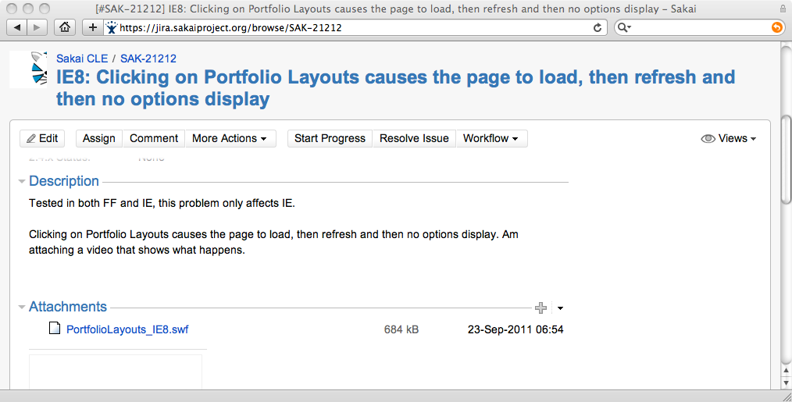

Slide 50
Using getElementById()
In order not to have to traverse each unique DOM, we use a function call that all browsers support. This allows us to bypass the DOM structure and jump to a particular tag within the DOM and manipulate that tag.

Slide 51
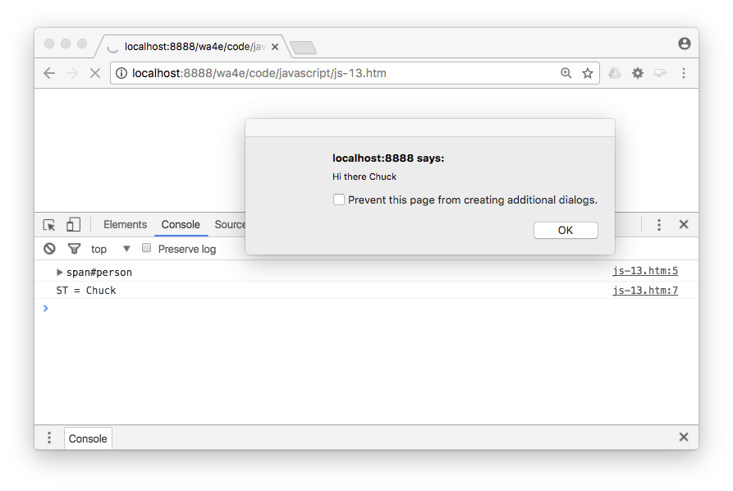
<p>
Hello <b><span id="person">Chuck</span></b> there.
</p>
<script type="text/javascript">
st = document.getElementById('person').innerHTML;
console.log("ST = "+st);
console.dir(document.getElementById('person'));
alert('Hi there ' + st);
document.getElementById('person').innerHTML = 'Joseph';
</script>
js-13.htm

Slide 52
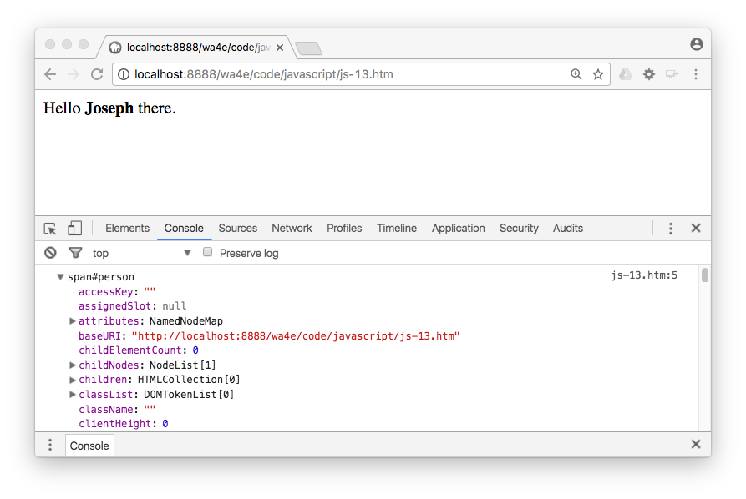
js-13.htm
console.dir(document.getElementById('person'));

Slide 53
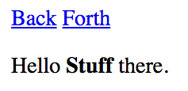
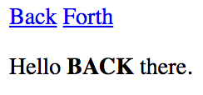
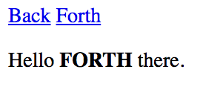
Updating the Browser Document
<a href="#"
onclick="document.getElementById('stuff').innerHTML='BACK';return false;">
Back</a>
<a href="#"
onclick="document.getElementById('stuff').innerHTML='FORTH';return false;">
Forth</a>
</p>
<p>
Hello <b><span id="stuff">Stuff</span></b> there.
js-14.htm
This is one reason why you can only have one id per document.

Slide 54
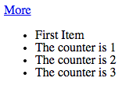
<p>
<a href="#" onclick="add();return false;">More</a>
</p>
<ul id="the-list">
<li>First Item</li>
</ul>
<script>
counter = 1;
console.log(document.getElementById('the-list'))
function add() {
var x = document.createElement('li');
x.className = "list-item";
x.innerHTML = "The counter is "+counter;
document.getElementById('the-list').appendChild(x);
counter++;
}
</script>
Js-15.htm

Slide 55
JQuery to the Rescue
While the DOMs are not particularly portable, and direct DOM manipulation is a little clunky, there are a number of JavaScript frameworks that handle the myriad of subtle differeces between browsers.
With JQuery, instead of manipulating the DOM, we use JQuery functions and everything works much better...
http://jquery.org

Slide 56
Summary
Using JavaScript
Syntax errors
Debugging
Language features
Global and local scope
Arrays
Control structures
Document Object Model
JQuery

Slide 57
Acknowledgements / Contributions
These slides are Copyright 2010- Charles R. Severance (www.dr-chuck.com) as part of www.wa4e.com and made available under a Creative Commons Attribution 4.0 License. Please maintain this last slide in all copies of the document to comply with the attribution requirements of the license. If you make a change, feel free to add your name and organization to the list of contributors on this page as you republish the materials.
Initial Development: Charles Severance, University of Michigan School of Information
Insert new Contributors and Translators here including names and dates
Continue new Contributors and Translators here
Notes:
Note from Chuck. Please retain and maintain this page as you remix and republish these materials. Please add any of your own improvements or contributions.

