Slide 1

Customer Shopping Behavior Analysis
Uncovering insights from 3,900 purchases to guide strategic business decisions

Slide 2

Dataset Overview
3,900
18
Total Purchases
Data Columns
Transaction records analyzed
Comprehensive transaction data
37
Missing Values
Only in Review Rating column

Slide 3
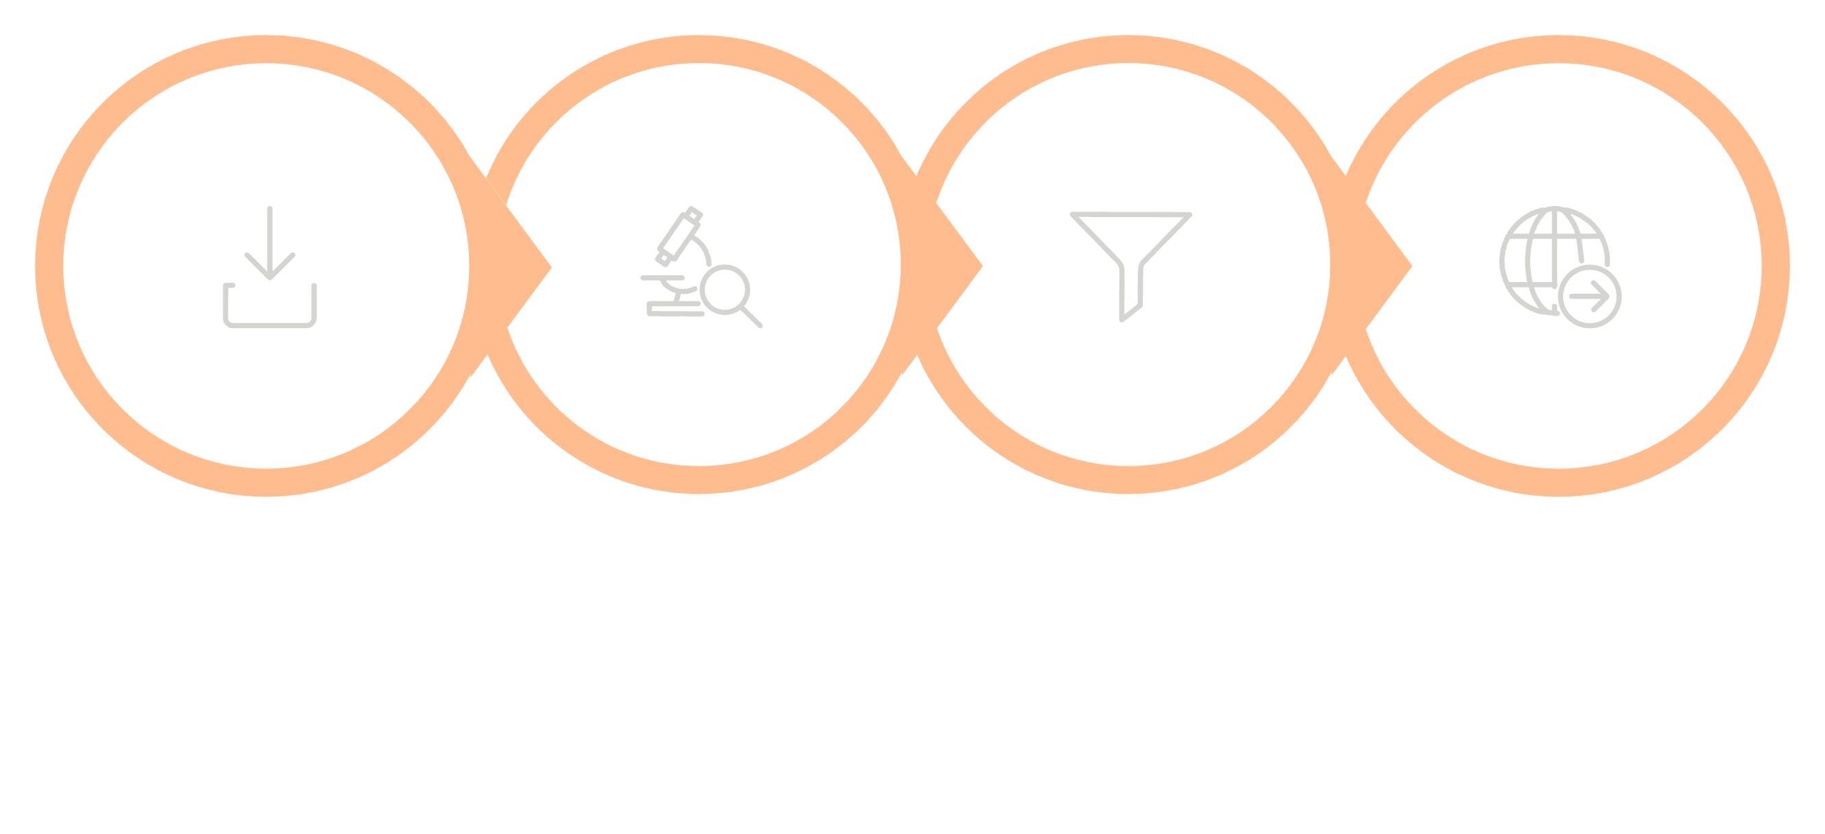

Data Preparation Process
Handle Missing
Engineer & Save
Load Data
Explore
A clean, structured dataset was the foundation for all downstream analysis.

Slide 4


Revenue by Gender Analysis
Key Insight
Female customers generate slightly higher total revenue than male customers
Gender-based marketing strategies could optimize revenue streams

Slide 5

High-Value Discount Users
Who They Are
Smart Shoppers
Customers using discounts while spending above average
High spenders who maximize value with discounts
Strategic Opportunity
Target premium customers with exclusive offers

Slide 6

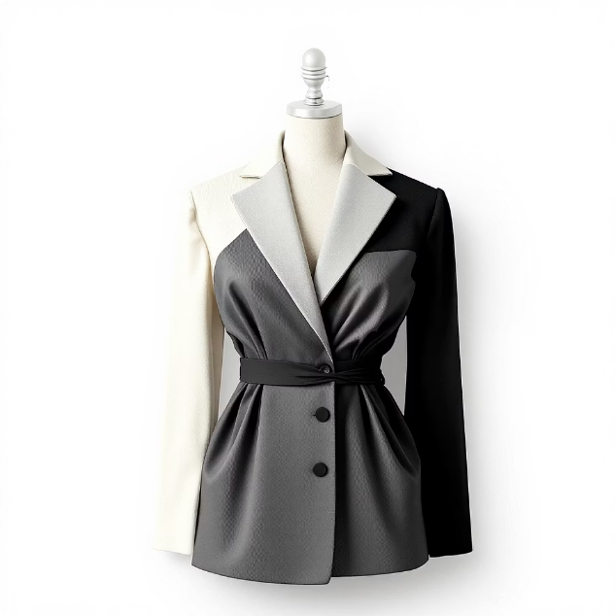
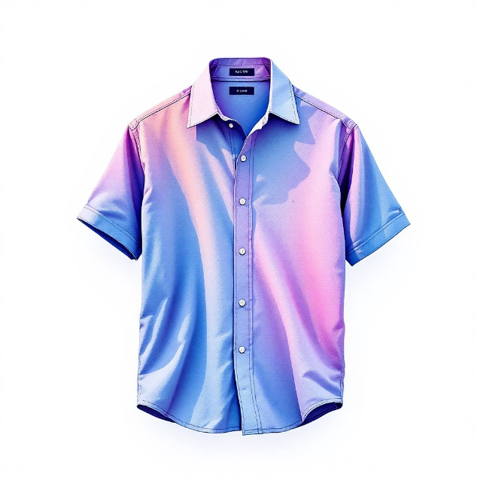
Top-Rated Products
Blouse
Dress
Shirt
Highest customer satisfaction
Consistently excellent reviews
Strong customer approval

Slide 7
Shipping Preferences Impact
Express Shipping
Standard Shipping
$65
$58
Average purchase amount
Average purchase amount
Express shipping customers spend 12% more per transaction — a signal of purchase intent and urgency.

Slide 8



Subscription Impact
Higher Spend
Revenue Share
Loyalty Rate
Subscribers vs non-subscribers
From subscription customers
Repeat purchase frequency

Slide 9



Customer Segmentation
1
Loyal — 15%
2
Returning — 35%
3
New — 50%
Focus on converting New → Returning → Loyal

Slide 10

Strategic Recommendations
Boost Subscriptions
Promote exclusive benefits for subscribers
Loyalty Programs
Reward repeat buyers to increase retention
Targeted Marketing
Focus on high-revenue segments and express users
Product Positioning
Highlight top-rated products in campaigns

