Slide 1
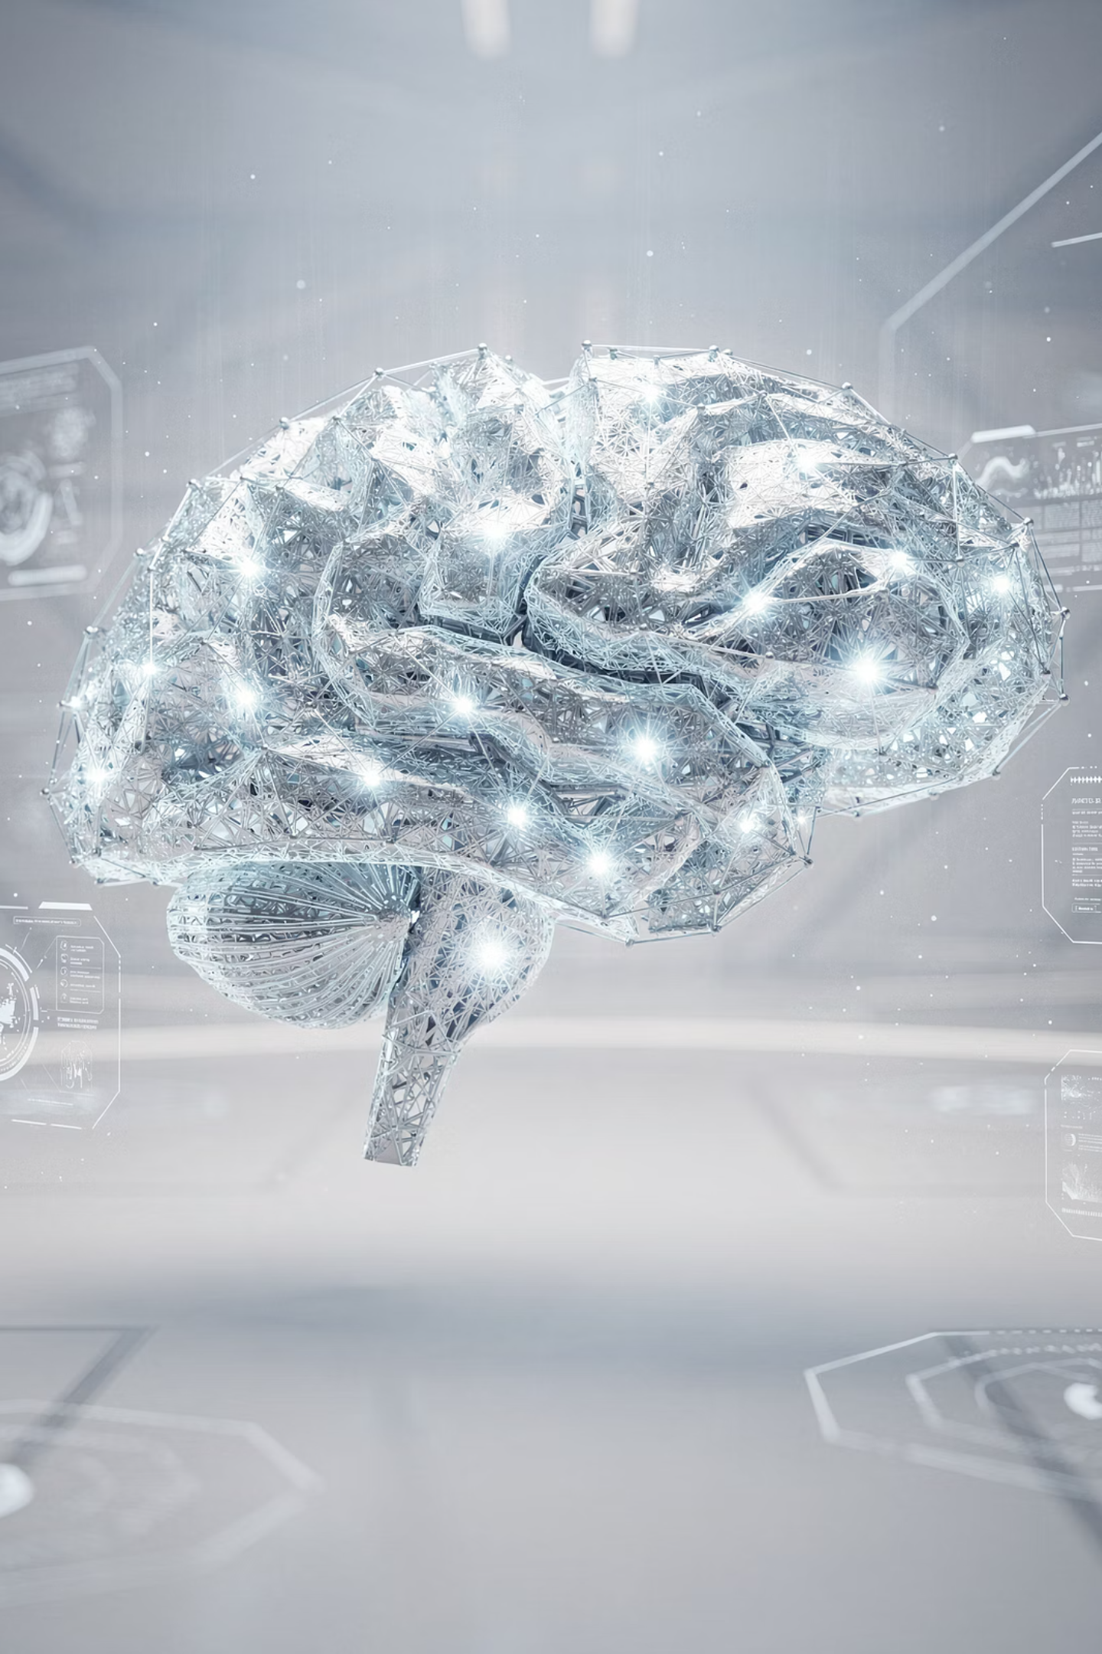
AmaDema AI Training Programme
Day 3: Understanding AI Under the Hood
How Computers Turn Words Into Predictions
Notes:
Welcome to Day 3. Days 1-2 taught you how to use AI—frameworks, IP protection, verification. Today we answer the "why." As engineers, you trust tools you understand. By the end of today, you'll understand the mechanism from words to predictions, why AI hallucinates, and how to prevent it. This transforms you from AI users to informed practitioners.

Slide 2
Days 1-2: How to Use AI
From Application → Understanding
Days 1-2: How to Use AI
Today: How AI Actually Works
AUTOMAT/CO-STAR frameworks
Words become mathematical coordinates
Red List & IP protection
Why "Large" matters (attention + scale)
Verification basics
Why AI hallucinates & how to stop it
Notes:
Quick recap. Days 1-2: practical application skills. Today: the mechanism behind those skills. Understanding how AI works makes you better at using it. You'll see why structured prompts work, why hallucinations happen, and why verification isn't optional. Let's look under the hood.

Slide 3
Today's Journey
Part 1: NLM Foundations
Part 2: The "Large" in LLM
Part 3: Truth vs. Probability
How words become coordinates in semantic space
Attention mechanism + scale = context understanding
Why models hallucinate & grounding techniques
Notes:
Three parts building on each other. Part 1: Foundation—how words become coordinates. Part 2: Scale—how attention enables context. Part 3: Critical section—hallucinations and prevention. We'll use materials science analogies throughout. You already have the mental models; we're just mapping them to AI.

Slide 4
PART 1
Neural Language Models FOUNDATIONS
How Words Become Coordinates
The foundation of all AI language processing
Notes:
Part 1: Neural Language Model foundations. The core problem: computers can't read "steel" or "polymer." They need mathematics. This section shows how AI converts words into coordinates in mathematical space using a concept you already know from materials engineering.

Slide 5
You Already Know This Concept!
Materials Property Space
Material
Density
Strength
Conductivity
Steel
7.85
400-550
50
Aluminium
2.70
47-70
237
Titanium
4.51
293
22
PTFE
2.1-2.2
13-30
0.25
Each material = Point in property space
Similar properties = Close together
Notes:
You already work with this concept! You describe materials with properties: density, strength, conductivity. Each material is a point in property space. Steel and aluminum cluster as metals. PTFE sits far away as a polymer. Plot these values, and relationships become spatial. AI does exactly this with words—semantic space instead of property space, but identical mathematics.

Slide 6
AI Does the Same with Words
Semantic Space - Words as Coordinates
'Steel' →
'Iron' →
[0.12, -0.98, 0.45, ...] (768 numbers)
[0.15, -0.95, 0.42, ...] (768 numbers)
'PTFE' →
'Banana' →
[-0.45, 0.23, -0.67, ...] (768 numbers)
[0.88, 0.34, -0.12, ...] (768 numbers)
Words with similar meanings → Similar vectors → Close together in "semantic space"
https://projector.tensorflow.org/
Notes:
Same concept, different space. Each word gets 768 coordinates in semantic space. Just like (7.85, 450, 50) locates steel in property space, this vector locates "steel" in meaning space. Steel and Iron are close—both appear in similar contexts. Banana is distant—different domain entirely. The AI learned these relationships from reading billions of documents, learning statistical patterns of word co-occurrence, not chemistry itself.

Slide 7



From Text → Math: Three Steps
Example: "Electrospinning PLA nanofibers requires voltage control."
Step 1: TOKENIZATION
Step 2: EMBEDDINGS
Step 3: SEMANTIC SPACE
["Electro", "spinning", " PLA", " nan", "of", "ibers", ...]
Each token → 768-dimensional vector
All words plotted in meaning-space
Result: Computer sees NUMBERS, not words
Tokenizer - OpenAI API
Notes:
Three-step process. Tokenization: break into chunks (~4 characters each)—like unit cells in crystal lattice. Embeddings: each token becomes 768-number coordinate. Semantic space: all vectors plotted. Final result: when you type "steel," computer sees mathematical coordinates, not letters. Everything from here is vector math in 768-dimensional space.

Slide 8
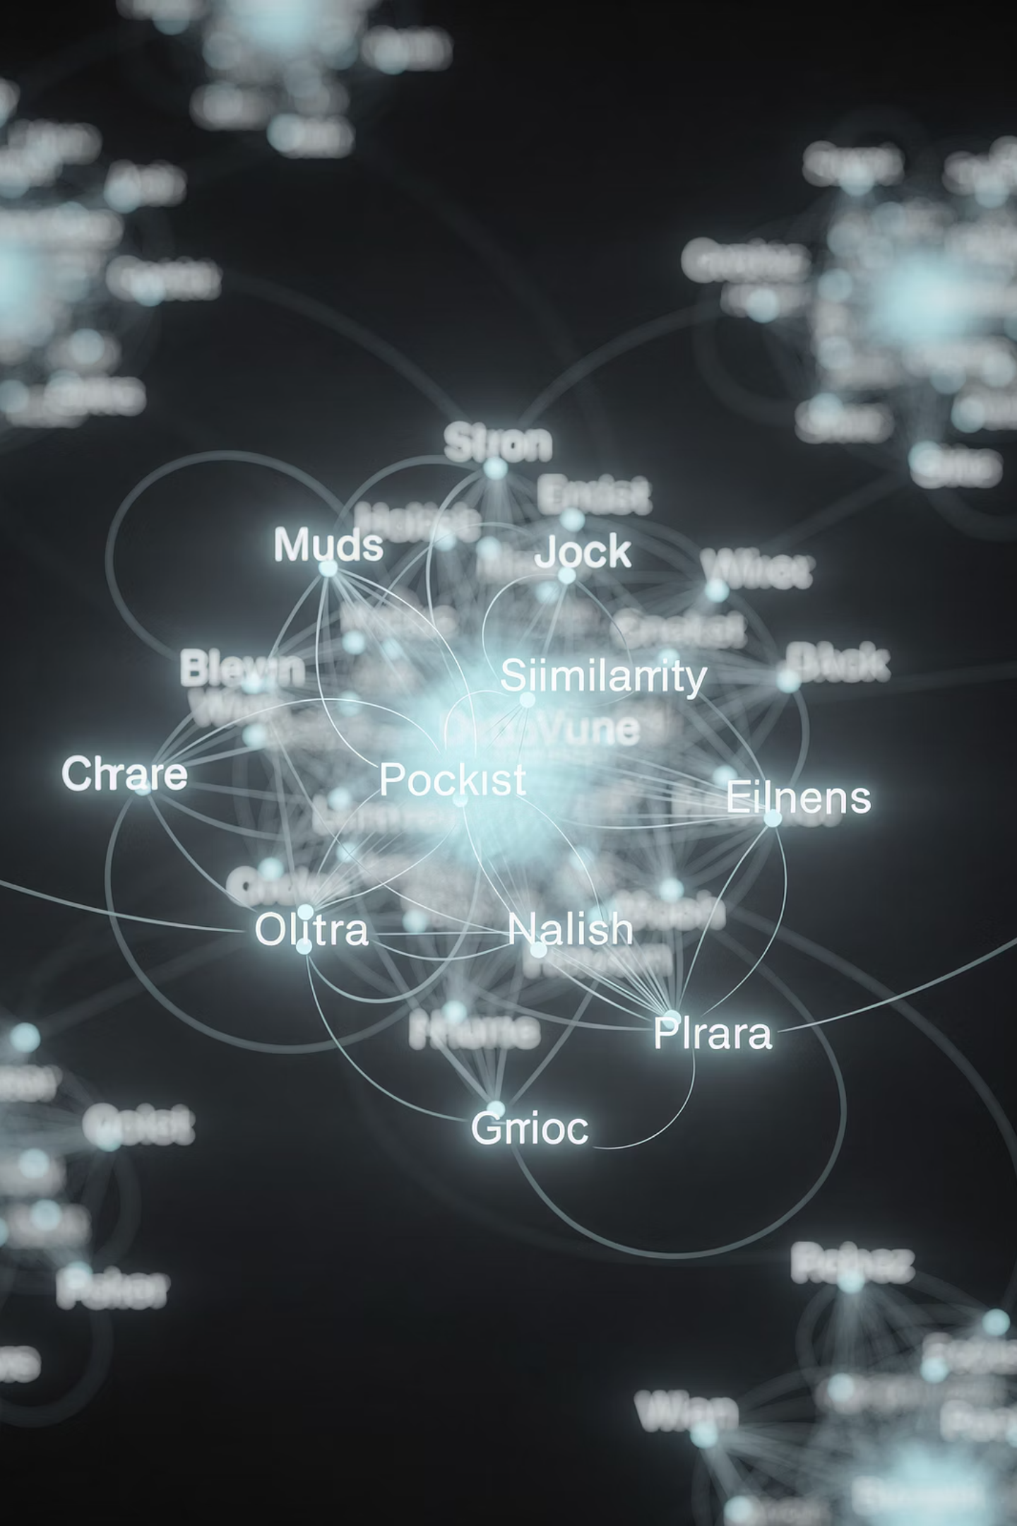
AI Doesn't "Understand"—It Measures Similarity
You ask: "What's similar to steel?"
Often correct:
AI doesn't think "metals with high strength"
Iron, Aluminium
AI finds words with vectors close to steel's vector
Sometimes wrong:
If training data has biases/gaps
Notes:
Critical distinction. When you ask what's similar to steel, AI doesn't reason about metallurgy. It finds words with nearby vectors in semantic space. Often correct—Iron, Aluminium appear in similar contexts. Sometimes wrong if training data had gaps. It's pattern matching in mathematical space, not knowledge. This explains both AI's power and its limits.

Slide 9
Section 1 Summary: Words → Coordinates
Key Concepts:
Words are tokenized (broken into chunks)
Each token gets 768-number embedding (vector)
1
2
Similar meanings → Similar vectors in semantic space
AI operates in math space, not language space
3
4
Materials Science Parallel:
Property space (materials) = Semantic space (words)
Notes:
Section 1 complete. Words become coordinates through tokenization and embedding. Similar meanings cluster in 768D space. Everything AI does is vector math. The materials parallel: exactly how you work with property space. Limitation: no context yet. That's Part 2—attention mechanisms and scale.

Slide 10
PART 2
THE "LARGE" IN LLM
Scale + Attention = Context Understanding
How AI learned to disambiguate meaning
Notes:
Part 2: What makes language models "Large." We've built the foundation—words as coordinates. Now we scale up and add the key ingredient: attention mechanisms. By the end of this section, you'll understand how AI went from simple pattern matching to apparent context understanding.

Slide 11
The Context Problem
Sentence 1:
Sentence 2:
"The lead shielding protected the sensor from radiation."
"The lead investigator supervised the electrospinning trials."
Meaning: Metal (Pb)
Meaning: Leadership
Same word: "lead"
Different meanings
At NLM stage: ONE embedding for "lead"
How does AI know which meaning?
Answer: CONTEXT + ATTENTION
Notes:
Here's the problem NLMs can't solve. Same word—"lead"—completely different meanings. You instantly knew sentence 1 is about Pb metal, sentence 2 about leadership. How? You looked at surrounding words. "Shielding," "radiation"—scientific context. "Investigator," "supervised"—human context. This is context-dependent disambiguation. For AI to do this, it needs attention mechanisms that weight surrounding words' importance.

Slide 12

Engineering Analogy: Composite Materials
In fiber-reinforced composites:
Matrix and fibers INTERACT
Properties don't just add linearly
Each component's contribution depends on:
Interface bonding
Load transfer
Spatial arrangement
→ Dynamic weighting based on context
Attention Does the Same for Words
Notes:
Use a concept you know: composites. Matrix and fibers don't simply add—there's complex interaction. Interface bonding, load transfer, spatial effects. Each component's contribution is dynamically weighted based on surrounding context. Strong bonding means fibers carry more load. Attention mechanisms do exactly this for words. "Lead" dynamically weights surrounding words. High weight to "shielding"? Metal context. High weight to "investigator"? Leadership context. Same principle.

Slide 13
Attention in Action
Sentence: "The lead shielding protected the sensor"
When processing "lead":
The
lead
shielding
protected
sensor
↓
↓
↓
↓
↓
Weight: 0.05
Weight: 1.0
Weight: 0.85
Weight: 0.60
Weight: 0.75
High attention to "shielding" and "sensor" → Metal (Pb) context activated
The word "lead" dynamically adjusts meaning based on weighted context
Notes:
Attention visualized. Processing "lead," the model assigns importance weights to every word. "The" gets low weight—not informative. "Shielding" gets high weight—very informative! "Sensor" also high. Result: "lead" incorporates context from high-weight words, determining we're discussing Pb metal. Different sentence—"lead investigator"—would show high attention to "investigator," triggering leadership meaning. Context changes everything.

Slide 14






Three Aspects of "Large"
1. Training Data Scale
2. Parameter Count
3. Context Window
Read ~billions of pages (nearly entire internet)
Billions of adjustable weights
Process thousands of words at once
Scale Comparison:
Small NLM: ~100M parameters
Medium LLM: ~8B parameters
Large LLM: ~70B parameters
Massive LLM: ~175-405B parameters
More parameters = More pattern complexity
Notes:
What makes models "Large"? Three aspects. Training data: read billions of pages. Parameters: billions of adjustable weights—like regression coefficients, but billions instead of dozens. Context window: process thousands of words simultaneously. Scale comparison: 100 million to 405 billion parameters. More parameters means more capacity for complex patterns. But bigger isn't always better—more parameters means slower, more expensive, higher energy use. Match model size to task complexity.

Slide 15
Not Facts Probabilities
Training Task: Predict the next word
Example: "The tensile strength of PLA is approximately __"
Model Learned:
Model Did NOT Learn:
"50" or "60" appear often after this phrase
Actual tensile strength of PLA
"MPa" usually follows strength values
Why PLA has this strength
Common sentence patterns in materials papers
How to measure tensile strength
Learned: How scientists WRITE about strength
Not: What strength actually IS
Notes:
Critical insight: training learned patterns, not facts. From thousands of papers mentioning PLA tensile strength, it learned "50 MPa" is common completion. Not because it knows polymer chemistry—because it saw this pattern repeatedly. The model learned how scientists write about PLA, not what PLA actually is. Can't calculate, can't measure, can't reason from first principles. Pattern completion feels like knowledge. It isn't. Always verify.

Slide 16
The Illusion of Knowledge
What You See
What Actually Happens
You Ask: "What is the Young's modulus of PLA?"
Tokenize: ["What", " is", " Young", "'s", " modulus", " PLA"]
Embed: Convert to vectors
Looks Like: AI "knows" → tells you "3.5 GPa"
Attend: High attention "Young's modulus" + "PLA"
Predict: Most probable tokens → "3" "." "5" "GPa"
Is it correct? Often yes. Sometimes no.
It's PATTERN COMPLETION, not knowledge retrieval
Notes:
The illusion of understanding. You ask about PLA's modulus, AI responds confidently "3.5 GPa." Feels like it looked it up, right? Wrong. Here's what happened: tokenization, embedding, attention between modulus and PLA, then predicting most probable next tokens. "3.5 GPa" appeared frequently enough in training that it's highly probable. Often correct—if pattern was common. Sometimes wrong—if interpolating. Don't mistake confident pattern completion for reliable knowledge.

Slide 17
What LLMs Are Good/Bad At
Strengths:
Weaknesses:
Context awareness (disambiguates words)
No fact database (can't "look up" values)
Long-range dependencies (across paragraphs)
No calculation (can't reliably multiply)
Semantic reasoning ("similar" vs "opposite")
No logical certainty
(everything probabilistic)
Pattern synthesis (novel combinations)
Hallucinates when uncertain (plausible guesses)
!!! CRITICAL: Confidence ≠ Accuracy
Always verify, especially numbers and citations
Notes:
Strengths and weaknesses consolidated. Strengths: context awareness, long-range connections, semantic reasoning, pattern synthesis—impressive capabilities. Weaknesses for scientists: no fact database, can't calculate reliably, everything probabilistic, hallucinates when uncertain. Most dangerous: presents guesses with same confidence as facts. For scientists: Confidence does NOT equal accuracy. Always verify numbers and citations. This is what Part 3 is all about.

Slide 18
Section 2 Summary: Scale + Attention = Context
Key Concepts:
1
Attention: Dynamic weighting of surrounding words
2
Context changes meaning ("lead" example)
3
"Large" = Billions of parameters (pattern capacity)
4
Training learned patterns, not facts
5
Multi-head attention: Multiple perspectives
Engineering Parallel: Composite design, components interact, context determines contribution
Notes:
Section 2 complete. Attention enables context-dependent understanding through dynamic weighting. "Large" refers to billions of parameters capturing complex patterns. Training learned text patterns, not factual knowledge. Engineering parallel: like composite materials where contributions depend on context and interactions. Now the critical question: If AI is pattern-completing, why does it fabricate realistic-looking citations? That's Part 3—most important section for scientists.

Slide 19
PART 3
TRUTH VS. PROBABILITY
Why Models Hallucinate & How to Ground Them
The most critical section for scientists
Notes:
Part 3: Truth versus probability. Most critical section for scientific work. You understand how AI works—words to coordinates, attention for context, pattern completion. Now we confront the danger: AI confidently generates fabricated information. Why does this happen? How do we prevent it? By the end, you'll understand hallucinations deeply enough to protect yourself and use AI responsibly.

Slide 20
The Hallucination Problem
You Ask: "Find papers on high-entropy alloy electrospinning"
AI Responds:
"Zhang, L., et al. (2021). 'Electrospun High-Entropy Alloy Nanofibers for Catalysis.' J. Mater. Chem. A, 9(15), 9876-9885. DOI: 10.1039/d1ta02847k"
Check CrossRef → DOI doesn't exist
But Looks Perfect:
Realistic author (Zhang is common)
Plausible title (combines your keywords)
Real journal (J. Mater. Chem. A exists)
Valid DOI format (10.1039/... correct for RSC)
COMPLETELY FABRICATED
Notes:
Real example of the problem. You ask for citations, AI provides this beautiful citation. Check every element: Zhang is common in materials science. Title combines your keywords. Journal is real and high-impact. DOI format is correct for Royal Society of Chemistry. Looks absolutely authentic. Problem: CrossRef check—DOI doesn't resolve. Paper doesn't exist. AI fabricated it. Not malicious—pattern completed a plausible citation. This is terrifying for scientists. If you trusted without checking, you might cite non-existent paper. This is why understanding hallucinations is critical.

Slide 21

Why Hallucinations Happen

Slide 22
The Mechanism Behind Fabrication
01
02
03
AI recognizes "You want citations"
Knows citation format: [Author] et al. ([Year]). "[Title]." [Journal], [Vol], [Pages]. DOI
Generates plausible tokens
"Zhang" → Common surname
"2021" → Recent year
"Electrospun HEA..." → YOUR keywords
Each component is plausible
"J. Mater. Chem. A" → Real journal
The combination doesn't exist
"10.1039/..." → Valid DOI format
Pattern completion, not information retrieval
Notes:
Why this happens. When you ask for citations, AI recognizes the pattern and starts completing it. "Zhang"—high probability surname. "2021"—recent, plausible. Title—combines your keywords. Journal—real and relevant. DOI—correct format. Each piece is plausible based on training patterns. But—critical point—AI never checked if this combination exists. It stitched together probable components. Result: looks real, is fake. Pattern completion at its most dangerous.

Slide 23
The Four Grounding Techniques
How to Prevent Hallucinations
You can't eliminate them, but you can reduce them:
1. Explicit Constraint Instructions
2. RAG (Retrieval-Augmented Generation)
Force AI to admit ignorance vs. guess
Ground AI in your specific documents
3. Temperature Control
4. Chain-of-Thought
Reduce randomness for technical tasks
Force step-by-step reasoning
Notes:
Good news: while you can't eliminate hallucinations—fundamental to LLMs—you can dramatically reduce them. Four core techniques: Explicit constraints—tell AI "if you don't know, say so." RAG—provide specific documents, force citations. Temperature—reduce randomness, be conservative. Chain-of-thought—force explicit reasoning, catch errors early. Let's explore each.

Slide 24

Technique 1: Explicit Constraints
Without Constraint:
With Constraint:
"What is the tensile strength of PLA/graphene?"
"Based ONLY on attached papers, extract tensile strength. If no value reported, respond 'Not reported in provided sources.' Do NOT estimate or use external knowledge."
→ AI generates plausible number (may be wrong)
→ AI admits ignorance instead of guessing
Key Phrase: "If unknown, state 'Not reported' do not estimate"
Notes:
Technique 1: Explicit constraints. Simplest and most effective. Without constraints, AI generates plausible number even if uncertain. With constraints, you explicitly instruct: "If no value, say 'Not reported.' Don't estimate." Now AI admits ignorance. Magic phrase: "if unknown, state 'Not reported'—do not estimate or use external knowledge." Single sentence dramatically reduces hallucinations. Why it works: clear instructions for handling uncertainty. Without them, defaults to pattern completion.

Slide 25



Technique 2: RAG (Retrieval-Augmented Generation)
Problem: AI's knowledge frozen at training time
Solution: Give AI access to YOUR documents
How RAG Works:
Create document database
Query retrieves relevant chunks
AI generates using ONLY those chunks
(your papers/protocols)
automatically
Example:
You: "What temperature did Zhang use?"
RAG: [Retrieves Zhang paper, Section 3.2]
AI: "Zhang used 23±2°C (Section 3.2, p.8)"
Response grounded in actual text you provided
Notes:
Technique 2: RAG—game-changer for document work. Problem: AI's knowledge froze at training. Can't access your latest papers, protocols, proprietary data. RAG gives AI real-time access to your documents. Upload documents, they're chunked and embedded. Your query finds relevant chunks. AI responds using only those chunks, citing specifically. Critically: grounded in text you provided, not pattern-matched from training. Huge reduction in hallucinations. Tools like LlamaIndex, LangChain make this easy.

Slide 26
Technique 3 & 4 - Temperature and Chain-of-Thought
Technique 3: Temperature Control
Technique 4: Chain-of-Thought
"Temperature" = Randomness in token selection
Force AI to "show its work"
Instead of: "Is PLA/graphene aerospace-suitable?"
Low (0.0-0.3): Deterministic, conservative, factual
High (0.7-1.0): Creative, exploratory, risky
Use: "Analyze step-by-step: 1) Requirements? 2) Properties? 3) Match/mismatch? 4) Assessment?"
Use Low for: Data extraction, citations, technical work
Use High for: Brainstorming, creative tasks
Catches reasoning errors early
Notes:
Techniques 3 and 4 together. Temperature: controls randomness. Low temperature (0.1)—conservative, picks most probable token, fewer hallucinations. High (0.9)—creative, explores alternatives, more risk. For technical work, use low. For brainstorming, use high. Chain-of-thought: force explicit reasoning. Instead of quick answer, require step-by-step analysis. Catches nuance quick answers miss. Like peer review during writing, not after. Essential for complex assessments.

Slide 27
http://192.168.1.183:3000/
AmaDema

Slide 28
Practical Verification Checklist
Before Trusting AI Output:
Citations are real (DOI resolves, authors match)
Numbers are reasonable (within known ranges)
Units are correct (MPa not GPa, unless appropriate)
Methods exist (no "nano-quantum-XPS" fabrications)
Logic is sound (no contradictions)
Sources are primary (not vague "studies show...")
Risk-Based Approach:
Low Risk
Medium Risk
High Risk
Quick spot-check
Verify citations and key facts
Full verification, multiple sources
Notes:
Practical checklist for verification. Six key checks before trusting output: citations real, numbers reasonable, units correct, methods exist, logic sound, sources primary. Apply risk-based approach: low risk (general knowledge)—quick check. Medium risk (specific claims)—verify citations. High risk (critical decisions, safety, IP)—full verification, cross-reference. This becomes second nature. AI is tool, not oracle. Your expertise is final arbiter.

Slide 29
Red Flags: Heightened Skepticism Required
🚩 Suspiciously round numbers
🚩 Excessive precision
(exactly 100°C, 5.0 GPa)
(87.34256°C when ±2°C precision)
🚩 Vague attributions
🚩 Impossible combinations
("studies show" without citation)
(high modulus AND ductility)
🚩 Nonexistent techniques
🚩 Perfect results
(quantum-resolution methods)
(no error bars, no uncertainties)
If it sounds too good to be true, verify extensively
Your domain expertise is your best defense
Notes:
Red flags signaling heightened skepticism. Suspiciously round numbers—nature isn't that neat. Excessive precision beyond measurement capability—fabricated. Vague attributions—hallucination territory. Impossible combinations—rare, needs verification. Nonexistent techniques—quantum-resolution anything usually fake. Perfect results—not real science. Bottom line: if it sounds too good to be true, verify extensively. Your domain expertise is your best defense. Trust your instincts. If it feels wrong, it probably is.

Slide 30
Day 3 Summary & Takeaways
What You've Learned Today
Part 1: NLM Foundations
Part 2: The "Large" in LLM
Part 3: Truth vs. Probability
Words → Coordinates in semantic space
Attention + Scale = Context understanding
AI prioritizes plausibility over truth
→ Use grounding techniques (constraints, RAG, temperature, CoT)
→ Always verify
Practical Takeaways:
Never trust citations without verification
Use RAG for document-based tasks
Set low temperature (0.1-0.2) for technical work
Apply domain expertise—if it sounds wrong, it is
You now understand AI better than 95% of users
Notes:
Day 3 complete. Part 1: Words become coordinates—semantic space parallel to property space. Part 2: Large models use attention for context—pattern matching, not knowledge. Part 3: AI prioritizes probability over truth—hallucinations predictable and preventable with grounding techniques. Practical takeaways: never trust citations without verification, use RAG for documents, low temperature for technical work, apply your expertise. You understand AI better than 95% of users. You know how it works, why it fails, how to prevent failures. Tomorrow: Green AI and advanced optimization. Excellent work!

