Slide 1

Day 1
AmaDema AI Training Programme

Slide 2
Welcome
Logistics
Workshop Style
WiFi: [Network name]
Interactive, hands-on
Restrooms: [Location]
Learn by doing, not just listening
Breaks: As needed (flexible)
Safe environment - all questions welcome
Questions: Anytime - interrupt me!
Materials: Website accessible throughout

Slide 3
4-Day Training Agenda
Your Learning Journey
Day 1: Foundation & AUTOMAT
Day 2: Context & CO-STAR
Introduction to prompt engineering
Mastering context specification
AUTOMAT framework for functional tasks
CO-STAR framework for strategic communication
Conversational learning basics
Advanced hallucination detection
Responsible AI & IP protection
Framework selection skills
Day 3: Technical Understanding & Green AI
Day 4: Mastery & Integration
NLMs vs LLMs tool selection
Advanced optimization techniques
Environmental impact awareness
Deep conversational learning
Carbon footprint calculation
Ethics, bias, and privacy
Green optimization strategies
Putting it all together

Slide 4
Today's Learning Objectives
By End of Day 1, You Will:
Understand why prompt engineering matters for R&D efficiency
Apply the AUTOMAT framework to functional scientific tasks
Use conversational learning to build expertise (not just get answers)
Protect IP using the Red List Protocol
Practice in the sandbox with real scenarios
Create your first prompt templates

Slide 5
PART 1
Introduction to Prompt Engineering
Why it matters for materials scientists

Slide 6
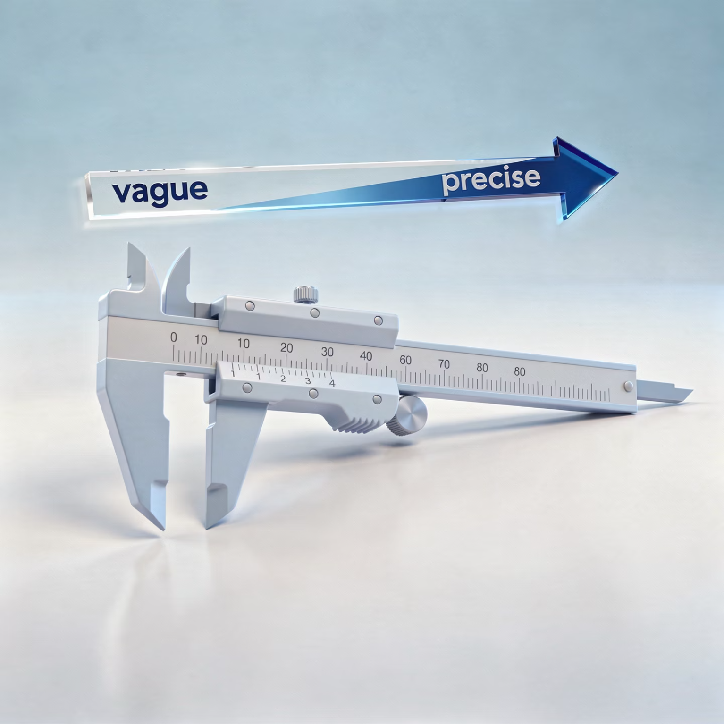
What is Prompt Engineering?
Definition:
The practice of designing inputs (prompts) to get specific, high-quality outputs from AI models
For Materials Scientists:
The skill of transforming vague requests into precise instructions that yield scientifically rigorous results
Think of it as:
The experimental design of AI interactions

Slide 7
The Problem We're Solving
Casual AI Use (Inefficient)
Professional AI Use (Efficient)
User: "Summarize this paper"
[AUTOMAT structured prompt]
AI: Generic summary
→ First-shot success
User: "I need parameters"
Precise output
AI: Inconsistent format
Correct format
Complete data
User: "Make it a table"
Ready to use
AI: Missing columns
Time: 3 minutes
User: "Add temp/pressure"
Quality: Publication-ready
AI: Mixed units
Reproducible: Yes (templated)
User: "Consistent units"
... 5 more iterations
Time: 20 minutes
Quality: Mediocre
Reproducible: No

Slide 8
Why This Matters for R&D
Efficiency Gains (Real Data)
Before Prompt Engineering:
After Prompt Engineering:
Literature review: 8 hours
Literature review: 2 hours (75% ↓)
Protocol formatting: 30 min/protocol
Protocol formatting: 5 min (83% ↓)
Experimental brainstorming: 2 hours
Experimental brainstorming: 30 min (75% ↓)
Quality: Same or better
Reproducibility: Template-based
Time savings: 5-10 hours/week

Slide 9
Quality Improvements
Beyond Speed: Quality Benefits
Consistent Output Format
Fewer Hallucinations
Verifiable Results
No more reformatting AI responses
Explicit constraints prevent guessing
Cite sources, show calculations
Suitable for Professional Use
Reproducible Workflows
Publication, patents, reports
Templates for recurring tasks

Slide 10
The Learning Journey
Your Skill Development Path
Month 1: Natural Integration
Week 1: Mechanical Application
Frameworks become intuitive
Prompts feel structured but mechanical
70% first-shot success rate
Checking cheat sheet frequently
→ Achievement unlocked
→ Normal!
Month 6: Teaching Others
Month 3: Template Building
Identifying new applications
10-20 templates for common tasks
Team-wide efficiency gains
Colleagues asking for your prompts
→ Recognized expert
→ Time savings: 5-10 hrs/week

Slide 11
PART 2
The AUTOMAT Framework
Your systematic method for scientific prompts

Slide 12







AUTOMAT Components
A - Audience
Who will read/use this?
U - User Persona
Who is AI acting as?
T - Task
What specific action required?
O - Output
What format/structure?
M - Method
How to approach?
A - Assumptions
What constraints apply?
T - Tone
What voice/style?
Seven components = Complete specification

Slide 13
A - Audience
Define who will consume this output
Affects:
Technical depth
Terminology level
Required disclaimers
Level of detail
Examples:
IP Legal Team
R&D Colleagues
Formal, cite sources, flag novelty
Technical, assume domain knowledge
Management
External Partners
High-level, business impact focus
Balanced, avoid proprietary info

Slide 14
U - User Persona
Define AI's role and expertise
Why it matters:
Without persona → "Helpful generalist" (too broad)
With persona → Domain expert (targeted depth)
Examples for Materials Science:
"Act as a Senior Polymer Chemist with expertise in electrospinning"
"Act as a Materials Science Patent Analyst"
"Act as a Laboratory Safety Officer reviewing protocols"
"Act as a Data Scientist specializing in mechanical testing analysis"

Slide 15
T - Task
Specify the precise action required
❌ Vague:
✅ Explicit:
"Summarize this paper"
"Extract synthesis parameters from Section 3.2"
"Analyze this data"
"Calculate tensile strength and Young's modulus from these 7 stress-strain curves, excluding outliers >2 SD"
"Help me with synthesis"
"Propose 5 alternative synthesis routes that avoid toxic solvents"

Slide 16
O - Output
Define exact format and structure
Common Scientific Formats:
Markdown table with specified columns
CSV data with headers
JSON structure
Bullet points with citations
Structured report (sections defined)
Python code (commented)
Example Specification:
"Output: Markdown table with columns:
Polymer Type
Synthesis Temperature (°C)
Yield (%)
Source (DOI)
Sort by: Yield (descending)
Include: 10-15 entries"

Slide 17
M - Method
Specify approach or methodology
Examples for Materials Science:
"Use systematic literature review principles"
"Apply ISO 527 tensile testing standards"
"Follow IUPAC nomenclature"
"Compare results against baseline (pure PLA)"
"Calculate statistics using standard error of the mean"
"Use linear regression for modulus (strain 0.05-0.25%)"

Slide 18
A - Assumptions (Constraints)
Critical for scientific accuracy
Three Types:
01
02
03
Whitelist (What to Include)
Blacklist (What to Exclude)
Uncertainty Handling
"Focus exclusively on non-oxide ceramics"
"Exclude review papers"
"If data missing, mark 'Not Reported' - do not estimate"
"Ignore pre-2020 publications"
"Only papers published 2020-2024"
"If conflicting values, flag discrepancy"
"Do not extrapolate from related materials"

Slide 19




T - Tone
Set voice and style
Scientific Tones:
Technical/Objective
Formal
For peer review, reports
For legal, regulatory documents
Conversational
Cautious
For internal brainstorming
For safety-critical procedures
Example Specification:
"Tone: Technical and objective, suitable for submission to Materials Science & Engineering: A. Avoid speculation or promotional language."

Slide 20
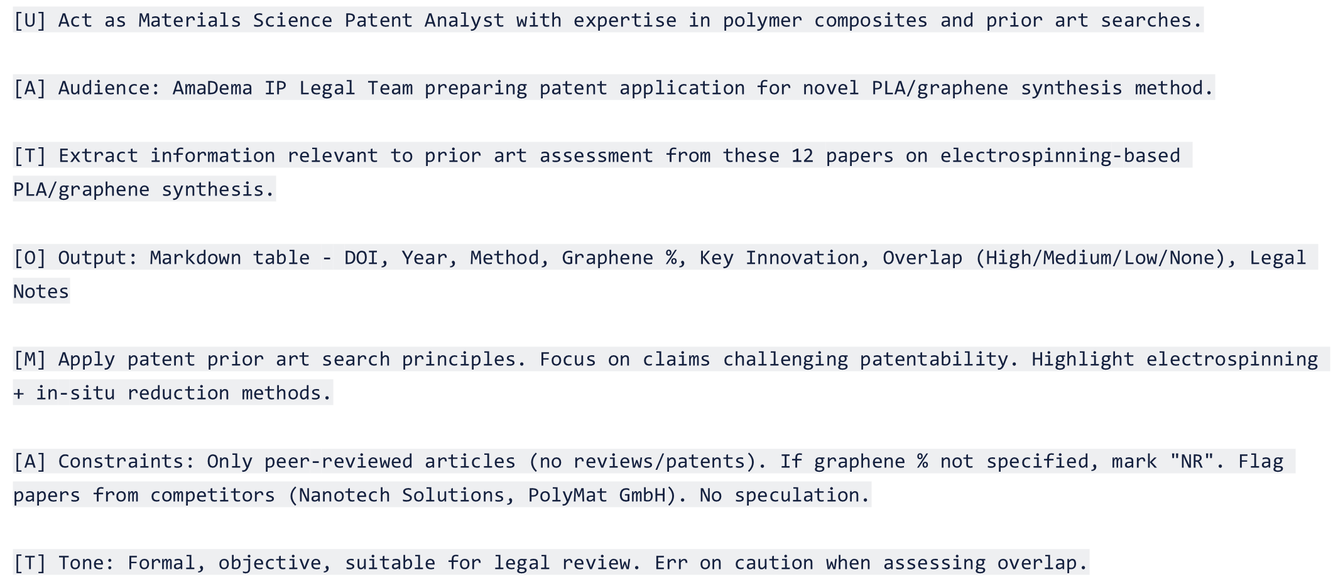
Complete AUTOMAT Example

Slide 21
AUTOMAT in Action - Live Demo
Live Demonstration Task: Extract synthesis parameters from materials science paper
Without AUTOMAT:
Vague request
Generic response
Multiple iterations needed
With AUTOMAT:
Complete specification
First-shot success
Production-ready output
[LIVE SANDBOX DEMO]
Live Demo:
Show vague prompt: "Summarize synthesis parameters from this paper"
Show poor result requiring clarification
Show complete AUTOMAT prompt
Show first-shot success with production-ready table
Emphasize time difference (30 seconds vs 5 minutes)

Slide 22
When to Use AUTOMAT
AUTOMAT is Best For:
Not Ideal For:
Functional tasks with clear outputs (data extraction, formatting)
Open-ended brainstorming
Scientific workflows requiring precision
Conversational learning (use CO-STAR - Day 2)
Tasks where IP protection is critical
Simple, one-sentence tasks
Situations requiring reproducible results

Slide 23

PART 3
Conversational Learning
From task executor to learning partner

Slide 24
The Mindset Shift
Transactional ❌ → Learning Partnership ✅
Transactional:
Learning Partnership:
"Summarize this paper" → [Copy summary] → Done
"Summarize this paper" → [Read summary]
Result: Summary obtained, no learning
"Why did you structure it this way?"
"What criteria determined 'key findings'?"
"How would you adapt this for ceramic papers?"
Result: Summary + Methodology understanding
Same time, 5× learning

Slide 25
The Power of "Why" Questions
Basic Learning Question Types:
01
02
03
Process Questions
Justification Questions
Alternative Questions
"How did you reach that conclusion?"
"Why this approach over alternatives?"
"What other approaches could work?"
"Walk me through your thinking"
"What assumptions underlie your recommendation?"
"How would this change in different contexts?"
Start simple, build depth progressively

Slide 26

Conversational Learning Example
Practical Example: Polymer Synthesis
Transactional (30 seconds):
Learning Partnership (5 minutes):
User: "Best method to synthesize PLA?"
User: "Best method to synthesize PLA?"
AI: "Ring-opening polymerization with tin catalysts"
AI: "Ring-opening polymerization (ROP) of lactide..."
User: "Thanks"
User: "Why ROP over direct polycondensation?"
AI: "ROP achieves higher Mw (100-300 kDa vs 10-30 kDa)..."
Knowledge gained: Zero
User: "What trade-offs exist? When would polycondensation be better?"
AI: "Polycondensation simpler and cheaper for lower Mw applications..."
User: "You mentioned tin catalysts. What alternatives and why aren't they standard?"
AI: "Al, Zn, Mg catalysts avoid tin toxicity concerns..."
Knowledge gained: Decision framework, trade-off understanding, transferable methodology

Slide 27

PART 4
Responsible AI & IP Protection
Protecting AmaDema while leveraging AI

Slide 28
🚫 THE RED LIST 🚫
NEVER Share with Public AI Tools
1. Unpublished Research Data
2. Commercial Sensitive Information
Novel molecular structures
Exact formulations
Exact synthesis parameters (proprietary)
Yield data
Experimental results (ongoing R&D)
Customer identities
Pricing strategies
3. Personal & Confidential Data
4. Security-Sensitive Information
Employee information
Access credentials
Internal communications
System configurations
Financial data

Slide 29
Hallucinations - What They Are
Understanding Hallucinations
What: AI generates plausible-sounding but factually incorrect information
Why They Occur: LLMs are pattern-matching prediction engines, NOT knowledge databases
When you ask: "What is the tensile strength of Ti₆Al₄V at 400°C with 2% oxygen?"
AI doesn't:
AI does:
Look it up in database
Predict most probable tokens
Calculate from first principles
Synthesize plausible-sounding answer
Admit uncertainty
Present with confidence
→ Confidence ≠ Accuracy

Slide 30
Preventing Hallucinations
Hallucination Prevention Through Constraints
Without Constraints ❌:
With Constraints ✅:
"What is the melting point of this polymer?"
"If melting point is reported in paper, extract it with page citation. If not reported, state 'Not Reported' - do not estimate."
→ AI guesses if not in paper
→ AI admits ignorance instead of guessing
Key Strategies:
Explicit uncertainty handling
Require citations for claims
Demand "Not Reported" over estimation
Flag missing data, don't fill gaps

Slide 31
Verification Protocols
Never Trust, Always Verify
Citation Verification:
Quantitative Verification:
DOI resolves to real paper
Value within physically reasonable range
Authors match
Units are consistent
Journal and year correct
Compare to known benchmarks
Abstract aligns with claimed content
Check against authoritative sources
Check actual data in paper
Tools:
CrossRef DOI Search
Google Scholar
PubMed
Materials handbooks
Your domain expertise

Slide 32
Data Sanitization Strategies
Using AI Safely with Sensitive Data
1
2
3
Strategy 1: Anonymization
Strategy 2: Aggregation
Strategy 3: Hypothetical Framing
Replace specifics with placeholders
Share trends, not specific values
❌ Specific: "25kV, 15cm, 12% PLA (Mw 100kDa) in DMF:DCM (3:1), 5% graphene, 80°C, Yield: 87%"
❌ "Batch #343: 45.2 MPa at 23°C"
Ask about principles, not your specific case
✅ "Strength decreases ~15% between 20-60°C"
✅ Sanitized: "[VOLTAGE], [DISTANCE], [CONCENTRATION]% polymer (Mw [VALUE]) in [SOLVENT], [X]% nanofiller, [TEMPERATURE], Yield: [HIGH/MEDIUM/LOW]"

Slide 33
The Local Sandbox Advantage
For Red List Items: Use Local Sandbox
How it Works:
Ollama + Open WebUI running on instructor laptop
Llama 3.2 3B model (fully local)
Connected via local WiFi (no internet)
Benefits:
Data never leaves the laptop
No external servers
No logging by third parties
No internet required
Full privacy for sensitive work
Access: http://[instructor-IP]:3000
Best For:
Proprietary synthesis data
Patent applications
Customer information
Any Red List item

Slide 34

TIME TO PRACTICE
Hands-On Exercises
Applying what you've learned

Slide 35

Exercise 1 - AUTOMAT for Literature Review
Build Your First AUTOMAT Prompt
Scenario: You have 8 papers on electrospun PLA/graphene nanocomposites. Need to extract synthesis parameters for competitive analysis (quarterly R&D review).
Your Task:
Construct complete AUTOMAT prompt that:
Extracts key synthesis parameters
Outputs structured format for comparison
Includes constraints for consistency
Handles missing data appropriately
Time: 15 minutes
Location: Use sandbox at http://[IP]:3000

Slide 36

Exercise 1 - Debrief
What We Learned
Common Mistakes:
❌ Vague Task: "Extract info from papers"
✅ Specific: "Extract synthesis temp, voltage, graphene %, yield from Methods sections"
❌ Undefined Output: "Make it a table"
✅ Specific: "Markdown table with columns: [DOI, Method, Temp (°C), Voltage (kV)...]"
❌ No Constraints: AI guesses when data missing
✅ Explicit: "If parameter not reported, mark 'NR'"
Key Takeaway: Specificity eliminates iterations

Slide 37
Exercise 2 - The Hallucination Hunt
Find the Errors
Challenge: AI-generated synthesis report contains 5 deliberate errors:
1 fabricated citation
1 physically impossible value
1 misattributed discovery
1 inconsistent claim
1 non-existent characterization technique
Your Task:
Read report (on website)
Identify all 5 errors
Explain why each is wrong
Suggest verification method
Time: 20 minutes
Prize: "Critical Thinker" badge for fastest team

Slide 38

Exercise 2 - Debrief & Answers
Hallucination Hunt: Answers
1
2
3
Error 1: Fabricated Citation
Error 2: Physically Impossible
Error 3: Non-existent Technique
Zhang et al. (2023), DOI: 10.1002/pen.2023.08.445
Simultaneous modulus AND ductility increase
"Quantum-resolution XPS"
→ No such characterization method exists
→ DOI format wrong, doesn't resolve
→ Typically trade-off (stiffness ↔ flexibility)
Verify: Domain knowledge
Verify: CrossRef search
Verify: Materials science principles
[Continue for all 5...]

Slide 39
Exercise 3 - Red List Assessment
IP Protection Practice
For each scenario, determine:
✅ Green: Safe for external AI
⚠️ Yellow: Safe after sanitization
🚫 Red: Local sandbox only
Scenarios:
A
Format lab notebook (exact synthesis conditions, patent-pending process)
B
Summarize 6 published papers (DOIs provided)
C
Analyze SEM image (from proprietary experiment)
D
Generate Python code (generic, no data attached)
E
Draft customer email (names company, revenue %)
Time: 10 minutes

Slide 40
Exercise 3 - Debrief & Answers
Red List Assessment: Answers
Scenario A: 🚫 RED
Scenario B: ✅ GREEN
Scenario C: 🚫 RED
Patent-pending = unpublished IP
Published papers = public data
Proprietary experiment = Red List
→ Local sandbox only
→ Any tool fine
→ Local sandbox OR sanitize image (remove metadata)
Scenario D: ✅ GREEN
Scenario E: 🚫 RED
Generic code request, no data = public info
Customer name + revenue = confidential
→ Any tool fine
→ Local sandbox OR sanitize (remove names/numbers)

Slide 41
Exercise 3 - Debrief & Answers
Red List Assessment: Answers
Scenario A: 🚫 RED
Patent-pending = unpublished IP → Local sandbox only
Scenario B: ✅ GREEN
Published papers = public data → Any tool fine
Scenario C: 🚫 RED
Proprietary experiment = Red List → Local sandbox OR sanitise image (remove metadata)
Scenario D: ✅ GREEN
Generic code request, no data = public info → Any tool fine
Scenario E: 🚫 RED
Customer name + revenue = confidential → Local sandbox OR sanitise (remove names/numbers)
The pattern: published/public = green, unpublished/confidential = red, unless you can sanitise to remove sensitive details.

Slide 42
Key Takeaways - Day 1
What You've Learned Today
✓ Why prompt engineering matters (50-75% efficiency gains possible)
✓ AUTOMAT framework (Seven components for functional tasks)
✓ Conversational learning (Build expertise, not just collect answers)
✓ IP protection (Red List + verification protocols)
✓ Practical skills (Exercises completed in sandbox)
Tomorrow: Context mastery & CO-STAR framework
Let's recap. You now understand why prompt engineering isn't optional - it's professional skill delivering 50-75% efficiency gains. You've learned AUTOMAT - seven components ensuring first-shot success on functional tasks. You've practised conversational learning - using "why" questions to build expertise. You know the Red List and verification protocols - protecting AmaDema's IP whilst leveraging AI. And you've practised in the sandbox with real scenarios. Tomorrow, we go deeper into context and learn CO-STAR framework for strategic communication. Excellent work today!

Slide 43
Action Items Before Day 2
Before Day 2 (Optional but Helpful)
☐ Review Day 1 content on website (Especially AUTOMAT examples)
☐ Try one AUTOMAT prompt in your real work (Template something you do regularly)
☐ Note questions or challenges (We'll address at Day 2 start)
☐ Optional pre-reading:
Context Matters
What are LLMs?
LLM Tools Comparison
Website: [URL]
Password: AmaDema2026
Optional homework before Day 2. Review today's content on the website - especially AUTOMAT examples. If you feel ambitious, try one AUTOMAT prompt in your real work before tomorrow. Template something you do regularly. Note any questions or challenges - we'll start Day 2 addressing those. There's also optional pre-reading on context and LLM basics. Website credentials on screen. But if you do nothing, that's fine - Day 2 will recap what's needed.

Slide 44
Thank You & Questions
Thank You!
Questions?
Contact:
Website: [URL]
Instructor: [Email]
Sandbox access: Available during all sessions
See you for Day 2: Context & CO-STAR Framework
Excellent work today! Before we wrap, let's take questions. Anything unclear? Anything you want to practise more? Sandbox remains available - you can keep practising after we end. Day 2 tomorrow, we'll dive into context mastery and CO-STAR framework. Thank you for your engagement and great questions today!
Interactive Element:
Open Q&A: Take all remaining questions, provide clarification, invite feedback on today's session

Slide 45
END OF DAY 1 SLIDES

Slide 46
APPENDIX: Facilitation Notes
Timing Guidance (Flexible)
Troubleshooting Tips
Welcome & Agenda: 10 min
Intro to Prompt Engineering: 20 min
If sandbox slow: reduce participants per query
AUTOMAT Framework: 35 min
If exercise too hard: provide AUTOMAT template
Conversational Learning: 15 min
If exercise too easy: add complexity challenge
Responsible AI: 20 min
If running over time: skip Exercise 3, assign as homework
Exercises: 30-40 min
If ahead of time: add more live demo examples
Debrief & Wrap: 10 min
Total: ~90 minutes (flexible)
Adaptation Notes
Interactive Elements Summary
Slides are detailed but flexible - adjust to group pace
6 Polls/Show of hands
Interactive elements are suggestions - read the room
4 Think-Pair-Share activities
Technical level assumes materials science PhDs - adjust examples if different audience
3 Live demonstrations
Emphasise AmaDema-specific examples when possible
3 Group discussions
1 Volunteer sharing session
Exercise facilitation throughout
Materials Needed
Laptop with sandbox running
Projector/screen for slides
Whiteboard for ad-hoc explanations
Participants need: laptops, website access, sandbox URL
Handouts: Cheat sheet (optional, on website)

