Slide 1

Day 4: Mastery & Responsibility
Mastering Optimization, Ethics, and Data Security

Slide 2

Quick Check-In
Before we dive into today's advanced topics, let's reconnect with our recent progress and ground ourselves in what we've accomplished so far.
1
2
3
Local Sandbox Success
Hallucination Detection
Semantic Space Recall
Have you successfully deployed and tested the Local Sandbox environment on your machine?
Did you identify any instances of AI hallucination in your work this week? What strategies helped you spot them?
What's one concept you remember about semantic space and how embeddings represent meaning?

Slide 3
Day 3 Recap
Let's refresh our understanding of the foundational concepts we explored yesterday. These building blocks are essential for today's advanced techniques.
NLMs vs LLMs
Embeddings & Tokens
Hallucination Prevention
We distinguished between Natural Language Models and Large Language Models, understanding that size isn't everything—smaller specialized models often outperform general-purpose giants for specific tasks.
We explored how language transforms into mathematical coordinates in semantic space, where words and concepts exist as vectors that capture meaning through their relationships.
We learned critical techniques including Retrieval-Augmented Generation (RAG), temperature control, and systematic verification to ensure AI outputs remain grounded in truth.

Slide 4

LEARNING GOALS
Day 4 Learning Objectives
Today we advance from fundamentals to mastery. These objectives represent the professional competencies that separate AI users from AI practitioners.
01
02
03
Apply Green AI practices to reduce environmental impact
Master optimization techniques for efficient model usage
Build deep expertise using the Why Cascade methodology
04
05
Recognize and actively mitigate algorithmic bias
Apply AmaDema privacy protocols in production contexts

Slide 5

Efficiency & Sustainability
Artificial intelligence delivers transformative capabilities, but these benefits come with real environmental costs. Every query, every training run, every inference consumes electricity—often generated from non-renewable sources.
As AI practitioners, we carry a professional responsibility that extends beyond technical excellence. Efficiency isn't just an optimization goal—it's an ethical imperative. The choices we make about model selection, prompt engineering, and query patterns directly impact our collective environmental footprint.
Understanding these costs transforms us from passive users into conscious practitioners who balance capability with responsibility.

Slide 6





The Hidden Environmental Costs
Behind every AI interaction lies an infrastructure most users never see. These hidden costs accumulate across billions of queries worldwide.
Water Consumption
Data centers require massive cooling systems that consume millions of gallons of water annually. Training a single large language model can use as much water as it takes to produce 370 BMW cars.
Carbon Footprint Variability
Server location dramatically impacts emissions. The same computation in a coal-powered data center produces 10x more CO₂ than in a facility powered by renewable energy.

Slide 7

Why Efficiency Matters
The AI industry stands at an inflection point. Current growth trajectories suggest energy consumption will increase dramatically—unless we change our practices.
Model Size Impact
1
GPT-4 requires approximately 50x more computational resources than GPT-3. Each parameter increase compounds energy requirements exponentially.
2
Usage Frequency
As AI becomes ubiquitous, billions of daily queries multiply the per-interaction costs. More users and higher frequency create unprecedented energy demands.
Projected Growth
3
Industry analysts predict a 50x increase in AI energy consumption by 2027 if current trends continue without efficiency interventions.
The good news: Individual practitioners can make a measurable difference through conscious optimization choices.

Slide 8

GREEN AI
Green AI Principles
These four principles form the foundation of environmentally responsible AI practice. Master them to dramatically reduce your computational footprint without sacrificing capability.
One-Shot Prompting
1
Engineer prompts that work on the first attempt. Every retry multiplies energy costs. Invest time in prompt design
to eliminate wasteful iterations.
Right-Size the Model
2
Don't use GPT-4 for tasks that GPT-3.5 handles well. Smaller models consume less energy and often respond faster. Match model capacity to task complexity.
Batch and Cache Queries
3
Combine similar requests into single prompts. Cache frequently requested information. Reduce redundant API calls that waste computational resources.
Value vs Cost Analysis
4
Always evaluate whether the insight justifies the environmental cost. Not every question requires AI—sometimes traditional methods suffice.

Slide 9
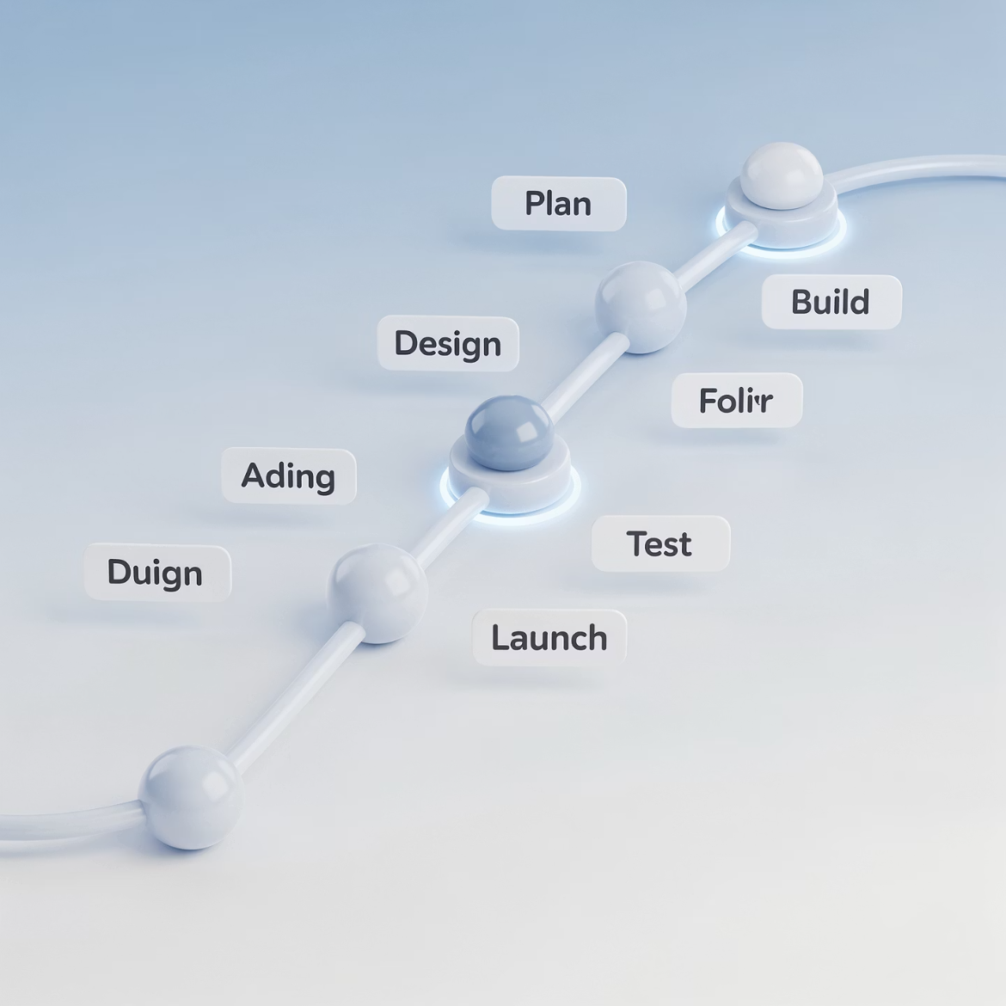
The One-Shot Principle
Trial-and-error prompting wastes energy, time, and money. Professional AI practitioners engineer prompts that succeed on the first attempt.
The Problem with Iteration
Every failed prompt attempt:
Consumes computational resources
Generates carbon emissions
Costs API tokens
Delays results
The One-Shot Solution
Use structured prompt templates that include:
Clear role definitions
Explicit output formats
Example-driven instructions
Constraint specifications
Investing five minutes in prompt engineering saves hours of iteration and prevents unnecessary energy consumption.

Slide 10

Context Pruning
Every token in your prompt consumes computational resources. Context pruning removes unnecessary information while preserving task-critical details.
Remove Irrelevant Background
Provide Task-Specific Context
Reduce Cost and Risk
Include only information that directly informs the requested task. If details don't change the output, they shouldn't be in the prompt.
Smaller prompts mean lower API costs, faster processing, and reduced exposure of intellectual property to external systems.
Company history and tangential information bloat prompts without improving outputs. Strip context to essential facts only.
Rule of thumb: If you removed a sentence and the output quality stayed the same, that sentence was wasting tokens.

Slide 11



Query Batching
Batching transforms inefficient sequential queries into optimized parallel processing. This technique dramatically reduces overhead while improving output quality.
70%
3x
60%
Token Reduction
Speed Improvement
Cost Savings
Batching similar queries reduces overhead tokens by up to 70% compared to sequential processing.
Batched requests process up to 3x faster than equivalent sequential queries.
Organizations report 40-60% API cost reduction through systematic batching strategies.
Batching Benefits
Beyond efficiency, batching improves AI performance. Models detect patterns more effectively across grouped examples, leading to more consistent and higher-quality outputs. Structure your workflow to identify repetitive tasks that can be combined into single, comprehensive prompts.

Slide 12

Ethics & Data Responsibility
Technical proficiency means nothing without ethical practice. This section addresses the two critical responsibilities every AI practitioner must master: recognizing and mitigating bias, and protecting sensitive information.
These aren't optional considerations—they're professional requirements. Bias produces harmful outputs that damage users and organizations. Privacy breaches destroy trust and violate legal obligations.
Mastering these principles separates responsible practitioners from reckless users who create liability and harm.

Slide 13



Types of Bias in AI Systems
Bias isn't a single problem—it's a constellation of systematic errors that emerge from training data, cultural assumptions, and historical inequities. Recognition is the first step toward mitigation.
Geographic Bias
Gender Bias
Historical Bias
Models trained primarily on Western data underrepresent global perspectives. Search results, recommendations, and classifications favor dominant cultural viewpoints while marginalizing others.
Historical training data embeds occupational stereotypes. AI systems associate certain professions with specific genders, perpetuating discrimination in recommendations and classifications.
Training on historical texts preserves outdated social norms and prejudices. Models reproduce discriminatory language and assumptions that society has since rejected.
Remember: AI doesn't create bias—it amplifies and systematizes biases present in training data. Our job is vigilant detection and active correction.

Slide 14

Bias Mitigation Strategies
Awareness accomplishes nothing without action. These practical techniques actively counter bias in AI outputs, transforming recognition into responsible practice.
Explicitly Request Diversity
Challenge Assumptions
Don't assume balanced representation. Specify requirements directly:
When AI outputs feel narrow or stereotypical, push back:
"Include perspectives from multiple geographic regions"
"What alternative perspectives exist?"
"Ensure gender-neutral language throughout"
"How would this answer change in different cultural contexts?"
"Represent diverse age groups and abilities"
"What groups might this overlook?"
Your critical questioning forces the model to consider perspectives beyond its default patterns.
Explicit instructions override default biases embedded in training data.

Slide 15


CRITICAL
The Red List: What Never Goes to AI
Certain information must never enter prompts sent to cloud-based AI systems. This isn't paranoia—it's professional responsibility and legal obligation.
Proprietary Recipes & Formulations
Unpublished Research & Data
Trade secrets, manufacturing processes, chemical formulations, and proprietary algorithms. Once exposed, these cannot be unshared.
Pre-publication findings, experimental results, and confidential research data. Exposure risks intellectual property and competitive advantage.
Patent-Pending Methods
Client & Personal Data
Innovations awaiting patent protection are especially vulnerable. Disclosure before filing can invalidate patent applications.
Customer information, personal identifiers, financial records, and health data. Legal frameworks like GDPR and HIPAA mandate strict protection.
When in doubt, keep it out. The consequences of data exposure far exceed the convenience of AI assistance.

Slide 16


The Local Sandbox Advantage
Local AI deployment solves the privacy problem by ensuring sensitive data never leaves your device. This architectural approach enables AI capabilities without compromising confidentiality.
Complete Data Sovereignty
Zero Network Exposure
When models run locally, your data remains under your exclusive control. No transmission to external servers, no third-party processing, no cloud storage vulnerabilities.
Local inference works offline, eliminating network interception risks. Perfect for air-gapped environments and classified workflows.
Use local sandboxes for any task involving Red List information. This architectural choice transforms AI from a privacy liability into a confidential tool you can trust with your most sensitive work. The slight reduction in model capability is a small price for absolute data security.

Slide 17
PART 2
The CO-STAR Framework
Strategic communication with rich context
Notes:
> Part 2: CO-STAR framework. Yesterday was AUTOMAT for functional tasks. Today is CO-STAR for strategic communication - reports, summaries, pitches. When context matters more than strict structure. When audience perspective changes everything.

Slide 18
Framework Selection Guide
Use AUTOMAT when:
Use CO-STAR when:
✓ Functional, structured tasks
✓ Strategic, narrative content
✓ Clear input output transformation
✓ Audience perspective matters
✓ Format is most important
✓ Context and tone critical
Examples: Reports, pitches, literature reviews, management communication
Examples: Data extraction,
formatting, protocol conversion
Notes:
> When to use which? AUTOMAT: functional tasks where output format matters most. Data extraction, protocol formatting - clear transformation. CO-STAR: strategic content where audience and context matter. Reports for investors vs engineers need different approaches - that's CO-STAR territory. Think: Is audience perspective critical? If yes, CO-STAR.
**Interactive Element:**
> **Quick Check:** "I'll name a task. Call out which framework! Ready? Task 1: Literature review for journal introduction..." (5 quick-fire examples)

Slide 19






CO-STAR Components
C - Context
O - Objective
(Background & situation)
(Goal you want to achieve)
S - Style
T - Tone
(Writing approach)
(Voice & emotional quality)
A - Audience
R - Response
(Who will read/use this)
(Format & structure)
Six components = Strategic specification
Notes:
> CO-STAR: six components for strategic communication. Context provides background and situation. Objective defines what success looks like. Style sets writing approach - academic? Journalistic? Technical? Tone sets emotional quality - confident? Cautious? Formal? Audience defines who reads this and their needs. Response specifies exact format and structure. Together, these eliminate ambiguity for narrative tasks.

Slide 20

C - Context
Provide rich background information
Example:
What to Include:
"AmaDema is preparing for Series A funding focused on sustainable materials. We need to demonstrate our ceramic nanofibres' environmental advantages. Target investors prioritise ESG metrics. We have strong technical data but lack compelling narrative for non-technical stakeholders."
Current situation
Why this task is needed
Relevant constraints
Historical background
Related work
Sets stage for everything that follows
Notes:
Context component - rich background. Not just "write about our materials" but WHY (funding round), WHO (ESG-focused investors), WHAT'S AVAILABLE (strong technical data), WHAT'S MISSING (narrative). This context shapes everything - writing style, technical depth, emphasis. Without it, AI writes generic content.

Slide 21
O - Objective
Define specific goal
❌ Vague:
✅ Specific:
"Create compelling narrative positioning our non-oxide ceramics as sustainable alternative to PLA, emphasising lifecycle carbon footprint reduction of 40%"
"Write about our materials"
Key: Define what success looks like
Not just topic, but desired outcome
Notes:
> Objective must be specific. Not "write about materials" but "create compelling narrative positioning ceramics as sustainable alternative, emphasizing 40% carbon reduction." See the difference? Vague objective gets generic writing. Specific objective defines success criteria. What should reader think/feel/do after reading?
**Interactive Element:**
> **Think-Pair-Share:** "Turn to neighbor. Take this vague objective: 'Help with grant proposal.' Make it specific." (2 minutes, then share examples)

Slide 22
S - Style and T - Tone
Style defines your writing approach, such as:
Academic, Journalistic, Technical, Executive, or Conversational
Tone conveys the emotional quality of your message:
Confident, Cautious, Inspirational, Objective, or Urgent
Together, Style and Tone create your unique Voice.
This is a strategic choice, not an arbitrary one. For example:
An investor pitch might blend a journalistic style with a confident tone to inspire trust
and demonstrate potential.
Safety protocols, conversely, demand a technical style with a cautious tone
to ensure clarity and precision.
Align Style and Tone, craft a Voice that effectively resonates with your audience and purpose.
Notes:
Style and Tone together create voice. Style is writing approach - academic formality vs journalistic storytelling. Tone is emotional quality - confident vs cautious. Different combinations for different needs. Investor pitch: journalistic style, confident tone. Safety protocol: technical style, cautious tone. These aren't optional - they're strategic choices.

Slide 23
A - Audience and R - Response
A - Audience (Who Reads This)
R - Response (Format & Structure)
Define:
Specify:
Technical background
Length (pages/words)
Priorities/concerns
Sections and order
Existing knowledge
Required elements
Decision criteria
Visual callouts
Example: Audience: "VC partners at deep-tech firms. Understand business fundamentals but not materials science. Sceptical of greenwashing - want hard data."
Response: "2-page executive summary: Hook (1 para), Problem (2 paras), Solution (3 paras), Market (2 paras), Ask (1 para). Include data visualisation callouts."
Notes:
Audience and Response complete the framework. Audience defines who reads this and their needs - technical background, priorities, skepticism. Response specifies exact structure - not just "write a summary" but "2-page summary with these specific sections in this order." Together they ensure output matches audience needs perfectly.

Slide 24
Live Demo 3 - CO-STAR in Action
LIVE DEMO #3
Complete CO-STAR Example
Task: AmaDema's R&D Director wants a 1-page memo on adopting AI tools,
addressing concerns about accuracy, IP security, training time, and cost vs benefit.
Watch:
Building prompt with all 6 components
First-shot result
Quality assessment
Real-world scenario, real-time demo
Live demo time!
Notes:
> Live demo time! Real scenario: R&D Director wants to understand business case for lab AI adoption. I'll build complete CO-STAR prompt live, covering all six components. Then we'll execute and assess quality. Watch how each component shapes the output. [Execute live: Build prompt explaining each component as you add it, then show result and assess whether it meets all criteria]
**Interactive Element:**
> **Live Demo (7 min):**
> 1. Explain scenario (1 min)
> 2. Build CO-STAR prompt live, component by component (3 min)
> 3. Execute in sandbox (1 min)
> 4. Review output quality together (2 min)
5. Highlight which components shaped which output elements
[C] Context: AmaDema's R&D team (12 scientists) currently spends
significant time on literature reviews, data analysis, and report
writing. We're evaluating AI tool adoption following this training
programme. R&D Director is scientifically-minded but cautious about
new technologies. She's concerned about accuracy and reliability,
IP security (we have proprietary synthesis methods), staff training
time investment, and whether productivity gains justify costs. Two
team members are enthusiastic, but others are sceptical. Decision
needed within 2 weeks for budget planning.
[O] Objective: Persuade R&D Director to approve AI tool adoption
by directly addressing her four concerns whilst building confidence
in the technology. Goal is approval to proceed with pilot programme
(3 months, 5 users) rather than wholesale rejection or indefinite
"we'll think about it."
[S] Style: Professional scientific memo. Evidence-based arguments
using quantitative data where possible. Acknowledge risks honestly
rather than overselling. Think "credible colleague recommendation"
not "sales pitch." Use clear structure with bullet points for
scannability.
[T] Tone: Confident but measured. Respectful of concerns (they're
legitimate). Optimistic about benefits but realistic about
limitations. "Informed recommendation" tone rather than "breathless
enthusiasm" or "fearful caution."
[A] Audience: R&D Director with PhD in materials science, 15 years
industry experience. Values evidence over hype. Responsible for
team productivity and budget. Familiar with AI in popular media
but limited hands-on experience. Will fact-check claims and consult
with team. Priorities: protecting IP, maintaining research quality,
team efficiency, budget justification.
[R] Response: 1-page memo (approximately 600 words) with structure:
Opening: Brief context and recommendation (1 paragraph)
Section 1: Benefits - Quantified productivity gains (1 paragraph)
Section 2: Addressing Concerns - Directly tackle each of 4 concerns
with evidence-based responses (4 short paragraphs or bullet sections)
Section 3: Proposed Pilot - 3-month trial with clear success
metrics (1 paragraph)
Closing: Call to action - meeting request (1 sentence)
Use bold for key metrics. Professional memo formatting.
**Expected Output:** Persuasive memo that addresses all concerns, provides evidence, proposes concrete pilot, appropriate for scientifically-minded decision-maker.
**Speaker Notes:**
> Live demo time! Real scenario from your world: R&D Director considering AI adoption, has four concerns. I'll build complete CO-STAR prompt live. Watch how each component shapes output. [C] Context - situation and concerns [type whilst explaining]. [O] Objective - not just "explain AI" but persuade toward specific decision [type]. [S] Style - professional scientific memo, evidence-based [type]. [T] Tone - confident but measured, respectful of concerns [type]. [A] Audience - PhD scientist, values evidence, responsible for budget [type]. [R] Response - exact structure, section by section [type]. Now execute [run in sandbox]. Let's assess: Does it address all four concerns? Is tone appropriate? Would this persuade you if you were the Director? [Discuss output quality, highlight how each CO-STAR component shaped specific output elements]
**Interactive Element:**
> **Live Demo (7 min):**
> 1. Explain scenario - R&D Director's concerns (1 min)
> 2. Build CO-STAR prompt live, explaining each component as you type (3 min)
> 3. Execute in sandbox (30 sec)
> 4. Review output quality together (2.5 min):
> - Does it address all 4 concerns?
> - Is tone appropriate for scientific audience?
> - Would this persuade a sceptical Director?
> 5. Highlight how specific CO-STAR components shaped output (e.g., Tone → respectful acknowledgement of concerns; Audience → evidence-based rather than hype)

Slide 25
Small Group Activity 2 - Build CO-STAR Prompt
SMALL GROUP ACTIVITY #2
(15 minutes) Build Your Own CO-STAR Prompt
Groups of 3-4
Scenario: Write 1-page memo to AmaDema management about implementing green AI practices in R&D team.
Your task:
Discuss what each component should contain (5 min)
Write complete CO-STAR prompt together (7 min)
One group will test in sandbox (3 min)
Assign roles:
Facilitator (keeps discussion on track)
Note-taker (writes the prompt)
Presenter (will share if selected)
Quality checker (ensures all 6 components covered)
Notes:
> Big group activity! Groups of 3-4. You'll build a complete CO-STAR prompt for a management memo about green AI practices. Assign roles now: facilitator, note-taker, presenter, quality checker. Spend first 5 minutes discussing what each component should say, then 7 minutes writing it. One group will test their prompt in sandbox. Fifteen minutes starting... now!
**Interactive Element:**
> **Small Group Work (15 min):**
> - Form groups, assign roles
> - Circulate to guide discussions
> - Listen for good examples to highlight
> - Give 5-min and 2-min warnings
- Select one group to test in sandbox
Big group activity! Groups of 3-4. You'll build a complete CO-STAR prompt for a management memo about green AI practices. Assign roles now: facilitator, note-taker, presenter, quality checker. Spend first 5 minutes discussing what each component should say, then 7 minutes writing it. One group will test their prompt in sandbox. Fifteen minutes starting... now!

Slide 26
SCENARIO: Green AI Practices Memo
Background:
- AmaDema management is evaluating company-wide sustainability initiatives
- R&D team uses AI tools extensively for literature review and data analysis
- Current usage: Untracked, no guidelines on efficiency
- Management wants to understand: costs, environmental impact,
optimisation opportunities
Your task:
Write a 1-page internal memo to AmaDema management recommending
implementation of "green AI" practices in the R&D team.
Considerations:
- Management includes CEO (business focus), CTO (technical focus),
CFO (cost focus)
- They care about: Environmental responsibility, cost efficiency,
competitive advantage
- Must balance: Productivity vs environmental impact
- Company has public ESG commitments
Required in memo:
- What green AI practices mean
- Why AmaDema should implement them
- Estimated impact (environmental and cost)
- Proposed action plan
Notes:
**GUIDANCE FOR GROUPS:**
**Context component should include:**
- Current AI usage in R&D
- Management's sustainability priorities
- Why this matters now
**Objective should be:**
- Specific goal (approval? pilot programme? budget allocation?)
- What decision you want management to make
**Style considerations:**
- Mixed audience (technical and business)
- Need to balance technical credibility with business language
**Tone considerations:**
- Opportunity framing vs problem framing?
- Urgent vs informational?
**Audience considerations:**
- CEO, CTO, CFO have different priorities
- What does each care about?
**Response format:**
- What structure would work for busy executives?
- How to make it scannable?
**Speaker Notes:**
> Big group activity! Groups of 3-4, form now. Here's your scenario [display on screen]: Write memo to management about green AI practices. Assign roles: facilitator keeps discussion on track, note-taker writes the prompt, presenter will share if selected, quality checker ensures all 6 CO-STAR components are covered. First 5 minutes: discuss what each component should contain. Next 7 minutes: write the complete prompt together. Final 3 minutes: one group will test theirs in sandbox. Fifteen minutes starting... now! [Circulate between groups, listen for creative approaches, give time warnings at 10 min and 13 min, select one group for presentation based on interesting approach you observe]
**Interactive Element:**
> **Small Group Work (15 min):**
> - Form groups (3-4 people), assign roles (1 min)
> - Groups discuss component by component (5 min)
> - Groups write complete CO-STAR prompt (7 min)
> - Circulate to guide discussions, listen for good examples to highlight
> - Give warnings at 10 min ("5 minutes left") and 13 min ("2 minutes")
> - While circulating, mentally select one group with interesting approach for presentation
> - Prepare to transition to presentation slide

Slide 27
Activity 2 - Live Test & Debrief
Let's Test a Group's Prompt!
[Selected Group]: Present your CO-STAR prompt
We'll test it live in sandbox and assess:
Did all 6 components work together?
Is output appropriate for audience?
Does style and tone match specification?
Is structure as requested?
Would this persuade management?
Then: Other groups share their approaches
Notes:
[Selected group name], come present your prompt! Read it aloud so everyone hears all six components. Then we'll test it live. [Execute in sandbox]. Let's assess together - did components work? Is this appropriate for management? Would it persuade? [Facilitate discussion, then ask 1-2 other groups to share key differences in their approach. Highlight creative solutions.]
**Interactive Element:**
> **Group Presentation & Testing (8 min):**
> - One group presents their CO-STAR prompt (2 min)
> - Execute in sandbox live (2 min)
> - Group assessment discussion (3 min)
> - 1-2 other groups share their approach briefly (1 min)
[Selected group name], come present your prompt! Read it aloud so everyone hears all six components. Then we'll test it live. [Execute in sandbox]. Let's assess together - did components work? Is this appropriate for management? Would it persuade? [Facilitate discussion, then ask 1-2 other groups to share key differences in their approach. Highlight creative solutions.]

Slide 28
CO-STAR Examples for Materials Science
CO-STAR Quick Reference Examples
Scenario 1: Journal Introduction
Scenario 2: Patent Analysis
Scenario 3: Investor Pitch
C: Manuscript on PLA/graphene for Polymer journal
C: AmaDema's in-situ reduction method
for patent filing
O: Identify prior art that could challenge
Patentability
S: Technical legal analysis with materials
Focus
T: Cautious - flag risks, don't miss overlaps
A: Patent attorney (not materials scientist)
R: Risk assessment table with DOI,
method, overlap level
C: Series A funding round (5M target),
ESG-focused VCs
O: Position ceramics as sustainable
PLA alternative
S: Journalistic meets executive
(engaging + data-backed)
T: Confident, visionary, evidence-based
(no hype)
A: VC partners - business savvy,
not materials experts
R: 2-page executive summary
with clear section structure
O: Establish research gap justifying our study
S: Academic synthesis (not exhaustive listing)
T: Authoritative but respectful of prior work
A: Polymer scientists reviewing for publication
R: 4 paragraphs (~1000 words), specific structure
Save these as templates!
Notes:
ere are three CO-STAR templates for common materials science scenarios. Journal introduction, patent analysis, investor pitch. Each shows all six components. These are starting points - customize for your specific needs. Save these as templates for recurring tasks. Notice how audience changes everything - journal reviewers vs investors need completely different approaches.

