Slide 1

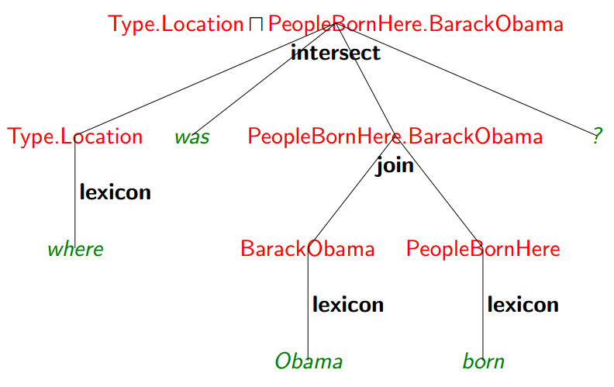
CS 221 Final Project
Sublexical Compositionality in
Sematic Parsing
Gunaa Veerapandian, Diana Wan
{avgunaa, jdwan}@ stanford.edu
Introduction
2. Template Based Model
Triples => Graph (V, E). V as entities, E as relationships.
How? Intersection between entity pairs in freebase triples and text triples.
a) Template 1: X -> Y
fb:en.barack_obama -> fb:people.person.placeofbirth -> fb:en.honolulu And “barack obama” -> “born in” -> “honolulu” are a successful match.
b) Template 2: X -> Mediator -> Y
Mediator: special compound value type node that connects entities following a similar relationship.
c) Template 3: X -> Y
C: a const with small domain
Eg. C: gender = {male, female}
“Who is the wife of Michelle Obama”
d) Template 4: X -> Y -> Z
Eg. Grandparent: λx(fb:people.person.parent(fb:people.person.parent(var x)))
Limitations of traditional sematic parsers: 1) requiring supervision 2) limited domains with few predicates.
In this project, we implement a semantic parser without annotated logical forms.
Motivation
Natural language abstraction level is different from the level in knowledge bases. Words that are intuitive to us have to be presented in compositional logical forms in the KB.
“actress” => Gender.Female Π Profession.Actor
“grandfather” => Gender.Male Π Child.Child.X
Goal: 1) Map text phrases to complex
logical forms.
2) Answer questions automatically.
Results and Discussions
Data
Freebase: Triples of predicates
We gathered a subset of 14,873,062 data entries from categories like People, Business, Government and Organization.
fb:en.barack_obama -> fb:people.person.profession -> fb:en.politician
Text Data: Triples of text
“Barack Obama” -> “profession of” -> “politician”
Algorithm
References
1. Exact Match – Baseline
Find the alignments between formula and lexeme using exact match between text relation and freebase relation.
[1] J. Krishnamurthy and T. Mitchell. 2012. Weakly supervised training of semantic parsers. In Empirical Methods in Natural Language Processing and Computational Natural Language Learning (EMNLP/CoNLL), pages 754765.
[2] T. Kwiatkowski, L. Zettlemoyer, S. Goldwater, and M. Steedman. 2010. Inducing probabilistic CCG grammars from logical form with higher-order unification. In Empirical Methods in Natural Language Processing (EMNLP), pages 12231233.
[3] J. Berant, A. Chou, R. Frostig, P. Liang, Semantic Parsing on Freebase from QuestionAnswer Pairs, ACL, 2013.

