Slide 1
Link Explanation for Heterogeneous Graphs
Abhijit Gupta, advised by Rex Ying
12/09/2022

Slide 2
GNN Explainability
Explainability builds trust, promotes fairness, and can improve human-in-the-loop performance
Multiple Tasks
Why is an item recommended to a user? → Explain Link Prediction
Why is the molecule mutagenic? → Explain Graph Classification
Why is the user classified as fraudulent → Explain Node Classification

Slide 3
GNN Explainability
Explainability builds trust, promotes fairness, and can improve human-in-the-loop performance
Multiple Tasks
Why is an item recommended to a user? → Explain Link Prediction
Why is the molecule mutagenic? → Explain Graph Classification
Why is the user classified as fraudulent → Explain Node Classification

Slide 4
GNN Explainability
Explainability builds trust, promotes fairness, and can improve human-in-the-loop performance
Multiple Tasks
Why is an item recommended to a user? → Explain Link Prediction
Why is the molecule mutagenic? → Explain Graph Classification
Why is the user classified as fraudulent → Explain Node Classification
Heterogeneous Graph Explanation

Slide 5
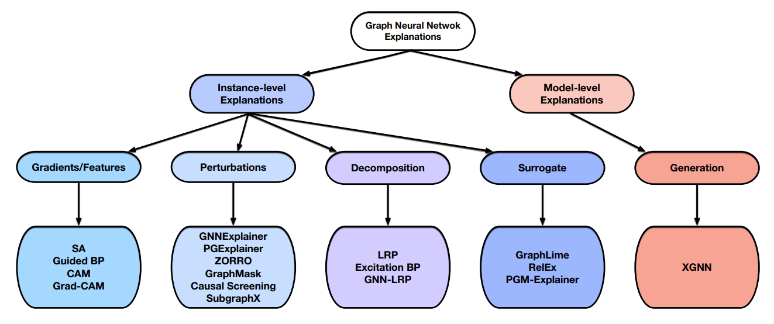
GNN Explainability

Slide 6
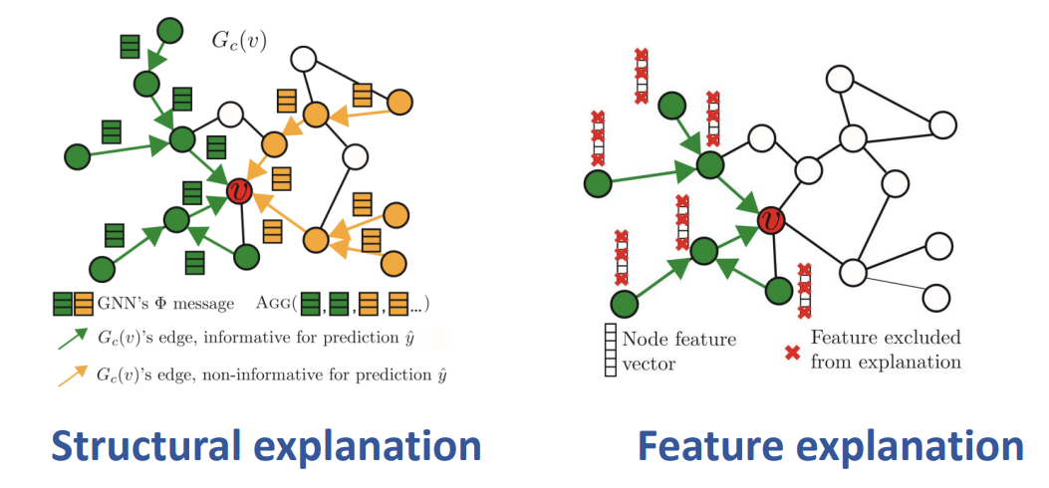
Types of Explanations

Slide 7
Problem Statement
Explaining Link Prediction
Positive edges only
Support Heterogeneous Graphs
Instance-level Perturbation methods
Focus on Structural explanation, Model explanation

Slide 8
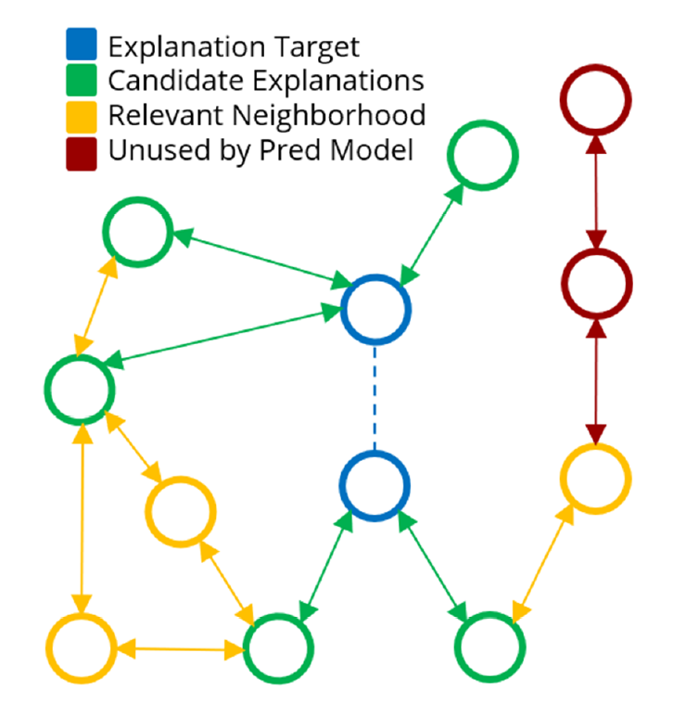
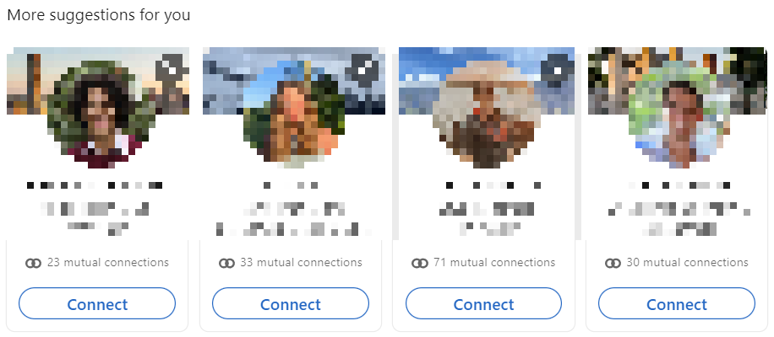
Rethinking Explanation Format
Explanations are restricted to immediate neighbors for increased interpretability real world use cases.

Slide 9
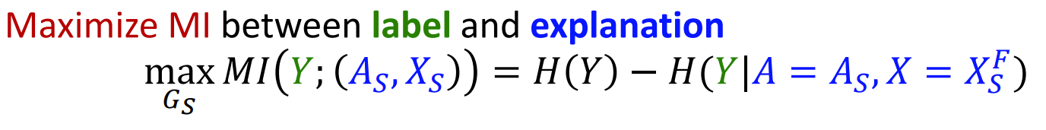
GNNExplainer
Explain by Mutual Information (MI):
Use continuous relaxation, optimize the expected adjacency matrix A_{S}
Modifications: Do not optimize X_{S}, only optimize 1-hop neighborhood in A_{S}

Slide 10
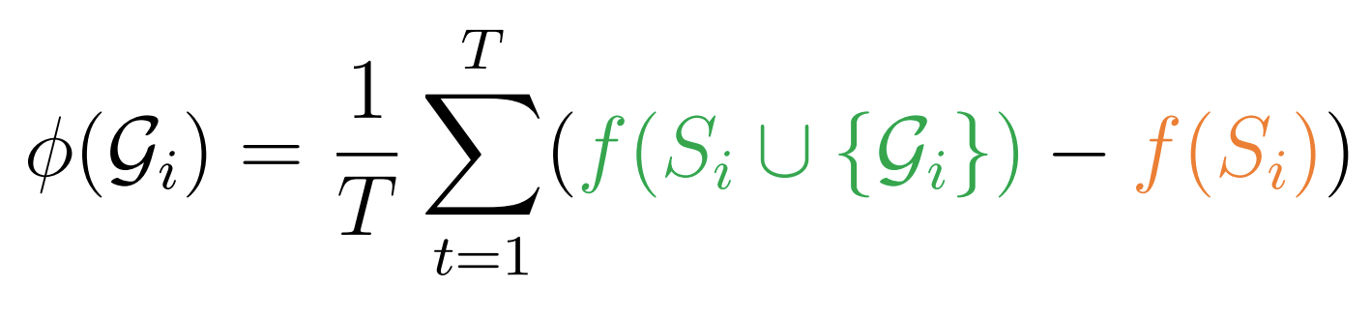
SubgraphX
Uses Monte Carlo Tree Search (MCTS) and Shapley values to find subgraph explanations.
Modifications: Remove MCTS component, reduce T from 100 to 5 to improve inference time.
Output including explanation
Output excluding explanation

Slide 11
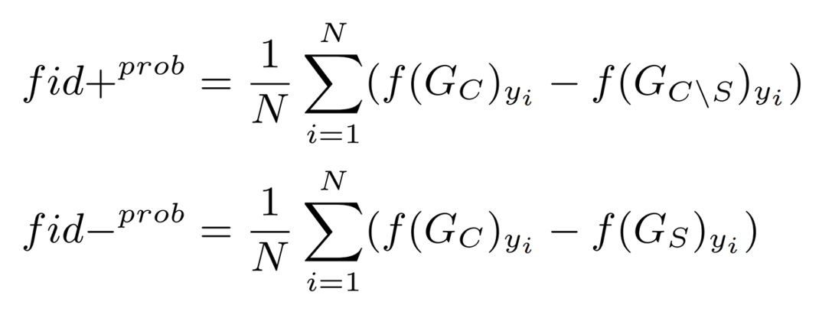
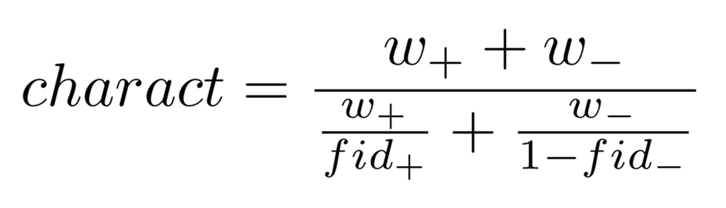
Evaluation Metrics
Focus on explaining model outputs, not necessarily phenomenon
Measure fidelity for varying sparsity
Necessary and sufficient explanations, Characterization measures both

Slide 12
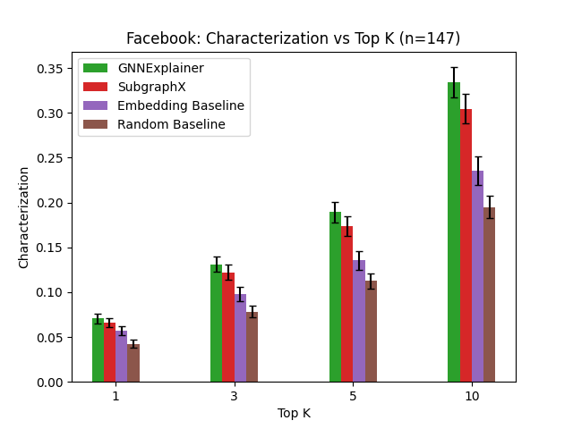
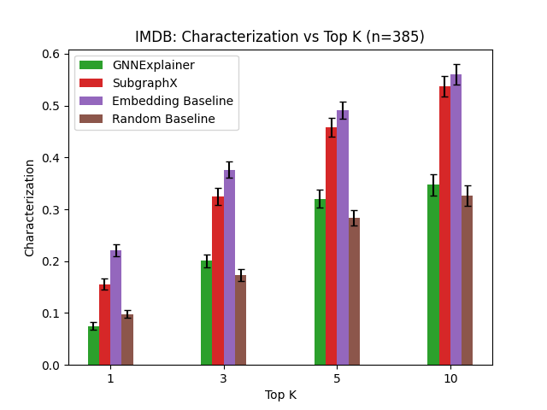
Initial Results
Facebook Ego (Homogeneous) and IMDB (Heterogeneous) datasets

Slide 13
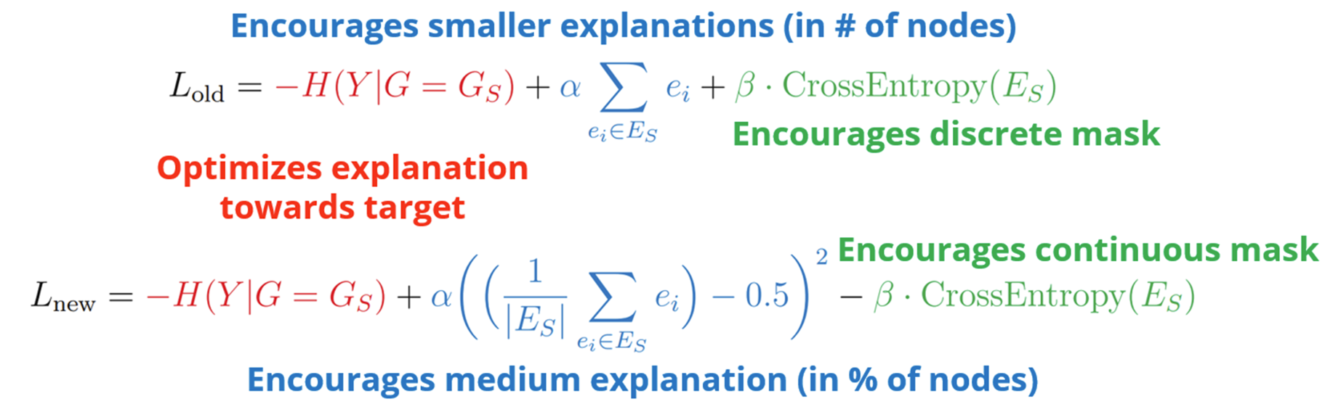
Modified GNNExplainer
New loss function encourages ordering of candidate nodes, handles varying neighborhood sizes better.

Slide 14
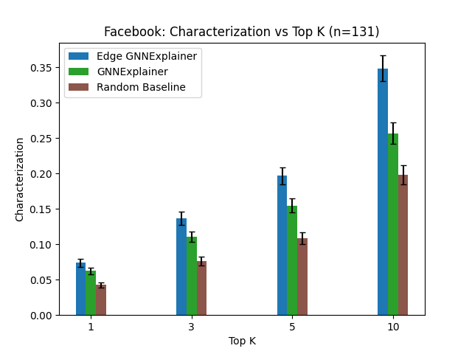
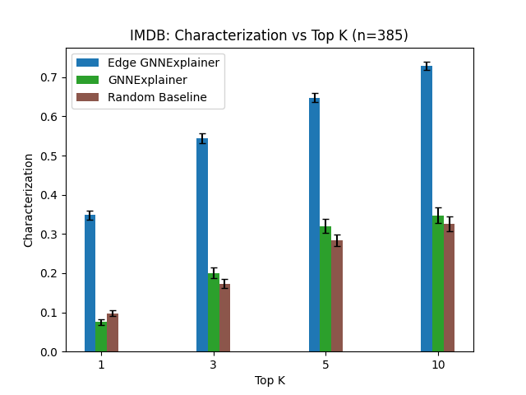
Modified GNNExplainer Results
Moderate improvement on Facebook, substantial improvement on IMDB

Slide 15
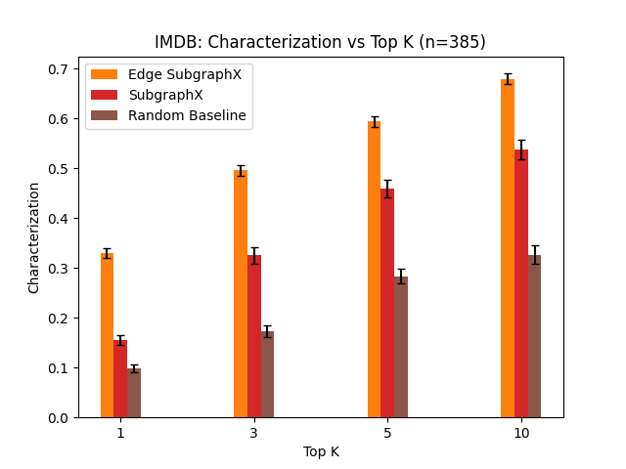
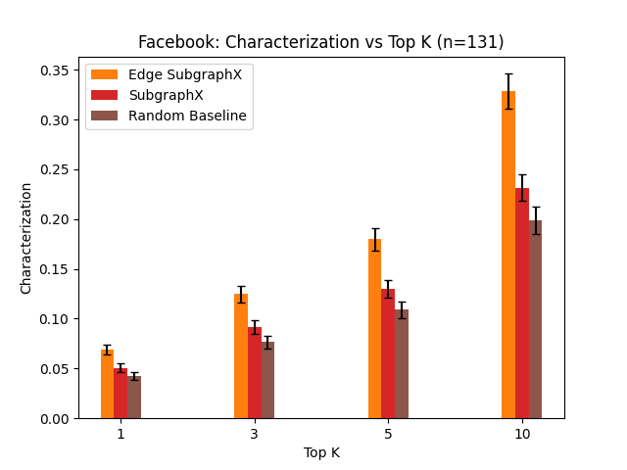
Modified SubgraphX
Normally, SubgraphX masks node by setting all features to 0
Since every candidate node is adjacent to the target link, only mask the edge between the node and the target endpoint.

Slide 16
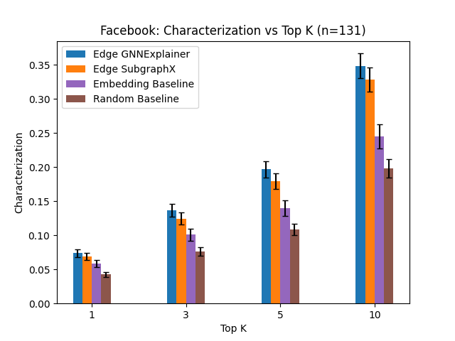
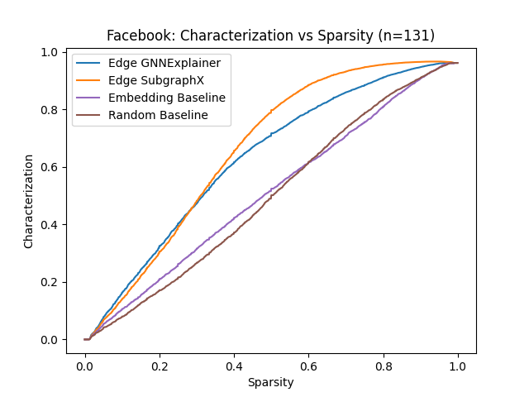
Combined Results: Facebook

Slide 17
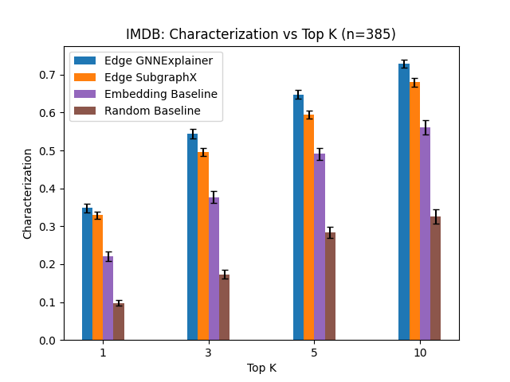
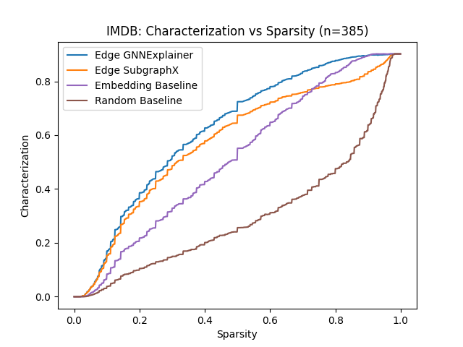
Combined Results: IMDB

Slide 18
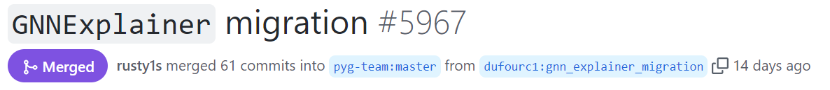
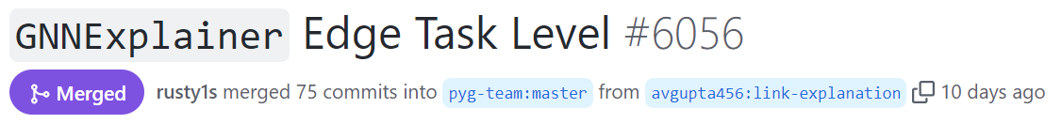
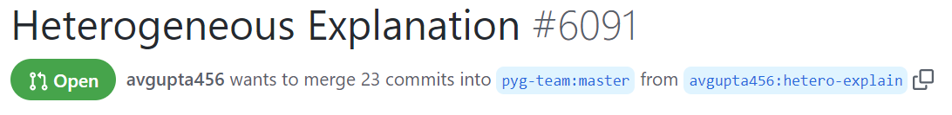
Open-Source Contributions
Contributed to PyTorch Geometric Explainability Sprint
New GNNExplainer implementation, Link Explanation support, Heterogeneous Graph support

Slide 19
Next Steps
Improve scalability of masking implementation, run larger experiments
Extend to the LastFM heterogeneous dataset for more results and insights
Develop new explanation formats, methods leveraging heterogeneous graph meta-paths

Slide 20
Questions?

